Slide 1


Volunteerism
Health, Social & Environmental Responsibility
Term 3: Lesson 1
Notes:
Introduction & Watch Video (7 min)
Good day, Grade 9s. Our next set of lessons is centred around VOLUNTEERISM.
You have a Concept Map (Activity 1, Lesson 1 – Worksheet) to complete while we go through this lesson – the questions in the concept map will be answered as we go, so jot down your answers.

Slide 2
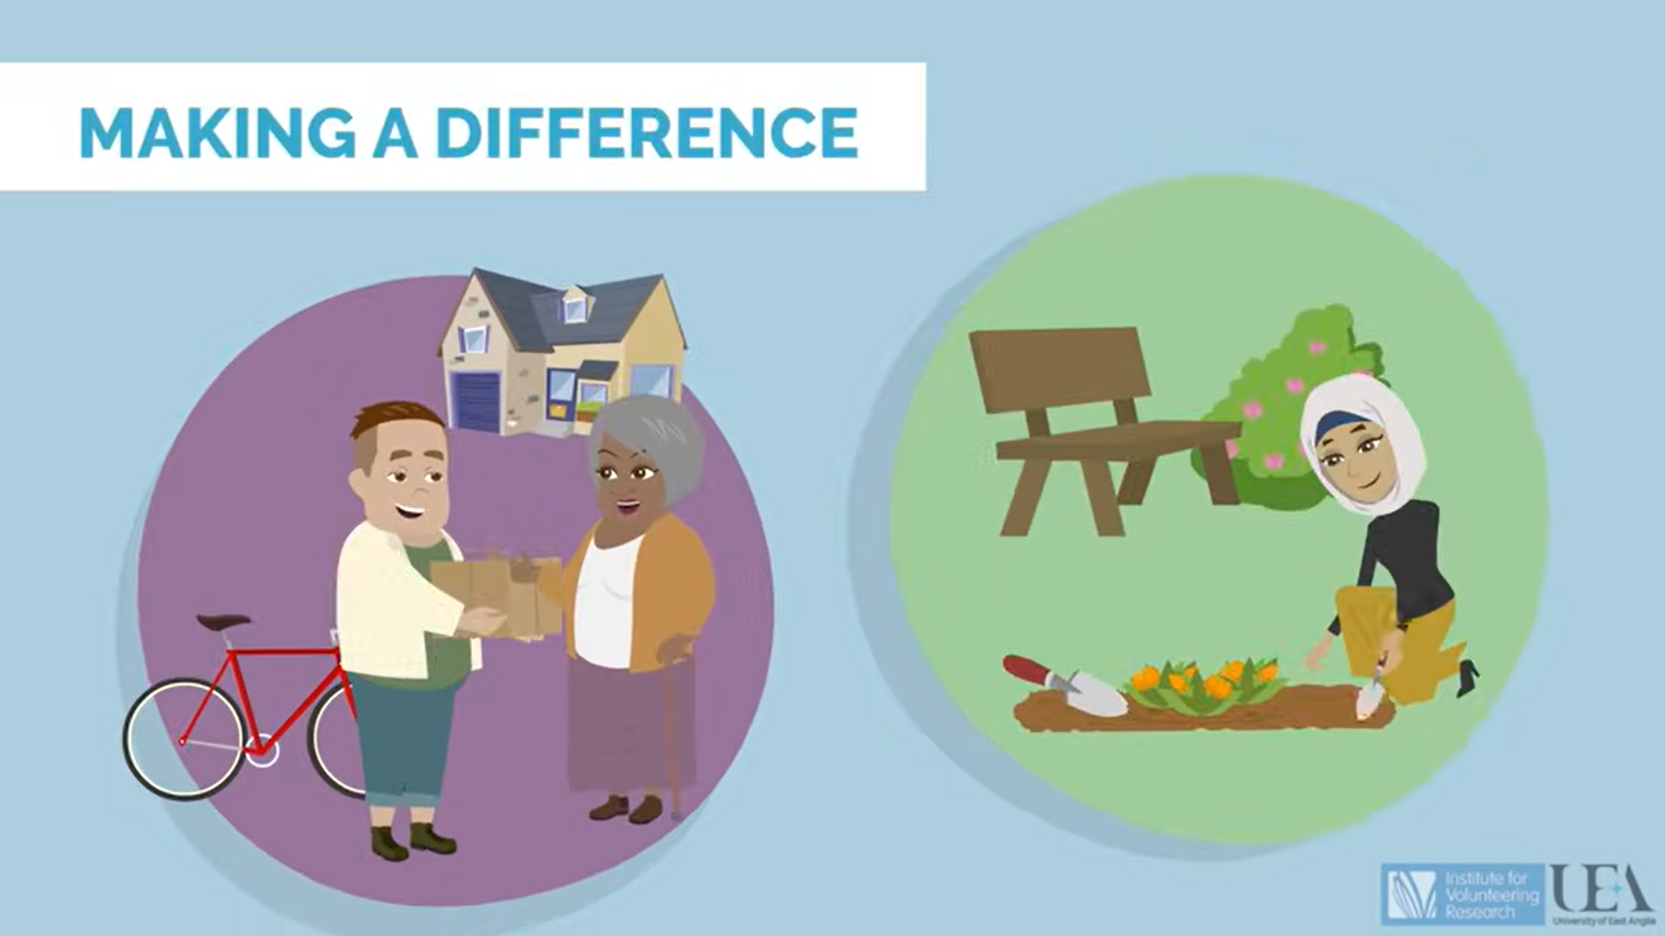
Watch: What is Volunteering?
https://www.youtube.com/watch?v=tYmvsrkN8po (1 min 42 sec)
Notes:
Let’s start with figuring out what volunteering is.
CONCEPT MAP QUESTION 1: How would you define this term? What ideas do you have? Use this as a discussion point – put learners' answers on the board.
Let’s watch this quick video and see if your answers line up:
What is Volunteering?
https://www.youtube.com/watch?v=tYmvsrkN8po (1 min 42 sec)

Slide 3

What is volunteerism?
Volunteerism is when you willingly offer your time, skills or services.
You do this without expecting payment.
The goal is to help others, support a cause, or improve your community.
Notes:
To put all your ideas together, let's refine our definition: Volunteerism can be defined as the act of willingly offering time, skills, and services without expecting financial compensation, typically to help individuals, support a cause, or improve a community.

Slide 4
Where does volunteerism come from?
Volunteerism has deep roots in the human desire to help others and contribute to society.
It started in ancient cultures as a moral duty.
Influenced by religious beliefs, cultural values, and organised giving.
Motivated by compassion and the desire to create positive change.
Today, it supports community strength, social unity, and global development.
Notes:
Teaching & Individual Activities (16 min)
So where does Volunteerism come from? What is the history behind it?
Volunteerism has deep historical roots in the human desire to help others and contribute to society, evolving through changes in social structures, religious influences, and organised philanthropy.
While helping others has always existed, formal volunteerism began in ancient cultures where it was seen as a moral duty.
Across religions and cultures, volunteerism has adapted over time, driven by compassion and a desire for positive change.
Today, it is recognised as a crucial part of civil society, supporting social cohesion, community resilience, and global development.
CONCEPT MAP QUESTION 2: Where could VOLUNTEERISM happen?
Guide this question by asking the learners if it can happen in only one place or manner – are there multiple ways?
The outcome here should be for learners to recognise that it can happen in so many different ways – small acts or bigger acts, it’s not a “limited” act.

Slide 5
What does volunteerism look like?
Formal volunteering = organised and recorded (e.g. through a nonprofit)
Volunteering at a food bank or soup kitchen
Helping at a hospital or nursing home
Joining a community clean-up
Mentoring or tutoring through a programme
Informal volunteering = helping out in your community when needed
Helping a neighbour with chores
Babysitting for a friend in need
Assisting an elderly person with shopping
Picking up litter in a park
Notes:
Volunteerism is the act of contributing free labour to conduct community service or support a nonprofit organisation. Rather than receiving a financial reward, volunteers change the lives of their community members out of feelings of social responsibility and a desire to give back.
Individuals who sign up to volunteer with a nonprofit engage in formal volunteering, which is documented and recorded, while those who help in their community on an as-needed basis participate in informal volunteering.
CONCEPT MAP QUESTION 3 & 4: Examples of formal and informal volunteering.
Formal Volunteering Examples:
Volunteering at a food bank or soup kitchen.
Assisting at a hospital or nursing home as a registered volunteer.
Participating in a community clean-up organised by a nonprofit group.
Mentoring or tutoring through an established educational programme.
Informal Volunteering Examples:
Helping a neighbour with household chores or errands.
Providing childcare for a friend in need.
Assisting an elderly person with grocery shopping.
Picking up trash in your local park without being part of an organised group.
Both forms of volunteering are valuable and play important roles in supporting communities. Formal volunteering often allows for larger, coordinated efforts, while informal volunteering offers a personal and flexible approach to helping others.

Slide 6
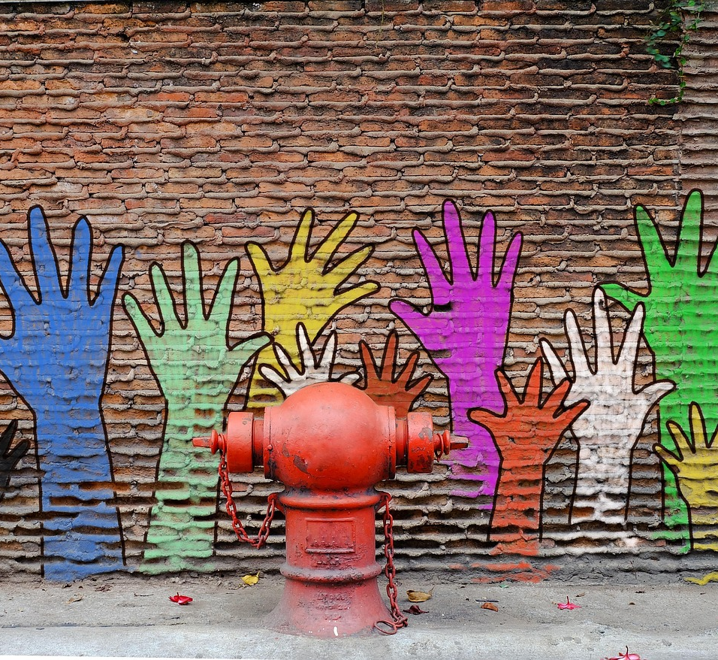
Volunteering is not employment
Volunteers are not employees and are not protected by employment law
Volunteering is always the volunteer’s own choice
Volunteer roles are different from employee roles
Volunteers should not replace paid staff
Notes:
BUT – it is important to understand that volunteering is not employment as volunteers aren’t employees and aren't covered by employment law. Volunteering is the volunteer's choice. Volunteer roles are not the same as employee roles and volunteers are not a replacement for paid staff.

Slide 7
Why is volunteerism important?
Volunteers give crucial support in both crisis and peace
Many nonprofits rely on volunteers to keep running
Volunteerism helps:
Nonprofits and community organisations
The volunteers themselves
Notes:
CONCEPT MAP QUESTION 5: Why is VOLUNTEERISM important? How does it help those around us?
Volunteers offer crucial support during both times of crisis and times of peace. Many nonprofits would not be able to operate without the help of volunteers. Volunteerism doesn’t just offer benefits to nonprofits and other community organisations but also benefits the volunteers themselves.

Slide 8
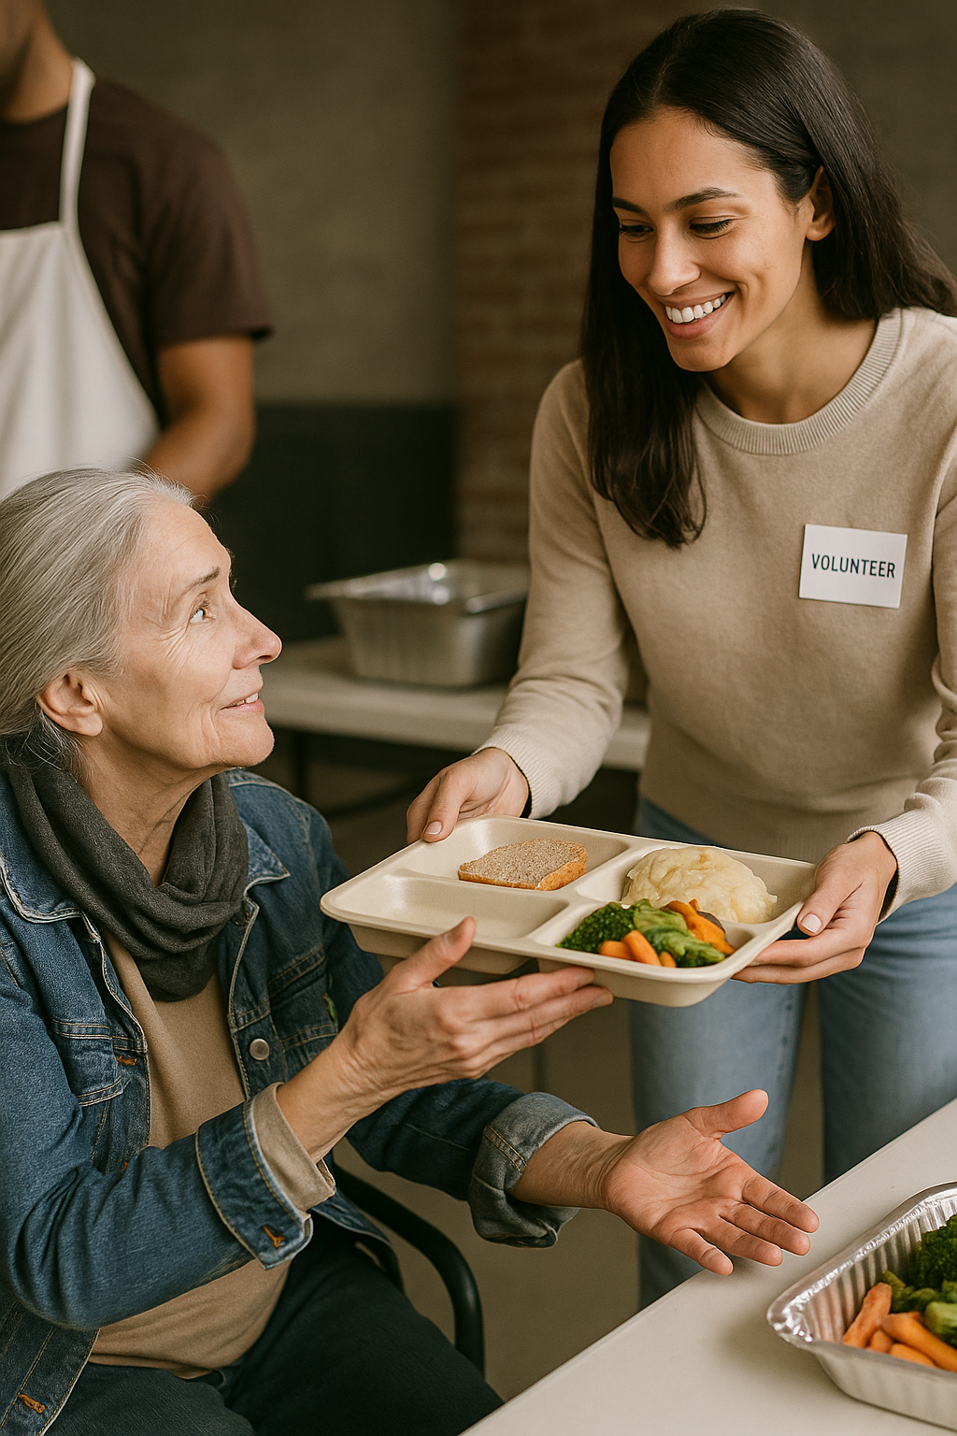
Discussion point
Kahlil Gibran said: “You give but little when you give of your possessions. It is when you give of yourself that you truly give.”
What does this mean?
Volunteering gives social and personal benefits
It helps to build a culture of empathy, support, and mutual growth
Notes:
Discussion point: Kahlil Gibran once wrote: "You give but little when you give of your possessions. It is when you give of yourself that you truly give."
What does that mean? Volunteering offers numerous social and individual benefits, enriching both communities and the lives of those who give their time by creating a culture of empathy, support, and mutual growth.
Let us look at these benefits.

Slide 9
Individual benefits of volunteering
Volunteering helps you:
Give back to your community
Feel a stronger sense of purpose, belonging and connection
Improve your mental and physical health
Other benefits include:
Connecting with others and making a real difference
Meeting new people and growing your support network
Building relationships and practising social skills
Reducing stress, anger and anxiety
Gaining a sense of pride, identity and accomplishment
Adding purpose to your life and boosting your mood
Staying active and feeling stronger and healthier
Learning new skills like leadership, planning, and time management
Gaining insight into different people and communities
Watch video: Mental health benefits of volunteering
https://www.youtube.com/watch?v=BYt5RNWvtws
(2 min 22 sec)
Notes:
Teaching, Watch Video & Individual Activity (9 min)
Individual Benefits
Let’s watch this quick video that discusses the benefits of volunteering for individuals:
Watch: Here are the mental health benefits of volunteering
https://www.youtube.com/watch?v=BYt5RNWvtws (2 min 22 sec)
Volunteering provides an opportunity to give back to the community. Volunteering offers experiences that can help to strengthen a sense of purpose, belonging, and connection to our communities. It has been linked to improved mental and physical health outcomes. It can also offer other benefits like:
It allows people to connect with their community and make it a better place. Even helping with the smallest tasks can make a real difference in the lives of people, animals, and organisations in need.
Volunteering is a great way to meet new people. It broadens support networks, by exposing people to others' common interests, neighbourhood resources, and fulfilling activities.
By giving people the opportunity to practise and develop social skills, and by meeting regularly with a group of people with common interests will make it easier to build relationships.
The social contact aspect of helping and working with others can have a profound effect on overall psychological well-being. Nothing relieves stress, anger and anxiety better than a meaningful connection to another person.
Doing good for others and the community provides a natural sense of accomplishment. This role can also give a sense of pride and identity. The better a person feels, the more likely they are to have a positive view of their life and future goals.
Whatever your age or life situation, volunteering can help take your mind off your own worries, keep you mentally stimulated, and add a sense of purpose to your life.
Volunteering often involves moving around. Staying active is good for your body and helps keep you strong and healthy. It also helps you appreciate what you have, which makes you feel more positive and happier.
Volunteering allows participants to gain new skills and knowledge in areas that interest them. They can network with new people and practice important skills such as leadership, planning, and time management.
Volunteer programmes create opportunities to learn from individuals from different walks of life. This is an excellent way to expand their understanding of others in their communities.
Additional discussion point (if time allows): Volunteering can help you gain valuable skills, build connections, and explore different industries. It enhances your resume, boosts confidence, and provides hands-on experience that employers and business leaders value. Networking through volunteering can lead to job offers or business opportunities, while leadership roles help develop an entrepreneurial mindset. Many organisations also hire dedicated volunteers for paid positions. Overall, volunteering is a great way to open doors to future employment or entrepreneurship.

Slide 10

Social benefits of volunteerism
Volunteers help build unity and support through regular involvement
Brings people together to work towards a common goal
Creates a more vibrant, supportive environment for all
Highlights issues that need change and encourages action
Builds mutual respect and a sense of social responsibility
Notes:
Social Benefits
Volunteering adds awareness to organisations that need support and can help to fill gaps in areas such as finances, physical labour, emotional support, and other skills. This awareness can also help increase an organisation’s capacity to take on new projects and initiatives.
CONCEPT MAP QUESTION 6: Social Benefits of VOLUNTEERISM include:
Strengthening communities: Volunteers offer their time and skills to support an organisation or local community. Volunteers who are regularly seen helping residents can bring people together and strengthen support within the community.
Community engagement: Volunteering brings people from all walks of life together to work towards a common goal. These elements create harmony and strength, and when many work together to support and build these principles, a community can begin to thrive.
Improves quality of life: Volunteering can help to improve the quality of life in communities and create a more vibrant and supportive environment for everyone.
Raises awareness of the issues underlying the need for change: Volunteering is an invaluable way to raise awareness and create positive change on a local and global level. It allows us to get involved in our communities, take an active role in fighting for justice, and bring attention to important issues that are often overlooked.
Raises diversity, equity, and inclusion efforts in communities: Volunteering connects local communities through service, and it can spark a great sense of social responsibility. Volunteers not only demonstrate their commitment to diversity and inclusion but also create a foundation of mutual respect that can have a strong, lasting impact on the community.

Slide 11
What does real volunteerism look like?
Helping your community or supporting a nonprofit
Giving your time, effort, or skills to help others
Do it without expecting personal gain
It’s not about self-promotion, but about inspiring others to join a cause
Volunteers make up one-third of the nonprofit workforce
They play a key role in bringing people together and changing lives
Notes:
Conclusion & Pair Activity (8 min)
Volunteering comes in many forms, from helping your community to supporting nonprofit organisations. It involves giving time, effort, or skills to benefit others without expecting personal gain.
Unlike self-promotion for popularity, true volunteerism focuses on encouraging others to join a cause. Volunteers make up one-third of the nonprofit workforce and play a key role in bringing people together to support meaningful causes. Volunteer programmes worldwide positively impact countless lives.

Slide 12

How could volunteerism benefit you?
Talk to your partner about how volunteering could benefit you personally
Think about what you would gain or learn
You have 5 minutes to discuss
Afterwards, we’ll share some ideas with the class
Notes:
CONCEPT MAP QUESTION 7: DISCUSSION in pairs: How could VOLUNTEERISM benefit YOU as an individual?
Take the next few minutes to discuss how volunteerism could benefit you personally. Share your thoughts with a partner, and after 5 minutes, we’ll share your answers with the class.
Note to teacher: If time permits, you can also share the memo with the class to review their answers.
Answers available in the Lesson 1 – Worksheet MEMO.

