Slide 1
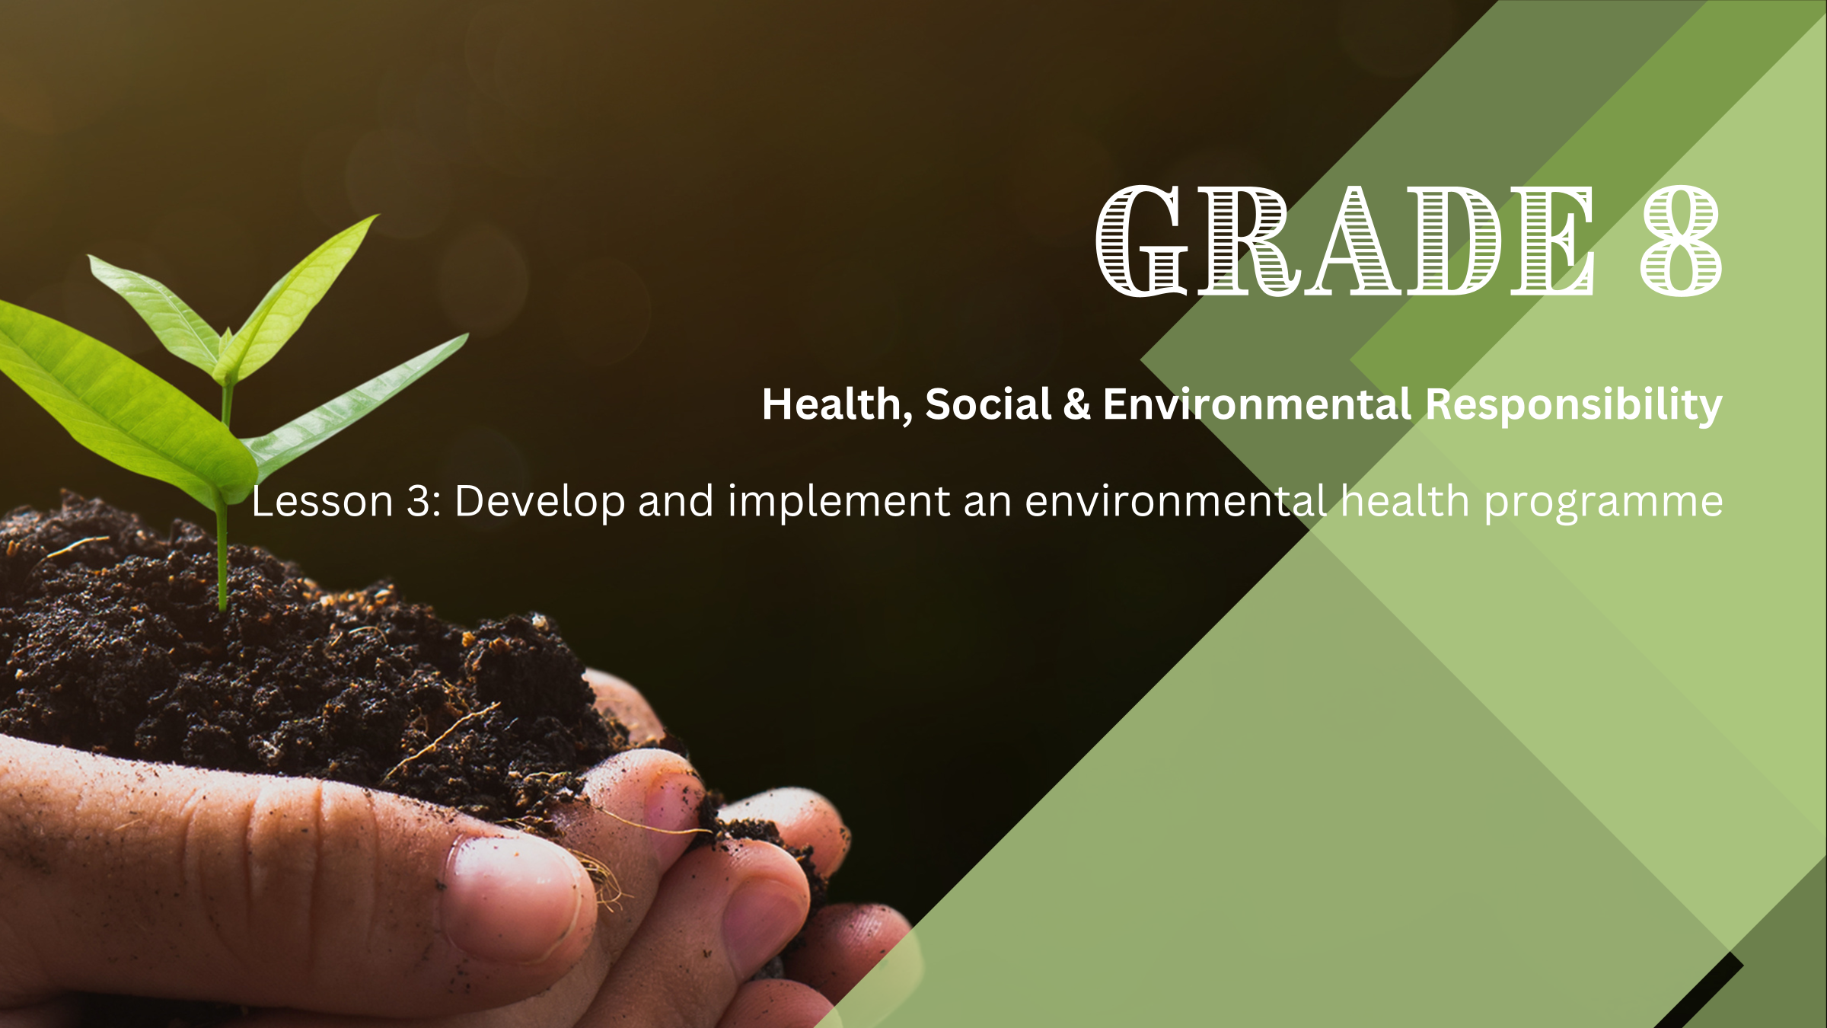

Notes:
Introduction Discussion (3 min)
Welcome the learners. Ask them to sit in their groups of FIVE that were allocated in Lesson 1. Allow them to settle down and get their learning materials ready.
Last week we explored how laws and individuals can address waste as an environmental issue. We also looked at what Earth Day is and how it is honoured and celebrated.
This week we will do an exciting group activity where you will develop and implement an environmental health programme.
In Lesson 1, you were assigned to groups of FIVE and asked to complete the Lesson 1 – Waste Audit Form as homework. You will be using this form in today’s lesson.
Before we get into the activity, let’s get some feedback from your reflection homework activity (Activity 2, Lesson 2 – Worksheet). Question 2.3 asked you to describe ways in which you can encourage family members to adopt environmentally friendly practices. You probably mentioned a couple of the practices we discussed in the lesson. While it may seem easy, convincing people to adopt new environmental practices can be very challenging. What are some of the challenges in this regard? (Allow learners to give feedback.)
Possible answers may include:
People are often set in their ways and find it difficult to change long-standing habits.
Some family members might not fully understand the importance or impact of environmental practices.
New practices may seem inconvenient or time-consuming compared to their usual routines.
There may be a perception that eco-friendly products or practices are more expensive.
Some people might be sceptical about the effectiveness of certain environmental practices.
If their peers or community do not practice environmentally friendly habits, they might feel less motivated to do so.
A part of developing and implementing an environmental health programme requires you to address these challenges.

Slide 2
Aims of an Environmental
Health Programme
Raising awareness
01
Promoting action
02
Fostering community involvement
03
Notes:
Teaching (4 min)
Let us begin by exploring what an environmental health programme entails.
An environmental health programme aims to educate the public about the importance of protecting our environment. Promoting environmental awareness helps us understand our environment's vulnerability and take steps to preserve it for future generations.
Three important aims of an environmental health programme include:
Raising awareness: Educating people about environmental issues such as pollution, global warming, and sustainable development. Making them aware of the dangers of excessive consumption and the importance of conserving resources.
Promoting action: Encouraging individuals to adopt environmentally friendly practices in their daily lives. This includes reducing waste, recycling, conserving water, and using eco-friendly products.
Fostering community involvement: Engaging the community in projects that benefit the environment, such as recycling initiatives, water purification efforts, e-waste collection, and conservation projects.

Slide 3
Developing an Environmental Health Programme
Step 1: Define objectives and goals
Step 2: Create an action plan
Step 3: Educate and engage
Step 4: Implement the programme
Notes:
Activity Instructions (2 min)
Hand out ONE copy of the Lesson 3 – Group Activity to each group.
Scenario: You are required to develop and implement an environmental health programme in our school. Your programme will focus on waste management. Based on your findings from the waste audit you conducted over the last two weeks, you will complete the questions in the Lesson 3 – Group Activity document.
There are four steps you need to follow in developing your programme.
Step 1: Define objectives and goals
Step 2: Create an action plan
Step 3: Educate and engage
Step 4: Implement the Programme
I will guide you through all of these steps. We have limited time, so you will need to work quickly.
At the end of the activity, one or two of your group members will come and present your programme.
Note to teacher: To make this activity more engaging, consider turning it into a friendly competition. At the end of the session, the class can vote for the best environmental health programme. Based on the time and resources available, the winning programme can be adopted as a grade-wide project or presented to the Environmental Club for potential implementation in the school. This approach not only motivates the learners but also provides an opportunity for their ideas to make a real impact.

Slide 4

Step 1: Define objectives and goals
Notes:
Group Activity: Step 1 (6 min)
Let’s start by defining objectives and goals. Remember, you cannot solve all the waste issues in the school at once. Focus your programme on one specific aspect. Use your findings from Question 1.16 of the Lesson 1 – Waste Audit Form to guide your programme. Choose ONE area for improvement to concentrate on.
Objectives are broad, general statements about what you want to achieve. They describe the desired outcome. For example: Reduce waste in the school.
Goals are specific, measurable steps to achieve the objective. They are detailed and quantifiable. For example: Decrease the amount of plastic waste by 20% in the next three months.
You will now have 5 minutes to identify your broader aim(s) (objective(s)) and then define precise actions to reach that aim (goals). (Q 1.1 and Q 1.2, Activity 1, Lesson 3 – Group Activity)
Note to teacher: Walk around the class to facilitate group discussions.

Slide 5

Step 2: Create an action plan
Notes:
Group Activity: Step 2 (6 min)
In this step, you will create an action plan. This means outlining the specific actions needed to achieve your goals and objectives. For example: Promote the use of digital resources to reduce paper usage OR encourage learners to bring reusable water bottles and lunch containers.
You will now have 5 minutes to create your action plan. (Q 1.3, Activity 1, Lesson 3 – Group Activity)
Note to teacher: Walk around the class to facilitate group discussions.

Slide 6
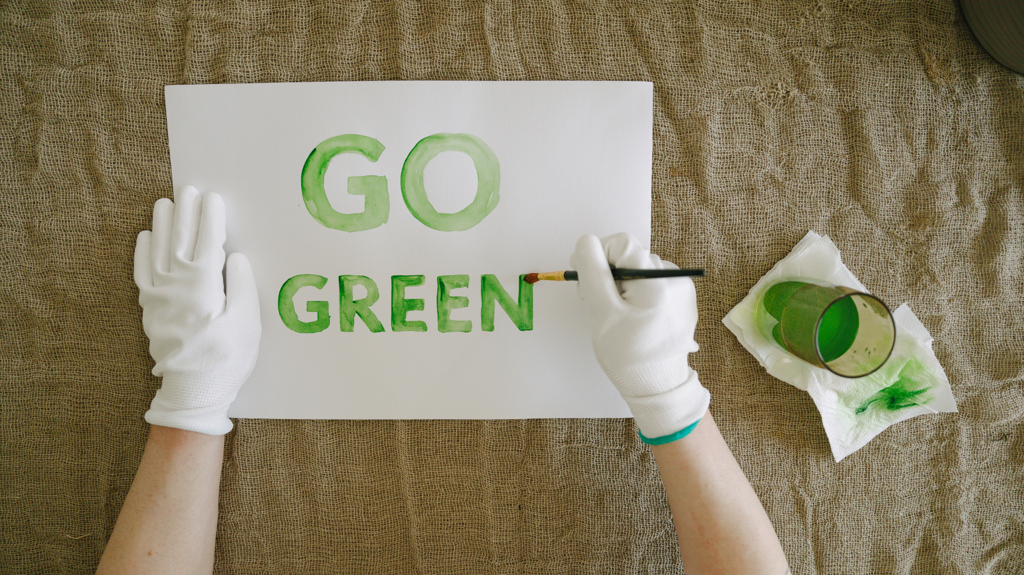
Step 3: Educate and engage
Notes:
Group Activity: Step 3 (6 min)
In this step, think about various methods to get everyone involved and informed about your environmental health programme. Consider using posters, social media, school assemblies, or interactive activities. Think about what will capture people’s attention and make your message memorable. How can you reach both learners and staff effectively?
You will now have 5 minutes to brainstorm your ideas. (Q 1.4, Activity 1, Lesson 3 – Group Activity)
Note to teacher: Walk around the class to facilitate group discussions.

Slide 7

Step 4: Implement the programme
Notes:
Group Activity: Step 4 (6 min)
In this step, you need to outline FOUR tasks required to put your programme into action. For each task, specify a due date, the resources you'll need, and who can help you. Think about all the steps involved, from preparing materials to organising events. For example, you might need to create posters, set up recycling bins, or host workshops. Make sure your plan is detailed so everyone knows what needs to be done and by when.
You will now have 5 minutes to come up with your implementation strategy. (Q 1.5, Activity 1, Lesson 3 – Group Activity)
Note to teacher: Walk around the class to facilitate group discussions.

Slide 8

Presentation
Notes:
Presentation (7 min)
Allow groups to present their environmental health programme briefly.
Note to teacher: Due to time constraints, all groups may not be able to present their programmes. You may allocate some time in the next lesson for these presentations. If your learners have access to digital devices, you may ask learners to record themselves presenting their programmes in this time. Learners can then upload these videos to a learning management system (LMS) such as Teams or Google Classroom. Reminder: If you would like to turn this activity into a competition where the winning programme can be adopted as a grade-wide project or presented for potential implementation in the school, you would need to create an opportunity for the learners to vote for the best programme. This can be done digitally or in person.
You all made excellent progress with your environmental health programmes. Remember, we have the right to a healthy environment, but it’s also our responsibility to protect it. Each small action you take can lead to big changes. Keep thinking about how you can make a difference, and let’s work together to create a healthier world for everyone!
Hand out the Content Summary before learners leave.

