Slide 1
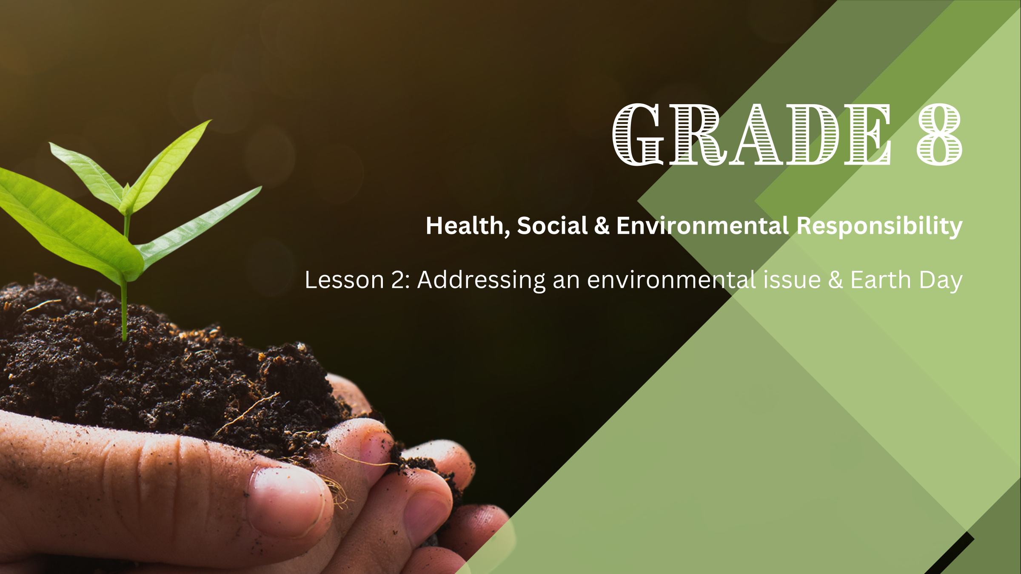

Notes:
Introduction (1 min)
Welcome the learners. Allow them to settle down and get their learning materials ready.
Last week we explored environmental health issues, the laws and policies that protect our environment, and how we can contribute to environmental care.
In today's lesson, we will explore how laws, policies, and individuals can address an environmental issue. Furthermore, we will briefly examine Earth Day and how it is honoured and celebrated.

Slide 2





Everyday items discarded by households such as food scraps, paper, plastic, glass, metal, and clothing.
Waste produced by businesses like offices, stores, schools and restaurants, similar in composition to household waste.
By-products from manufacturing and construction such as chemicals, scrap material, concrete, wood, metal, bricks, etc.
Includes toxic and flammable substances such as pesticides and batteries, as well as waste from healthcare facilities, including syringes, bandages, and expired pharmaceuticals.
Discarded electronic devices like computers, smartphones, televisions, and appliances.
A) E-waste
B) Commercial
C) Hazardous
D) Household
E) Industrial
Notes:
Ice-breaker Activity (5 min)
The environmental issue we will focus on today is waste.
Ask the learners to define the term “waste”.
Waste refers to any material or substance that is discarded (thrown away) because it is no longer needed or wanted.
Let's see how much you know about different types of waste. With the person sitting next to you, read the descriptions (numbers 1 to 5) at the top of the slide and decide which type of waste it is by selecting the appropriate trash can (A to E) at the bottom of the slide. Jot down your answers on a scrap piece of paper.
You will have 4 minutes to deliberate your answers, and then we will discuss them together.
Answer key:
1. D
2. B
3. E
4. C
5. A

Slide 3
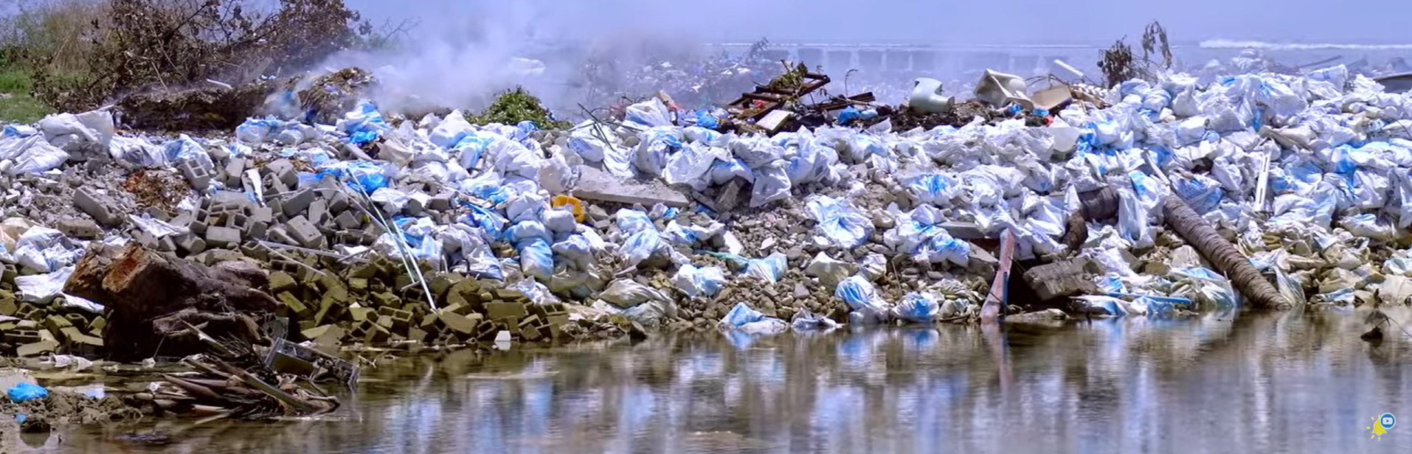
Watch: What happens to our 2.2 billion tons of trash? https://www.youtube.com/watch?v=AJVky2Fzl54
(5 min 32 sec)
Notes:
Watch Video (6 min)
Let us start by watching a video about what happens to the waste that we generate.
Watch: What happens to our 2.2 billion tons of trash? https://www.youtube.com/watch?v=AJVky2Fzl54 (5 min 32 sec)
Waste management is crucial to prevent environmental pollution and protect public health.
As we can see from this video, there are mechanisms in place to manage the tons of waste we create. Unfortunately, these mechanisms are not always efficient and are not applied uniformly across different countries. South Africa is running out of landfill space and is on the verge of a crisis. According to the President of the Institute of Waste Management of South Africa, Johannesburg has a maximum of three years left until its landfills reach capacity. This is a looming situation for many major cities in other parts of the country as well.

Slide 4

Recycling
Notes:
Teaching (2 min)
As individuals, we have a responsibility to help prevent this environmental crisis. One of the many ways we can contribute is by recycling correctly.
Recyclable materials like paper, cardboard, plastic, cans, and glass should not go into your general waste as they do not belong in a landfill. We should be separating our recyclables from our general/non-recyclable waste. These recyclables should be empty, dry, and clean. Dirty items can contaminate the recycling stream, making it difficult or impossible to recycle entire batches, resulting in more waste ending up in landfills.
To ensure an item can be recycled, look for the recycling icon (chasing arrows) and the accompanying code on the back. It can be challenging to recycle if your community doesn’t have proper support mechanisms in place.
If this is the case, you can try to find local recycling drop-off centres. Many communities have centres where you can take recyclables even if curbside pickup isn’t available. Some shops often have recycling programmes in place.

Slide 5
Importance of Waste Management
Uncontrolled waste can contaminate soil, water, and air, leading to environmental degradation.
Improperly managed waste can spread diseases and pose health risks to humans and animals.
Recycling and reusing waste materials help conserve natural resources and reduce the need for raw materials.
Proper waste management can reduce the emissions of greenhouse gases, contributing to climate change mitigation.
Notes:
Class Discussion (4 min)
Ask the learners to share reasons why waste management is important.
You can then reveal the following reasons on the slide:
Uncontrolled waste can contaminate soil, water, and air, leading to environmental degradation.
Improperly managed waste can spread diseases and pose health risks to humans and animals.
Recycling and reusing waste materials help conserve natural resources and reduce the need for raw materials.
Proper waste management can reduce the emissions of greenhouse gases, contributing to climate change mitigation.

Slide 6
Application of the NEMA in
Waste Management
Prevent pollution
Minimise waste
Share practices
Comply with laws
Implement waste management strategies
Use resources sustainably
Notes:
Teaching (4 min)
In our previous lesson, we discussed the National Environmental Management Act (NEMA) and its sub-acts. As you may recall, there is also a specific act for waste management called The Waste Act (Act No. 59 of 2008). This act encourages organisations (and individuals) to:
Prevent pollution by taking reasonable measures to manage waste in a way that is not harmful to the environment.
Minimise waste by adopting cleaner production methods and paying for waste management or remedying any damage caused by waste.
Share practices by informing the public about their waste management practices and involving them in environmental decision-making.
Comply with laws by inspecting facilities, investigating complaints, and taking legal action against violators.
Implement waste management strategies that align with national policies and objectives for sustainable waste management.
Use resources sustainably by engaging in practices that minimise the impact of resource use throughout its lifecycle.

Slide 7
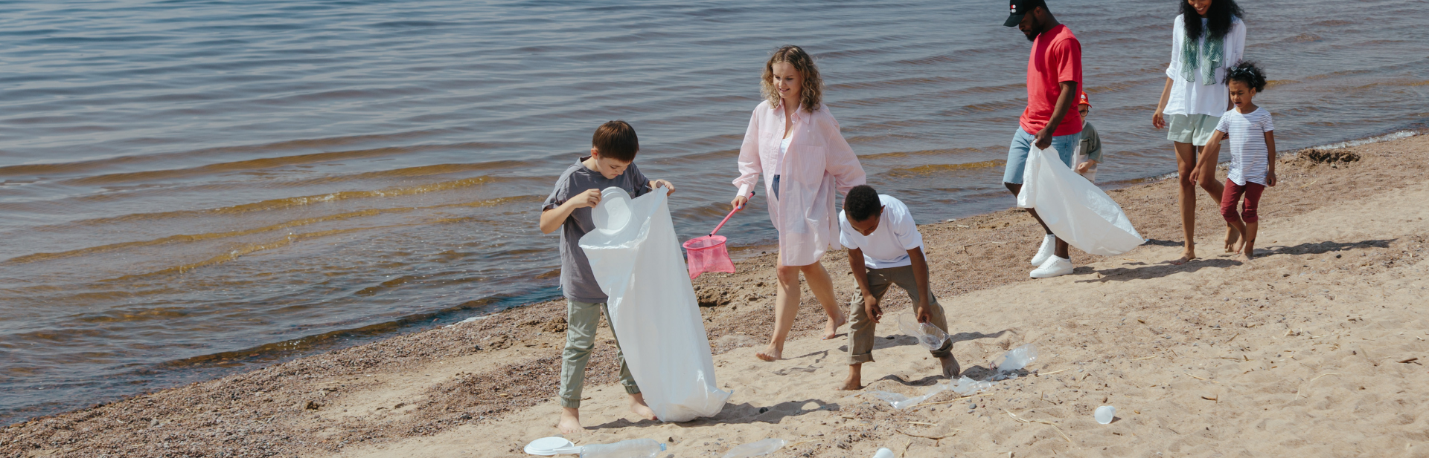
Class Discussion
Notes:
Class Discussion (4 min)
As mentioned earlier, we cannot rely solely on institutional laws and practices to address the waste issue. Each of us has an essential role to play in managing waste and promoting environmental health.
Think about practical ways toaddress waste in your homes and communities. Share your ideas with the class.
Answers may include the following:
At home:
Set up separate bins for recycling, compost, and general waste and teach family members the importance of sorting waste correctly.
Start a compost bin for kitchen scraps like fruit peels and vegetable cuttings. Use the compost in your garden.
Avoid single-use items by using reusable shopping bags, containers, and water bottles.
Donate old clothes, toys, and books instead of throwing them away or find new uses for items instead of discarding them.
Use environmentally friendly cleaning products and personal care items.
Choose products made from recycled materials.
In the community:
Join or organise community clean-up events to pick up litter in parks, beaches, and streets. Encourage friends and family to participate.
Help set up or improve recycling programmes in your community. Educate neighbours about the benefits of recycling and how to do it properly.
Work with local leaders to improve waste management services. Participate in community meetings and voice concerns about waste issues.
Encourage local shops and restaurants to reduce plastic packaging. Support businesses that use eco-friendly packaging.

Slide 8
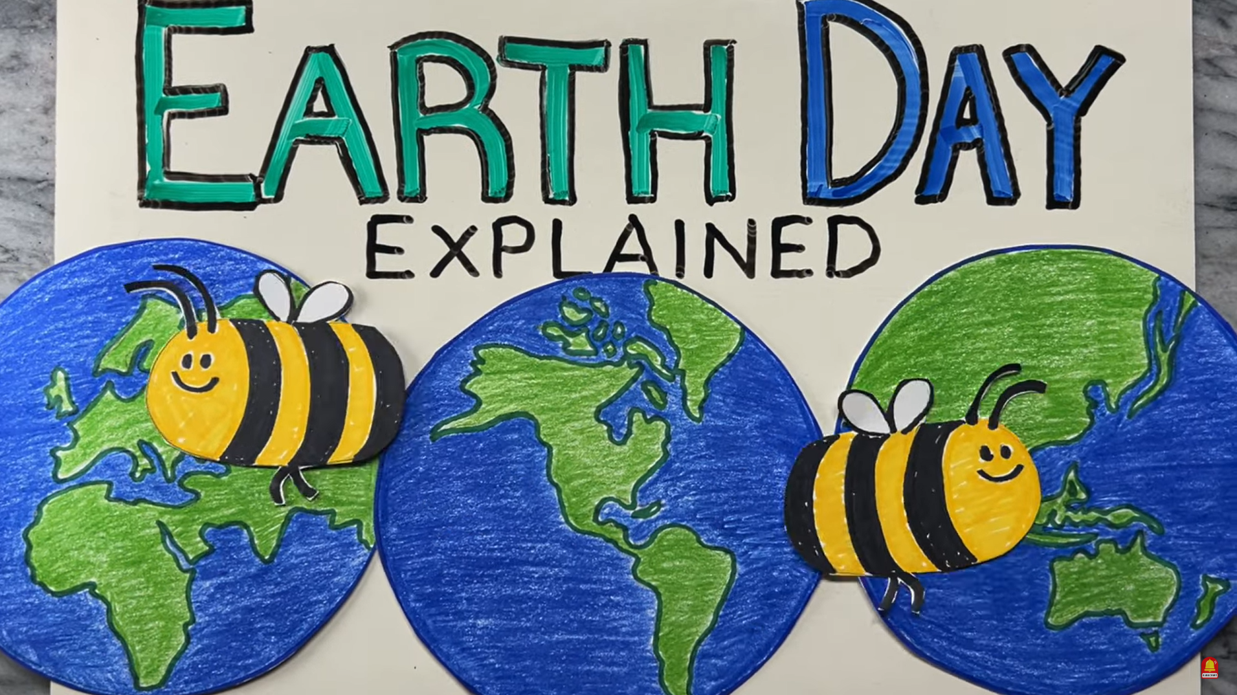
Watch: Where did Earth Day come from? Earth Day Explained | Who is Gaylord Nelson? https://www.youtube.com/watch?v=nr_0QR5oVVQ (3 min 22 sec)
Notes:
Watch Video (4 min)
It would be wonderful if we could practice these environmental protection behaviours (from class discussion) on a daily basis. Unfortunately, people aren’t always aware of the detrimental effects humans can have on the environment.
Earth Day is an annual event that helps educate people about environmental health on a global scale.
Let’s watch a video that explains what Earth Day is and how it can be celebrated.
Watch: Where did Earth Day come from? Earth Day Explained | Who is Gaylord Nelson?
https://www.youtube.com/watch?v=nr_0QR5oVVQ (3 min 22 sec)
Inform learners that notes on Earth Day will be available in their Content Summary (which they will receive in Lesson 3).

Slide 9

INFORMAL ASSESSMENT
Notes:
Informal Assessment (9 min)
You will now have an opportunity to complete the Informal Assessment in Activity 1 (Lesson 2 – Worksheet). You may work with a partner.
Please work quickly so that we can review the answers before the end of the lesson.
Once you have finished, we will go over the answers (available in Lesson 2 – Worksheet MEMO) together.

Slide 10
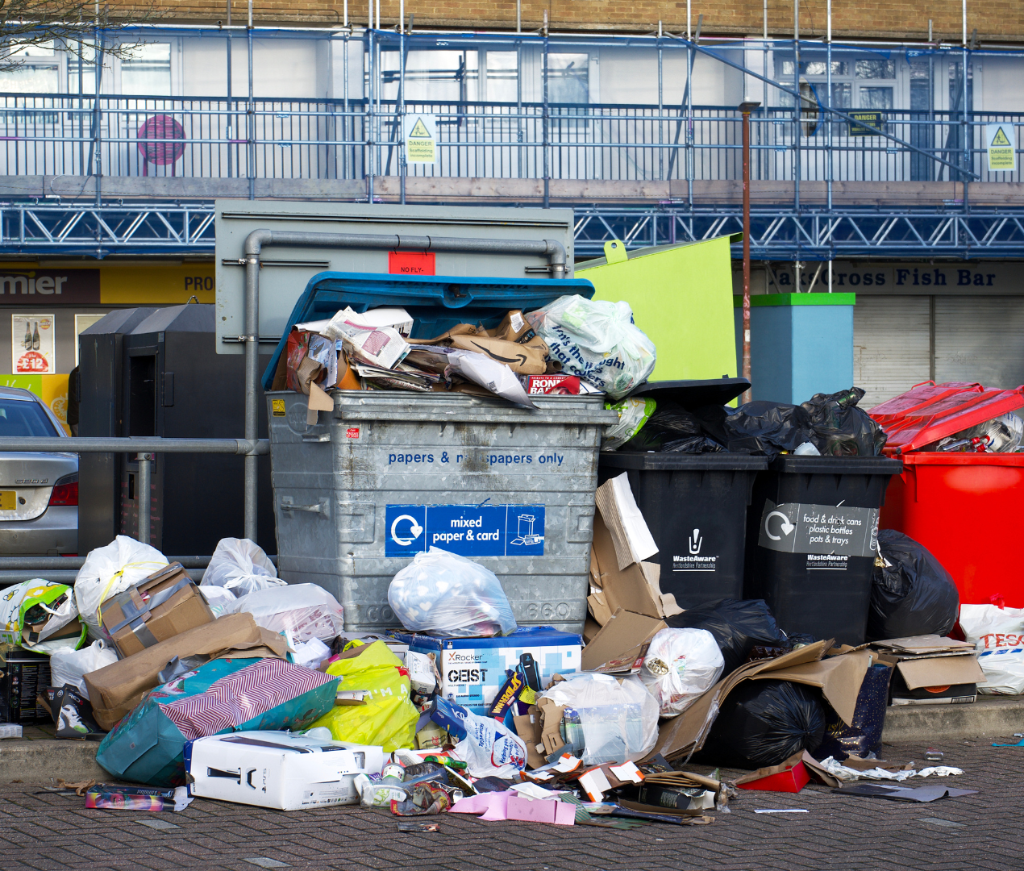
Homework
Notes:
Homework (1 min)
Remind the learners to complete the Lesson 1 – Waste Audit Form that was handed out last week. This form should be completed BEFORE the next lesson. Learners should not be scrambling in Lesson 3 to complete it.
Assign Activity 2 (Lesson 2 – Worksheet) as homework. This reflection activity will allow learners to think about their personal contribution to household waste as well as how they can encourage family members to adopt environmentally friendly practices.

