Slide 1
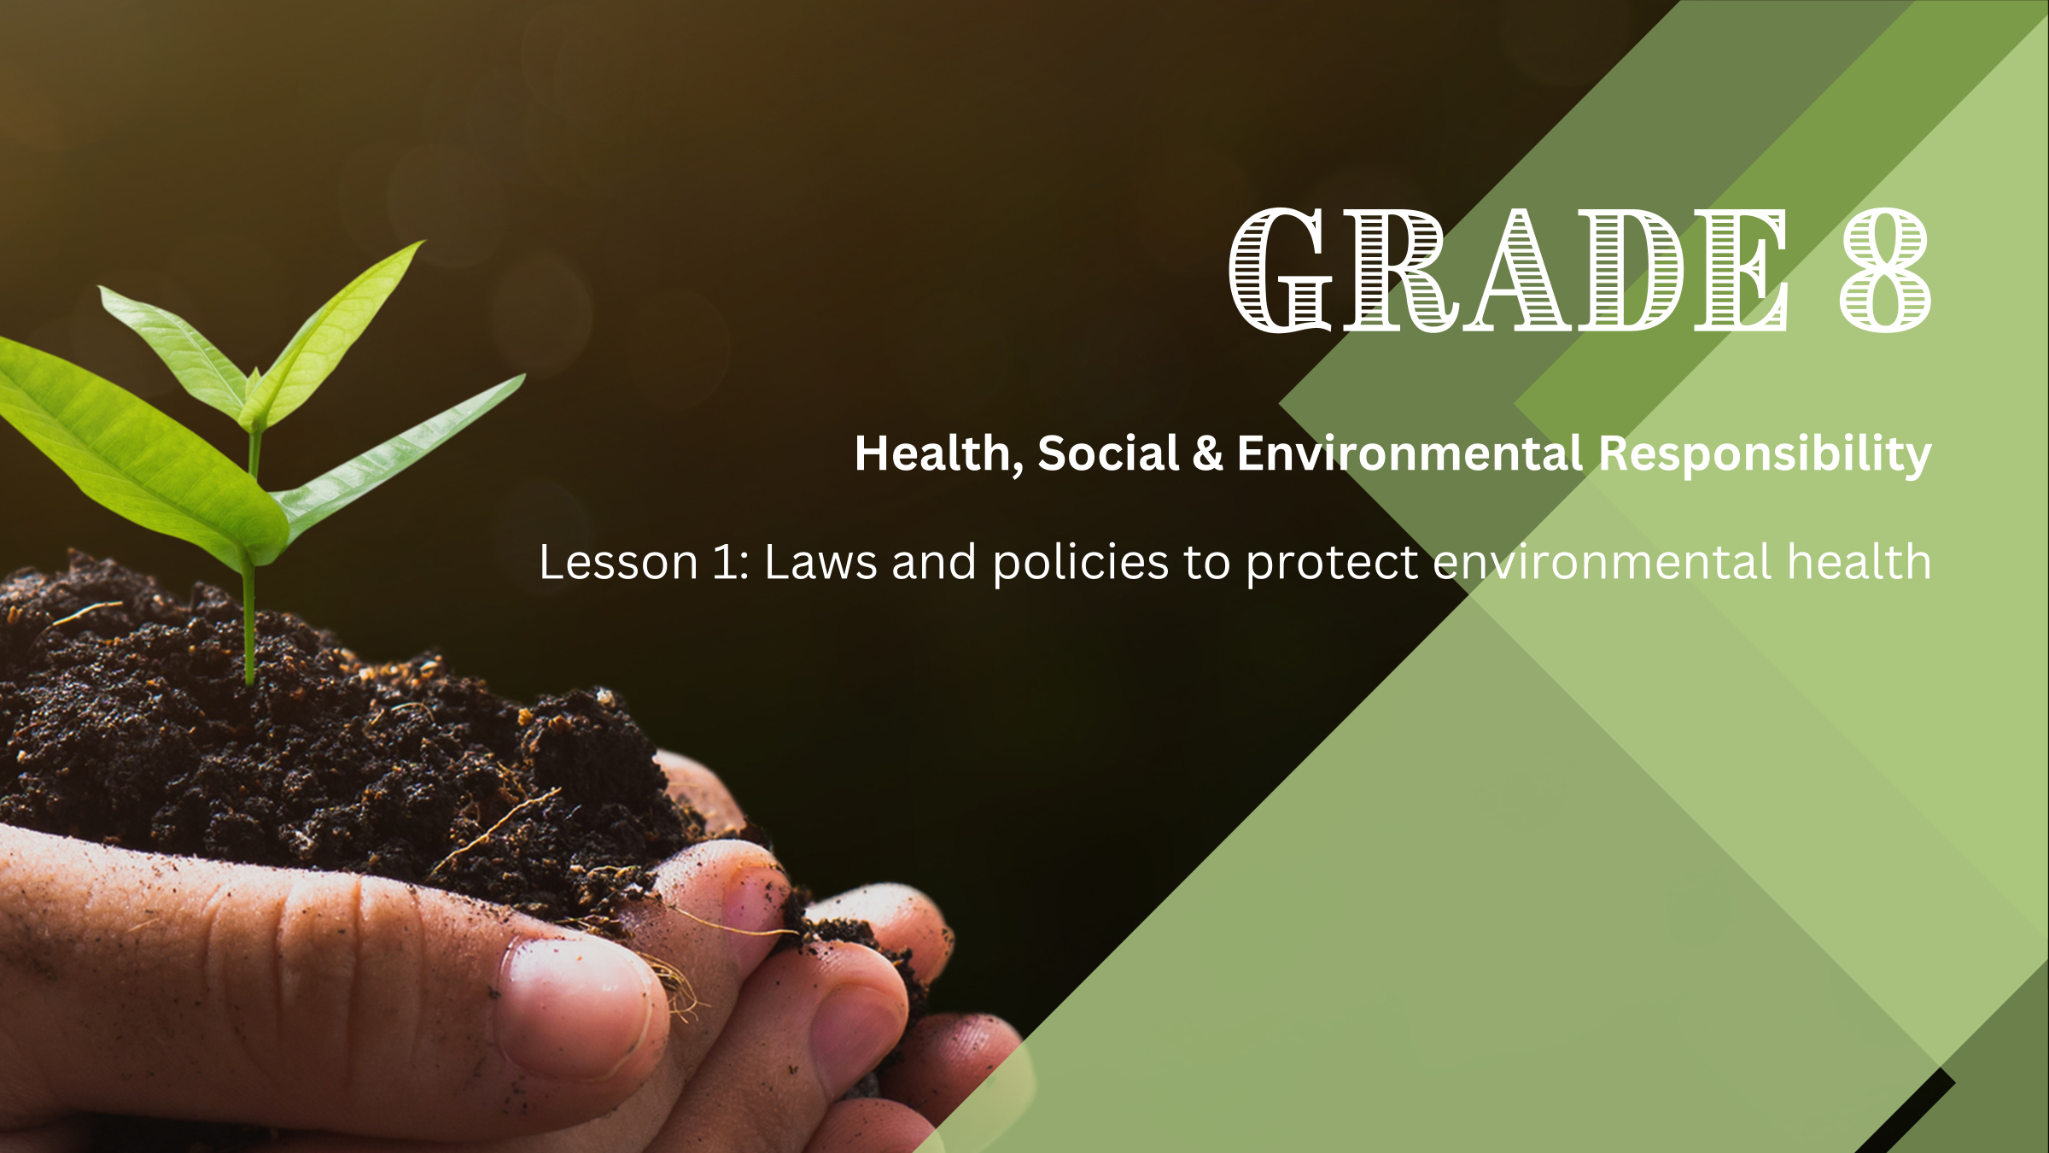

Notes:
Introduction (1 min)
Welcome the learners. Allow them to settle down and get their learning materials ready.
This week, we begin a new series of lessons focused on environmental health. Over the next three weeks, we'll explore environmental health issues, the laws and policies that protect our environment, and how we can contribute to environmental care.

Slide 2

Quiz
1.1. What is conservation?
a) Using resources without concern
b) Protecting Earth's natural resources
c) Developing technologies for the environment
d) Ignoring environmental problems
Notes:
Knowledge Recap (1 min)
Let us begin the lesson by quickly checking what you already know about Environmental Health. If you are unsure about any answers, don’t worry, we will cover the content in the next few weeks.
I’m going to display five multiple-choice questions (Slides 2-6). In Activity 1 (Lesson 1 – Worksheet) write down the answers to the quiz questions.
Allow 30 sec to answer Question 1.1.

Slide 3
Quiz
1.2. Why is conservation important?
a) To exploit resources for short-term gain
b) To ensure a sustainable future
c) To reduce biodiversity
d) To increase pollution
Notes:
Knowledge Recap (30 sec)
Allow 30 sec to answer Question 1.2.

Slide 4
Quiz
1.3. Which environmental issue is caused by greenhouse gases and affects marine habitats?
a) Pollution
b) Deforestation
c) Climate change
d) Noise pollution
Notes:
Knowledge Recap (30 sec)
Allow 30 sec to answer Question 1.3.

Slide 5
Quiz
1.4. How does pollution impact the environment and human health?
a) It has no effect
b) It enhances biodiversity
c) It causes ill-health in humans/animals
d) It only affects marine habitats
Notes:
Knowledge Recap (30 sec)
Allow 30 sec to answer Question 1.4.

Slide 6
Quiz
1.5. What does deforestation involve?
a) Protecting forests from wildfires
b) Planting new trees
c) Destroying nature for human activities
d) Building new homes for animals
Notes:
Knowledge Recap (30 sec)
Allow 30 sec to answer Question 1.5.

Slide 7
Quiz - Answers
1.1. B
1.2. B
1.3. C
1.4. C
1.5. C
Notes:
Knowledge Recap (2 min)
Review the answers so that learners can check their work. Do a tally of how many answers learners got correct.
1.1. What is conservation?
a) Using resources without concern
b) Protecting Earth's natural resources
c) Developing technologies for the environment
d) Ignoring environmental problems
1.2. Why is conservation important?
a) To exploit resources for short-term gain
b) To ensure a sustainable future
c) To reduce biodiversity
d) To increase pollution
1.3. Which environmental issue is caused by greenhouse gases and affects marine habitats?
a) Pollution
b) Deforestation
c) Climate change
d) Noise pollution
1.4. How does pollution impact the environment and human health?
a) It has no effect
b) It enhances biodiversity
c) It causes ill-health in humans/animals
d) It only affects marine habitats
1.5. What does deforestation involve?
a) Protecting forests from wildfires
b) Planting new trees
c) Destroying nature for human activities
d) Building new homes for animals

Slide 8

What is environmental health?
Environmental health is about how our surroundings affect our health and well-being. It focuses on making sure our air, water, plants, and food are clean and safe. This helps us stay healthy and builds strong, safe communities.
Notes:
Teaching & Class Discussion (5 min)
Ask learners to share their understanding of environmental health.
Reveal the definition on the slide: Environmental health is about how our surroundings affect our health and well-being. It focuses on making sure our air, water, plants, and food are clean and safe. This helps us stay healthy and builds strong, safe communities.
Prompt learners to provide reasons why environmental health is important.
Answers may include the following:
Clean air and water are vital for our health.
Healthy plants and food are necessary for our nutrition.
Our actions affect the environment, and in turn, the environment affects us.
A healthy environment means healthier people and communities.
We rely on a clean and healthy environment to survive. Pollution and other environmental problems are connected, so we need to address them together. We can protect our planet for ourselves and future generations by working together.

Slide 9





Environmental Health Issues
Climate Change
Air Pollution
Water Pollution
Soil Pollution
Deforestation
Notes:
Class Discussion (5 min)
Now, let’s explore issues that pose risks to our environment. Ask the learners to provide a brief explanation of each of the following environmental health issues:
Air Pollution: Smoke from factories, cars, and wildfires can make the air dirty, causing breathing problems and other health issues:
Water Pollution: Chemicals, litter, and sewage in rivers, dams, and oceans can contaminate the water we drink and use for cooking.
Soil Pollution: Harmful chemicals and waste can make soil unhealthy, affecting the plants and crops that grow in it.
Climate Change: Changes in the Earth's climate can lead to extreme weather, like hurricanes and droughts, which can harm people and animals.
Deforestation: Cutting down too many trees can destroy habitats for animals and affect the air we breathe.

Slide 10
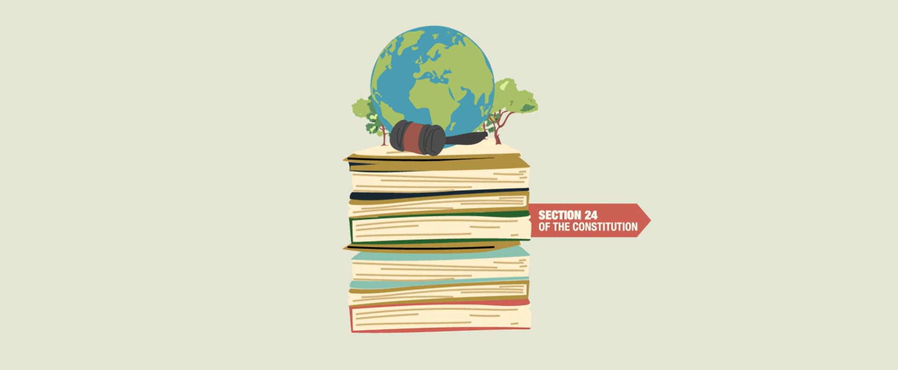
Watch: The South African Environmental Legal Framework to Sustain a Healthy Environment https://www.youtube.com/watch?v=bdUxO7m40MM (3 min 52 sec)
Notes:
Watch Video (6 min)
Discussing all these environmental issues can be unsettling. It is important to consider what actions we can take to address and solve these problems.
Governments around the world have created laws and policies to protect the environment and our health. In South Africa, there are many important rules/laws to ensure our environment is safe and clean.
Let us watch a video that explores one of the key environmental laws in South Africa:
Watch: The South African Environmental Legal Framework to Sustain a Healthy Environment https://www.youtube.com/watch?v=bdUxO7m40MM (3 min 52 sec)
This video highlights our constitutional right (Section 24) to an environment that does not harm our health or well-being. To enjoy our right to a healthy environment, we must also take responsibility for protecting and caring for it. We will discuss this responsibility in the next lesson (Lesson 2).

Slide 11
National Environmental Management Act 107 of 1998 (NEMA)
Working together
Manage and protect
Sustainable development
Notes:
Teaching (3 min)
To summarise what has been said in the video. The NEMA has several key aims, including:
Encouraging various groups and organisations to work together to protect the environment.
Making sure that we manage and protect our environment responsibly. It provides guidelines that everyone in South Africa should follow when dealing with environmental issues.
Finding a balance between protecting the environment and allowing sustainable development.
Ask learners to explain what sustainable development means.
Sustainable development is an approach to growth and human development that aims to meet the needs of the current generation without compromising the needs of future generations.

Slide 12

Individual Activity
Notes:
Individual Activity (6 min)
The video outlined several acts within the National Environmental Management Act (NEMA). Now, let's test your knowledge of what each act entails.
In Activity 2 (Lesson 1 – Worksheet) match the different acts with the correct description.
After learners have completed the activity, they can pair up with a peer to mark each other’s worksheet.
You can display the answers in Lesson 1 – Worksheet MEMO.

Slide 13
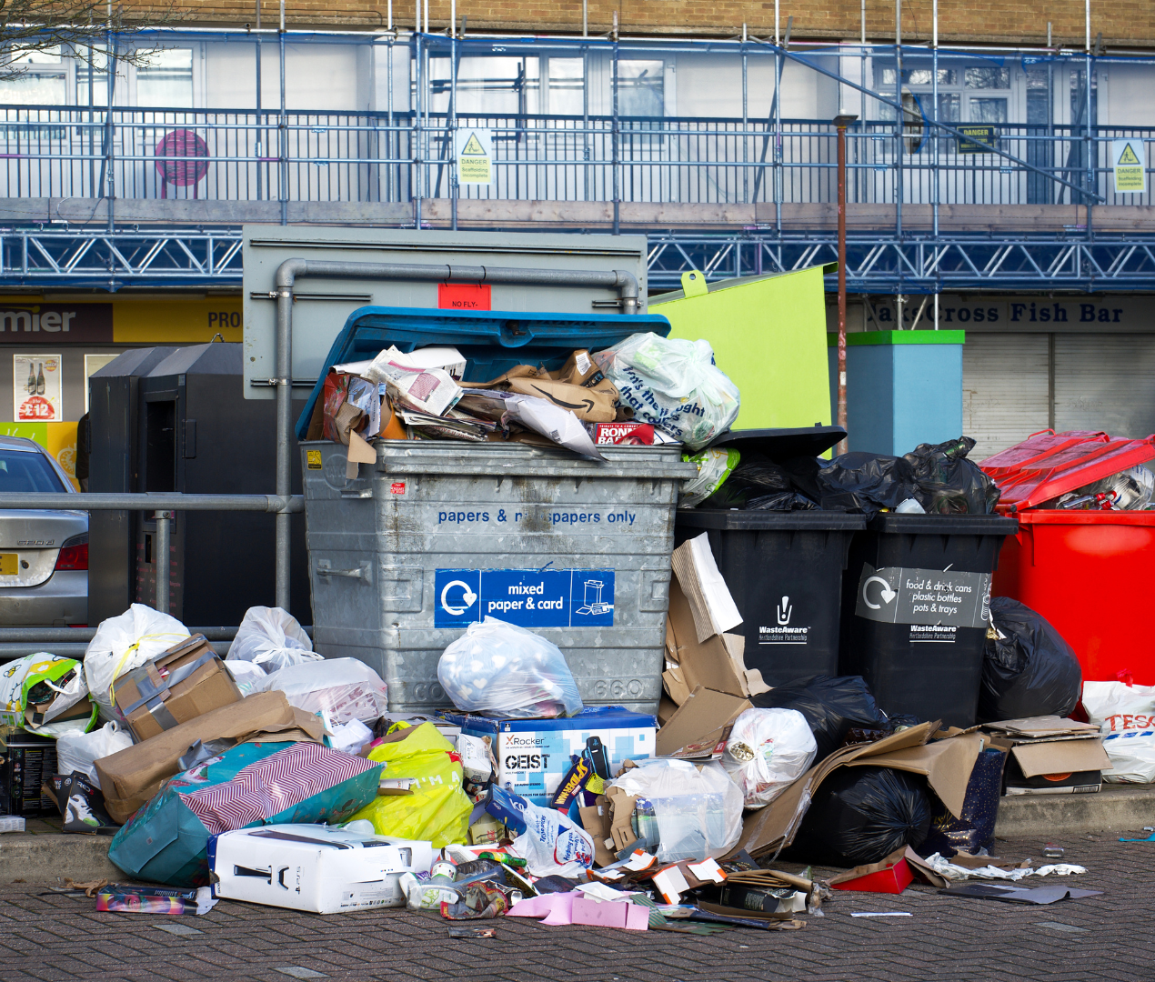
Homework: Waste Audit
Notes:
Homework: Waste Audit (5 min)
In two weeks (Lesson 3), we will do an exciting group activity. You will work with four other learners to develop and implement an environmental health programme. Today I will assign your groups and hand out a homework activity that must be completed by Lesson 3.
Assign learners in groups of FIVE or allow them to form their own groups.
Hand out the Lesson 1 – Waste Audit Form to ONE representative from each group.
Instructions: In your groups, you will need to make time (before or after school or during breaks) to conduct a waste audit in the school. You must walk around the school and make observations about waste generation and disposal. You can also talk to teachers, staff, and other learners to gather information. You will then need to fill out the form (16 questions) with your observations and findings. There is nothing else you need to do at this stage. You must only complete the Lesson 1 – Waste Audit Form.
Note to teacher: It's advisable to inform other teachers and staff about this assignment to ensure they are prepared if approached by learners.

Slide 14
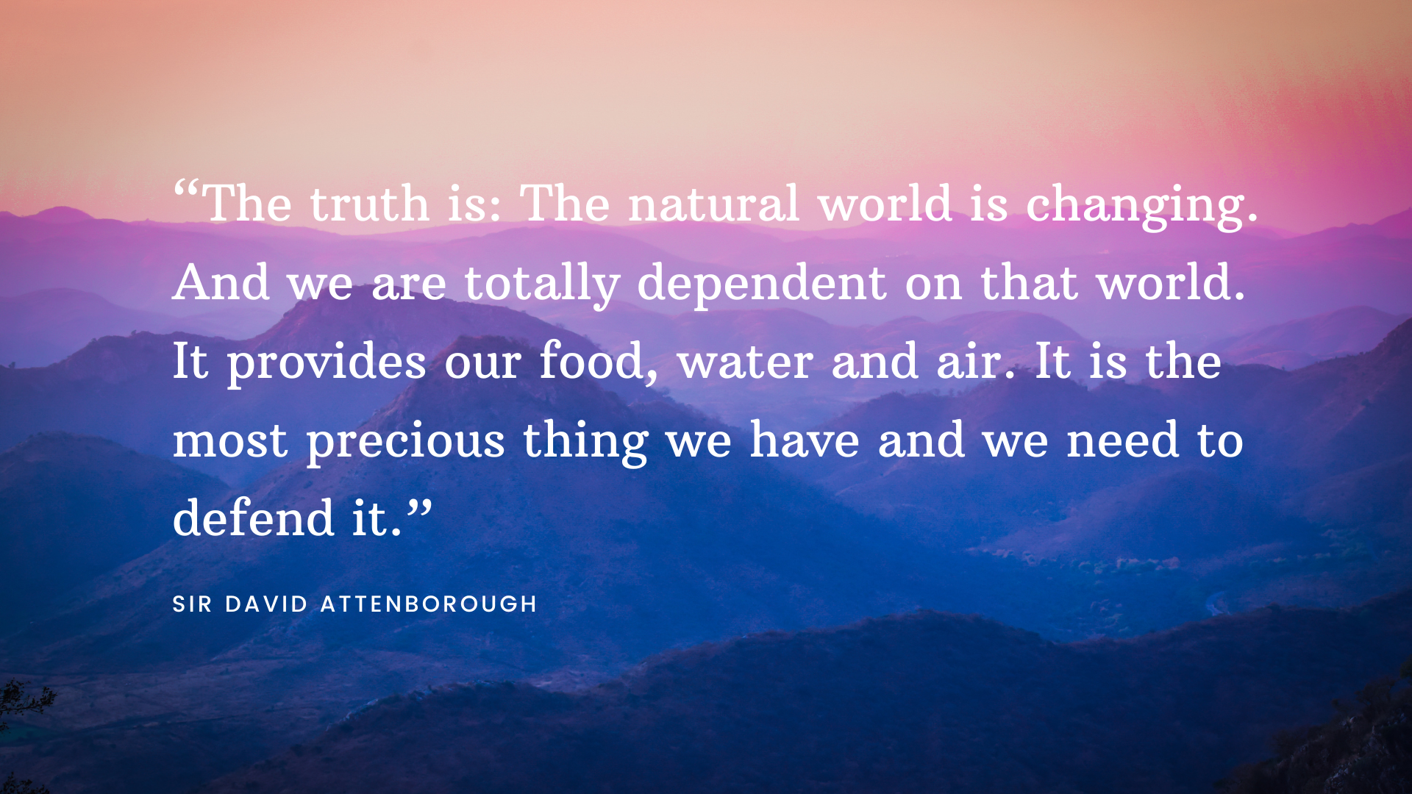
Reflection
Notes:
Reflection (4 min)
Read the quote on the slide: “The truth is: The natural world is changing. And we are totally dependent on that world. It provides our food, water and air. It is the most precious thing we have and we need to defend it.” (Sir David Attenborough)
Ask learners to reflect on this quote and answer the questions in Activity 3 (Lesson 1 – Worksheet).
Allow the learners to complete this activity for the remainder of the lesson.

