Slide 1


Notes:
Introduction (2 min)
Slide 1: Good day, Grade 8s! Over the next few lessons, we’re going to explore nation-building – what it means and how each of us plays a part in it. Today, we’ll look at how small actions and big role models can all help build a better South Africa.
This topic is important because nation-building strengthens unity, equality, and active citizenship in our diverse country. The Constitution of South Africa gives every person certain rights, like equality, freedom of expression, and human dignity, but it also reminds us that we have responsibilities.
These include respecting the rights of others, contributing to our communities, and promoting peace and fairness. By learning about nation-building, you’ll better understand how your choices, values, and actions can help shape a stronger, more united nation for everyone.

Slide 2
By the end of this lesson, you should be able to:
Define nation-building.
1
Identify ideas that support nation-building.
2
Identify how our normal day-to-day actions at home, at school and in the community promote nation building.
3
Research examples of individuals and groups building the nation.
4
Notes:
Slide 2: By the end of this lesson, you should be able to:
Define nation-building.
Identify ideas that support nation-building.
Identify how our normal day-to-day actions at home, at school and in the community promote nation building.
Research examples of individuals and groups building the nation.

Slide 3
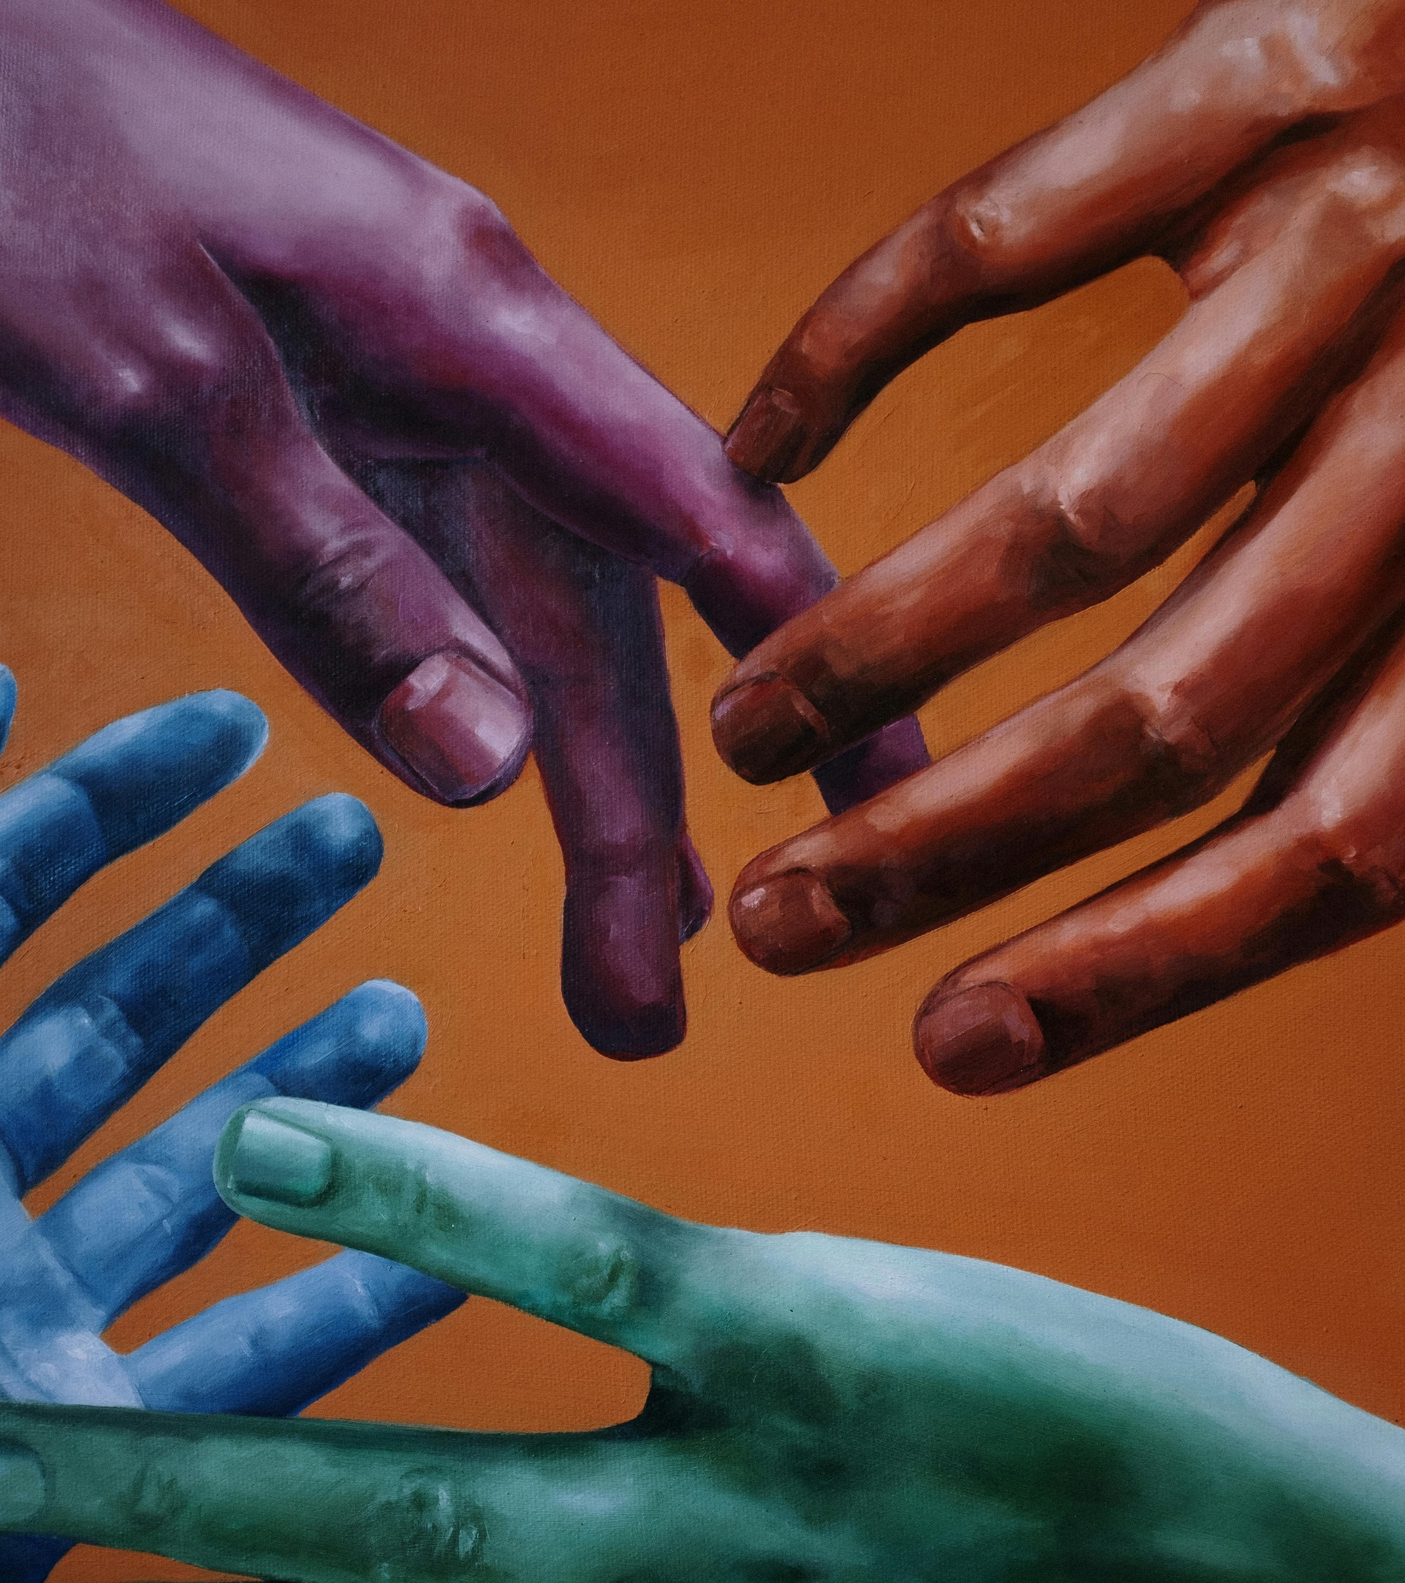
What is nation-building?
Strong and united country
Shared identity
Building trust
Sense of belonging
Notes:
Teaching & Discussion (5 min)
Slide 3: Explain the definition of nation-building: Nation-building is the process of helping a country become stronger and more united. It includes creating a shared identity, building trust between people, and making sure everyone feels like they belong. Nation-building also means working together to grow the country’s government, economy, and culture.
Explain that shared identity refers to people feeling united as part of the same team because they share common values, goals, or experiences, even if they come from different cultures or backgrounds.
Ask: What makes you feel proud to be South African? (Allow brief responses.)

Slide 4

Rainbow Nation & Ubuntu
Notes:
Slide 4: Two key ideas that support nation-building are Rainbow Nation and Ubuntu. Ask learners to explain their understanding of these terms.
The term "Rainbow Nation" was used by Archbishop Desmond Tutu to describe South Africa after 1994. It refers to the diverse range of people, cultures, languages, traditions, and beliefs found in our country. Just like a rainbow is made up of different colours, our unity as a nation is made up of our beautiful diversity. Respecting diversity means accepting and valuing everyone’s differences and understanding that each person is unique
Ubuntu is a South African term that means "I am because you are". It speaks about our shared humanity, the importance of community, and the way we rely on each other. Ubuntu encourages kindness, care, and responsibility towards others.

Slide 5
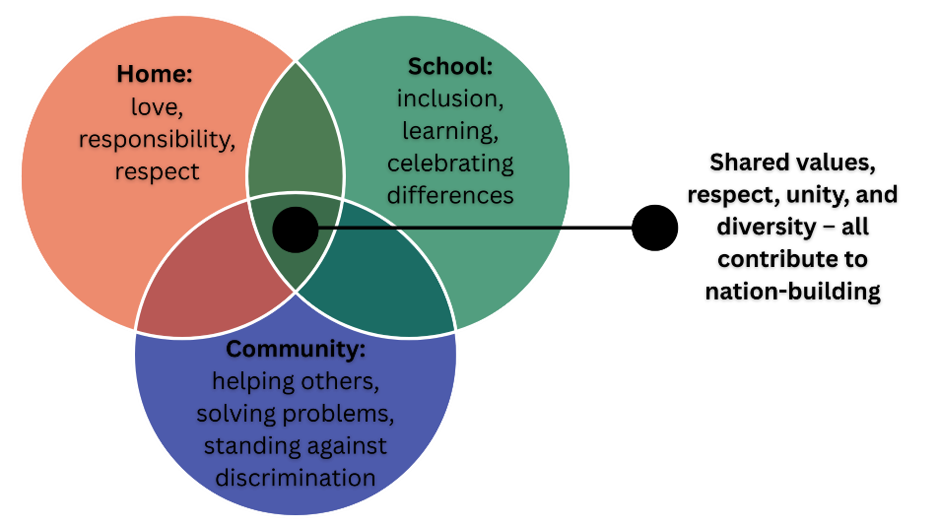
How home, school, and community work together to build the nation
Notes:
Teaching & Group Activity (3 + 7 min)
Slide 5: Nation-building doesn’t happen in just one place or on a particular day, like Heritage Day/Braai Day – it happens in many parts of our lives, and these parts are all connected. Home, school, and the community are like building blocks of our society. What we learn and practise in one area affects the others.
Let’s take a look at the diagram on the slide. When we learn values like love, responsibility and respect at home, we carry them into school and into our community. If our schools teach us to celebrate diversity, we take that attitude back home and into the community. When communities work together and support one another, they create safer, kinder environments for schools and families.
This diagram shows that each space supports and strengthens the others, and when all three work together, they help to build a united, strong nation.

Slide 6

Group Activity
Notes:
Slide 6: Nation-building starts with the small actions we take every day. You will now work in groups of THREE to FOUR to brainstorm at least THREE practical actions you can take in each area (home, school and community) to promote nation-building.
Learners to complete Activity 1 (Lesson 1 – Worksheet).
Allow groups to provide feedback. Possible answers are available in Lesson 1 – Worksheet MEMO.
You will explore sport as a nation-building tool in more detail later in high school, but it’s important to understand that sport can unite people across different backgrounds, languages, cultures, and beliefs. Supporting and celebrating our national teams (Springboks, Bafana-Bafana, Banyana Banyana, Proteas) helps build pride, unity, and a shared identity as South Africans.
A powerful example is the Springboks’ Rugby World Cup victories, especially in 1995, 2007, 2019, and 2023. These moments united the country, bringing people of all races and backgrounds together to celebrate a shared victory.

Slide 7
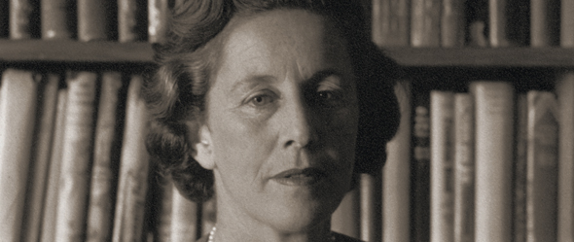
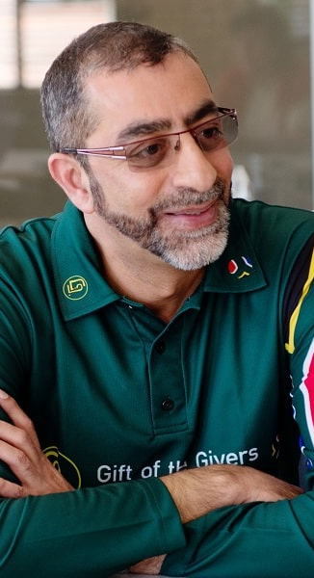
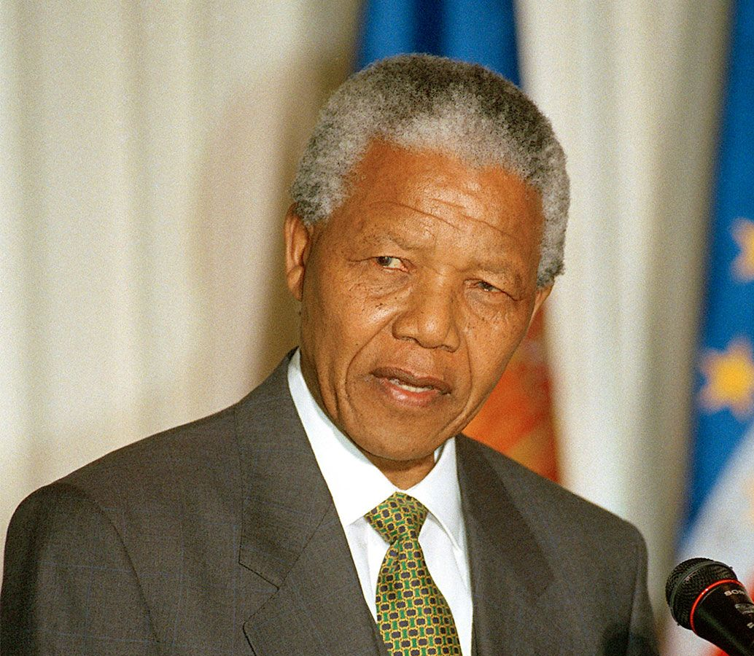

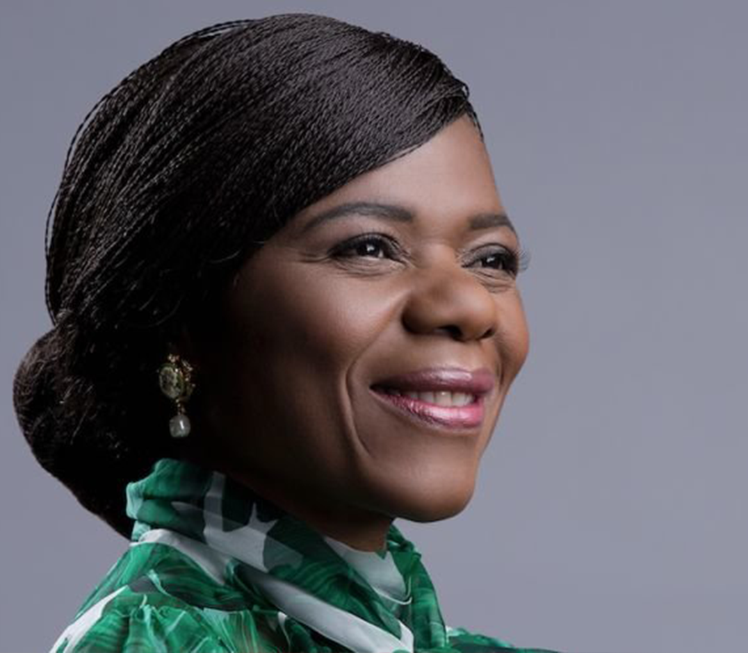
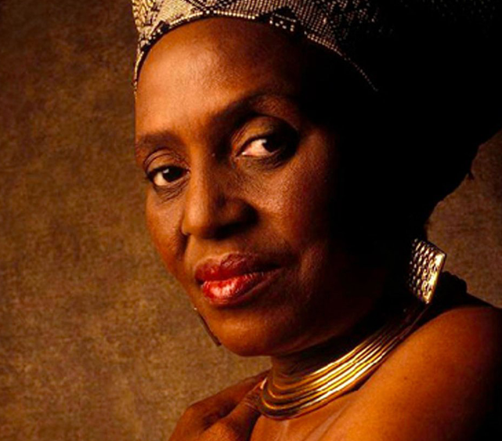
Nation-builders
Watch: WATCH | Backyard Varsity: Training SA's youth to build houses, shacks and their own lives
https://bit.ly/4djy1pj (4 min 41 sec)
Notes:
Watch Video & Pair Activity (5 + 10 min)
Slide 7: South Africa has many individuals and groups who have made major contributions to building a better South Africa.
Let’s watch a video of a real-life example of how ordinary people, especially the youth, can play an extraordinary role in building a more just, united, and dignified South Africa.
Watch: WATCH | Backyard Varsity: Training SA's youth to build houses, shacks and their own lives
https://bit.ly/4djy1pj (4 min 41 sec)
Isn’t this a great example of respecting human dignity by addressing inequalities of the past? There are many more examples of individuals and groups who have done or are doing amazing work in this area.
Let’s see if you are familiar with these people and the contributions they made. Working in pairs, match each individual or group to their correct contribution or impact.
Note to teacher: Learners may need to use electronic devices to look up individuals or groups they are unfamiliar with. Please allow this if permitted by your school’s policy. If not, be prepared to offer additional guidance as needed.
Learners to complete Activity 2 (Lesson 1 – Worksheet).
Allow groups to provide feedback. Possible answers are available in Lesson 1 – Worksheet MEMO.

Slide 8

Homework:
Informal Assessment
Notes:
Reflection & Homework (8 min)
Slide 8: Before learners complete the reflection activity, assign the Informal Assessment (Activity 4, Lesson 1 – Worksheet) as homework. If time permits, they may begin with the activity in class.

Slide 9
You can be a nation-builder too!
Notes:
Slide 9: Inspiration plays a big part in nation-building. When we hear stories of South Africans who made a difference, we feel proud and motivated to do the same. These heroes show us how ordinary people can make an extraordinary impact.
You can be a nation-builder too! Nation-building is not only for leaders or adults. Everyone has a role to play, even learners. Whether it’s by helping someone in need, standing up for a friend, or respecting people who are different, you are already helping to build a better South Africa.
Learners to complete Activity 3 (Lesson 1 – Worksheet).
Hand out the Content Summary.

