Slide 1
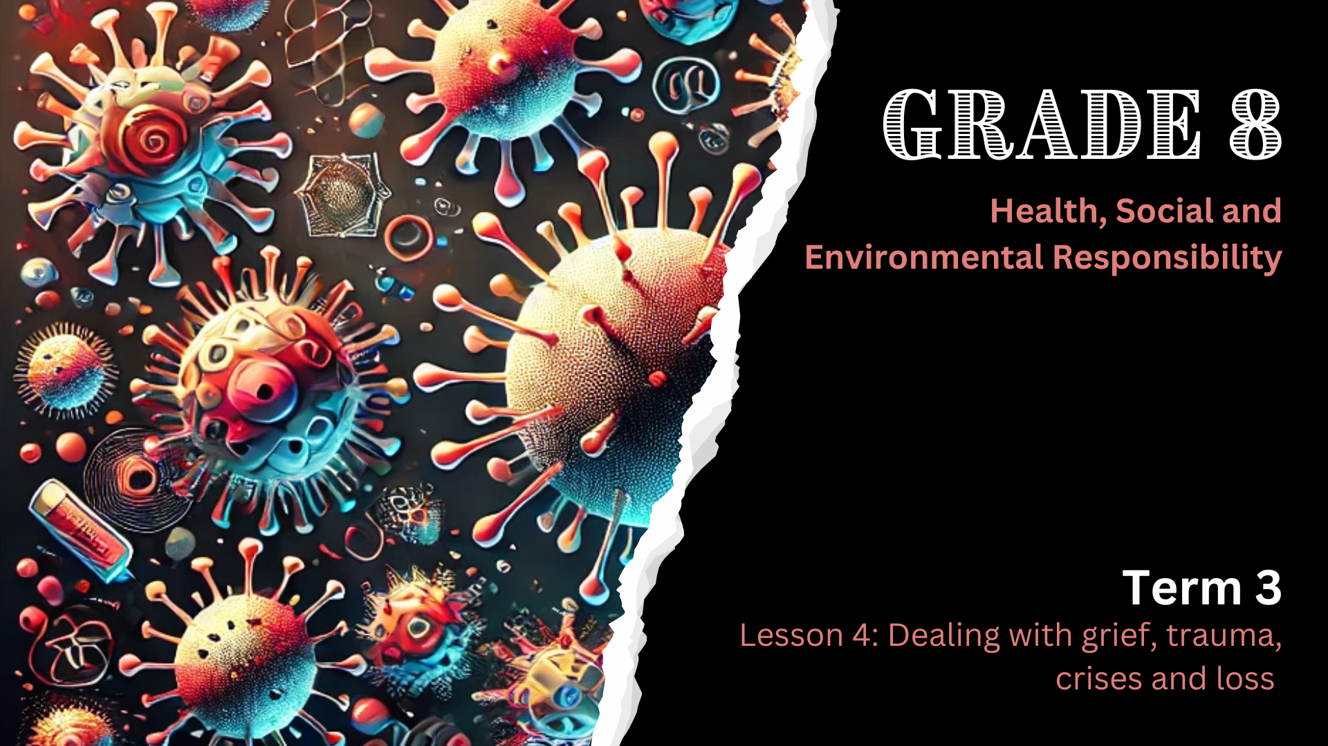

Notes:
Introduction (2 min)
Slide 1: Note to teacher: Please be aware that this lesson covers emotional topics such as grief, trauma, and crises. While these are important and relevant life skills, some learners may find the content upsetting or triggering, especially if they have experienced recent loss or trauma themselves. Let learners know at the start of the lesson that they can speak to you privately if they feel overwhelmed. Encourage learners to speak to a school counsellor, trusted adult, or support service if the topic brings up difficult emotions.
Welcome back, Grade 8s. In our last lesson, we learnt that managing HIV and COVID-19 isn’t only about taking medicine. Healthy habits and a positive attitude are just as important. These help us cope better, stay hopeful, and support both our physical and mental health.
Today, we’re going to take this further by looking at how to cope with grief, trauma, loss, and crises. Just like illness, these experiences can deeply affect our well-being, and it’s important to learn healthy ways to deal with them.

Slide 2
By the end of this lesson, you should be able to:
Explain the concepts of grief, trauma, crises, and loss.
1
Describe emotional and physical responses to loss, grief, trauma, crises and loss.
2
Identify healthy coping strategies for dealing with loss, grief, trauma, crises and loss.
3
Notes:
Slide 2: By the end of this lesson, you should be able to:
Explain the concepts of grief, trauma, crises, and loss.
Describe emotional and physical responses to loss, grief, trauma, crises and loss.
Identify healthy coping strategies for dealing with loss, grief, trauma, crises and loss.

Slide 3
Definitions
Crises
Loss
Grief
Trauma
Notes:
Teaching & Class Discussion (8 min)
Slide 3: Let’s start with the definitions of crises, grief and trauma. Can anyone tell me what these words mean?
Crises: Sudden, intense situations that cause disruption and stress. (Mention to learners that “crisis” is the singular form of “crises”.)
Loss: The experience of having something or someone important taken away or no longer available.
Grief: Deep sadness or sorrow after a loss.
Trauma: Emotional shock from a distressing or harmful event.

Slide 4
Example: COVID-19 Pandemic
Crisis
It disrupted daily routines, and created a sense of fear, uncertainty, and isolation.
Loss of loved ones, income and connection with friends and family, all of which led to grief.
Trauma
People were emotionally affected by stressful or frightening events.
Notes:
Slide 4: The COVID-19 pandemic is a real-life example that helps us understand the meaning of crises, grief, and trauma. Use the diagram on Slide 4 and the notes below to explain the example:
Can you remember what “pandemic” means? (Allow learners to respond.)
A pandemic is a widespread outbreak of a disease that affects multiple countries or continents
The COVID-19 pandemic was a global crisis that profoundly impacted individuals and communities. It can be described as a crisis because it disrupted daily routines, and created a sense of fear, uncertainty, and isolation.
Many people experienced the loss of loved ones, income and connection with friends and family, all of which led to grief.
These experiences also caused trauma, as people were emotionally affected by stressful or frightening events.

Slide 5

Resilience
Notes:
Slide 5: This is quite a heavy topic, but unfortunately, it’s a part of life. However, there is a silver lining. Amidst the devastation of COVID-19, humanity demonstrated remarkable resilience. People adapted, supported one another, and found ways to rebuild their lives.
Who can tell me what resilience means? (Allow learners to respond.)
Resilience is the ability to adapt, recover, and grow stronger after facing challenges. That’s exactly what we aim to do in this lesson: To equip you with the tools to heal and move forward after difficult experiences.
We all live unique lives, and at any given time, we may be dealing with a crisis, loss, grief, or trauma. Perhaps someone is coping with the death of a loved one, facing family problems, struggling with mental health, or dealing with financial stress. We don’t always know what others are going through, and that’s why it’s so important to show kindness and empathy.

Slide 6
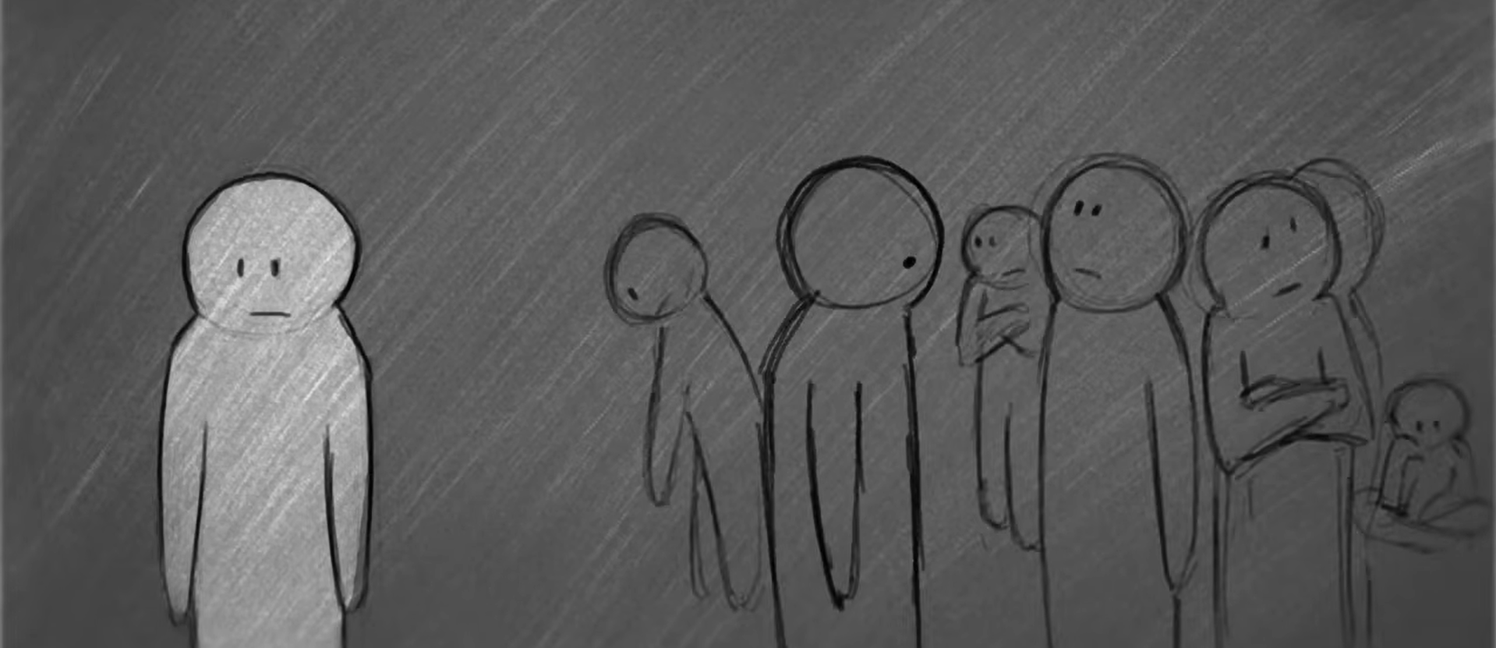
Watch: The Grieving Process: Coping with Death https://www.youtube.com/watch?v=gsYL4PC0hyk&ab_channel=watchwellcast
(4 min 13 sec)
Notes:
Watch Videos & Activities (8 + 8 min)
Slide 6: Now, let’s take a closer look at how loss, grief, crises, and trauma show up in our lives, and how we can begin to deal with them in healthy ways. We are going to watch two videos. Pay close attention as we watch. After each video, we’ll pause to complete a short activity based on what we’ve just learnt.
Our first video deals with loss and grief. Let’s watch.
Watch: The Grieving Process: Coping with Death
https://www.youtube.com/watch?v=gsYL4PC0hyk&ab_channel=watchwellcast (4 min 13 sec)
Learners to complete Activity 1 (Lesson 4 – Worksheet).
Allow learners to provide feedback. Possible answers are available in the Lesson 4 – Worksheet MEMO.

Slide 7
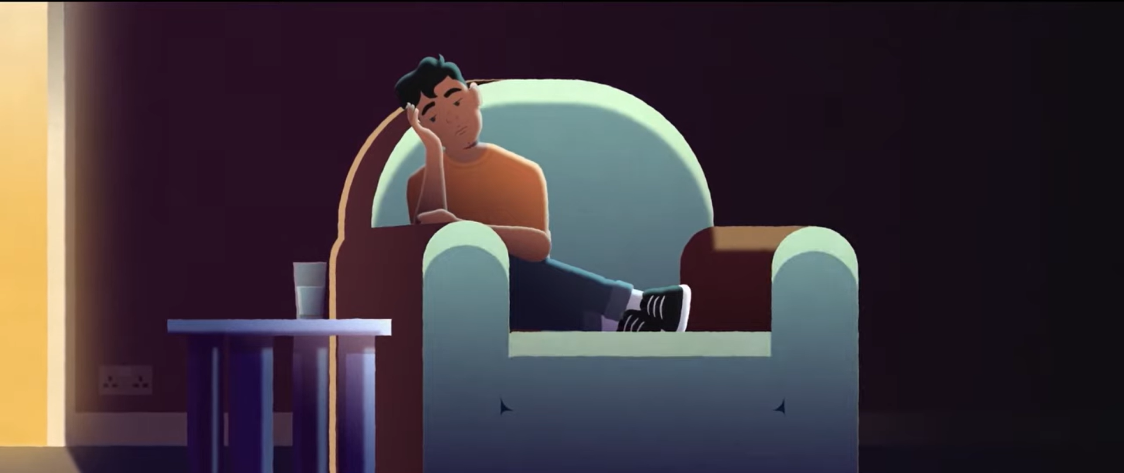
Watch: Coping with scary and distressing memories | UK Trauma Council https://www.youtube.com/watch?v=F5CrmanerlY&ab_channel=AnnaFreud
(3 min 14 sec)
Notes:
Slide 7: Our second video deals with crises and trauma.
Watch: Coping with scary and distressing memories | UK Trauma Council
https://www.youtube.com/watch?v=F5CrmanerlY&ab_channel=AnnaFreud (3 min 14 sec)
As you can see, there is a lot of overlap in coping with loss, grief, crises and trauma.
Learners to complete Activity 2 (Lesson 4 – Worksheet).
Allow learners to provide feedback. Possible answers are available in the Lesson 4 – Worksheet MEMO.

Slide 8

Informal Assessment
Notes:
Conclusion & Informal Assessment (14 min)
Slide 8: That brings us to the end of our content. Today we spoke about how people experience grief, trauma, crises, and loss, and how these can affect our emotions, bodies, and daily lives. We used COVID-19 as an example and learnt that grief is a process, not something you “get over.” We also looked at healthy ways to cope, like talking to someone, taking care of yourself, and doing things that bring you comfort. Most importantly, remember that you’re not alone, and it’s okay to ask for help.
Hand out the Content Summary.
We will now do an informal assessment based on the entire lesson series from the past four weeks. You will complete this activity on your own. Any work not finished in class must be completed for homework.
Learners to complete Activity 3 (Lesson 4 – Worksheet).
Possible answers are available in the Lesson 4 – Worksheet MEMO.

