Slide 1
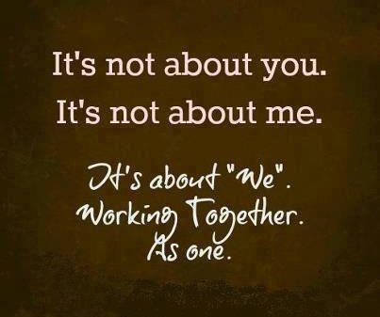

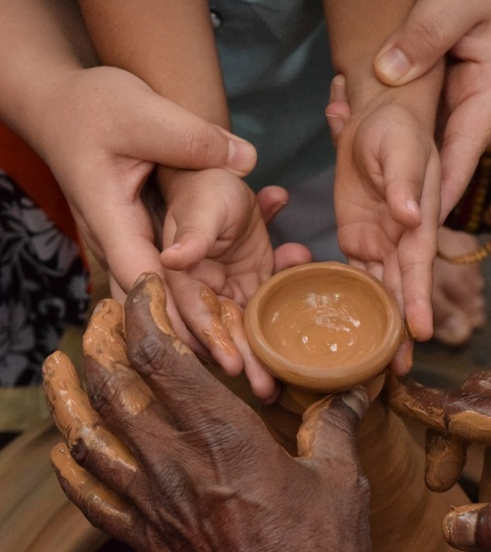
LIFE ORIENTATION COMMON ASSESSMENT TASK A
Covering Questions 1, 2 and 4

Slide 2
Life Orientation Topics Covered in CAT A
Social and Environmental Responsibility
Community responsibility to provide environments and services that promote safe and healthy living: – Responsibilities of various levels of government: laws, regulations, rules and community services
– Educational and intervention programmes; impact studies
Democracy and Human Rights
Responsible Citizenship:
– Evaluating own position when dealing with discrimination and human rights violations, taking into account the Bill of Rights
– Discussion of projects, campaigns and events which address discrimination and human rights violations

Slide 3
The 2025 Common Assessment Task will explore the concept of Ubuntu. It will unpack the different aspects of the philosophy and examine how Ubuntu is a concept understood worldwide. It will also examine the positive impact of living according to the principles of Ubuntu.
Aims of the 2025 CAT A

Slide 4
Use in conjunction with the CAT A Manual and information provided by the IEB.
Resources for
Question 1, 2 and 4
Notes:
ASSESSMENT REQUIREMENTS
Questions 3 (20 marks) and 4 (60 marks) are compulsory questions for assessment.
We will work through Question 1 and Question 2 and you must take careful notes of the comments and observations made. These will give you insight into the multiple perspectives of each contextual source that you may not have previously considered. This will aid you in providing quality responses in the CAT A and B.
Regarding your responses in both CAT A and CAT B – please ensure that you provide sufficient detail in your answers. You are required to think deeply about each question and to ensure that your opinions and thoughts are supported by valid reasoning

Slide 5
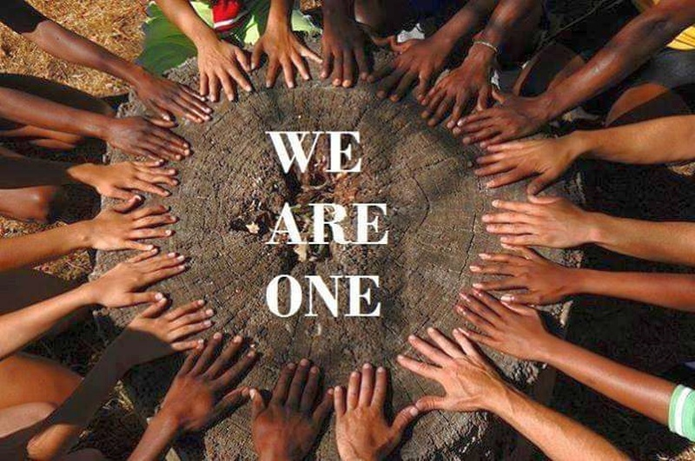
An understanding of the philosophy of Ubuntu.
An exploration of how this philosophy is expressed in different countries and across various cultures.
How we can use the philosophy of Ubuntu to better our lives and the lives of those around us.
The IEB CAT A will explore:

Slide 6
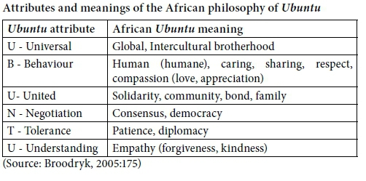

An understanding of the philosophy of Ubuntu
WATCH:
UBUNTU told by Nelson Mandela: https://youtu.be/HED4h00xPPA
Notes:
QUESTION 1 AN EXPLORATION OF UBUNTU
AIM: To explore the concept of Ubuntu and gain an understanding of how it manifests in different cultures and countries.
Watch the video clip on UBUNTU as told by Nelson Mandela.

Slide 7

Origins and Meaning of Ubuntu
Etymology of Ubuntu
  'Ubuntu' originates from the Nguni Bantu language, highlighting its cultural roots and significance in African philosophy.
Meaning of Ubuntu
  Ubuntu translates to 'humanity to others,' emphasising the interconnectedness and compassion among individuals within a community.
Philosophical Significance
  The phrase 'I am because we are' encapsulates the essence of Ubuntu, stressing the value of community and mutual support.

Slide 8

Core Principles and Values
Philosophy of Ubuntu
  Ubuntu emphasises the importance of compassion and respect for all individuals, fostering a strong community bond.
Interconnectedness
  The principle of interconnectedness highlights how every individual's actions impact the community and the world.
Collective Good
  Ubuntu encourages individuals to work together for the collective good, fostering a sense of belonging and shared responsibility.

Slide 9
Ubuntu in African Culture
Concept of Ubuntu
Ubuntu is a philosophical concept emphasising interconnectedness and mutual support within communities, fostering a sense of belonging.
Social Harmony
The principle of Ubuntu promotes social harmony and cooperation among individuals, highlighting the importance of collective well-being.
Ethics of Care
Ubuntu forms the foundation of social ethics, where caring for others enhances the overall health and well-being of the community.

Slide 10

WATCH:
Brené Brown - Embracing Vulnerability:
https://youtu.be/AO6n9HmG0qM
Notes:
Question 1.1.2: Trusting People can be Vulnerable.
Watch the Brene Brown clip, Embracing Vulnerability.

Slide 11
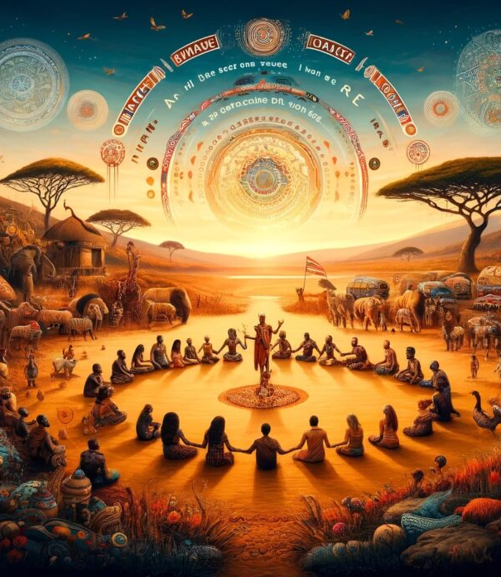
Ubuntu: The Philosophy of Shared Humanity
Link to the above article: https://thepanafrica.com/ubuntu-the-philosophy-of-shared-humanity/

Slide 12
Ubuntu: The Philosophy of Shared Humanity continued…
“The Roots and Reach of Ubuntu
In contrast to Western individualism, epitomised by Descartes’ “I think, therefore I am,” Ubuntu holds that one’s humanity is defined through others. It was popularised globally by figures like Nelson Mandela and Archbishop Desmond Tutu, particularly in the context of South Africa’s Truth and Reconciliation Commission, where it played a critical role in restorative justice.
Ubuntu values compassion, mutual support, and the well-being of the collective. This moral obligation transcends superficial kindness—it’s about genuine empathy and the recognition that your humanity is tied to the humanity of others. By fostering communal harmony, Ubuntu encourages consensus-building and peaceful conflict resolution.”
Retrieved from: https://thepanafrica.com/ubuntu-the-philosophy-of-shared-humanity/

Slide 13
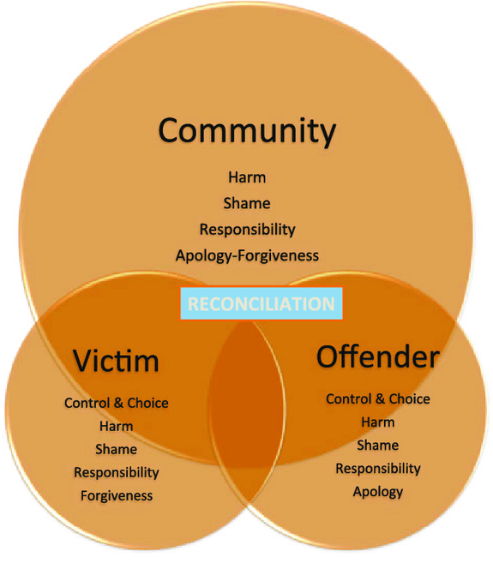
What is Restorative Justice?
NOUN
a system of criminal justice which focuses on the rehabilitation of offenders through reconciliation with victims and the community at large.
Notes:
Question 1.1.8 The conflict resolution process in the context of Ubuntu is similar to restorative justice.
How can we link the concept of restorative justice to Ubuntu?
Restorative justice is the process of dealing with wrongdoing that focuses on healing, making peace, and fixing relationships instead of punishing people. It brings together everyone involved—victims, offenders, and the community— in a collaborative process to understand the harm caused and to develop a plan for making amends. Ubuntu also focuses on resolving conflict by restoring harmony in the community. It addresses the needs of everyone involved and strengthens relationships between people. Restorative justice and Ubuntu are similar because they both aim to heal and bring people together. Instead of focusing on punishment, they prioritise repairing harm, helping people reconcile, and reintegrating individuals into the community. By focusing on the well-being of everyone and their connections, they create a more peaceful and united society. (Taken from Teacher’s Guide)

Slide 14
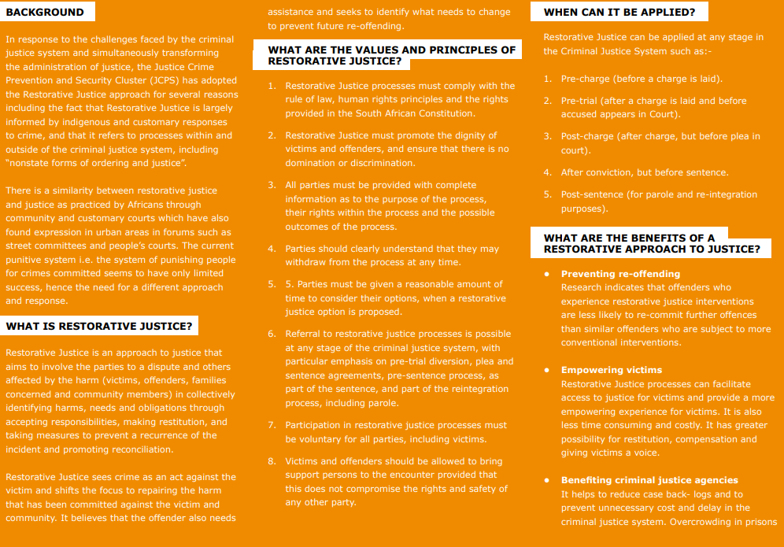
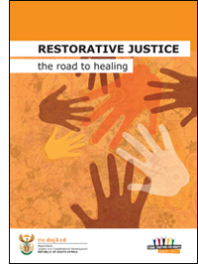
Link to the above Fact Sheet: https://www.justice.gov.za/rj/2011rj-factsheet-eng.pdf
Link to the above booklet:
https://www.justice.gov.za/images/p_pdf.gif

Slide 15
Equality, Dignity and Non-discrimination
Constitution of the Republic of South Africa, 1996 - Chapter 2: Bill of Rights
Equality
Everyone is equal before the law and has the right to equal protection and benefit of the law.
Equality includes the full and equal enjoyment of all rights and freedoms. To promote the achievement of equality, legislative and other measures designed to protect or advance persons, or categories of persons, disadvantaged by unfair discrimination may be taken.
The state may not unfairly discriminate directly or indirectly against anyone on one or more grounds, including race, gender, sex, pregnancy, marital status, ethnic or social origin, colour, sexual orientation, age, disability, religion, conscience, belief, culture, language and birth.
No person may unfairly discriminate directly or indirectly against anyone on one or more grounds in terms of subsection (3). National legislation must be enacted to prevent or prohibit unfair discrimination.
Discrimination on one or more of the grounds listed in subsection (3) is unfair unless it is established that the discrimination is fair.
Retrieved from: https://www.gov.za/documents/constitution/chapter-2-bill-rights#9

Slide 16
Everyone in society needs to play a part, regardless of how small one may think it is. We all have a role to play and it’s of vital importance that our actions inspire others to want to be a part of a better and brighter future.
Ubuntu is also about justice, and particularly, justice for all people. As much as we must look after each other, it is also just as important that we exercise fairness and equality for all people regardless of race, gender, or social status.
So essentially, Ubuntu is about togetherness as well as a fight for the greater good.
Retrieved from: https://www.globalcitizen.org/en/content/ubuntu-south-africa-together-nelson-mandela/
Notes:
Read through Question 1.1 – “What is Ubuntu” and get learners to discuss and complete the questions.

Slide 17

WATCH:
The story of UBUNTU: https://www.youtube.com/watch?v=GjVwsgL2i98
Ubuntu – I am because we all are.
This is a powerful and inspiring story about the African philosophy of teamwork and collaboration.
Narrated by Tim Duggan
Notes:
Question 1.2 – The Popularisation of Ubuntu
Watch the Clip about UNBUNTU – African Philosophie of Teamwork and Collaboration.
Read through Question 1.2 and get learners to discuss and complete the questions.

Slide 18

“Africa’s wisdom must be shared with the world now. Africa has so much to offer the world…but alas, people only focus on negativity and problems.” – Credo Mutwa

Slide 19
Ubuntu: The Philosophy of Shared Humanity continued…
“Embracing Ubuntu for a Better Future
By embracing Ubuntu, we can cultivate a more inclusive and empathetic society. This involves building deeper connections, approaching conflicts with understanding, and recognising our roles within the larger community. From small acts of kindness to global peacebuilding efforts, Ubuntu’s call to shared humanity reminds us that “I am because we are.”
As the world faces increasing division and isolation, the principles of Ubuntu—interdependence, empathy, and communal responsibility—offer a path to a more harmonious and sustainable future.
Ubuntu is more than an African concept; it’s a universal philosophy that encourages us to view ourselves not in isolation but as part of a greater collective. As we seek to address the world’s challenges, Ubuntu serves as a timeless reminder that our strength lies in our interconnectedness. Together, we can build a future based on shared humanity and collective well-being.”
Retrieved from: https://thepanafrica.com/ubuntu-the-philosophy-of-shared-humanity/
Notes:
Question 1.3 – Ubuntu in other words

Slide 20
UBUNTU and the Earth/Environment
Reconnecting with the Earth is a journey that demands both introspection and action.
It challenges us to see the world through the lens of Ubuntu, recognising that our well-being is tied to the health of our environment.
This challenge calls for courage, creativity, and commitment. It is a call to embrace our roots, honour our heritage, and innovate for a sustainable future.
Our Mother Earth is not a distant entity but a living community to which we belong.
Reconnecting with the Earth will create a more harmonious, sustainable, and just world.
Retrieved from: https://laudato-youthinitiative.org/2024/07/30/ubuntu-and-the-earth-reviving-ancient-wisdom-for-modern-environmental-stewardship/
Notes:
Get learners to discuss and complete Question 1.3 questions.

Slide 21

AI and Ethics
“AI technology brings major benefits in many areas, but without the ethical guardrails, it risks reproducing real-world biases and discrimination, fueling divisions and threatening fundamental human rights and freedoms.
AI systems have the potential to embed biases, contribute to climate degradation, threaten human rights and more.”
Notes:
QUESTION 2 THE IMPACT OF UBUNTU ON SOCIETY
AIM: To gain an understanding of how 'Ubuntu in action' can have a positive impact on society.
[For the teacher: For your information, see Source: Ethics of Artificial Intelligence. Read through UNESCO recommendation on the Ethics of Artificial Intelligence.]
The rapid rise in artificial intelligence (AI) has created many opportunities globally, from facilitating healthcare diagnoses to enabling human connections through social media and creating labour efficiencies through automated tasks.
However, these rapid changes also raise profound ethical concerns. These arise from the potential AI systems have to embed biases, contribute to climate degradation, threaten human rights and more. Such risks associated with AI have already begun to compound on top of existing inequalities, resulting in further harm to already marginalised groups.
Go through Question 2.1 and get learners to complete the questions.

Slide 22
WATCH:
Desmond Tutu (forgiveness)
https://www.youtube.com/watch?v=uo2LGGqtjqM
Notes:
Watch the clip on Forgiveness by Desmond Tutu.
Go through Question 2.2 UBUNTU and the judiciary and get learners to discuss and complete the questions.

Slide 23
QUESTION 4 Compulsory – 60 Marks:
CHANGING OUR COMMUNITIES THROUGH THE PRINCIPLES OF UBUNTU
Aim: Through research, you will be required to select an area of your community that you feel needs to change so that it operates according to the principles of Ubuntu. The skills of analysis, critical thinking and creativity will be required to respond adequately to this section.
Task instructions
You are required to identify an area in your community that lacks the principles of Ubuntu in some way. Your focus can be on any area in your community where the principles of Ubuntu have been distorted in some way to fit a specific agenda OR where your community reflects specific problems that the principles of Ubuntu could make healthier.
As part of your research, you are required to interview at least THREE people from your community. The people you choose need to be from different ethnic/cultural groups. These interviews are necessary for you to gain an understanding of Ubuntu as seen through the eyes of those around you, but also to help you identify areas that need to be changed to be more in line with the principles of Ubuntu.
Notes:
Work through Question 4 and the rubric with your learners ensuring that they understand what is required.

Slide 24
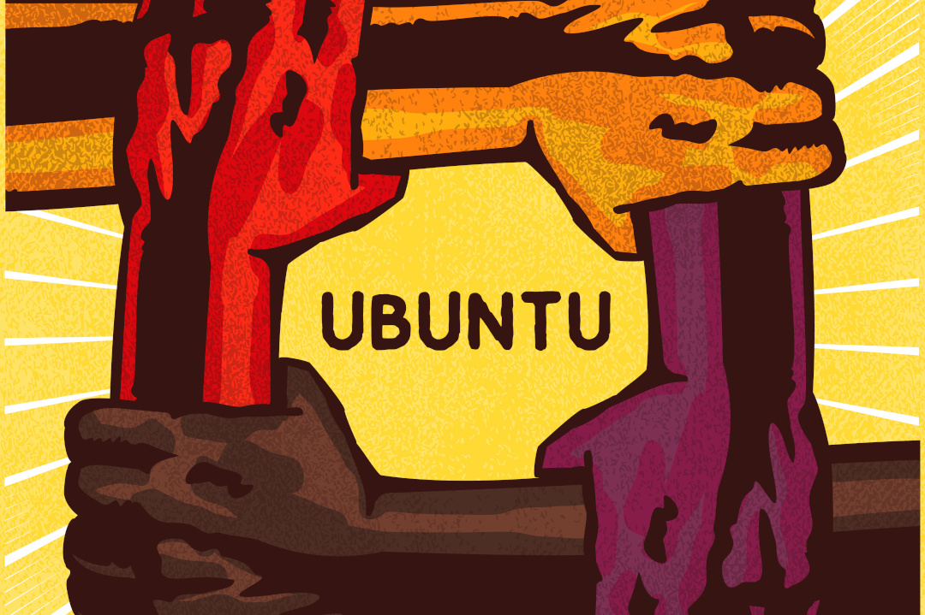
Because WE ARE
All the words in the world wouldn’t tell you
All the money you never could spend it
You deserve all the praise in the world cos
It’s all because of you that
In the middle of all that is changing
We can count on the difference you’re making
Cos everyday you are there, come what may
Nakanjan ukona da
All because of you
Oh the world keeps spinning round
Because of you
we can stand on firmer ground
All because of you
keep our heart beat safe and sound
Cos of you
We can feel we’re stronger now
Eli vili liyajika
Ngengxa yakho
WE ARE
All the best of a nation united
WE ARE
Coming through like a light in the darkness
WE ARE
Any test we will pass
Amandla!
ANY STRUGGLE WE WILL WIN!
Because WE ARE
The greatest dream of our mothers before us
Nkosi sikelela will remind us
moving forth to our destiny calling
WE WILL BUILD THE DREAM
All because of you
Oh the world keeps spinning round
Because of you
we can stand on firmer ground
All because of you
keep our heart beat safe and sound
Cos of you
We can feel we’re stronger now
And even when life is hardest
There’s nothing stronger than kindness
On your knees every night like a fighter
Getting up every morning stronger
Thuma thina we will rise, yeah
Maluphakamis’wu phondo lwayo
To the light we moving together
Building a future our ancestors could only dream
All because of you
Nomakanjani jy’s daarso bra
We just want to say dankie daarso
Ons waardeer dit en eer dit ngiyabonga man
Mhlobo wami dankie son
Ey, we’ve been through the worst
The last shall be first
It’s all Because...you you you!
All because of you
Eli vili liyajika
Ngengxa yakho
Syanibonga
We Love You
We Appreciate You
Siyabulela
Sphuma Kude,Futhi Siya Phambili
Oh! Because Of You...
WATCH:
Because We Are https://www.youtube.com/watch?v=JeUL-d5ssE4
Notes:
Watch the clip of the song, Because we are.

