Slide 1
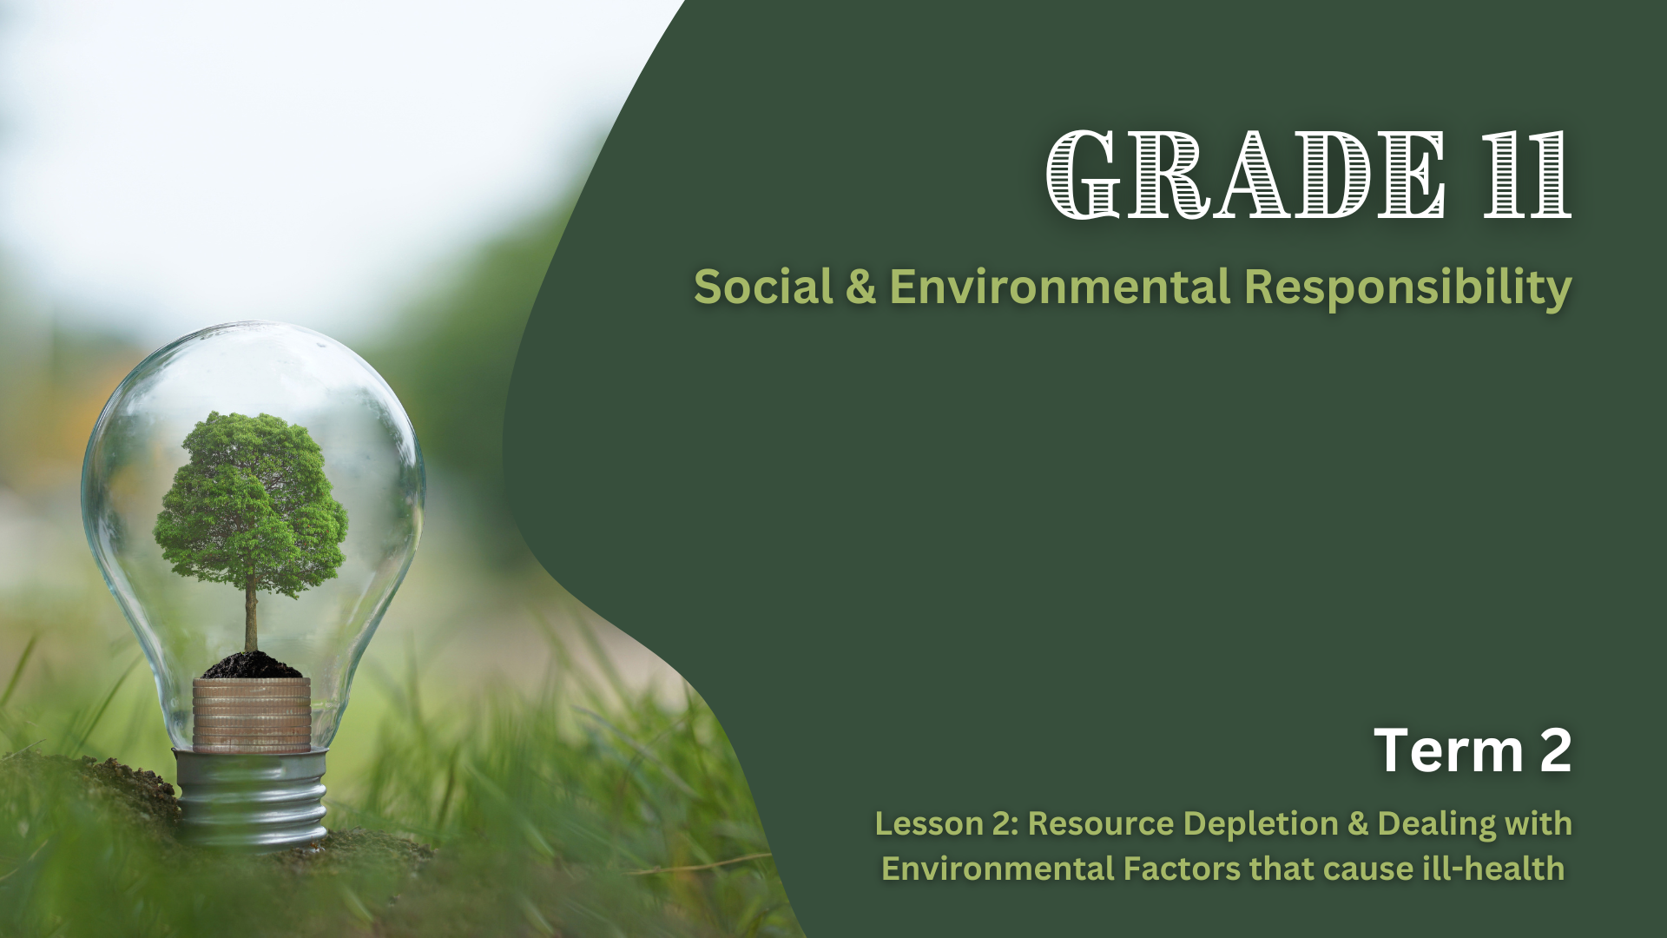

Notes:
Introduction (3 min)
Welcome back Grade 11s. Last week, we examined how harmful substances in food production and inhumane farming practices impact both the environment and human health. Today, we’ll expand our focus to broader environmental issues, such as resource depletion and natural disasters, and their effects on our well-being.
Imagine if the ocean ran out of fish – no sushi, no fish and chips, no seafood at all! How do you think that would affect your health, your meals, or even your community?
Possible responses:
A lack of fish would result in the loss of protein and omega-3 fatty acids, which are essential for good health.
Communities that rely on fishing as a source of income would face significant economic challenges.
The disappearance of fish could disrupt marine ecosystems, as many species depend on fish as a primary food source.
Coastal communities that depend on fish for both sustenance and livelihood would be severely affected.
Tourism industries that thrive on fishing activities or seafood experiences could face a decline, impacting local economies.
The depletion of natural resources is a major concern. In this lesson, we will explore various resources at risk and their impact on the environment.

Slide 2
By the end of this lesson, you should be able to:
Understand the impact of the depletion of natural resources.
Develop practical skills to mitigate environmental effects on health, including fostering positive attitudes, ensuring safety, applying first aid, and coping with disasters.
Notes:
This lesson will be divided into two parts. By the end of the lesson, you should be able to:
Part 1: Understand the impact of the depletion of natural resources.
Part 2: Develop practical skills to mitigate environmental effects on health, including fostering positive attitudes, ensuring safety, applying first aid, and coping with disasters.

Slide 3
Depletion of Fish Stocks (Overfishing)
Disruption of marine ecosystems
Food insecurity
Economic consequences
Notes:
Teaching & Whole-Class Discussion (10 min)
Let’s begin with the first part of our lesson: resource depletion. We will focus on three key issues: overfishing, deforestation, and land degradation
Depletion of fish stocks, also known as overfishing, occurs when fish are caught faster than they can reproduce, leading to a decline in fish populations. We’ve already discussed the consequences of overfishing, but to recap, it can result in:
Disruption of marine ecosystems, reducing biodiversity and threatening ocean health.
Food insecurity, as many coastal communities rely on fish as a primary protein source, potentially leading to malnutrition and hunger.
Economic consequences, as fishing communities suffer from declining catches, causing job losses and financial instability.

Slide 4
Depletion of Firewood (Deforestation)
Loss of habitats
Increased erosion
Release of stored carbon
Notes:
In South Africa, many people rely on firewood for cooking and heating. When trees are cut down faster than they can regrow, this is known as deforestation which can lead to the depletion of firewood. Deforestation has numerous negative consequences for environmental health, including:
Loss of habitats for many animal species, leading to a decline in wildlife populations.
Increased erosion due to the absence of tree roots to hold soil in place, which reduces soil fertility and results in poor agricultural yields.
Release of stored carbon, as trees absorb carbon dioxide. When trees are cut down, this carbon is released into the atmosphere, contributing to increased greenhouse gas emissions and global warming (these concepts will be addressed in Lesson 3).
What would happen to people if they don't have access to firewood? (Allow learners to respond.)
Possible responses:
Without firewood, people may have to turn to other, often more expensive, energy sources like gas or electricity for cooking and heating, which can strain household budgets.
In areas where firewood is the primary cooking fuel, the lack of it could lead to the use of unsafe alternatives, such as plastic or other materials that release toxic fumes when burned, increasing the risk of respiratory diseases.
Many communities depend on gathering and selling firewood for income. Without access to firewood, people may lose their livelihoods, affecting their financial stability.

Slide 5
Depletion of land (Land Degradation or Desertification)
REDUCED AGRICULTURAL PRODUCTIVITY
INCREASED RISK OF NATURAL DISASTERS
WATER SCARCITY
LOSS OF LIVELIHOODS
Notes:
Depletion of land, also known as land degradation or desertification, is caused by the overuse of land for farming, urban expansion, and industrial activities. This can lead to:
Reduced agricultural productivity, which threatens food security.
Increased risk of natural disasters, as deforested and overgrazed lands are more prone to floods, landslides, and droughts.
Water scarcity, since degraded land retains less water, reducing groundwater recharge and causing water shortages.
Loss of livelihoods, as farmers and rural communities dependent on fertile land struggle to grow food and earn a living.

Slide 6
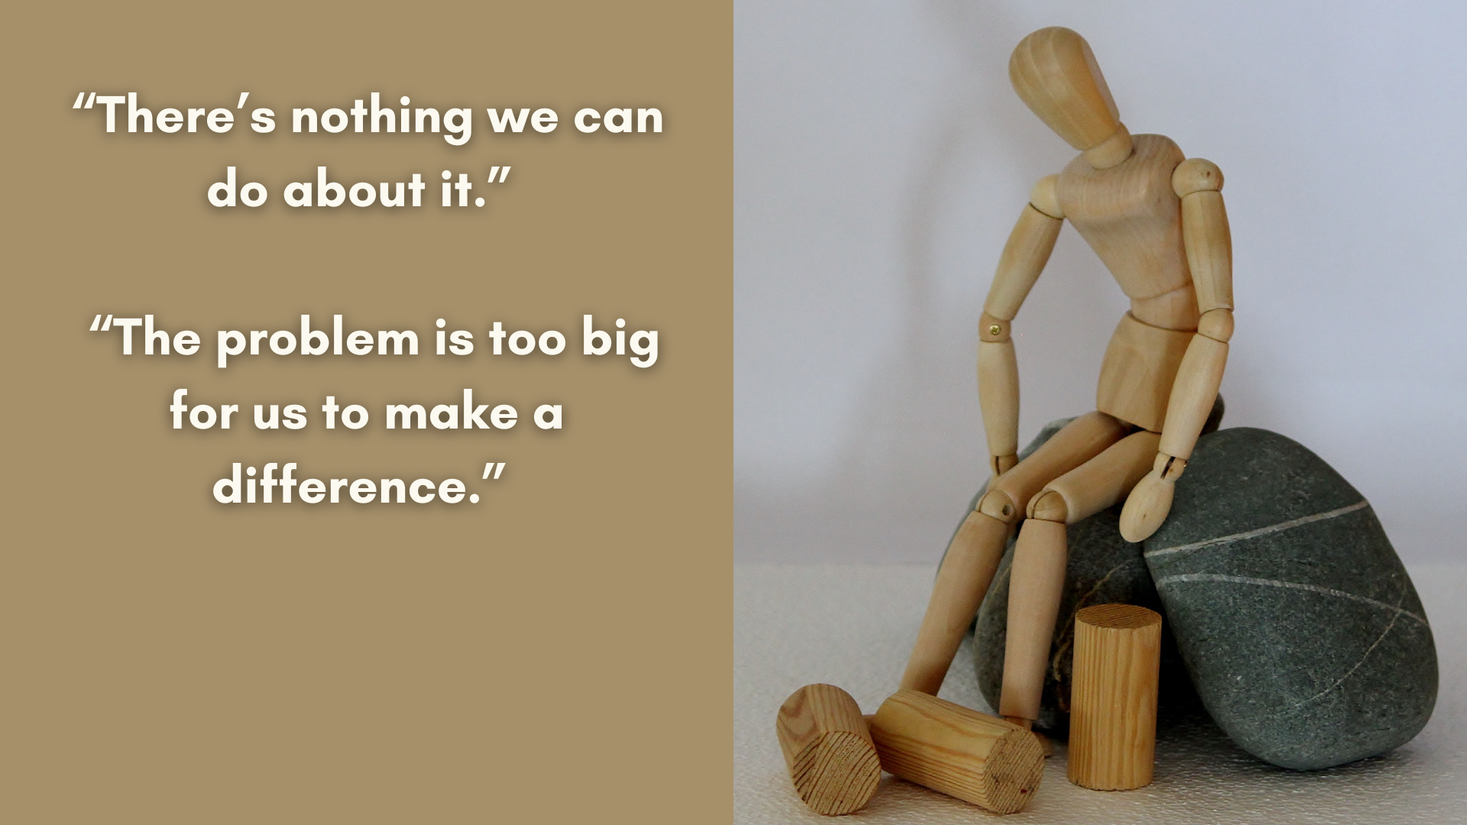
Personal Attitudes in Dealing with Environmental Factors
Notes:
Teaching & Group Activity (10 min)
We now move on to the second part of our lesson, where we’ll focus on practical skills to mitigate the environmental effects on our health. Building on our previous lesson, we’ll explore environmental hazards such as floods, fires, and pollution.
It’s easy to feel overwhelmed and negative about environmental issues, especially when they seem beyond our control. People often express frustration with statements like, “There’s nothing we can do about it,” or “The problem is too big for us to make a difference.” But what if we shifted our perspective and adopted a more positive attitude?
Let’s explore how we can reframe our responses to the environmental factors that contribute to ill-health:
Harmful substances in food production: Instead of feeling helpless, we could say, “We should be proactive in choosing safer, healthier, and environmentally friendly food options.”
Pollution: Rather than feeling defeated, we could say, “Taking care of the environment is everyone’s responsibility, and small actions can make a big difference in reducing pollution.”
Developing a positive attitude toward these environmental factors is key to preventing harm to our health and promoting sustainability. Reflecting on our relationship with the environment and adopting eco-friendly behaviours can reduce the risks to our personal well-being and the health of the planet.
In our previous lesson, we discussed actions we can take to mitigate the impact of harmful substances used in food production, inhumane farming, pollution, fires, and floods. As the saying goes, “Prevention is better than cure.” Adopting this mindset will help us navigate these environmental issues in a way that promotes safety and sustainability.
Now, in your groups, you’ll brainstorm preventive actions we can take to ensure our safety and the well-being of our environment. Think about the positive changes we can implement and how they can contribute to a healthier world.
Learners to complete Activity 1 (Lesson 2 – Worksheet). Allow the learners to share their ideas with the class. Possible answers can be found in the Lesson 2 – Worksheet MEMO document.

Slide 7
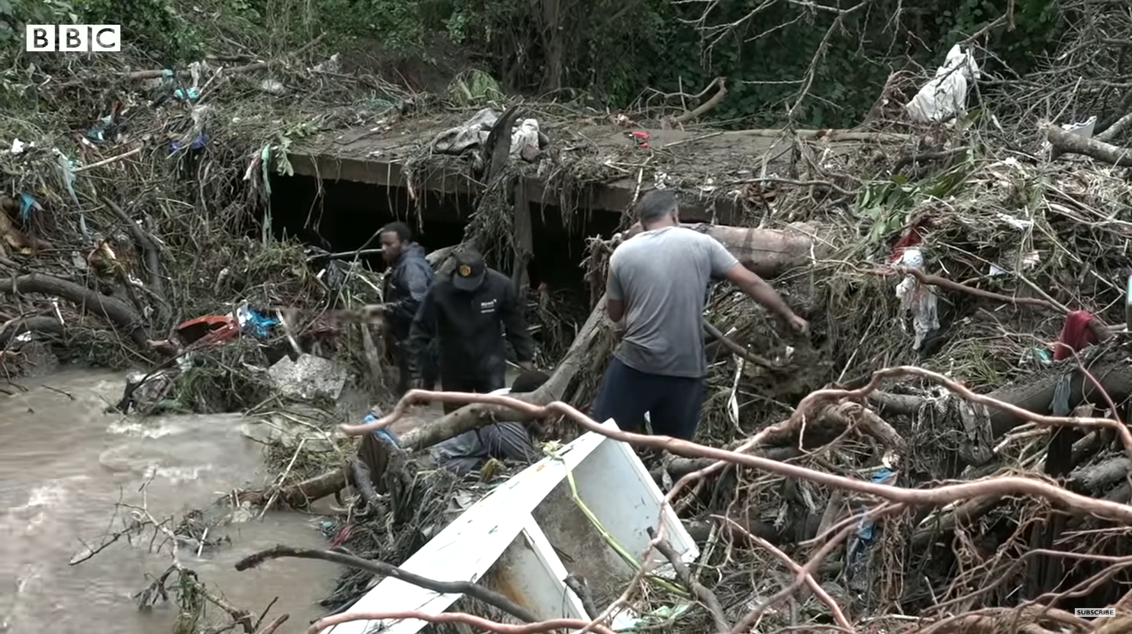
Watch: At least 45 dead in South Africa floods - BBC News https://www.youtube.com/watch?v=zj2PWkBmJEQ&ab_channel=BBCNews (2 min 54 sec)
Notes:
Teaching & Watch Video (5 min)
To address this section of the lesson, we will be looking at a real-world example. In April 2022, the KwaZulu Natal coastal zone, including the greater Durban area and South Coast, received more than 300mm of rain in 24 hours. This led to calamitous flooding, with 459 people losing their lives. Over 4000 homes were destroyed, 40,000 people were left homeless, and 45,000 people were temporarily left unemployed. Pay attention while watching the following video of the occurrence in 2022.
Watch: At least 45 dead in South Africa floods - BBC News https://www.youtube.com/watch?v=zj2PWkBmJEQ&ab_channel=BBCNews (2 min 54 sec)
We will now discuss coping techniques for floods. Keep in mind that these techniques are also applicable to other disasters, such as fires.
Let us divide our coping techniques into three parts, starting with pre-flood strategies, which we can refer to as the preparedness and prevention phase.
First, it’s important to stay informed. We can do this by:
Monitoring weather reports and paying attention to warnings from disaster management authorities.
Following our local municipality’s official social media pages, as well as those of local emergency services, for real-time updates.
Secondly, create an emergency plan:
Identify safe evacuation routes and higher ground areas in your community.
Establish a family communication plan in case you are separated.
Thirdly, prepare an emergency kit:
Include essentials such as clean drinking water, non-perishable food, a flashlight, batteries, a first aid kit, important documents, and necessary medication.
A basic first aid kit should contain essential items to treat common injuries and emergencies. (Inform learners that there is a first aid kit list in their Content Summary.)
Lastly, secure your property:
Clear drains and gutters to prevent blockages.
Move valuable belongings and electrical items to higher ground.
Reinforce weak areas in your home to minimise potential damage.

Slide 8
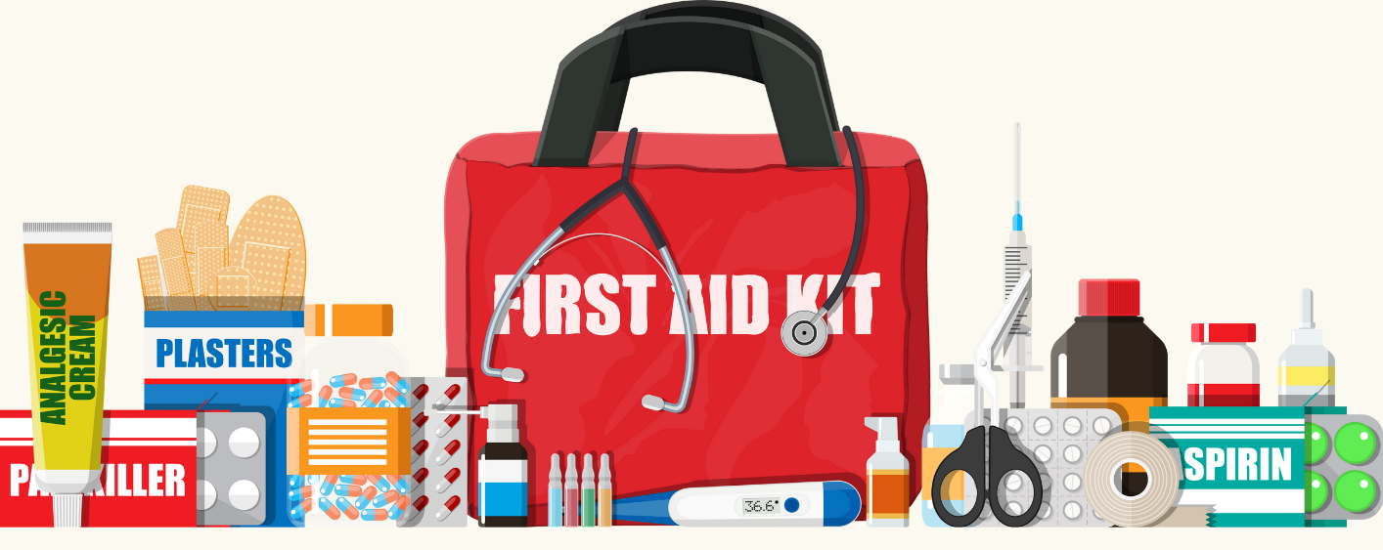
First Aid Skills
Watch: Treating burns: SAFE STEPS First Aid: Burns https://www.youtube.com/watch?v=z_5tuB1YMK0&ab_channel=SAFESTEPS
(1 min 0 sec)
Watch: Smoke inhalation: How to Treat Smoke Inhalation https://www.youtube.com/watch?v=8EkX2qeAzp0&ab_channel=FirstAidforLife
(1 min 58 sec)
Notes:
Teaching & Watch Videos (5 min)
The second phase we'll focus on is during the flood, which we’ll call the safety and survival phase. Here are key steps to ensure your safety:
Evacuate early: Move to higher ground or designated shelters as soon as evacuation orders are issued.
Do not wait until water levels rise, as this can make escape more difficult.
Avoid floodwaters: Never walk, swim, or drive through floodwater, they may contain dangerous debris, pollutants, or hidden currents. Just 15–30 cm of moving water can knock a person down, and 60 cm can sweep a vehicle away.
Stay in a safe place: Remain on elevated ground or upper floors of sturdy buildings. Keep emergency supplies nearby and stay indoors until authorities declare it safe to leave.
Stay connected: Use a radio or phone to stay informed about the situation and communicate with family or emergency services.
Help vulnerable people: Assist elderly individuals, disabled persons, or young children in evacuating safely.
Now, let’s look at some basic first aid skills to use in the event of a fire.
Ask the learners to define first aid, before sharing the following definition with them: First aid is the immediate care or treatment given to someone who is injured or ill before professional medical help arrives. Its goal is to preserve life, prevent the condition from worsening, and promote recovery.
Watch: Treating burns: SAFE STEPS First Aid: Burns
https://www.youtube.com/watch?v=z_5tuB1YMK0&ab_channel=SAFESTEPS (1 min 0 sec)
Watch: Smoke inhalation: How to Treat Smoke Inhalation
https://www.youtube.com/watch?v=8EkX2qeAzp0&ab_channel=FirstAidforLife (1 min 58 sec)

Slide 9
Recovery & Resilience
Safety first
Sanitation and health
Emotional support
Repair and rebuild
Notes:
Teaching (3 min)
The final phase is after the flood, which we’ll call the recovery and resilience phase. Here are key steps to help rebuild safely and sustainably:
Ensure safety first:
Only return home once authorities confirm it is safe.
Be cautious of weakened structures, fallen power lines, and contaminated water.
If your home is unsafe, seek temporary shelter at community centres, schools, or with relatives.
Sanitation and health:
Do not drink or cook with floodwater, as it may be contaminated with bacteria or chemicals.
Wash hands regularly to prevent disease.
If clean water is unavailable, boil water or use purification tablets before drinking.
Emotional Support:
Seek free counselling services at community centres, religious organisations, or NGOs.
Join support groups to share experiences and access emotional relief.
Encourage open discussions within families to help children and vulnerable individuals cope with stress.
Repair and rebuild:
Work with community programmes, NGOs, or government aid to access building materials and financial assistance.
Organise community clean-up efforts to remove debris safely and efficiently.

Slide 10

Reflection Activity
Notes:
Conclusion & Reflection (7 min)
Today, we explored how the depletion of natural resources, like fish stocks, firewood, and land, affects the environment and human health. We then looked at practical ways to reduce these impacts and keep ourselves safe, especially in the face of disasters like floods and fires.
We covered three key disaster phases: before, during, and after. We discussed how to prepare, stay safe, and recover. The goal was to shift our thinking from feeling powerless to taking action to build resilience and protect our well-being.
Now, you will complete the reflection activity (Activity 2, Lesson 2 – Worksheet). If you don't finish in class, please complete it for homework.

