Slide 1
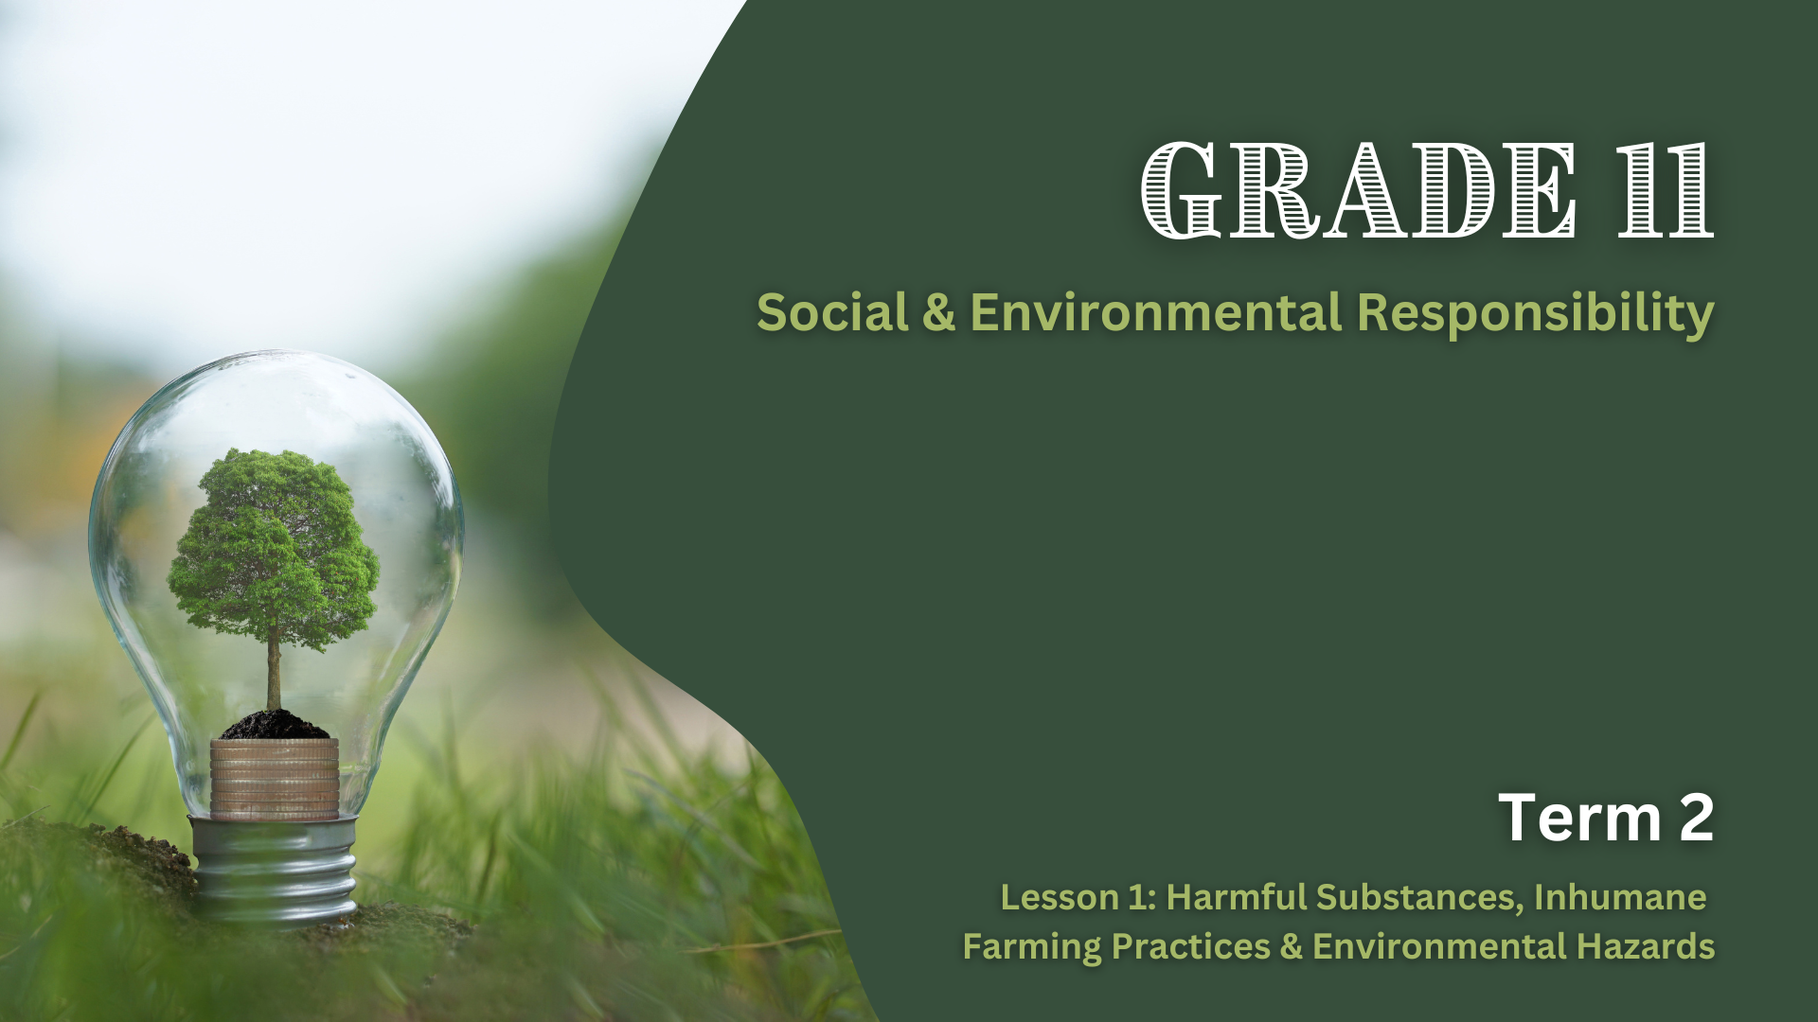

Notes:
Introduction (3 min)
Good day, Grade 11s. Today, we begin a new lesson series on Social and Environmental Responsibility. We will explore environmental issues that harm human health and the environment.

Slide 2
By the end of this lesson, you should be able to:
Understand how harmful substances in food production contribute to environmental degradation and ill-health in humans.
Identify inhumane farming methods and explain their societal and environmental impacts.
Recognise the connection between environmental hazards (e.g., soil erosion, pollution, floods) and health and environmental issues.
Notes:
Let us look at what we will be covering. By the end of the lesson, you should be able to:
Understand how harmful substances in food production contribute to environmental degradation and ill-health in humans.
Identify inhumane farming methods and explain their societal and environmental impacts.
Recognise the connection between environmental hazards (e.g., soil erosion, pollution, floods) and health and environmental issues.

Slide 3
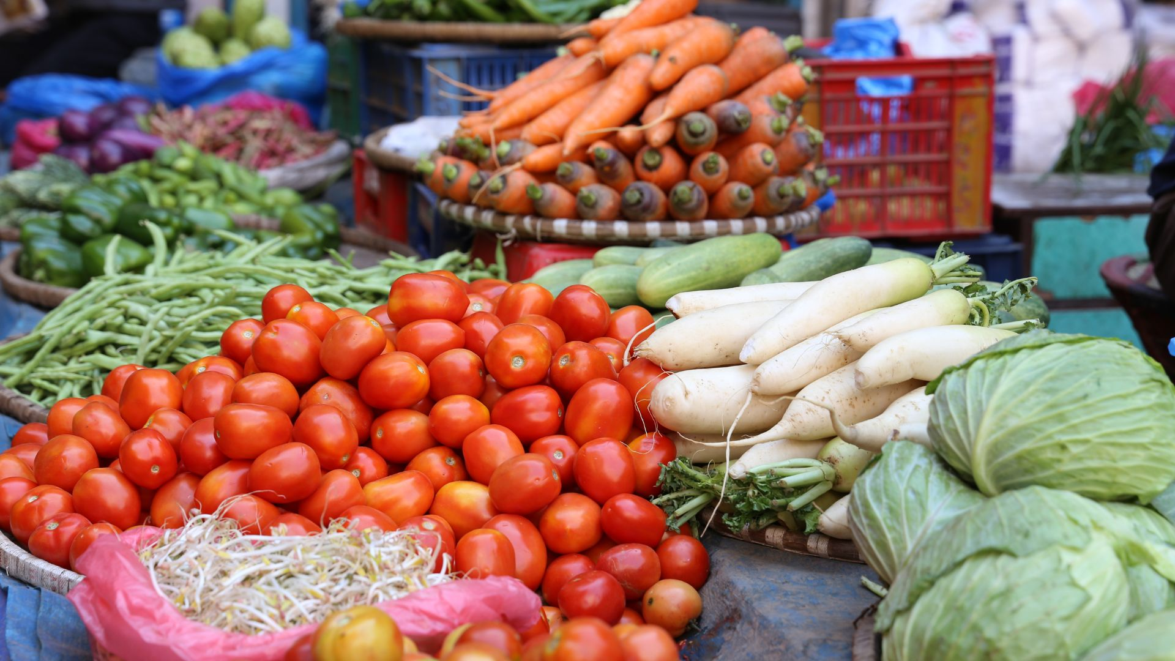
How do you think the way we grow and produce food affects our health and the environment?
Notes:
Let us begin with a question: How do you think the way we grow and produce food affects our health and the environment? (Allow learners to respond.)
Possible responses:
Using chemicals like pesticides can make food unsafe to eat.
Antibiotics in animals might affect our health if we eat that meat.
Pollution from farms can cause diseases like cancer or breathing problems.
Harmful additives in food might make us sick.
Farms might pollute rivers and dams with chemicals.
Farming causes air pollution from machinery and animals.
Cutting down trees for farming destroys the environment.
Forests are homes for animals, and farming takes that away.
Farming releases gases like methane, which can make the Earth hotter.
Burning land for farming causes global warming.

Slide 4
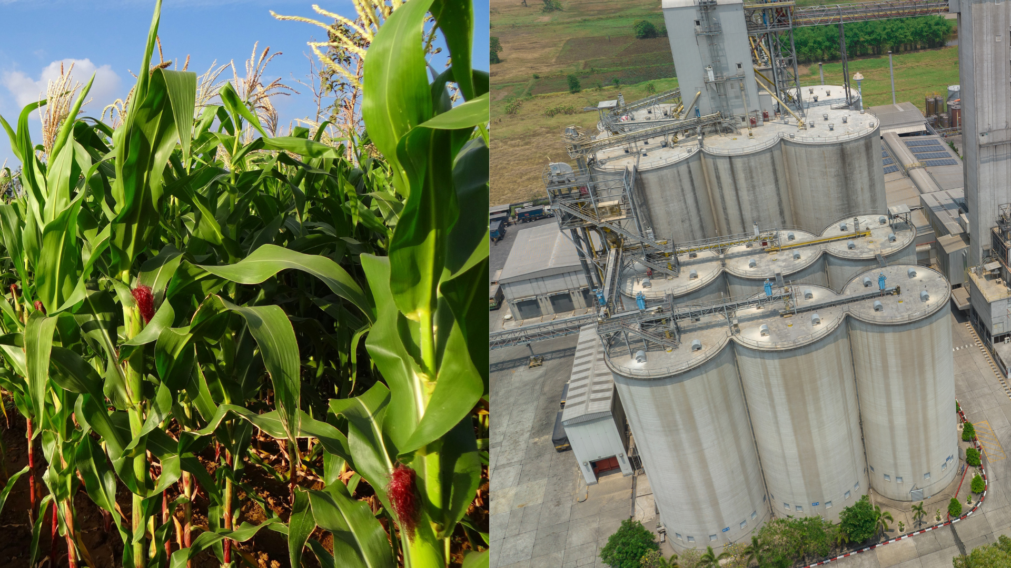
Notes:
Teaching & Whole-Class Discussion (10 min)
Food production processes involve the use of chemicals like pesticides, herbicides, antibiotics, and additives. While these substances help protect crops, keep livestock healthy, and extend the shelf life of processed foods, they can also negatively impact our health and the environment. Let us take a closer look at the impact of each of these substances.

Slide 5
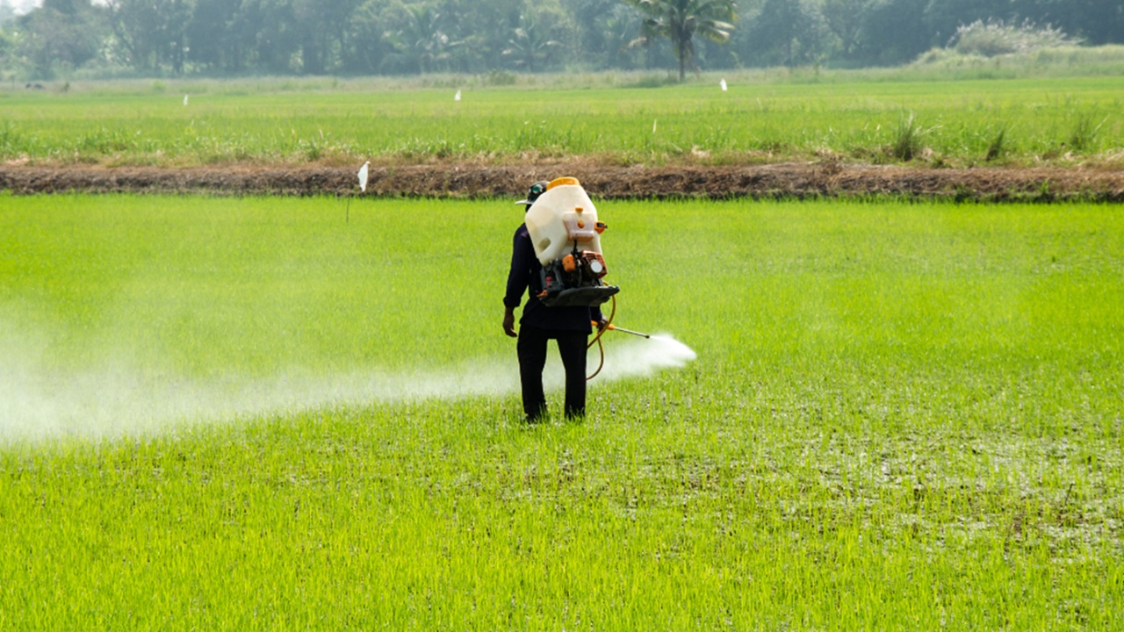
Herbicides & Pesticides
Notes:
What are herbicides and pesticides? (Allow learners to respond.)
Definitions:
Pesticides are chemicals used to kill or control pests, such as insects, rodents, or fungi.
Herbicides are chemicals designed to kill or inhibit the growth of unwanted plants (weeds).
Farmers use herbicides and pesticides to improve crop quality and provide the best produce to markets. However, when we consume fruits, vegetables, or grains exposed to these chemicals, we ingest the residues. Over time, these residues can accumulate in our bodies and potentially lead to health problems, such as cancer, hormonal disruptions, or neurological damage. That is why it is important to wash fruits and vegetables thoroughly with clean water before eating them.

Slide 6
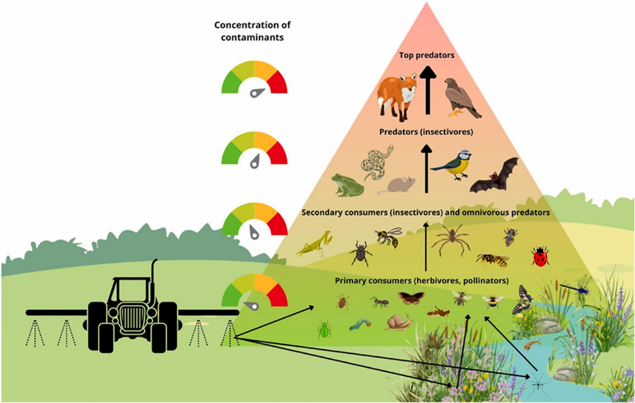
[Taken from https://www.sciencedirect.com/science/article/pii/S0045653524009299 Accessed on 23 January 2025]
Notes:
Now, let us look at the impact of these chemicals on the environment (refer to the illustration on Slide 6). As shown in the illustration, these chemicals can seep into the soil or be washed away by rain into nearby water sources, leading to environmental contamination. This can harm wildlife and disrupt habitats, resulting in a loss of biodiversity. Species such as birds, bees, bats, and earthworms, which are crucial for pollination and maintaining healthy crop environments, can be particularly affected.

Slide 7
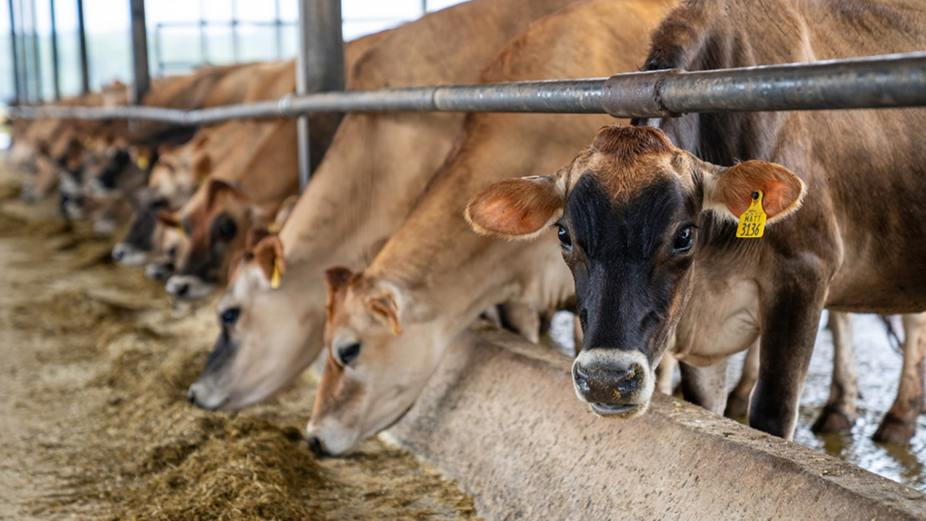
Antibiotics
Notes:
The next harmful substance in food production we will discuss is antibiotics. Antibiotics are drugs used to treat or prevent infections in animals, particularly in factory farming, where animals are often kept in overcrowded conditions. While this may seem like a good practice to ensure healthy food, antibiotics are sometimes added to livestock feed or water to prevent disease even when the animals aren’t sick.
When humans consume meat, milk, or eggs from animals treated with antibiotics, they can ingest small amounts of these drugs, which can contribute to antibiotic resistance, making it more difficult to treat infections when they occur. Some studies show that some antibiotic residues can even increase the risk of cancer.

Slide 8
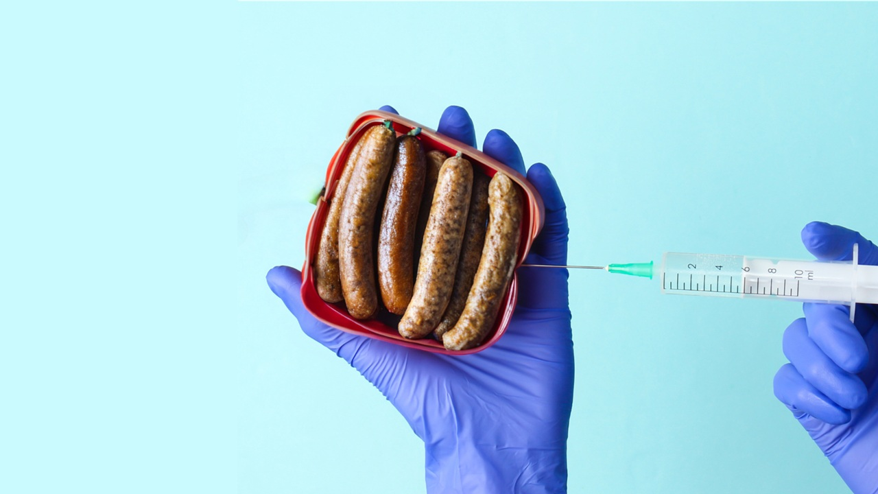
Additives
Notes:
Now, let’s move away from farming practices and look at the factory processing stage. Food production companies often use additives like preservatives and artificial colouring. Why do you think they use these substances? (Pause for learner responses.)
That’s right – additives are used to enhance taste, appearance, or shelf life. However, they can also have negative health effects. Let us look at a few examples:
Artificial colours have been linked to hyperactivity and allergies.
Artificial sweeteners can contribute to weight gain and metabolic issues.
Trans fats increase the risk of heart disease.
Sodium nitrate, found in processed meats, has been linked to cancer.

Slide 9

Notes:
You might be surprised at how many of our favourite foods contain these additives. Take a look at some common examples (refer to the images on Slide 9):
Potato crisps contain flavour enhancers, artificial colour, artificial flavourings and preservatives.
Frozen pizza includes preservatives and trans fats.
Sausages and ham contain sodium nitrate and preservatives.
Soft drinks often include artificial colours, sweeteners, and high-fructose corn syrup.
Cookies contain artificial colours and sweeteners.

Slide 10

Peer Discussion:
Healthier food choices that minimise or avoid harmful additives.
Notes:
Although this might sound alarming, we don’t need to stop eating all foods that contain additives. The key is to consume them in moderation and avoid them when possible. The first step in doing this is learning to recognize these additives in food products. Make it a habit to read ingredient lists on food packaging and research any ingredients you’re unsure about.
Let’s see if you can come up with solutions to avoid harmful additives. Turn to the person next to you and discuss: healthier food choices that minimise or avoid harmful additives. (Allow learners to discuss for 2 minutes and then ask for feedback.)
Possible responses:
Buy fresh fruits, vegetables, and unprocessed meats instead of packaged or processed foods.
Prepare meals from scratch to control the ingredients used.
Limit consumption of fast food.
Drink water or natural beverages instead of sodas or artificially flavoured drinks.
Replace chips, candy, and other processed snacks with natural alternatives like popcorn (without artificial flavouring), nuts, seeds, or dried fruit.
Look for products with natural preservatives or sweeteners like honey or stevia.

Slide 11
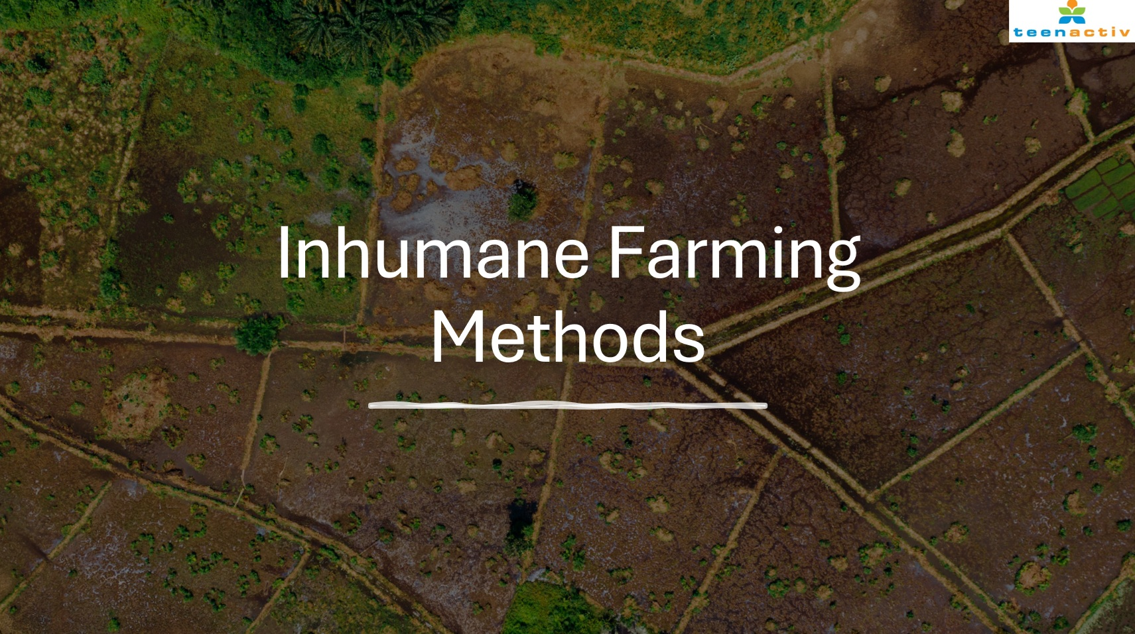
Notes:
Teaching (10 min)
We now move on to our second part of the lesson where we will discuss inhumane farming methods and their impact on society and the environment. What are inhumane farming methods? (Allow learners to respond.)
That's right – inhumane farming methods are agricultural practices that prioritise profit over the well-being of animals, the environment, and society. These practices can harm ecosystems, degrade natural resources, and raise ethical concerns about animal welfare. We will briefly look at three inhumane farming methods: factory farming, deforestation for agriculture and overgrazing.

Slide 12
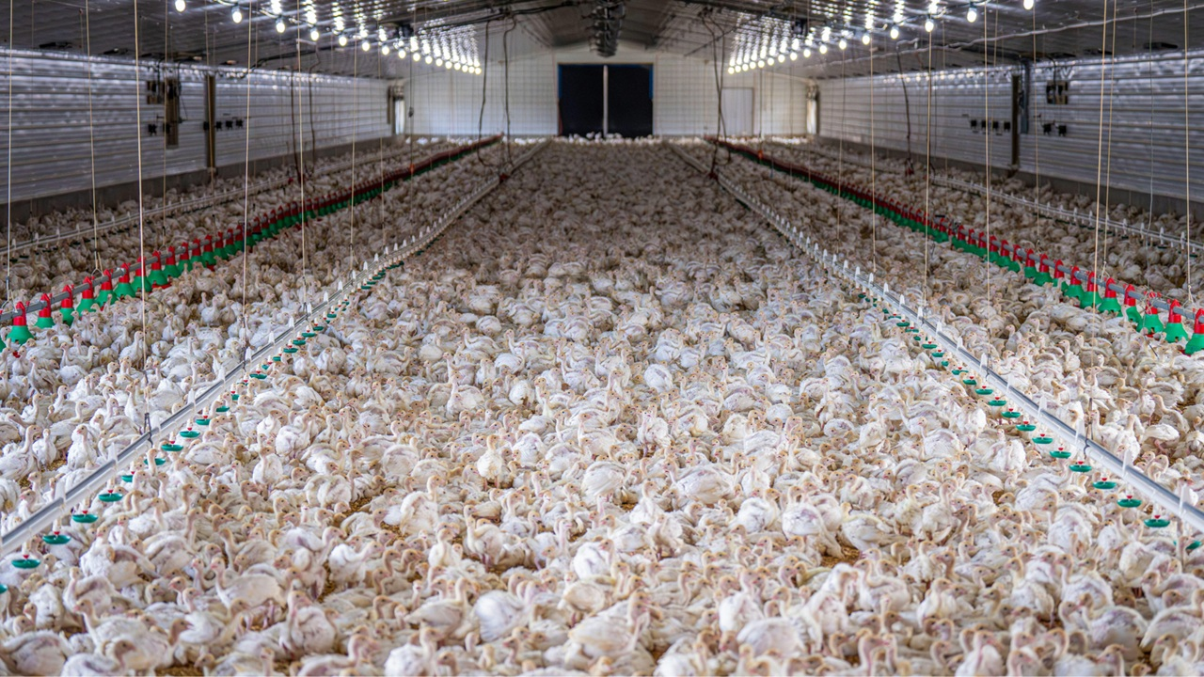
Factory Farming
Notes:
Factory farming, also known as intensive animal farming, involves confining large numbers of animals in small spaces to maximise production. This often results in poor animal welfare, as the animals are overcrowded and have limited movement. Additionally, factory farming contributes to environmental pollution, with animal waste contaminating water sources and emitting greenhouse gases (this concept will be addressed later in the lesson series).

Slide 13
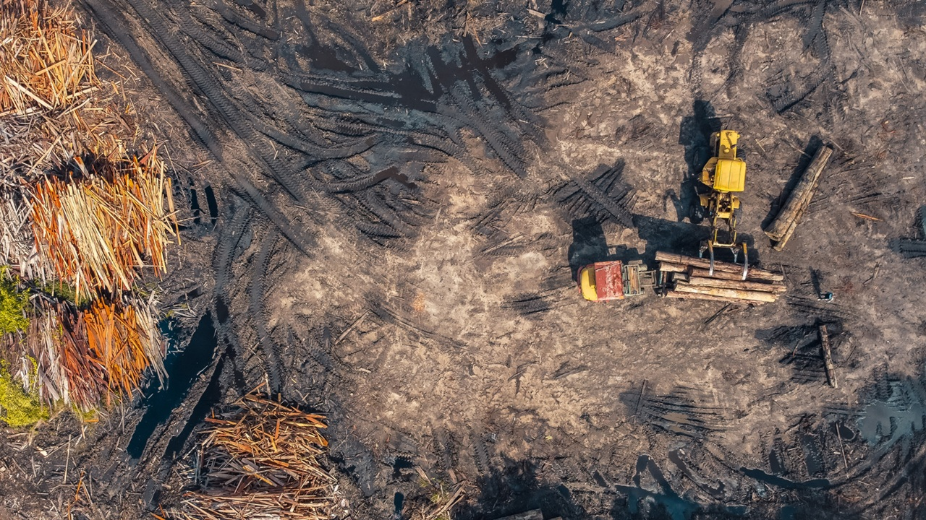
Deforestation for Agriculture
Notes:
Deforestation for agriculture includes clearing forests to create farmland or pastures. This has significant environmental impacts, including:
Loss of biodiversity and habitats for wildlife.
Increased carbon emissions (through burning trees and vegetation, and machinery use) contributing to climate change (this concept will be addressed later in the lesson series).
Soil erosion due to the loss of tree cover. (Take a moment to explain soil erosion to the learners: Soil erosion is the process where the top layer of soil is removed and transported by natural forces or human activities. This leads to land degradation, making the soil less fertile and reducing its ability to support plant growth.)

Slide 14
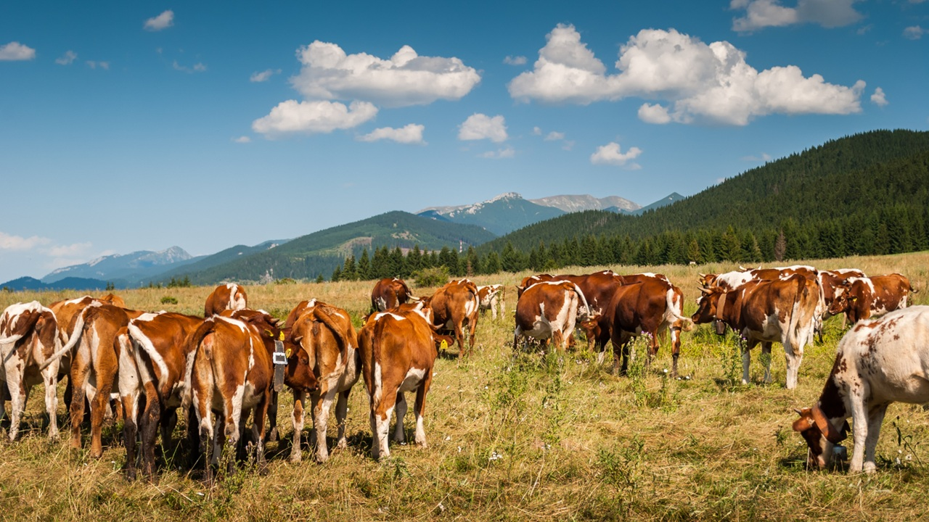
Overgrazing
Notes:
Overgrazing occurs when livestock graze excessively on land without allowing vegetation time to recover. This can lead to:
Loss of vegetation, which may contribute to desertification.
Soil erosion and decreased soil fertility, making the land less productive.
Reduced plant species diversity, disrupting ecosystems and food sources for wildlife.

Slide 15
Economic & Social Impact of Inhumane Farming
Notes:
Inhumane farming methods not only harm animals and the environment but also impact the economic and social well-being of communities worldwide. Ask the learners to share their thoughts before discussing the following impacts:
Large industrial farms dominate the market, making it difficult for small farmers to compete, often forcing them out of business or into unfair contracts with big corporations.
Land degradation, water overuse, and soil erosion reduce food production, leading to higher food prices and making it harder for low-income communities to access affordable, nutritious food.
Workers in factory farms and industrial agriculture often face low wages, unsafe conditions, and exposure to harmful chemicals, with vulnerable groups like migrants and children being the most exploited.
Large-scale deforestation for farming displaces indigenous communities and destroys traditional farming practices, reducing biodiversity and food self-sufficiency.

Slide 16

Group Activity
Notes:
Group Activity (10 min)
Now that we've looked at the impact of inhumane farming on the environment and society at large, let us further investigate the impact of other environmental hazards: soil erosion, pollution, floods, fires, and radiation.
Divide the class into groups of five to six. Assign each group an extract from the Lesson 1 – Group Activity document. Learners will read their extract and collaborate to answer the questions.
Note to teacher: Learners may need to conduct brief research to develop answers for this activity. If your school policy permits, consider allowing them to use devices for research. However, ensure they stay focused and work within the 10-minute time limit. Encourage learners to read each question carefully before answering.
The first question focuses on the impact on human health.
The second question addresses environmental health.
The third question requires them to explore mitigation strategies.
Afterwards, each group will share their responses with the class. Refer to the Lesson 1 – Group Activity MEMO for possible answers.

Slide 17

Wrap-Up & Reflection
Notes:
Wrap-Up & Reflection (7 min)
Today, we explored the impact of harmful substances in food production on both our health and the environment. We learned how chemicals like pesticides, herbicides, and antibiotics can contaminate our food and the environment. We also discussed the harmful additives found in processed foods, which can accumulate in our bodies over time and cause health problems.
We then looked at inhumane farming practices, such as factory farming, deforestation, and overgrazing, and their effects on the environment and society at large.
Furthermore, we investigated the connection between environmental hazards and societal and environmental well-being.
Take a moment to reflect on today's lesson. In Activity 1 (Lesson 1 – Worksheet) write a short journal entry (about 4-5 sentences) in response to the following:
After today’s lesson, what thing(s) will you do differently in your life to help reduce the impact of inhumane farming practices and food production methods?
The entry should include:
A brief reflection on what you learned.
Specific action(s) you can take or change(s) you can make based on the lesson.
Learners must complete this activity for homework if there is not enough class time to complete it.

