Slide 1

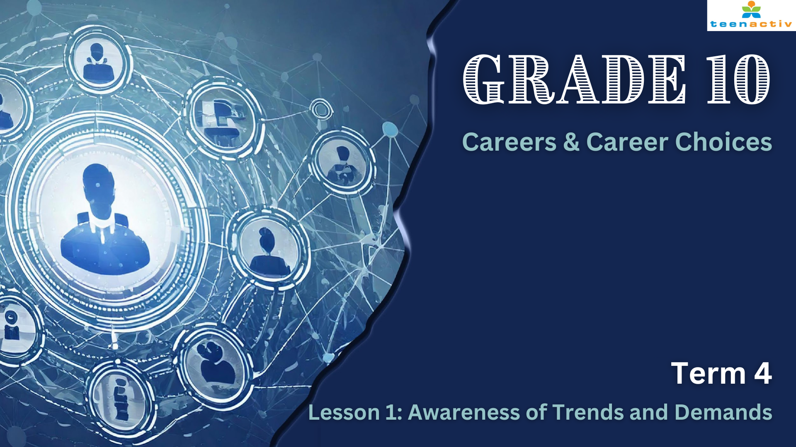

Notes:
Slide 1: Introduction (2 min)
Note to teacher. These lessons will often work with discussions with a partner. At times learners will be required to work in their groups of six.
Good day, Grade 10s. Today we start a new series of lessons in trends and demands in the job market. I can imagine that sometimes it must be quite scary thinking of the future and the decisions you need to make about your future. I’m sure everyone here would like to earn a stable income one day to support you and your family. This future might seem far away, but the reality is that this time in two years you will be writing your matric finals and your future awaits. So how do you choose a career path that will sustain you? How do you choose a career to study and know that there are jobs available in South Africa? How do you know that you would find employment? (Turn to your partner and discuss your thoughts on these questions.)
Maybe some of you mentioned that if you could research the career or job you are interested in and find out what the trends of employment are today, you would have a higher likelihood of employment in the future. This would be a good place to start. Basically, you need to research the trends and demands of the job market. The trends tell us the way that a market is moving, and the demands mean the need for a certain type of career. This would then mean that that career is "in demand".
Let’s start and do some research together.

Slide 2

?
?
Teacher
Electrician
Software
Developer
?
?
Doctor
?
Notes:
Slide 2: Group Activity (10 min)
We’re going to explore these careers (Teacher, Doctor, Electrician and Software Developer) and assess their demand in our class. The aim is to find out which of these careers are the highest in demand. You will briefly answer a couple of question and then rate the careers from 1 (most essential) to 4 (least essential). You need to complete all three section's questions and ratings. You will the submit a summary of your statistics to me (the teacher).
In your groups you will now have 8 minutes to complete Activity 1 (Lesson 1 – Worksheet) Don’t spend too much time discussing. As a group, appoint one person to provide the statistics to the teacher.
Note to teacher: Either appoint a learner to receive the statistics and calculate the top 3 or draw columns on the board for the results. You will need this data to continue with this lesson.
(Allow 2 minutes for class feedback.)
Well done class. It is so interesting to see which of the following careers are perceived as the most essential by the class. Now the reality is that we still need to research even further to find out whether our class statistics line up with the reality in South Africa today. So, how would we do that?

Slide 3

Notes:
Slide 3: Teaching (5 min)
Remember we are talking about trends and demands. We could start by determining the demand for a job on the job-market. This is where you find people who are actively looking for employment or people advertising for employment.
When analysing trends and demands in the job market, the key focus is understanding how many job openings are available, how many people are actively looking for work, how employers are responding to these needs and where these jobs are available.
Let’s look at teaching for example:
Teacher
Job market demand: In many regions, teachers are highly in demand, especially in areas with growing populations, school shortages, or specific subject needs.
Teacher shortages are a frequent topic in the news, particularly for primary, secondary, and special education teachers. There may be more openings in urban or underserved areas. However, some schools may also struggle to attract teachers due to low pay or tough working conditions.
Where employers are hiring: Schools (public and private), tutoring centres and online education platforms.
Challenges: The demand for teachers is often constrained by government funding or policy changes, which can limit the number of new hires despite high demand.
In South Africa today, despite a shortage of teachers, we might find that the government lacks the funds to hire new educators. As a result, newly qualified teachers may face difficulties securing employment locally. However, there is a demand for South African teachers abroad, which may lead many to consider relocating to another country for work opportunities.
Can you see why it is important to know what's happening in the job market? By staying informed, you can anticipate future demand for careers that interest and plan accordingly. Choosing a career path with strong job prospects and higher demand can set you up for greater success and stability in the future.

Slide 4

Impact of AI on future careers…
Notes:
Slide 4: Individual Activity/Homework (10 min)
(Note to teacher: Some learners might not finish this activity in the allocated time. Encourage them to finish as homework OR you may even decide to give this entire activity for homework and allow a bit more time for the next activity.)
Just as we research demands by looking at the job market, we also need to look at other trends or changing patterns that impact careers. In the past few years, we have seen an increase in AI (artificial intelligence) as part of our daily lives. The reality is that with the increase of AI, some people are afraid that this trend will make certain careers obsolete in the future. However, with the increase in demand for AI creators, there will also be an increase in the skills needed to develop AI platforms. This explains why some of the most in-demand careers at the moment are software developers.
Turn to your partner and tell them about one career that you think could be replaced by AI. Give a reason for your answer.
Now you’ll have some time to read the extract “The Impact of AI on the Job Market and Employment Opportunities” and answer the questions in Activity 2 (Lesson 1 – Worksheet).
We can refer to AI as a driver for change. This means that AI is changing the job market. These changes take place because:
Companies save money using AI rather than employing someone to do the work.
AI could work faster and more effectively than humans.
AI can be used by anyone rather than just one skilled person.
Ask the class to respond:
“Should AI be allowed to replace jobs, even if it increases productivity?” or “What happens to people whose jobs are replaced by AI? How should society respond to this?”
These are difficult questions to answer but we need to realise that factors like this will impact our future. So we need to be prepared.

Slide 5

Notes:
Slide 5: Group Activity (10 min)
Note to teacher: This is a key activity in today's lesson. Learners need to discuss in groups and then give feedback to the class. Each group will be given a different set of questions based on the statistics they have been given. The groups will be "teaching" the class by giving 1 minute of feedback.
Most careers will experience changes. There is no such thing as a 100% secure or stable career. This is why it is so important to read about and study job market trends. You could also explore opportunities to fill a niche in the market. This involves identifying specialised roles where developing a unique set of skills makes you highly sought after. Focusing on such positions can set you apart and increase your chances of success in your chosen career. Niche jobs tend to offer higher pay due to their specialised nature, but they are also fewer in number. Additionally, these roles may not be as widely sought after, as they can involve unpleasant or dangerous tasks. For example, professions like bomb specialists, pilots, or morticians are highly specialised but often come with challenges that might deter many from pursuing them.
Each group has been given a set of statistics and a series of questions to discuss. Based on your discussion you need to choose one group leader that will provide feedback (30 seconds to 1 minute max.) to the class on the job security in South Africa of the career you were looking at.
Note to teacher: Make copies of Lesson 1 – Group Statstistics. There are six group questions and stats. You will need to have 6 feedback sessions. This should take no more than 5 minutes.
Allow 5 minutes for the group discussion, and 5 minutes for brief feedback to the class.

Slide 6
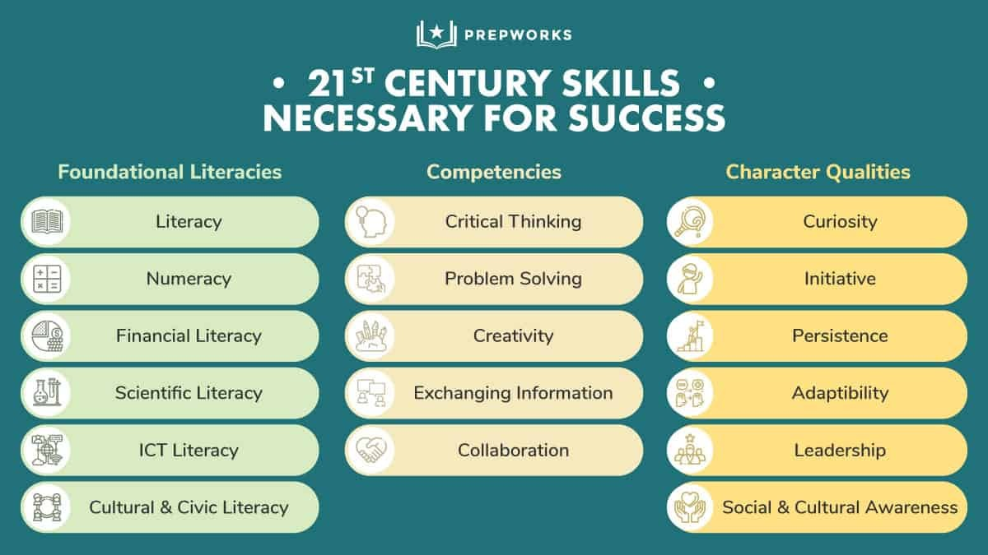
[Taken from https://blog.prep.works/blog/21st-centurt-skills-what-why-how Accessed on: 15 December 2024]
Notes:
Slide 6: Reflection (3 min)
As we come to the end of this lesson, I’m sure your mind is buzzing with everything you’ve learnt. You might even feel a bit anxious, wondering about the security of your future career. However, research shows that certain skills are currently in high demand and are expected to remain so in the future, offering opportunities for growth and stability.
Take a few moments to complete Activity 3 (Lesson 1 – Worksheet) where you list the top 3 skills 21st Century Skills you feel you already have and the top 3 you would like to develop during the last few years at school.
Reminder to complete Activity 2 (Lesson 1 – Worksheet) for homework if you did not complete it in class.

