Slide 1
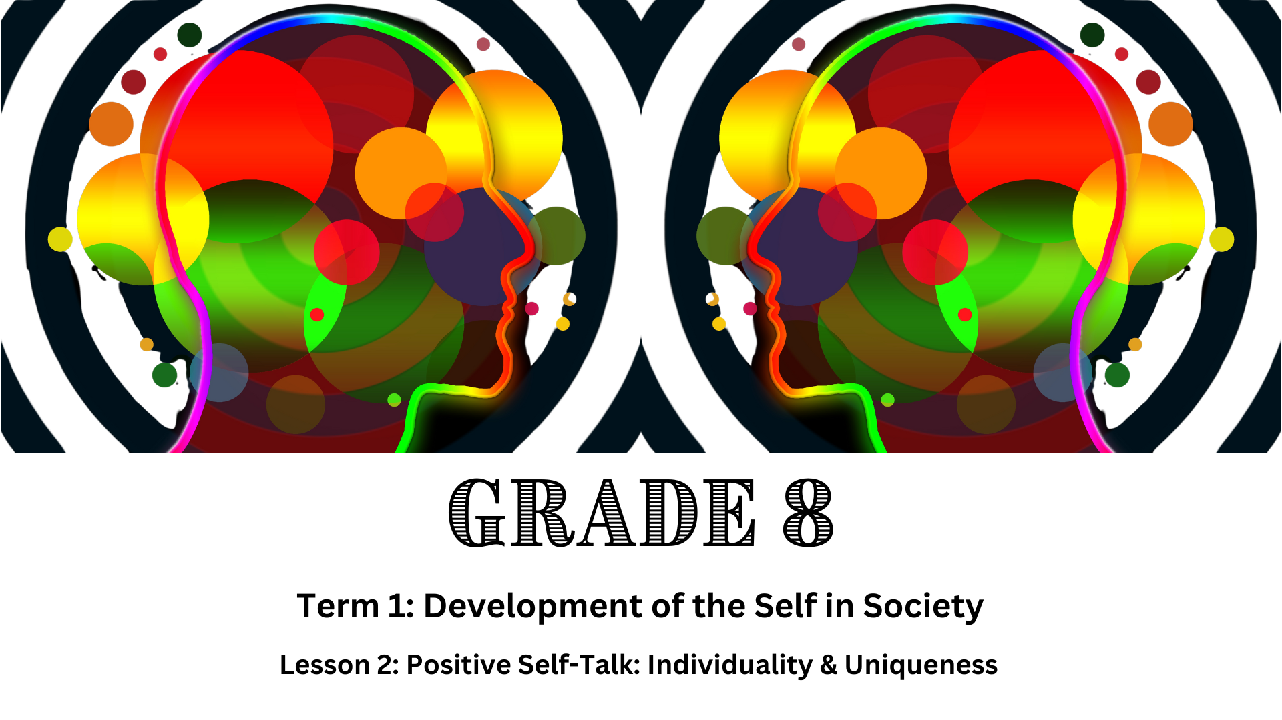

Notes:
Introduction (3 min)
Welcome the learners to class and allow them to settle down and get their learning materials ready.
Last week we looked at the importance of self-concept and self-motivation. Who can remember the factors that influence our self-concept and self-motivation?
Allow a few learners to respond to the question.
Factors: Media, family, friends and peers, environment, culture, religion and community.
As we learnt from the previous lesson, these external factors can either have a positive or a negative effect on how we see ourselves.
Today we are going to look at a factor within ourselves that can influence our self-concept, this factor is known as our inner voice or self-talk. We will also discuss the importance of embracing the individuality and uniqueness of ourselves and others.

Slide 2
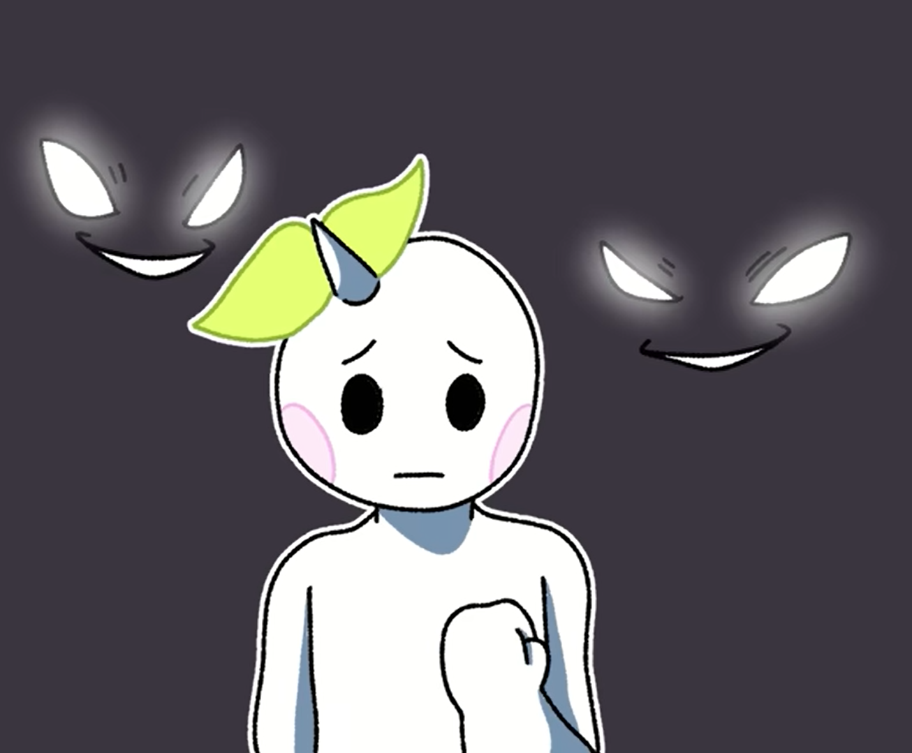
Watch:
5 Signs Your Inner Voice Is Cruel (What To Do) https://www.youtube.com/watch?v=EcD5hq8yazU
(4 min 26 sec)
Notes:
Teaching & Watch Video (6 min)
As a teenager, you go through many changes in your mind, behaviour, emotions, and body. During this time, your inner voice (or self-talk) is important.
Ask the learners to define “inner voice”.
Inner voice refers to “hearing” your own voice play out phrases and conversations in your mind.
At times, this voice can be quiet and hard to notice, but at other times it can be quite loud. It affects what you believe, how you see things, and what you do.
Self-talk consists of the messages and thoughts you tell yourself, either on purpose or without thinking about them. These thoughts can be positive or negative and can affect your self-esteem, your overall mental health, and your ability to bounce back from challenges.
To understand the benefits of positive self-talk, we first need to understand negative self-talk. Let us watch a video that explains this concept.
Watch: 5 Signs Your Inner Voice Is Cruel (What To Do) https://www.youtube.com/watch?v=EcD5hq8yazU (4 min 26 sec)

Slide 3
Transitioning to Positive Self-Talk
Be aware
1
Challenge negative thoughts
2
Replace negative thoughts with positive ones
3
Practice self-compassion
4
Use affirmations
5
Surround yourself with positivity
6
Notes:
Class Discussion (5 min)
The video we just watched mentioned a few techniques on how you could transition from negative to positive self-talk.
Ask the learners to mention the techniques they can remember from the video.
Briefly discuss the following techniques with the learners.
Be aware: Notice when you're engaging in negative self-talk. Pay attention to the words you use and how they make you feel.
Challenge negative thoughts: When you catch yourself thinking negatively, challenge those thoughts. Ask yourself if there's evidence to support them or if there might be another, more positive way to see the situation.
Replace negative thoughts with positive ones: Once you've challenged negative thoughts, replace them with positive ones. For example: “I can’t do anything right.” could be replaced with “I make mistakes like everyone else, but I learn from them and improve.”
Practice self-compassion: Treat yourself with kindness and understanding, like you would a friend. Remind yourself that everyone makes mistakes and that it's okay to not be perfect.
Use affirmations: Repeat positive affirmations to yourself regularly. These are short, positive statements that can help reprogramme your thinking. For example, "I am capable," "I deserve to be happy“ or "Carpe Diem" (which means seize the day).
Surround yourself with positivity: Spend time with people who uplift you and engage in activities that make you feel good about yourself.

Slide 4
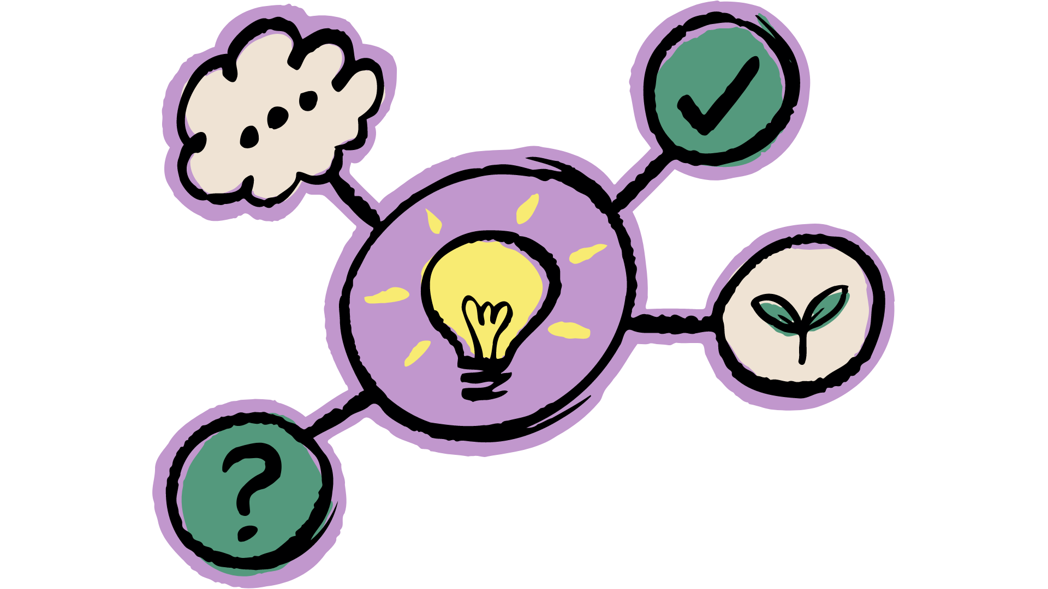
Pair Activity
Notes:
Pair Activity (7 min)
Learners to complete Activity 1 (Lesson 2 – Worksheet).
Learners will work in pairs to practise reframing negative thoughts into positive thoughts.
Allow the learners 5 minutes to complete the activity. Ask a few learners to give feedback to the rest of the class.
Possible answers are available on Lesson 2 – Worksheet MEMO.

Slide 5
Embracing YOUR Uniqueness
Understanding Uniqueness
Self-Discovery
Self-Acceptance
Confidence Building
Expressing yourself
Notes:
Teaching (5 min)
In our previous lesson, we explored the importance of having a strong self-concept. During the bingo game, we learned that everyone has unique characteristics and experiences. Embracing our individuality and uniqueness is crucial to developing a strong self-concept. Additionally, it's essential to create space for others to be their authentic selves, reducing judgment to create an environment where everyone can thrive.
Remember that you don't have to change who you are to fit in. You are great just the way you are. Embracing your uniqueness can boost your self-esteem, make you happier, build your confidence, and open your mind to new ideas and experiences. Let us look at how we can do this:
Understanding uniqueness: Every individual has unique qualities, talents and perspectives. These differences make each person special and valuable.
Self-discovery: Take time to explore your interests, hobbies and passions. Identify your strengths and areas where you excel.
Self-acceptance: Appreciate your unique traits and characteristics. Understand that imperfections are a natural part of being human.
Confidence building: Set personal goals and celebrate your achievements. Practice positive self-talk and avoid comparing yourself to others.
Expressing yourself: Find creative outlets like art, music, sports or writing to express your individuality. Share your thoughts and ideas with others confidently.

Slide 6
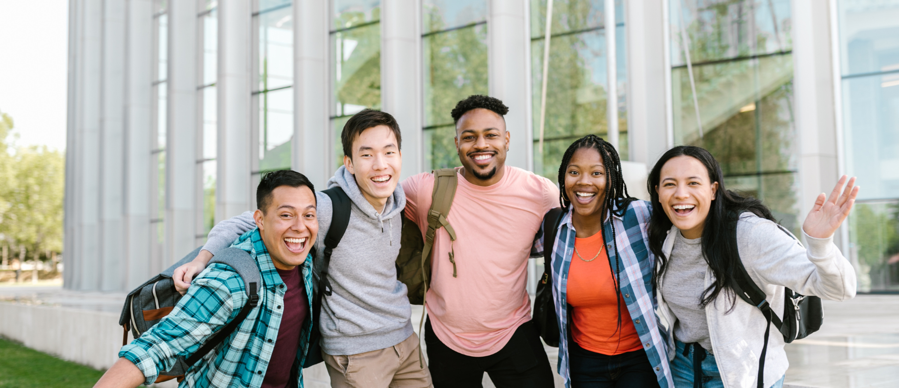
Embracing the Uniqueness of OTHERS
Notes:
Class Discussion (5 min)
Embracing uniqueness means not only loving yourself but also accepting and celebrating the diversity of others. If we all strive to show more compassion toward one another, we will feel less isolated in the challenges we face regarding our identities.
Note to teacher: Some learners in your class might be neurodivergent or face mental health challenges. What actions can their classmates take to include them more and be more mindful of their unique experiences?
Ask learners to share how they think we could embrace the uniqueness of others.
Examples can include:
Recognise that people come from different backgrounds, cultures, and experiences. Recognising diversity enriches our lives and broadens our perspectives.
Practise empathy by attempting to understand others' feelings and viewpoints by listening actively and with an open mind.
Respect everyone's opinions, even if they differ from your own. Treat everyone with kindness and fairness.
Make an effort to include everyone in group activities and discussions. Avoid excluding others based on their differences.
Challenge stereotypes and avoid making assumptions about people. Speak up against bullying and discrimination.
Take the opportunity to learn about different cultures, traditions, and lifestyles. Share your own experiences with others.

Slide 7

Reflection
Notes:
Reflection (9 min)
Learners are to complete Activity 2 (Lesson 2 – Worksheet) for the remainder of the lesson.
This activity is quite personal. However, in the last few minutes of the lesson, you may invite a few learners who feel comfortable to share some of their answers with the class.
If the learners are not able to finish this activity in class, it must be completed as homework.

