Slide 1
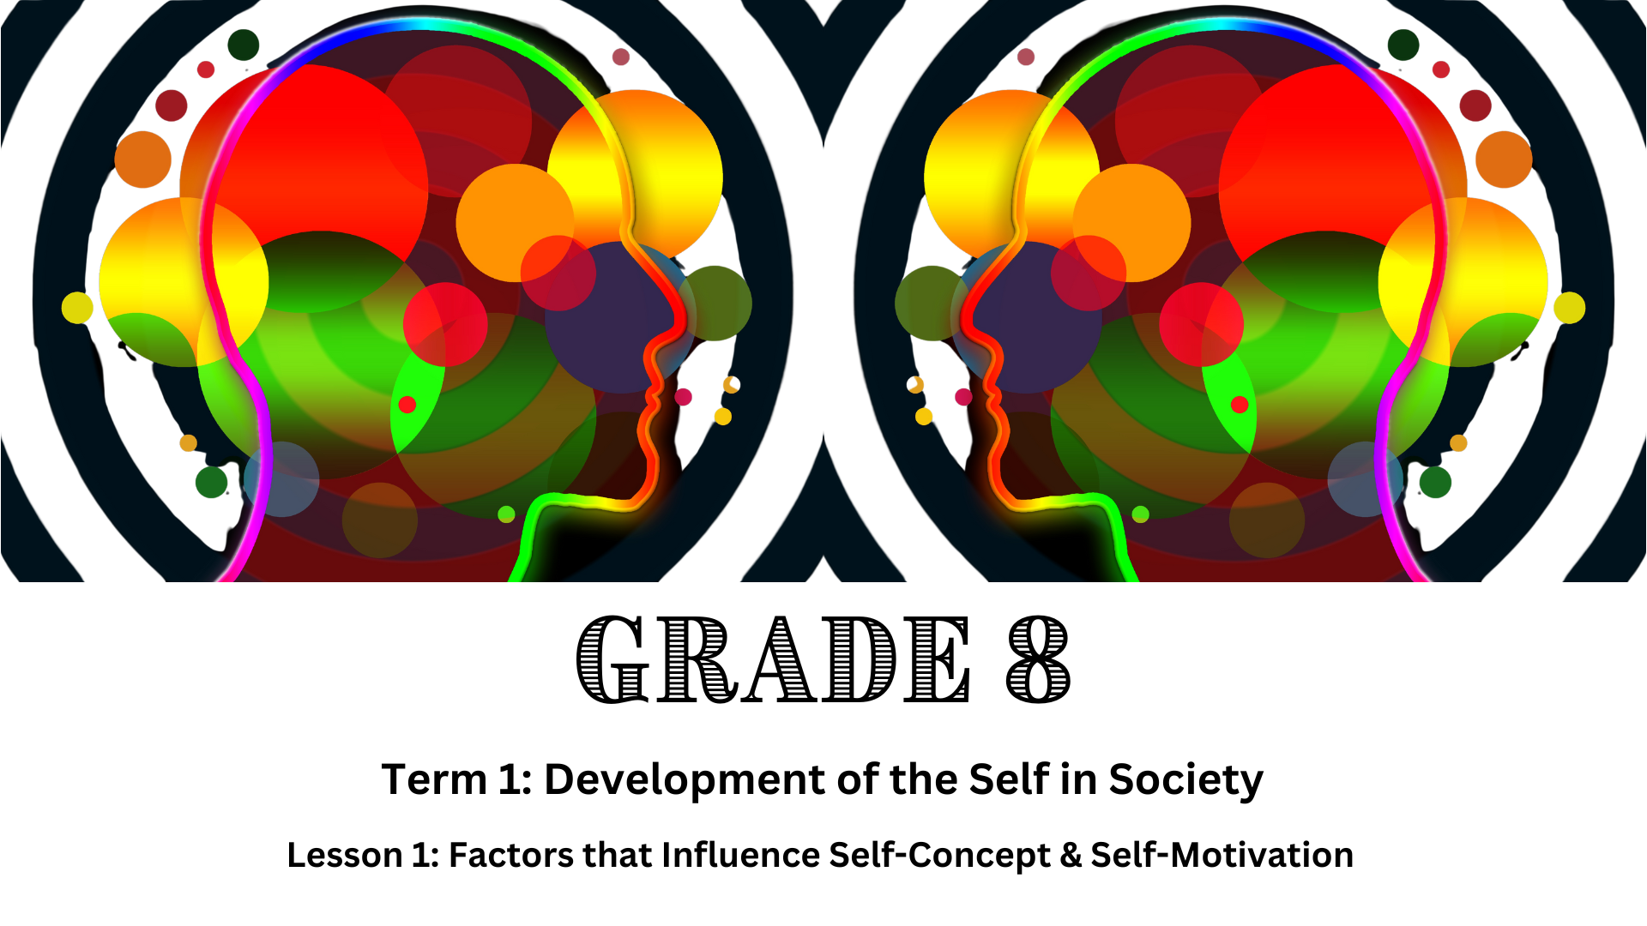

Notes:
Introduction (3 min)
Allow learners to settle down and get their learning materials ready.
Welcome Gr8’s to your first Life Orientation lesson of the year! Many of you come from different primary schools and might not know everyone sitting in this classroom. You might have had some difficulties in primary school, feel nervous about making the transition to high school, or have no idea what to expect.
During such a big transition in your life, it is important to understand who you are and what motivates you – so that you can make the most of the new experience and not get overwhelmed by the new environment, people and expectations.
The topic for the next three weeks is all about your self-concept, self-motivation and personal potential.
In this lesson, we’ll look at the factors that shape your self-concept and self-motivation.
By the end of these lessons, you'll have a better understanding of yourself and the tools you need to continue growing and succeeding.

Slide 2
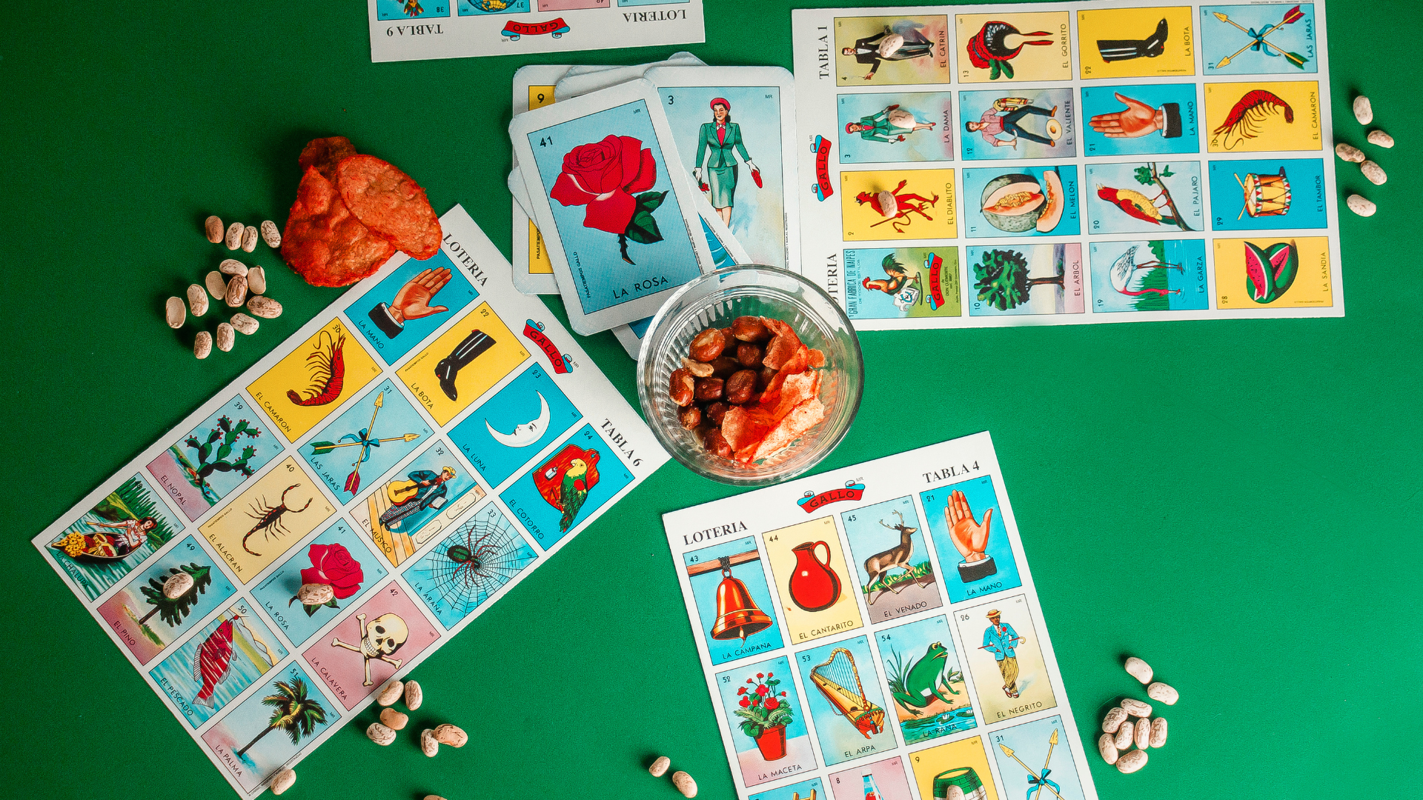
Human BINGO
Notes:
Ice-breaker (5 min)
Note to teacher: This activity will require learners to get up and move around. It might become a bit rowdy but sets the tone for discussions on self-concept.
We are going to play "Human Bingo" to learn interesting facts about our classmates.
This activity will help you discover unique aspects about each other.
Distribute ONE bingo card to each learner. (These cards need to be cut out from the Lesson 1 – Bingo Cards before the lesson.)
Instructions: Explain that the learners need to find classmates who match the statements in the squares and write that person's name in the square. They may not fill in the name of the same person person twice.
Once a learner has completed the card, they need to shout BINGO! Verify the card and award the learner with a small token such as a sweet.
Set a timer for THREE minutes. Allow the learners to mingle and ask each other questions to fill in their bingo cards. Encourage them to talk to as many classmates as possible. Give the learners time updates after each minute.
Once the activity has been completed, ask learners to return to their seats.
Briefly discuss how this activity helped them learn new things about their peers. Highlight how everyone has different experiences and interests, contributing to their unique self-concepts.
Understanding the diverse aspects of ourselves and others is an important part of building a strong self-concept.

Slide 3
Self-Concept
Self-Image: How a person sees themselves, which includes physical appearance and traits (characteristics).
Self-Esteem: How much value people place on themselves.
Ideal Self: The person one would like to be, which can include aspirations and goals.
Notes:
Teaching (5 min)
Let us now move on to what your ‘self-concept’ entails.
Self-concept refers to how you perceive and understand yourself. It is the mental image that a person has about who they are. Various factors shape self-concept and can change over time. Self-concept includes the following dimensions:
Self-image: How a person sees themselves, which includes physical appearance and traits (characteristics).
Self-esteem: How much value people place on themselves.
Ideal self: The person one would like to be, which can include aspirations and goals.
Sometimes it can be hard to determine how we see ourselves, but there are a few things you can do to determine the different aspects of your self-concept.
To determine your self-image you can:
Reflect on your personality traits, strengths and weaknesses.
Journal by writing down how you believe you act and your roles in your family and friendship circle.
Ask friends and family how they see you.
Observe your patterns of behaviour in interactions with others.
To determine your self-esteem you can:
Assess how you feel most of the time: confident and proud or inadequate and insecure?
Keep track of positive and negative thoughts about yourself. Which is more frequent?
Consider how you treat yourself in difficult times: Kind and understanding or critical and harsh.
To determine your ideal self you can:
Write down short-term and long-term goals.
Think about what qualities your role models have that you want to emulate.
Identify your values and beliefs which guide your actions.
Imagine your future self. What are you doing? How do you look? How do you feel?

Slide 4
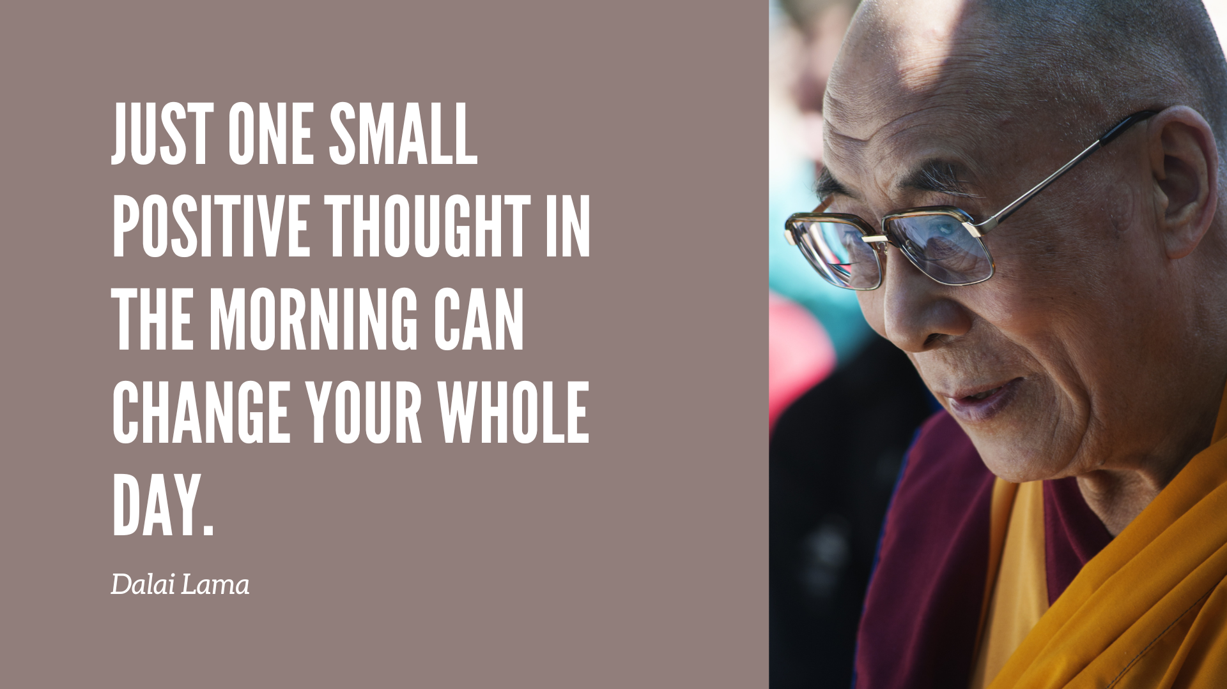
Notes:
Class Discussion (3 min)
Once we’ve determined who we are and who we would like to be, we need to find the motivation to pursue the best versions of ourselves.
This brings us to ‘self-motivation’. Self-motivation is the drive that pushes you to achieve your goals and desires. It can come from within (intrinsic) or from outside rewards (extrinsic), like money or praise.
Ask the learners to share ideas of what they could do to enhance their self-motivation.
Possible examples might include:
Set small, achievable goals, like finishing your homework or reading a book chapter.
Think about what you want to achieve by the end of the school year, like improving your marks in a particular subject.
Divide big tasks into smaller, more manageable steps. Instead of thinking about writing an entire essay, focus on writing the introduction first.
Surround yourself with positive friends who encourage and support you.
Treat yourself to something small after completing a task, like a snack or a short break.
Make daily to-do lists to stay focused and organised.
Identify people you admire and learn about their habits and strategies for success.
Read books, watch videos, or listen to podcasts that inspire you and provide motivation.
Ask parents, teachers or friends for help if you are struggling with something.
Stay healthy by eating balanced meals, exercising regularly and getting enough sleep.

Slide 5




Importance of Self-Concept & Self-Motivation
Academic Success
Personal Development
Healthy Relationships
Coping Skills
Notes:
Teaching (1 min)
Having a strong self-concept and being self-motivated can help you in the following ways:
It can help you believe in your abilities, stay focused on your studies, and work hard to achieve better marks. The same applies to a particular sport or hobby that you might want to do well in.
It can help you handle challenges and setbacks more effectively, helping you to bounce back from difficulties and persist in your efforts.
It can foster self-respect and confidence, which are essential for building and maintaining healthy relationships with peers, teachers, and family members.
It can drive you to set and achieve personal goals, explore new interests, and develop skills that contribute to your overall growth and future success.

Slide 6

Factors that Influence Self-Concept Formation and Self-Motivation
Notes:
Teaching (1 min)
Although we have power over our self-concept and self-motivation, there are factors outside of our control that can affect how we see ourselves and demotivate us.
Being aware of these factors helps us minimise their impact on our thoughts and actions.
Ignoring these influences might make it challenging to maintain our authentic identity (our true selves) or work towards our goals.

Slide 7

Watch: Toxic Influence: A Dove Film | Dove Self-Esteem Project https://www.youtube.com/watch?v=sF3iRZtkyAQ (3 min 48 sec)
Notes:
Watch Video & Discussion (7 min)
Let us start with one of the most influential factors nowadays, the media.
Media, such as social media, TV, and advertisements, greatly influence how you see yourself and what motivates you.
I’m going to show you a video in which mothers and their daughters address harmful beauty advice on social media. While this video focuses on girls specifically, it's important to remember that such 'quick-fix' advice affects people of all genders who may feel they don’t 'fit' the mould
Watch: Toxic Influence: A Dove Film | Dove Self-Esteem Project https://www.youtube.com/watch?v=sF3iRZtkyAQ (3 min 48 sec)
As mentioned earlier, all genders are bombarded with unrealistic expectations in the media. Ask the learners to share their experiences. Have they come across similar advice? How does this make them feel about themselves?
It is also important to acknowledge the fact that media can also have a positive influence on our self-concept. It can inspire us by showing us successful role models and positive messages.

Slide 8
Other Factors
Environment
Friends & Peers
Family
Culture
Religion
Community
Notes:
Class Discussion (10 min)
Ask the learners to interpret how the factors could have a positive or negative influence on their self-concept and self-motivation.
Note to teacher: These discussions need to be kept brief due to time constraints.
ENVIRONMENT: Your surroundings, including where you live and the people around you, affect your self-concept and motivation.
Supportive places like good schools or healthy communities can boost your confidence and growth.
Conversely, toxic or stressful environments can hinder self-esteem and motivation, making personal achievement more difficult.
FRIENDS & PEERS: Peers and friends significantly impact self-concept and self-motivation, especially during adolescence.
Positive relationships with peers can build your self-esteem and motivate you through encouragement.
Peer pressure and negative interactions, like bullying, can hurt your self-concept and decrease motivation.
FAMILY: Family is often the biggest influence on how you see yourself and what motivates you.
Families that offer love, support, and encouragement help build a strong self-concept and high motivation.
Families that are neglectful or abusive can damage your self-concept and demotivate you.
CULTURE: Your cultural background shapes your values, beliefs, and behaviours, which influence your self-concept and motivation.
Cultures that value personal achievement and growth can increase self-motivation.
Cultures with strict norms can limit self-concept development and motivation.
RELIGION: Religion can give you a sense of purpose, community, and moral guidance, affecting your self-concept and motivation.
Religious teachings can improve self-worth and motivation by promoting good values like perseverance and kindness.
Extreme religious views can sometimes limit personal growth or cause guilt and fear, hurting self-concept.
COMMUNITY: The larger community, including neighbourhoods and local organisations, also shapes your self-concept and motivation.
Communities that offer support and opportunities can enhance self-concept and motivation.
Communities with problems like crime or a lack of resources can negatively affect self-concept and motivation.

Slide 9

Individual Activity & Reflection
Notes:
Individual Activity & Reflection (5 min)
In this activity, you will be creating a "Self-Concept Shield" to reflect on important aspects of who you are.
A shield symbolises protection, identity and strength. Encourage learners to remember this shield when they are going through challenging times caused by the factors we discussed today. It should serve as a reminder to protect their self-concept, celebrate what makes them unique and face the future with inner strength.
Ask the learners to refer to Activity 1 on Lesson 1 – Worksheet.
Explain that each section on the shield represents a different aspect of their self-concept.
Encourage the learners to use words, drawings, or symbols to express these aspects.
If learners do not have enough time to complete this activity in class, it must be assigned as homework for the next lesson.

