Slide 1


Notes:
Introduction (3 min)
Welcome Gr9's to this next series of exciting lessons on sexual behaviour and sexual health. Before we get stuck into the content, I want you to think about your health for a minute. Turn to a partner in your group and answer these two questions: (Allow 2 min)
How would a person take care of their physical health?
What methods would a counsellor use to support a person's mental health?
Maybe you said that looking after your physical health could be something like exercising or eating healthy because it’s about the health of your body. Some of you might have said that the counsellor might help you with your mental health by helping you cope with your thought processes and how you feel about yourself.
So, now what could we possibly mean by the term “Sexual Health?”
Let’s have some fun. We’re going to play a game called “Assumptions Kill”. Firstly, I need a volunteer who will stand in the front and be our accountant to count the class votes. (Select a leaner to stand in the front with a piece of paper and pen to record results.)
What we want to do is find out if the class believes the statements are true or false. It’s important to remember that we’ll be counting the votes as a class and not looking at individual responses.
So, this is how it will work: I will make a statement, for example: “Girls with long hair are more feminine than girls with short hair”. Then I count to three. If you feel this assumption is true then you stand up and if you believe it is false, you remain seated.
Our class accountant will keep a tally of the class votes as to how many voted true and how many voted false. Remember, make your own decision, don’t look around to see what others are choosing.
Are you ready to start?

Slide 2
TRUE or FALSE
1) Sexual health is only about the health of your sex life.
2) How a person feels about the shape of their body is sexual health.
3) Sexual health includes any infection(s) caught from having sex with someone and needs to be treated by a doctor.
4) Sexual health includes your relationship with your boyfriend/girlfriend and how you feel about kissing.
5) Sexual health includes coping with the impact of a teenage pregnancy.
Notes:
Game (7 min)
: Note to teacher: This slide includes animations on the questions. This allows you to click for each question to appear.
We will be looking at assumptions on sexual health. (Click on the slide)
Do you believe that the following statements are true or false? (Click on the slide)
Sexual health is only about the health of your sex life. (Allow time to count the votes then click on the slide)
How a person feels about the shape of their body is sexual health. (Allow time to count the votes then click on the slide)
Sexual health includes any infection(s) caught from having sex with someone and needs to be treated by a doctor. (Allow time to count the votes then click on the slide)
Sexual health includes your relationship with your boyfriend/girlfriend and how you feel about kissing. (Allow time to count the votes then click on the slide)
Sexual health includes coping with the impact of a teenage pregnancy. (Allow time to count the votes then click on the slide)
Well done class! Allow the "accountant" to provide the outcome of the votes for each question.
Can you see that we all have different ideas of what constitutes sexual health? To summarise: Sexual health involves your physical body, your self-image, the quality of your relationships with others and your morals and values. All these factors influence our choices around our sexual behaviour.
Grade 9 is a special year because, in many ways, you begin to resemble an adult more closely. Some of you have increased in height quite a bit since last year. You know your bodies are changing and puberty is no longer something scary that’s going to happen. Remember puberty starts between ages 10-12 and ends around the age of 19.
This is a unique stage of human development and an important time for laying the foundations of good health. You are a young adult now and some of you might find that you are experiencing feelings of attraction toward someone else.
Remember that all choices have consequences. They could have a positive impact when making a healthy choice or a negative impact when making an unhealthy choice, for instance, choosing to drink alcohol with friends can lower your inhibitions, leading you to engage in physical activities with someone that you might not do when sober. Then you’ll have to deal with the embarrassment and possible pregnancy from that choice.
You need to develop standards for yourself, by which you will live your life, that protect your physical, emotional and sexual health. These standards are influenced by your physical health, self-image, quality of the relationships you have with others and your values.

Slide 3
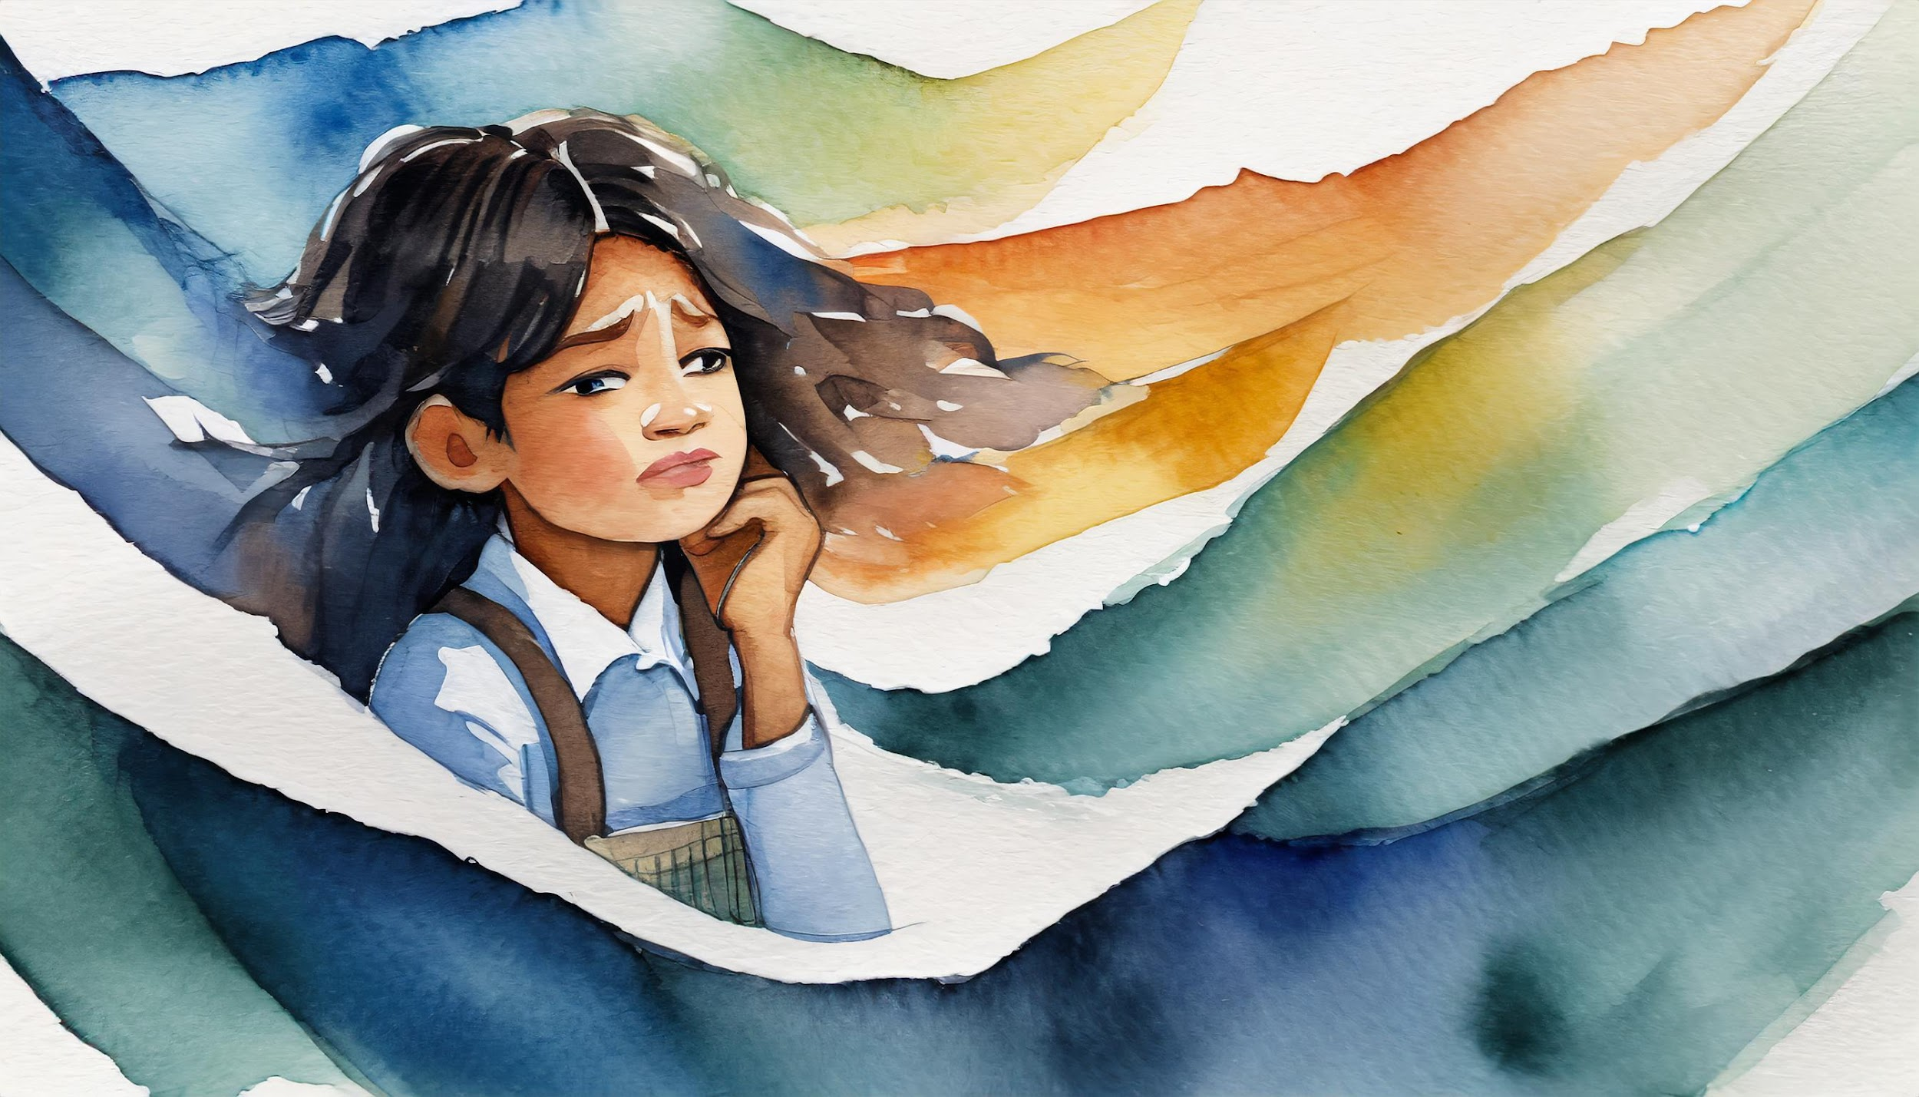
I feel so alone. My boyfriend said that unless I have sex with him this weekend, he’s going to leave me.
I don’t know what to do.
Notes:
Teaching (5 min)
Risk factors are the things that impact you to make poor choices about your sexual behaviour. These choices could place you at risk and lead to unhealthy sexual behaviour.
Can any of you give an example of a poor choice in terms of sexual behaviour and the consequence of that choice? (Allow time for the class to respond.)
Here are some common beliefs of teenagers:
Believing that nothing bad will happen to you even if you take risks, such as having sex without contraception and assuming that pregnancy won't occur.
Feeling the need to do something to be accepted by your peers, like boys believing they must have sex with a girl to be considered "cool."
Believing you have no control or say over what happens to you, such as feeling so insecure that you can't refuse unhealthy sexual attention.
Living in poverty often feels like you have no choice, leading to survival-driven decisions.
The use of drugs and alcohol inhibits your ability to make wise decisions.
Turn to a member in your group and briefly discuss what advice you would give the young girl on the slide.
The girl's dilemma: "I feel so alone. My boyfriend said that unless I have sex with him this weekend, he’s going to leave me. I don’t know what to do." (Allow 1 min for discussion.)
Well done Grade 9’s! I can hear some of you had some good advice.

Slide 4
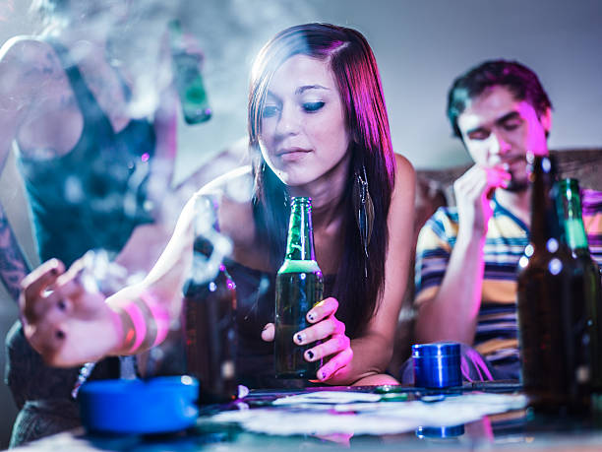
?
?
?
?
Risk Factors
?
[Source: https://www.brightfutures.org/development/adolescence/substance-abuse.html]
Notes:
Individual Activity (4 min)
Maybe you are fortunate enough to have parents who openly discuss healthy sexual behaviour habits with you. This could include things like having certain moral standards about your body that you would not compromise on. It could also mean that you believe in abstinence which means not having sex until you are older and more mature. Some young adults have not had the same privileges. Maybe they don’t have mothers and fathers and come from a community of extreme poverty where they have made unhealthy sexual choices out of necessity to survive.
Let’s look at this image on the slide. On your worksheet, complete Activity 1 (Lesson 1 – Worksheet). Identify unhealthy habits (use your imagination) and describe the negative and unwanted sexual experiences that could result from them. You’ll need to write quickly because you will only have 3 minutes.
Feedback: Let’s see, what did you find?
The girl is drinking alcohol which means she is not going to make wise decisions and might end up having sex.
The girl might be using drugs, which can make her feel invincible and believe that she won’t become pregnant or contract an STI even if she has sex.
She might not know anyone there, and if everyone ends up drunk, the worst-case scenario could be that she gets raped.
There could be a date rape drug in her drink that paralyses her and she can’t stop anything bad from happening.
I hope you can see that unhealthy sexual behaviour like this could cause a person to end up in a situation they would later regret.
Here are a few examples of unhealthy sexual behaviour:
having sex at a young age
having sex without a condom or having unprotected sex with more than one person.
having a high-risk partner (one who has multiple sex partners or other risk factors).
This is dangerous as a person can be infected with a sexually transmitted infection (STI) or even get HIV.

Slide 5


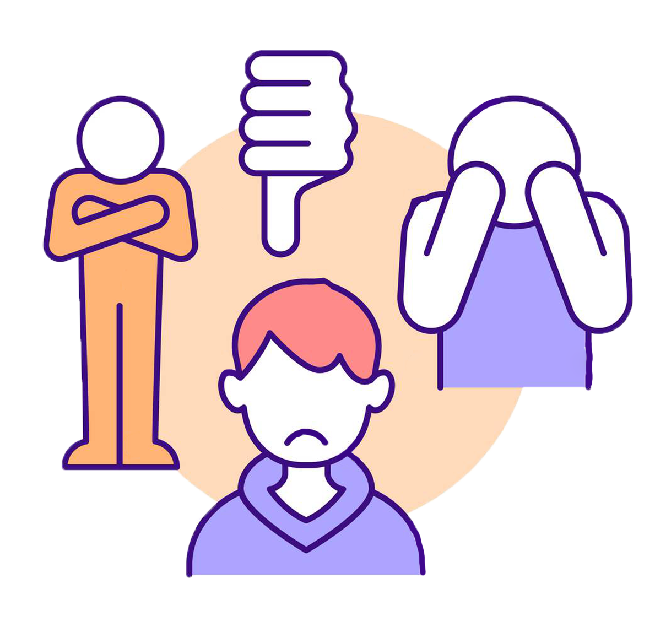
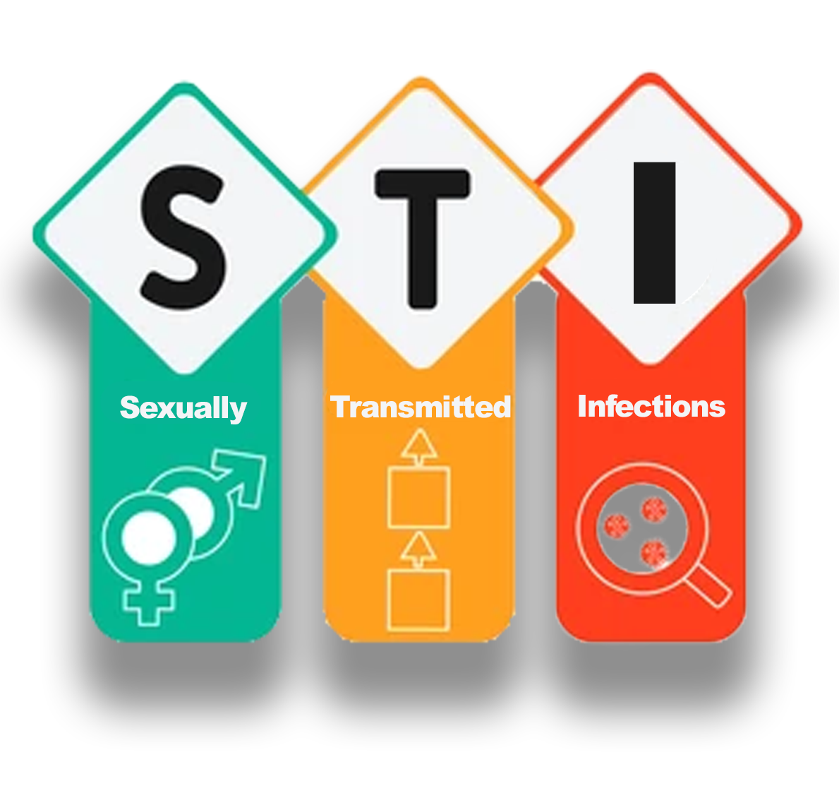

Risk Factors
Notes:
Individual Activity (4min)
As we saw in the previous slide, unhealthy or risky sexual behaviour can lead to serious and unwanted consequences. You’ve already identified some of those consequences in your first activity. Write the following in Activity 2 (Lesson 1 – Worksheet), as we go through them:
We could summarise the consequences of risky sexual behaviours as:
Teenage pregnancy
Sexually transmitted infections (STIs)
HIV and AIDS
Low self-esteem
Emotional scars
We’re going to look at each of these points in a little more detail in the next lesson. Today we’re just going to look at teenage pregnancy. I know many of you might be wondering why we keep discussing teen pregnancy. You might be tired of hearing about it and believe that it could never happen to you or one of your friends. The sad reality is that statistics show us that it happens to so many young girls who honestly believed they would never fall pregnant as a teenager. We will look at these statistics later on in the lesson. It’s better to know all the facts so you know how to prevent teen pregnancy before it happens.

Slide 6
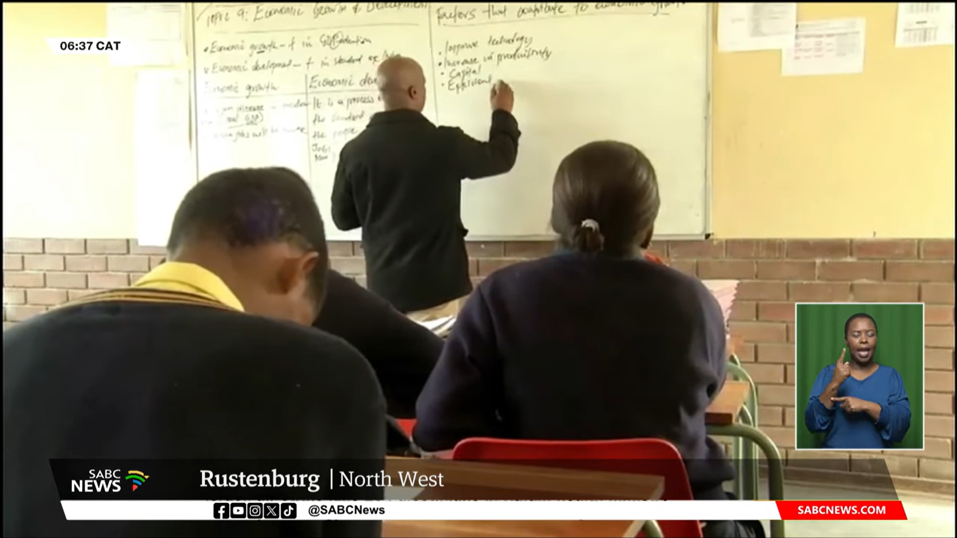
Watch: Teenage Pregnancy | Impact on education, health, and mental well-being explored
https://www.youtube.com/watch?v=16brQSvq1Vg (3 min 07 sec)
Notes:
Watch Video (5 min)
Let’s start by looking at teen pregnancy in South Africa. Can you find the answers to these three questions while watching the clip:
How did peer pressure impact the choices that were made to have sex?
Why are teenagers afraid to tell their parents about the pregnancy?
What factors contribute to young girls in poverty becoming pregnant?
Watch: Teenage Pregnancy | Impact on education, health, and mental well-being explored
https://www.youtube.com/watch?v=16brQSvq1Vg (3 min 07 sec)
It is sad that this is one of many stories in South Africa of young girls who have fallen pregnant. We have seen that some girls avoid using contraception out of fear. Remember the term contraception refers to using methods to prevent pregnancy. This could include a female going on a contraceptive pill, using a condom or using a contraceptive injection or a male wearing a condom while having sex.
It’s important to note that these methods do not guarantee a 100% chance of not falling pregnant. The most effective contraceptive is still abstinence.
Grade 9s, there is a myth or assumption that no one believes in abstinence. I know some of you think it is old-fashioned, but abstinence can be a way to avoid the risks that come with sex, like pregnancy and STIs until you’re ready to prevent and/or handle them. In our next lesson, we’ll focus more on sexually transmitted infections (STIs). It's important to understand that many STIs can remain with you for life, and some can cause significant discomfort or emotional distress. If you want to be 100% certain you don’t contract any STI, the only method is to practice abstinence.
Abstinence can also help you focus on other things in your life that are important to you, like friends, school, sports, activities, having fun, and planning for your future – that is your goals/dreams.
We saw in this clip that the peer pressure from friends resulted in the young teen making decisions that resulted in her getting pregnant. She wanted to be seen as “cool” by her friends. It was difficult for her to tell her parents about her pregnancy because she did not want to disappoint them. It is disheartening to learn that many young girls in poverty exchange sex for money. These are unfortunate realities faced in South Africa today.

Slide 7
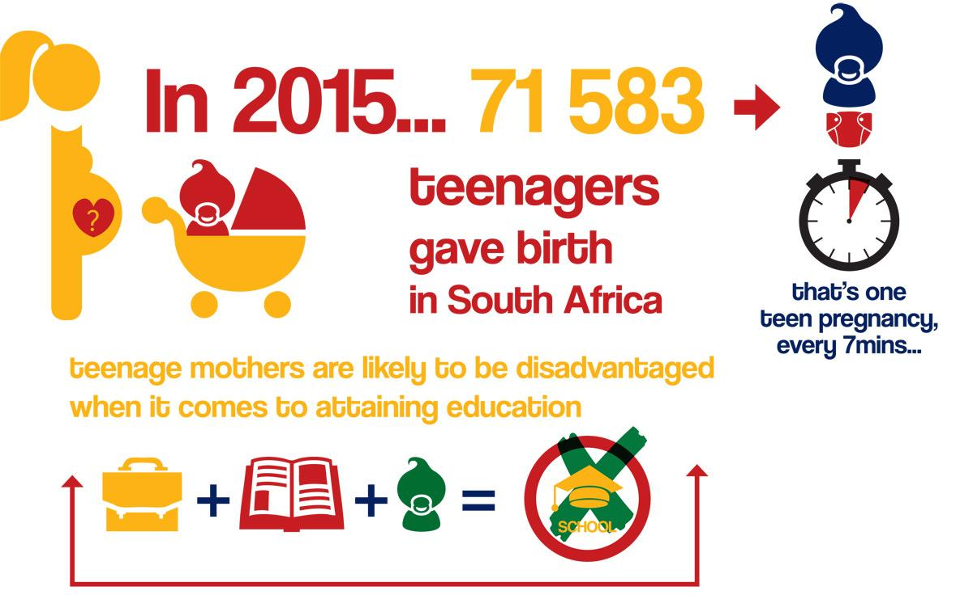
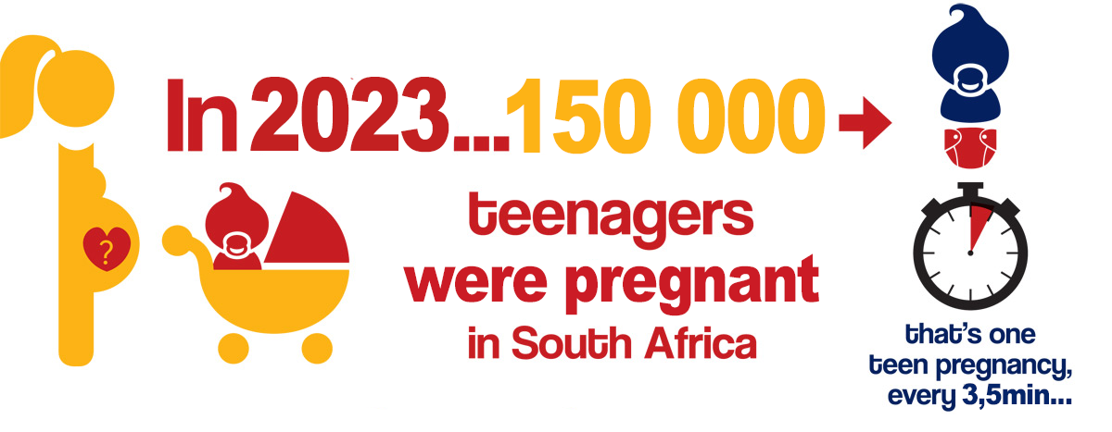
Adapted from: https://sheconquerssa.co.za/pregnancy/ & https://www.sabcnews.com/sabcnews/infographic-adolescent-teenage-pregnancy-crisis-in-south-africa/ Accessed on: 29 July 2024]
Notes:
Group Discussion (6 min + 3 min feedback to class)
Looking at these statistics (on the slide), we can see that there has been a massive increase in teenage pregnancies between 2015 and 2023. In your groups discuss the questions in Activity 3 (Lesson 1 – Worksheet). As a group write your answers onto your worksheet and provide a spokesperson to give feedback to the class.
Give THREE reasons for the increase in teen pregnancy since 2015.
Discuss THREE reasons why many teen moms drop out of school after their baby is born.
Suggest TWO ways schools could support teen moms in finishing their school education.
Allow a couple of minutes at the end of the activity for groups to provide feedback. Possible answers are available in Lesson 1 – Worksheet MEMO.

Slide 8

Notes:
Group Discussion (6 min + 3 min feedback to class)
Note to teacher: The aim of this activity is to create an opportunity for learners to ask questions without feeling intimidated and also reflect on their response to the content covered in this lesson. Hand out the Lesson 1 – Exit Ticket to each learner. Then you will stand by the door and take them in as the learners leave the class. It should be an anonymous ticket. Use this opportunity to say goodbye to your learners and check that they are okay, as some of them might have found the content unsettling.
We have covered a lot of content in today’s lesson. Sometimes we just need to stop for a moment and think about what we have learned and even what we still don’t know. When you travel on a train, you need to pay for your journey with a ticket. We’re going to do something similar in class today. I want you to write down THREE things in your Lesson 1 – Exit Ticket:
One question you would like answered about sexual health.
One interesting or new thing you learned in this lesson.
Complete the sentence: I am not comfortable discussing this topic because…
DO NOT write your name on the ticket. You will hand me the ticket to me as you leave the classroom.

