Slide 1
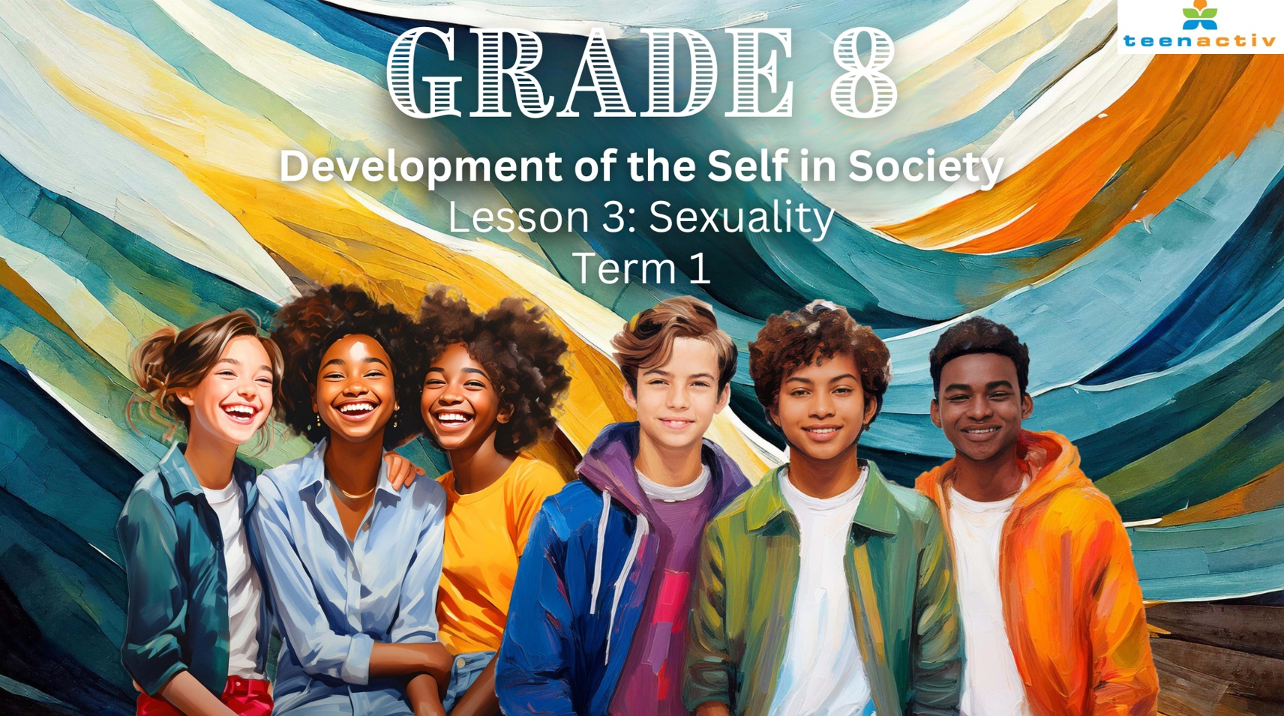

Notes:
Introduction (4 min)
Welcome back Grade 8’s! Today is our last lesson in this series on sexuality. You have learnt about what the definition of sexuality is and how friends, family and your community can influence your sexuality. In the previous lesson, you discussed different family and community norms that have impacted you.
Turn to a member in your group and mention ONE of the norms that you identify with and why. (Allow 1 minute)
Well done Grade 8’s. So far we have seen the influence of friends, family and the community on sexuality. The reality is that we are also strongly influenced by the media and the ideas of sexuality that the media promotes. Who can name one of these ideas the media promotes? (Allow the class to respond.)
With the invention of the internet and the development of smartphones that provide access to information from around the world, our area of influence has expanded drastically. Before cell phones, your sexuality would have been mostly influenced by friends, family, and your community. Today, teenagers face various pressures while defining their identity. These pressures can come from many sources: friends, family, and even classmates. We refer to this as social pressure, which often makes you feel the need to conform to certain appearances or behaviours to be accepted. These pressures can also come from the media.
I’m sure many of you can tell me about how the media influences your own views on sexuality. When I use the term “media”, what am I referring to? (Allow opportunity for learners to respond.)
Media is not only social media but it also includes all kinds of mass communication like music, movies, magazines, radio, newspapers and TV.
The problem is that these different platforms make you believe that there is an ideal way that you should look to be acceptable. The media can also present different values to what your parents or community express. For example, a Netflix movie labelled 'Parental Guidance' (which you love to watch) might show a couple who have just met sleeping together. While this may seem acceptable on TV, it could be completely unacceptable to your family. These differing influences can be confusing for a teenager

Slide 2
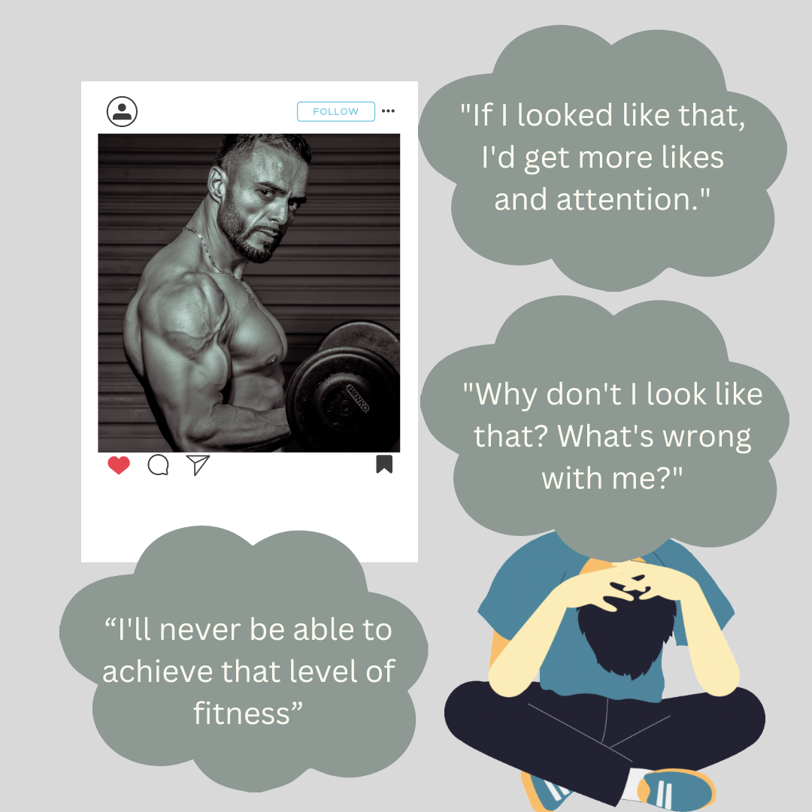
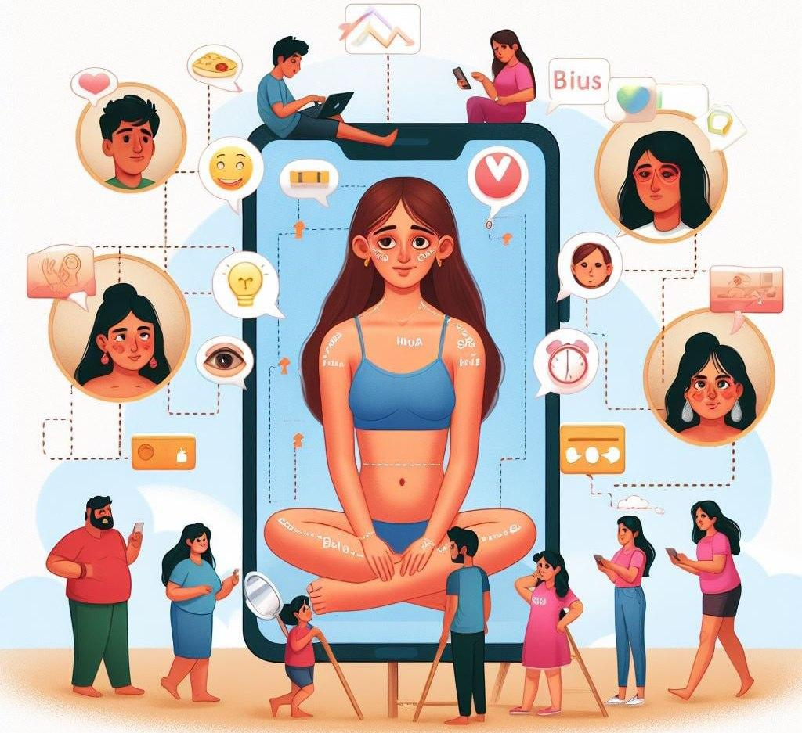
Social Media & Body Image
[Source: https://pinardin.com/posts/24/02/body-image-social-media/ Accessed on: 13 August 2024]
Notes:
Teaching (3 min)
Take a look at the images on this slide. How do you think they demonstrate the influence of social media on body image? (Allow opportunity for learners to respond.)
I'm sure many of you have seen posts on Instagram, Snapchat, or TikTok and noticed the comments and the number of "likes" or "shares" they've received. More and more people are posting pictures of themselves with friends or taking selfies for their social media profiles. Teens today have access to photos and images of classmates online every day, almost in real-time. Because of this, body image and social media are closely intertwined. Growing up can sometimes feel like you're always in the spotlight, and as a result, many of you might feel insecure about your body image due to the comments made on social media.

Slide 3
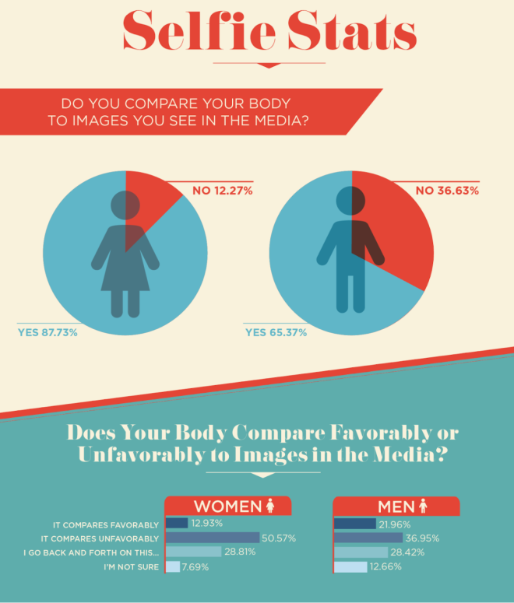
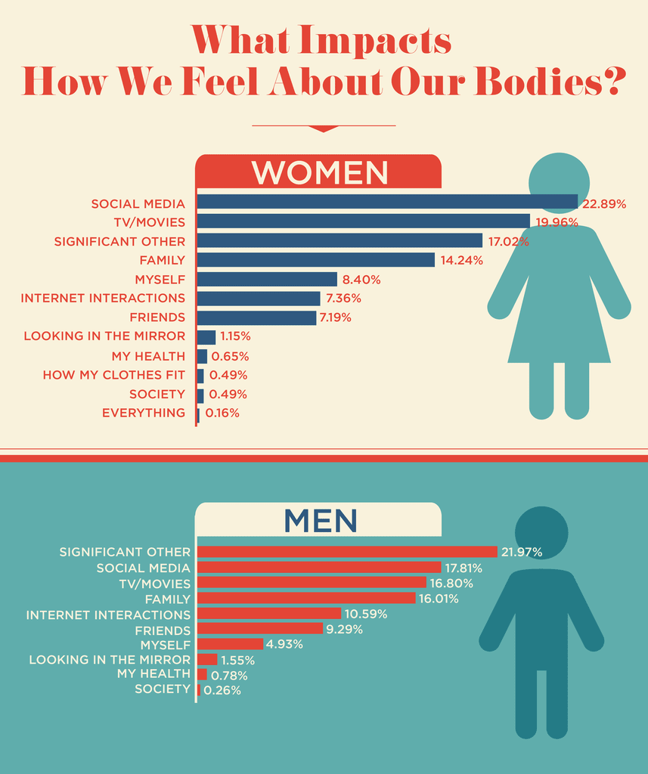
[Source: https://www.today.com/style/social-media-affecting-way-we-view-our-bodies-it-s-t128500/ Accessed on: 9 July 2024]
Notes:
Group Activity (5 min)
So how much of an influence does the media have? Look at the statistics on selfies. In your groups, discuss the questions in Activity 1 (Lesson 3 – Worksheet).
Why do you think more girls compare their bodies on social media than boys?
Look at the top influence on body image from men and women. Why do you think they are so different?
What advice would you give a friend who feels despondent because their body does not match what they see on social media?
The media affects your identity development by imposing certain standards of what is deemed acceptable. Teenagers often experience confusion as they navigate the conflicting influences of their parents’ values, their community, and the media. This confusion can lead to rebellious behaviour as they experiment and work through their own identity.
It is important to realise that you have a choice as to how much you will allow these influences to impact how you feel about yourself. We want to celebrate each of our unique qualities rather than trying to make everyone look a certain way. The goal is to focus on being healthy, not just 'skinny.'

Slide 4
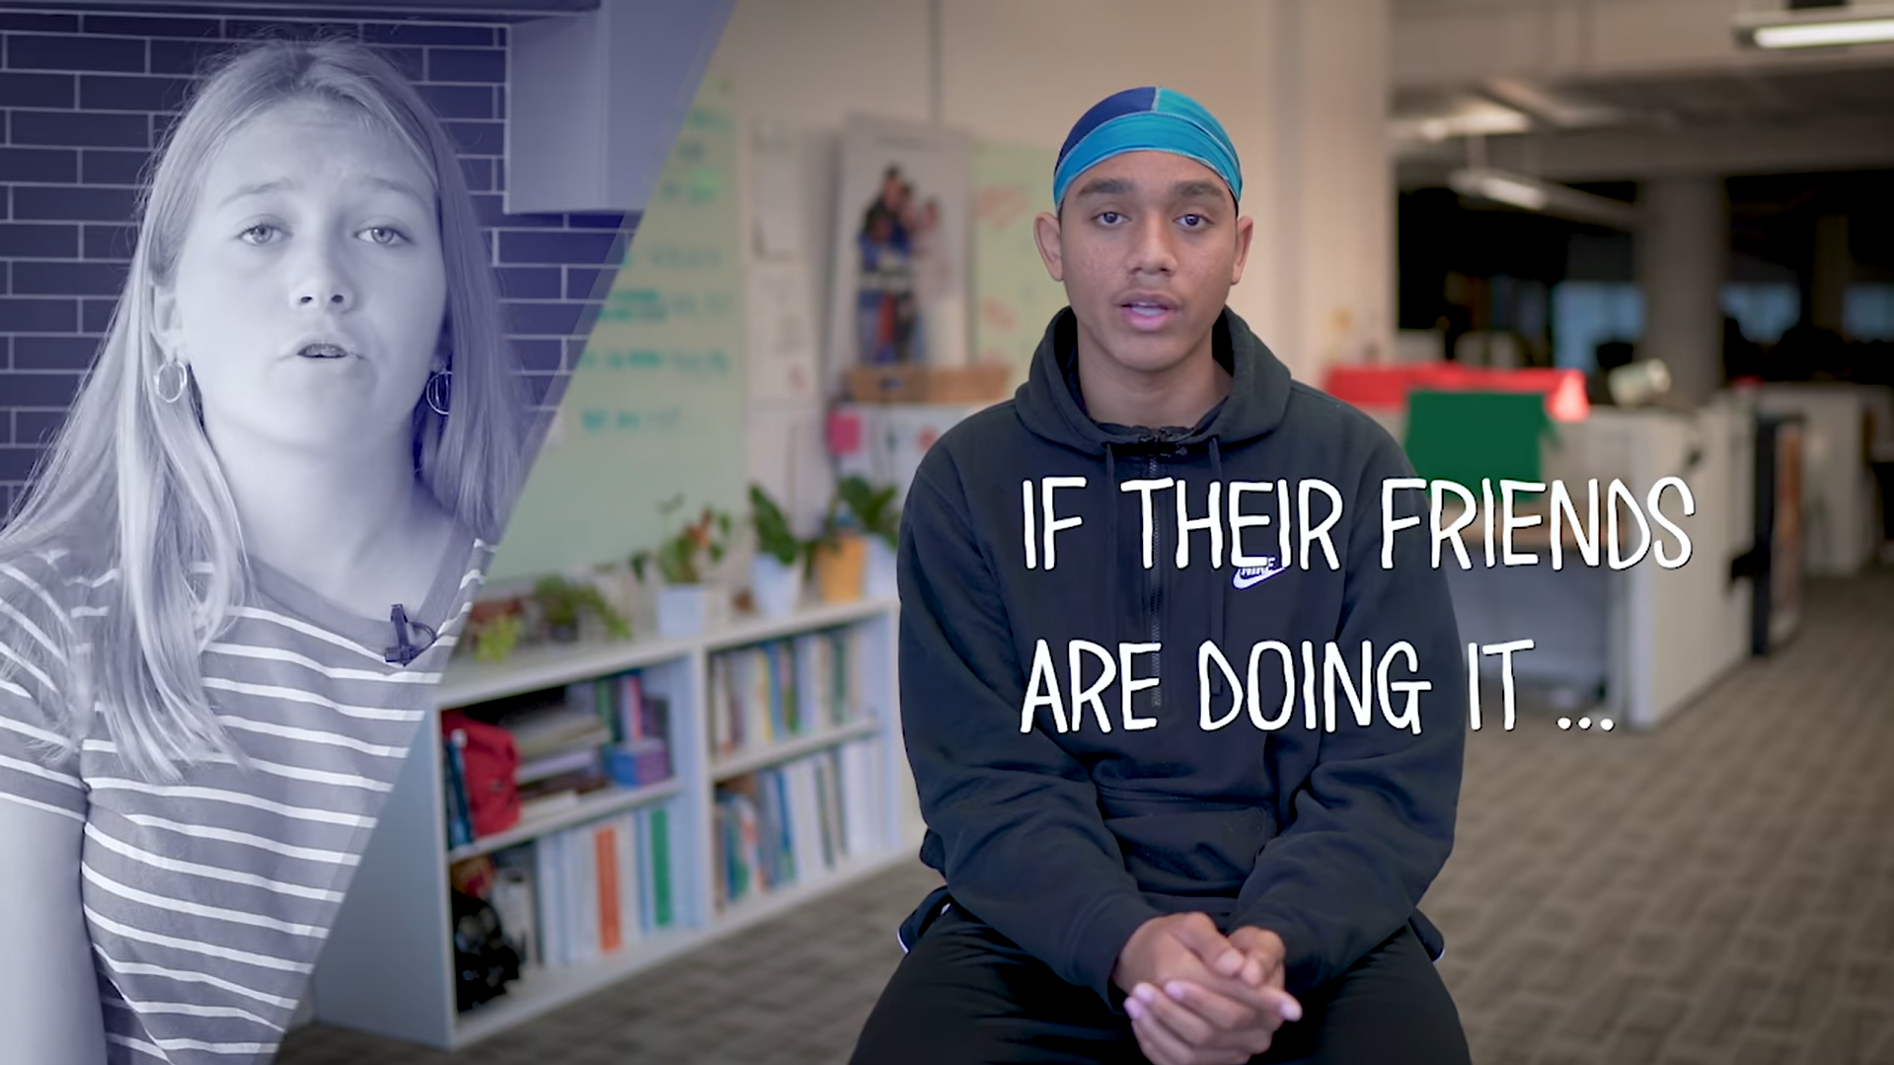
Watch: https://www.youtube.com/watch?v=IZwVT6WnPQY (3 min 58 sec)
Notes:
Watch Video (until 3 min 58 sec) & Teaching (8 min)
Watch: Teen Voices: Sexting, Relationships, and Risks
https://www.youtube.com/watch?v=IZwVT6WnPQY (3 min 58 sec)
I’m sure you have heard of some friends who made bad choices because of the influence of their friends. We’ve heard in this clip of this common form of rebellion among 13-15-year-olds called “sexting”.
In case you’re still not too sure what sexting is, it can be defined as sending inappropriate pictures of minors (under 18 years) via cell phones. This may include sharing images on social media or through messaging apps that involve:
Being partly or completely naked, or in your underwear.
Posing in a sexual position.
Let’s just go back to this clip we have just watched. This might seem like a harmless bit of rebellion, but the risks of being discovered can lead to stress and serious consequences.
In your groups, you will have 2 minutes to identify as many risks associated with the dangers of sexting as you can. Here are a few to get you started:
Images could end up shared all over the internet and everyone at school has access to naked pictures of you.
It could be reported to the police for distributing child pornography.
Remember, sexting as a minor (under the age of 18) is illegal in South Africa. It infringes on the human right of dignity and you can be prosecuted if you are caught sharing nude photos of a minor (even if you are a minor/teenager).

Slide 5
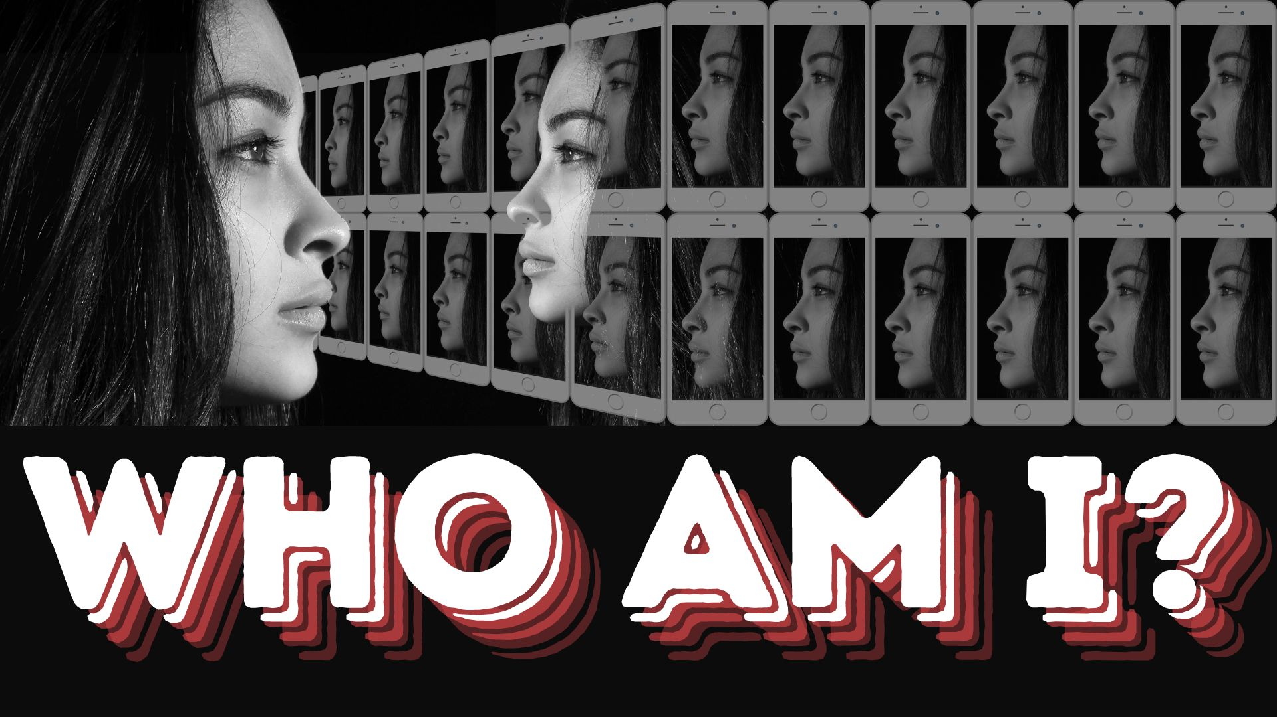
Notes:
Teaching (5 min)
Being an adolescent (teenager) can sometimes be very confusing. During these years of high school, you will find that you will often ask yourself this question "Who am I?". The combination of physical, mental, and social challenges, along with serious choices, can impact your identity. During this time, you are also exploring/refining your values (what’s important to you) about things like religion, ethics, sexuality and gender.
Sometimes teenagers feel insecure and lack self-confidence. In these times it can be difficult to be amongst friends or peers that try to pressure you into doing things you don’t want to do. Can you remember from Grade 7 what the term “peer pressure” means? (Allow opportunity for learners to respond.)
Peer Pressure is a feeling that one must do the same things as other people of one's age and social group, in order to be liked or respected by one’s peers.
Sometimes, working through these questions can be overwhelming. It might be helpful to express your thoughts and emotions by keeping a journal. If you find it too difficult to handle on your own, consider reaching out to a trusted teacher or the school counsellor (if available).
Let’s take a look at a very helpful strategy you can remember and practice when you find it difficult to say NO.

Slide 6

Notes:
Teaching (3 min)
Explain the ASK acronym to learners.
A – Ask yourself questions like: Is this against my beliefs, the law or my parents' rules? Can this be harmful to me or others? Will I regret doing this later? How will my friends and family feel when they find out?
S – Say NO to negative pressures, for example, "No, I have thought about what you have asked, and I don't want to do it."
K – Know positive options, for example, "I’d rather listen to music." or "I’d rather hang out with my friends and play sports."
Hand out the Content Summary

Slide 7
Solving a difficult situation
  Don’t make the decision when you feel emotional. Wait!
  Define the problem.
  What are the possible solutions?
  What are the consequences of each solution?
  Choose a suitable solution.
  DO IT! Implement your chosen solution.
  Evaluate (at a later date) if the problem was solved.
Notes:
Individual Activity (9 min)
Sometimes you find yourself in a difficult situation where a simple NO won’t solve the problem. In these situations, you would need to know HOW to solve it!
Take note of the following steps.
Don’t make the decision when you feel emotional. Wait!
Define the problem.
What are the possible solutions?
What are the consequences of each solution?
Choose a suitable solution.
DO IT! Implement your chosen solution.
Evaluate (at a later date) if the problem was solved.
Now, look at the problem in Activity 2 (Lesson 3 – Worksheet). Complete the table to help provide a solution.

Slide 8



[Sources: https://www.reddit.com/r/Bumperstickers/comments/1ehfh0q/heres_a_sticker_i_found_online/ & https://botswana.desertcart.com/products Accessed on: 13 August 2024]
Notes:
Reflection (3 min)
As we come to the last few minutes of this lesson, take a moment to reflect on the content we have covered today. Think of a catchy phrase you would put onto a bumper sticker that you could put in your room to remind you that you are precious and valuable. Complete Activity 3 (Lesson 3 – Worksheet).
Just a reminder: There are many things that impact your development, but YOU get to decide what you think and feel about yourself, your body and your sexuality!

