Slide 1

Celebrations of National and International Days
Lesson 3
CRR: Term 2 Week 1 - 3

Slide 2
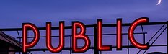
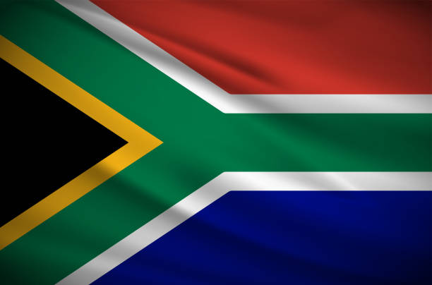
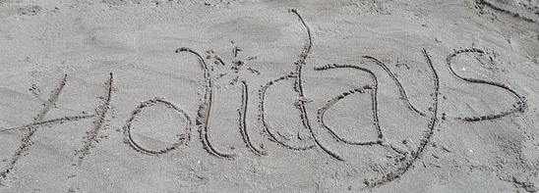
in
South Africa

Slide 3
Why do we have
public holidays and celebrate certain national days?

Slide 4
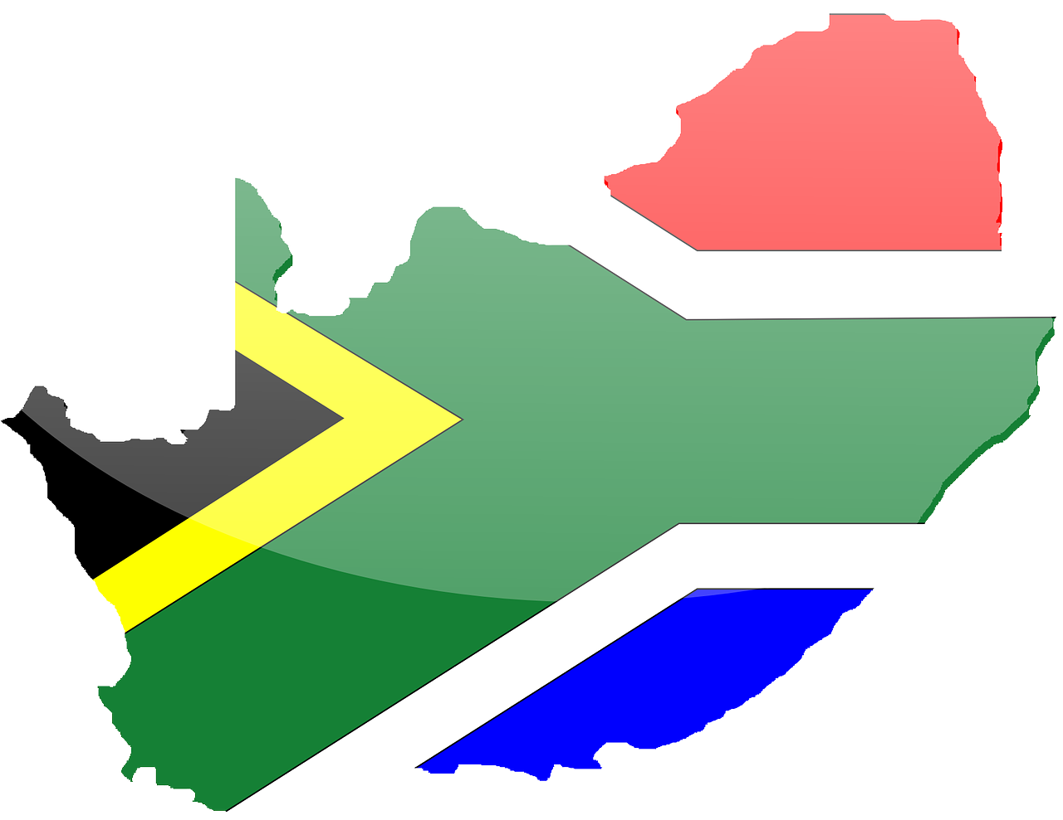
Human Rights Day
21st March

Slide 5
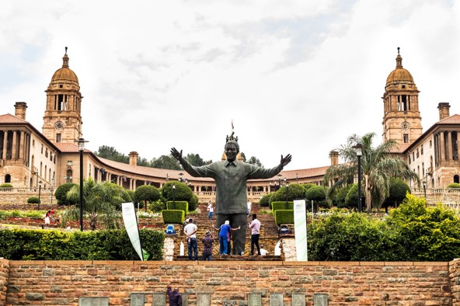

Freedom Day
27th April
https://www.youtube.com/watch?v=gCor9Gg-Vhw
(I min 19 sec)

Slide 6
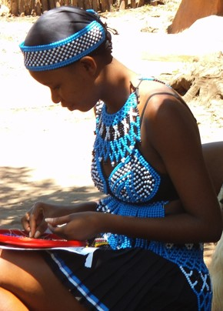
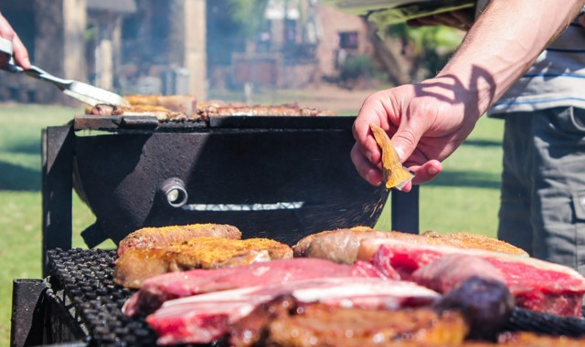
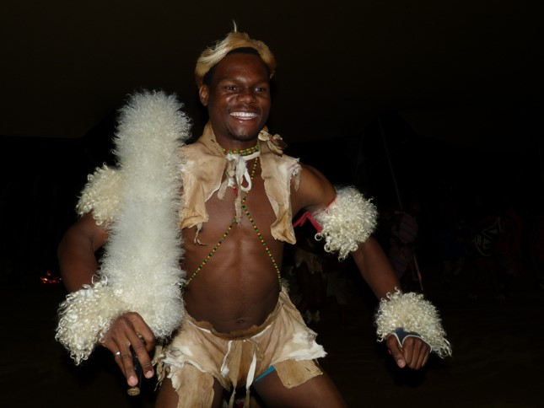
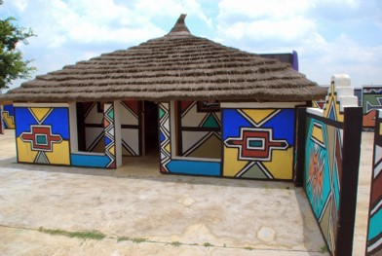
Heritage Day
24th September

Slide 7
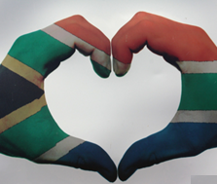
Reconciliation Day
16th December

Slide 8

Youth Day
16th June
https://www.youtube.com/watch?v=XxgqSWapzLo (2 min 09 sec)

Slide 9
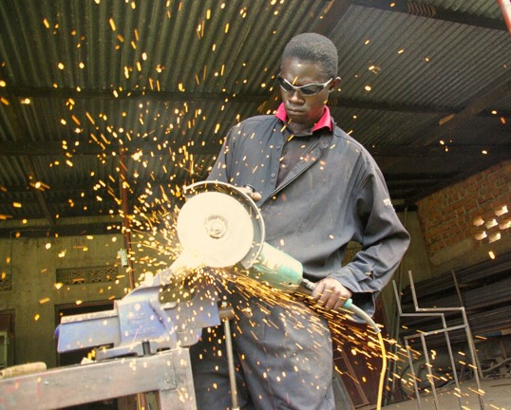
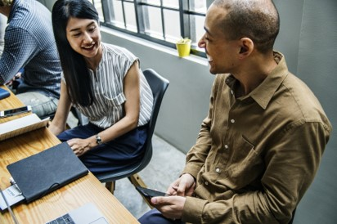

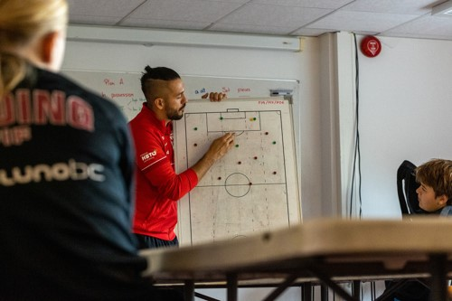


Worker’s Day
1st May

Slide 10
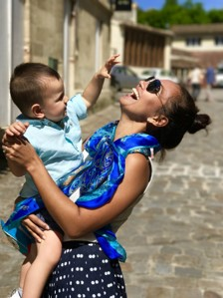
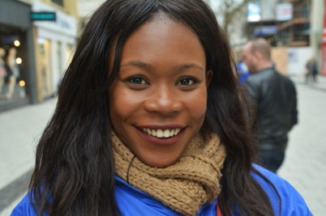

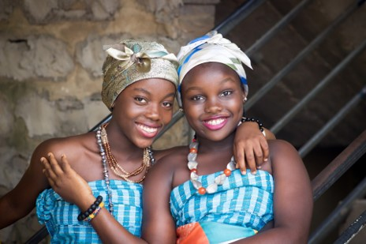
Women’s Day
9th August

Slide 11
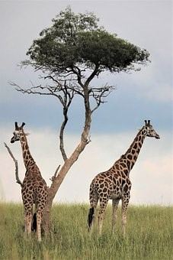
Africa Day
25th May

Slide 12
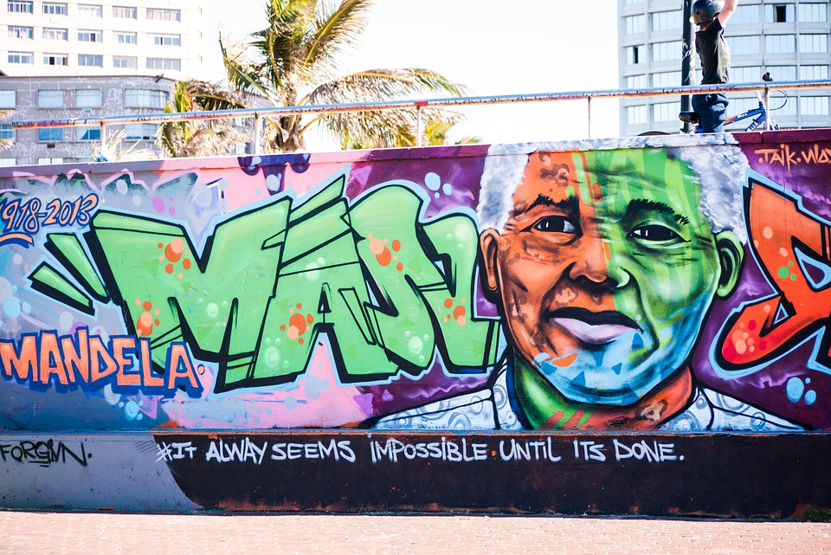
Nelson Mandela Day
https://www.youtube.com/watch?v=iiqFMx1_abc
(2 min 39 sec)

Slide 13
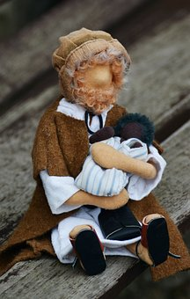
World Refugees’ Day
20th June

Slide 14

National Health Days:
What is the purpose of National Health Days?
World Cancer Day (4 Feb)
International Epilepsy
Day (13 Feb)
World TB Day (24 March)
World Malaria Day (25 April)
World Hygiene Day (5 May)
World Hypertension Day
(17 May)
etc

Slide 15
South African Public Holidays in 2023:
https://www.youtube.com/watch?v=Ic4tdiETK78 (1 min 27 sec)
How do YOU celebrate different Public Holidays?
What do you and your family do?

Slide 16
