Slide 1


Respect for others’ rights: People living with different disabilities and HIV / AIDS
Lesson 2
CRR: Term 2 Week 1 - 3

Slide 2
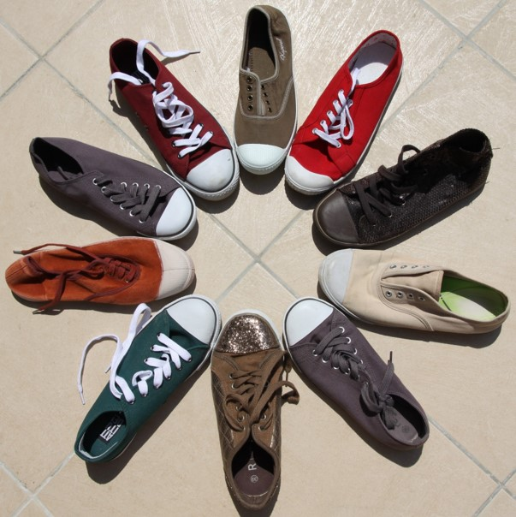
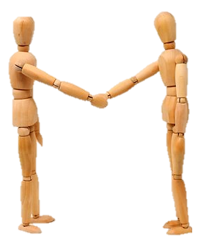
Respect

Slide 3
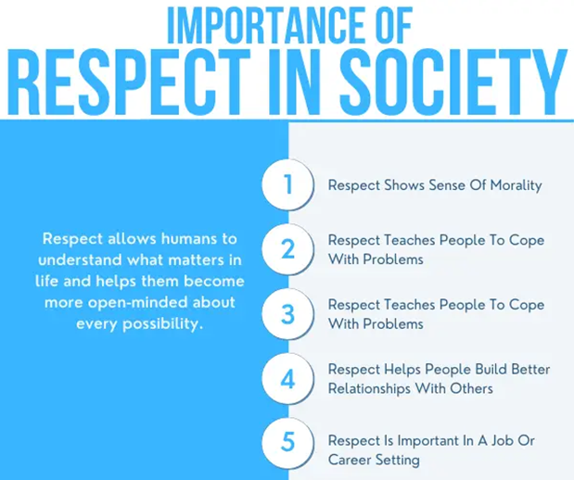

Slide 4
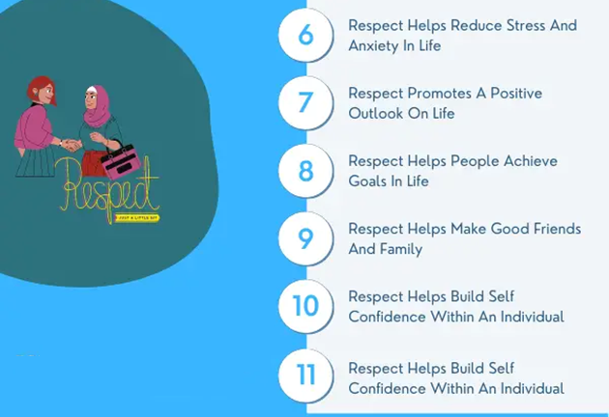
taken from www.curiousdesire.com

Slide 5


Respect and Tolerance
https://www.youtube.com/watch?v=ArNrrmprUZ0
(1 min 39 sec)

Slide 6

Disabilities & Disability Etiquette

Slide 7

Respect for People with Disabilities
https://www.youtube.com/watch?v=hjvmAUbfXdw (2 min 23 sec)

Slide 8



Learn to respect all kinds of people. Because everyone is fighting a battle of their own.
We all have our problems, bad sides and bad days.
But there is so much more behind it. Behind me, behind you and behind everyone.
Ian MacLaren

Slide 9

Living with HIV / AIDS
What is HIV?
What is AIDS?

Slide 10

HIV does not discriminate
Living with HIV
https://www.youtube.com/watch?v=IfBPQrmBwbA (3 min 10 sec)

Slide 11


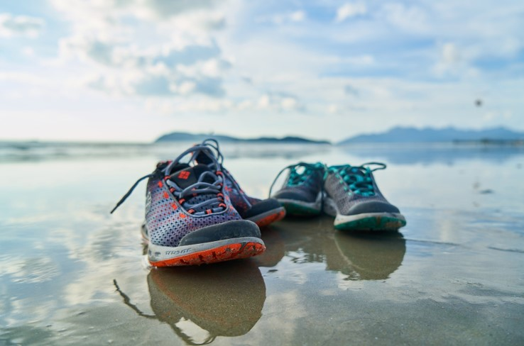
Impact on self and others

Slide 12

Stigma of HIV
What is it?
Examples

Slide 13

How can you provide support
to a person who is HIV positive?

Slide 14


