Slide 1
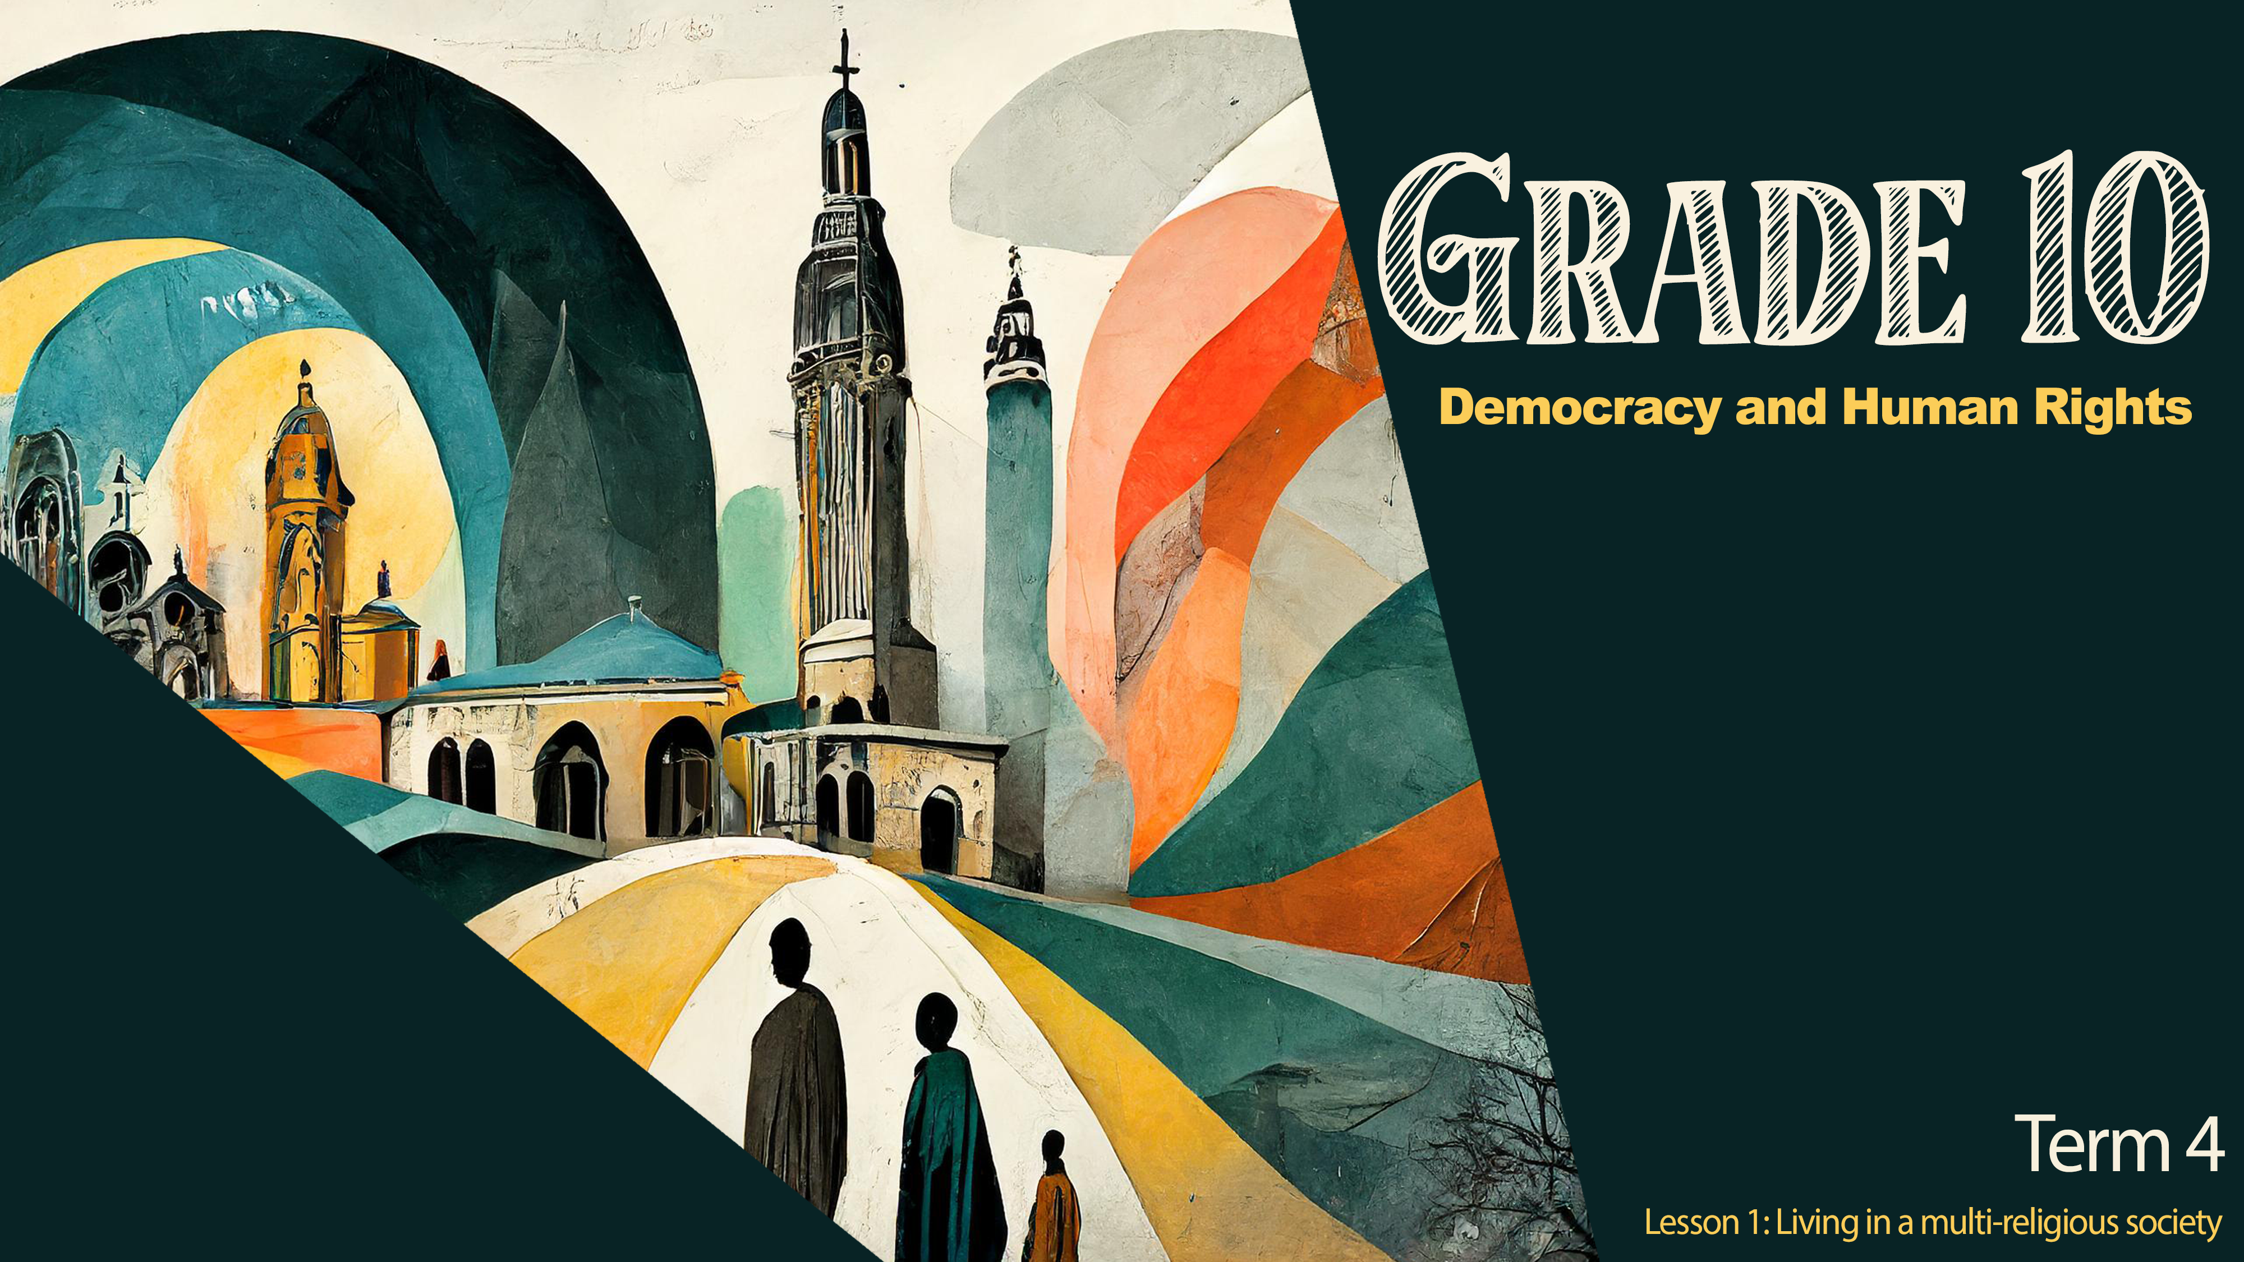

Notes:
Introduction (2 min)
Note to teacher: The discussion around religions could sometimes be sensitive for certain learners. Encourage learners to listen and respect one another regardless of their beliefs.
Good day, Grade 10s. Today we start a new series of lessons in Democracy and Human Rights for the next three lessons. In Grade 8 you learnt about the cultural diversity we have in South Africa and how we as South Africans should respect our diversity and celebrate our similarities.
As South Africans, we are fortunate to live in a country where we have freedom of religion because of our constitution. You might know someone who belongs to a different religion than what you know. By understanding the ethical teachings and religious laws of the different religions in South Africa, we can learn from one another and become better South Africans.
A religion defines a system of values/ideas that a group of people believe. Many people choose not to believe in a specific religion but still carry a set of beliefs around traditions and values they have adopted. E.g. An atheist does not believe in religion but can still celebrate Christmas if they have adopted a traditional Christian holiday as their own family tradition.

Slide 2
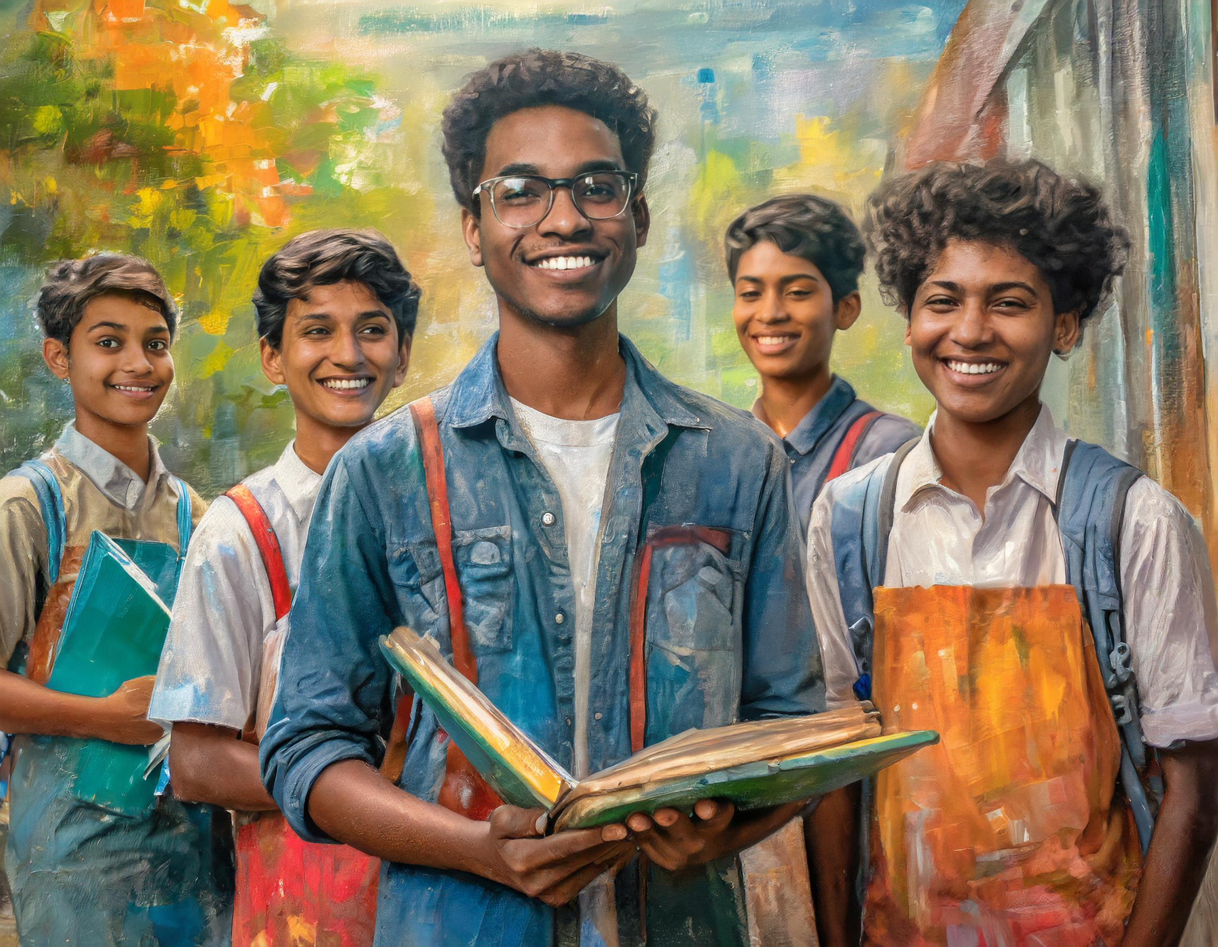
?
?
?
?
?
?
Notes:
Introduction & Teaching (6 min)
Let’s take a moment to see what religions are represented in our class. As a group, we will now collect information on how many of your group members belong to different religions. Then one group member will give the statistics back to the class.
One person will be appointed to collect the class data.
Remember we do not need to know the specific members of the group and what religion they have. The aim is to record the statistics of the entire class. Remember, having no religion is still a religion. (Allow 3 min per group and 2 min class feedback.)
Well done class. It’s lovely to see the variety of religions represented in our class. However, we are a small percentage that represents the people of South Africa. Sometimes we tend to be prejudicial (something that causes harm or unfair bias, often based on preconceived opinions or judgments) towards people because we do not understand some of their practices. It is important that we respect one another, regardless of our differences in beliefs and daily practices.
South Africa has seven major religions. Would you be able to name them? (Allow the opportunity for the class to respond.)

Slide 3

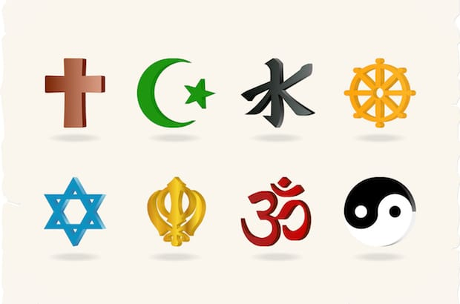
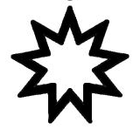
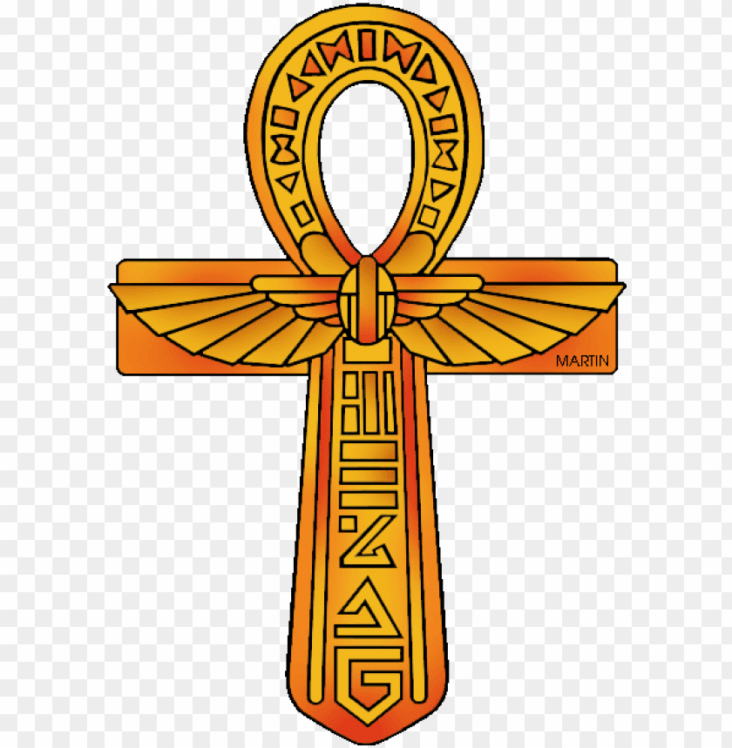
Major Religions of South Africa
Notes:
Individual Activity (5 min)
Well done! Take a look at this slide. Can you identify the names of these religions? Record the name of the religion next to the symbol in Activity 1 (Lesson 1 – Worksheet). Write ONE fact you know about each of these religions on your worksheet. (Allow 5 min)
Judaism
Christianity
Islam
Buddhism
Hinduism
Bahai
African Traditional Religions

Slide 4
Major Religions of South Africa
Judaism
Christianity
Islam
Buddhism
Hinduism
Bahai Faith
African Religion
Notes:
Individual Activity (3 min)
Note to teacher: This slide includes animations. Each click will reveal the name of the religion. Encourage learners to make corrections on their worksheets.
Let’s see how many of you identified the religion correctly. Make corrections on your worksheet.

Slide 5

Group Activity
Notes:
Group Activity (12 min)
Note to teacher: If you are teaching more than one class, it might be helpful to allocate a place on your class wall for the responses to this activity. The two classes will learn from one another.
We mentioned earlier that it is in understanding these different religions that we learn from their beliefs/ practices. This, in turn, can positively influence our beliefs and practices.
Hand out the Lesson 1 – Religions Info Sheet. In your groups, you will quickly need to read through the information about the different major religions in South Africa.
Then you need to complete Activity 2 (Lesson 1 – Worksheet) on the poster (Lesson 1 – Poster) provided. Use the questions on your worksheet to guide your creativity.

Slide 6
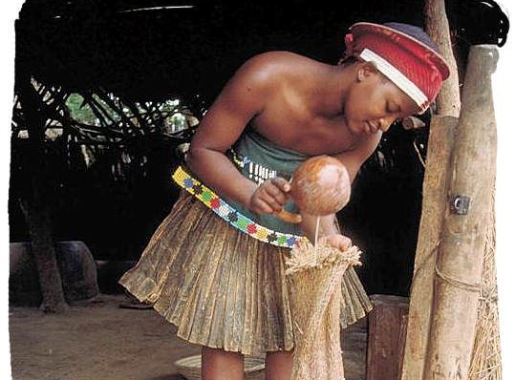
ORIGINS & PRACTICES OF INDIGENOUS BELIEF SYSTEMS IN SOUTH AFRICA.
Did you know these religions have been around for about 1500 years?
[Source: https://arcuyo.blogspot.com/p/tudumishe-uasili-wetuutamaduni-wetu.html?m=1 Accessed on: 17 September 2024]
Notes:
Teaching (4 min)
Before South Africa was colonised there were different indigenous groups that already had a belief system. Yes, over the years they have been influenced by Christianity, Islam, and Judaism but many African people still hold onto their religious "African roots" and traditions.
Let’s briefly take a look at the origins of the indigenous belief systems. These religions have been around for about 1500 years. Many of these indigenous belief systems are built around the traditions of stories told by the elders in the tribes. These oral traditions are passed on and followed. These elders are respected and very important in the tribe.

Slide 7
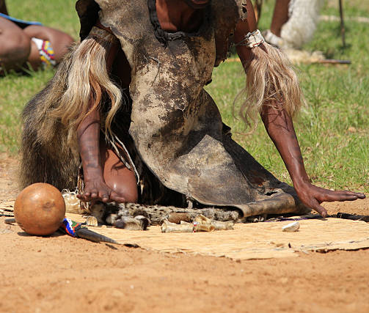
Spiritual Leaders &
Ancestors
[Source: https://www.sacap.edu.za/blog/applied-psychology/traditional-medicine/ Accessed on: 17 September 2024]
Notes:
Teaching (2 min)
Spiritual leaders & Ancestors: Sangomas are seen as spiritual leaders. They believe they are called by their ancestors to learn how to use herbs for healing and how to tell what will happen in the future. During special events like weddings, the ancestors are honoured by slaughtering a cow or sheep.

Slide 8
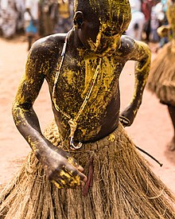
Followers
[Source: https://commons.m.wikimedia.org/wiki/File:Koku_Dancer.jpg Accessed on: 17 September 2024]
Notes:
Teaching (2 min)
Followers believe in wearing charms or bracelets to help protect them from evil or to bring good luck. Peace is important in the tribe. Family heads and political leaders in most African societies are peacemaking. This includes settling arguments and offering prayers.

Slide 9
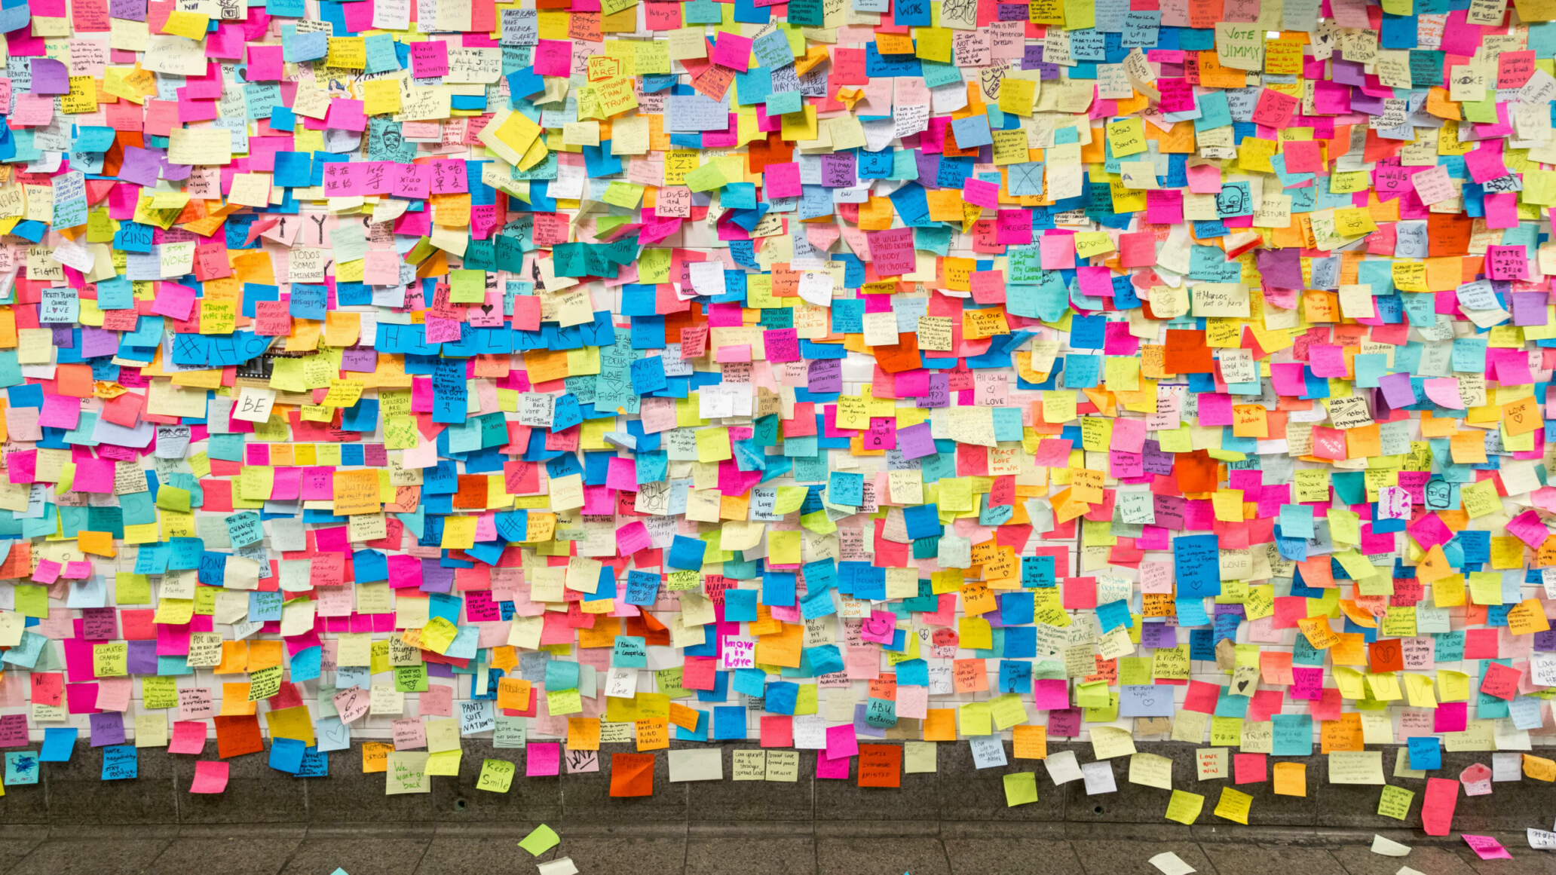
[Source: https://www.digitallearningmap.nhs.scot/the-training-evaluation-toolkit/tools-to-measure-reaction/ Accessed on: 17 September 2024]
Notes:
Reflection: Graffiti Wall (4 min)
Note to teacher: This graffiti wall would be a lovely reflective space for learners to read one another’s comments and questions. You could use the questions to start the next lesson. You could cut scrap paper into squares and have learners write on it or use pre-bought Post-it notes. This reflective space will be added in each lesson. It would be helpful to have three different colours of paper for each lesson or have three separate headings on your wall for learners to respond to.
Lesson 1: Religions in South Africa
Lesson 2: Sports Coverage in South Africa
Lesson 3: Unfair practice in sport
In this lesson, I believe some of you have learnt something about other religions that you didn’t know before. It’s important for us to reflect and think of how we have been positively influenced by what we have learnt from other religions In this final activity, you will reflect on an ethical/moral (what you believe is right or wrong or important) way of living that has inspired you from today's lesson. Allow learners to complete Activity 3 (Lesson 1 – Worksheet).

