Slide 1


Notes:
Recap Activity (5 min)
Welcome Grade 10s, to the last lesson in this series on Democracy and Human Rights. It’s been an exciting year with the Olympics and coverage of many different sporting codes. I wonder how many of you were following the Olympics and the conversations around gender equality? This year the Olympics in Paris took pride in the fact that male and female sports received the same sports coverage time online.
Let’s see how many of you can remember what we learnt in the last lesson.
Turn to a person in your group, pick TWO of these terms and give an example/description of the term (give only one sentence per term, it shouldn't be a long discussion).
Example: I’ve noticed gender bias in the sports coverage of women’s tennis, where more attention is given to their outfits than their athletic performance.
Gender bias
Racial prejudice
Sports code
Sports coverage
Well done class! It’s great to hear the discussion and how well some of you remember from the previous lesson. Today we will look into the “dark side” of sports coverage. We have seen how prejudice is an example of one of many unfair practices in sports. Today we will look further into how people act unethically in sports.
Let’s get started.

Slide 2

Unfair Practices in Sports
DRUG- TAKING
Notes:
Group Activity (7 min)
There has been an increase in performance-enhancing drugs (PEDs) in both professional and school sports. Some athletes feel that the pressure to perform is too high which leads them to use these drugs. Another term for these PEDs is steroids, which help people build muscles. There are also PEDs which increase stamina and stop athletes from getting tired.
In your groups discuss drug-taking in sports. Refer to the questions in Activity 1 (Lesson 3 – Worksheet). Choose a spokesperson to summarise your group's responses. (Allow 4 min for discussion and 3 min class feedback.)
Well done class and thank you for your insight and feedback. We have certainly seen an increase in teenagers using supplements like shakes and vitamins to build muscle. While these supplements are not classified as drugs, some teens may find them insufficient and begin experimenting with steroids to achieve their desired results.
The reality is that, although performance-enhancing drugs (PEDs) might seem less harmful compared to other substances, long-term use can lead to addiction and serious side effects. For instance, some women who use steroids may experience elevated testosterone levels, which can result in increased body and facial hair and disrupt their menstrual cycle.

Slide 3
Side effects of Anabolic Steroids
MEN MAY DEVELOP:
Prominent breasts
Shrunken testicles
Infertility
Prostate gland enlargement
Notes:
Teaching (1 min)
Note to teacher: These three slides include animations to visually engage the learners.
Let’s take a look at some of the dangers of taking anabolic steroids. Did you know that: (click on slide)
Men may develop: (click on slide)
Prominent breasts
Shrunken testicles
Infertility
Prostate gland enlargement

Slide 4

Side effects of Anabolic Steroids
WOMEN MAY DEVELOP:
A deeper voice, which may be irreversible
An enlarged clitoris, which may be irreversible
Increased body hair
Baldness, which may be irreversible
Infrequent or absent periods
Notes:
Teaching (1 min)
(click on slide)
Women may develop: (click on slide)
A deeper voice, which may be irreversible
An enlarged clitoris, which may be irreversible
Increased body hair
Baldness, which may be irreversible
Infrequent or absent periods

Slide 5
Side effects of Anabolic Steroids
BOTH MEN AND WOMEN MIGHT
EXPERIENCE…
Severe acne
Increased risk of tendinitis and tendon rupture
Liver abnormalities and tumours
High blood pressure (hypertension)
Heart and blood circulation problems
Notes:
Teaching (3 min)
(click on slide)
Both men and women might experience: (click on slide)
Severe acne
Increased risk of tendinitis and tendon rupture
Liver abnormalities and tumours
High blood pressure (hypertension)
Heart and blood circulation problems
As well as:
Aggressive behaviours, rage or violence
Psychiatric disorders, such as depression
Drug dependence
Infections or diseases such as HIV or hepatitis, if you're injecting the drugs.
Inhibited growth and development, and risk of future health problems in teenagers.

Slide 6

Notes:
Individual Activity (6 min)
You will now have the opportunity to reflect on what you have learnt by completing Activity 2 (Lesson 3 – Worksheet).
Possible answers are available on the Lesson 3 – Worksheet MEMO.

Slide 7
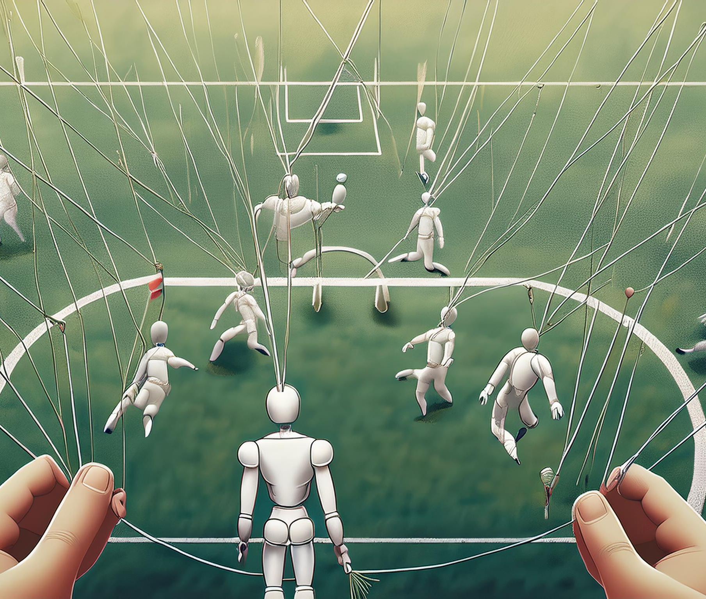
Unfair Practices in Sports
MATCH FIXING
SUBJECTIVE UMPIRING
MALADMINISTRATION
Notes:
Teaching (4 min)
Note to teacher: This slide includes animations to enhance learning.
Let us discuss THREE other forms of unfair practices in sports. (click on slide)
Match fixing: Match fixing occurs when players deliberately perform poorly to influence the outcome of a game, often to benefit those who have bet on the player or team. This practice is both unfair and unethical, as it undermines the principle of fair competition that is central to the integrity of the sport. (click on slide)
Subjective umpiring: This occurs when a referee fails to take appropriate action in a game which can lead to injuries or unfair disadvantages of players. This situation can escalate if the team reacts aggressively, potentially resulting in a fight. For example, in soccer, if one player is sent off for a serious high boot, but a similar incident by another player goes unpunished, it demonstrates a lack of fairness. Officials should always be fair and consistent in their decisions to ensure equal treatment for all players. (click on slide)
Maladministration in sport: Maladministration occurs when those responsible for managing a sport fail to do so properly. This includes the misuse or waste of funds, poor planning of sporting events that jeopardise the safety of players and spectators, and instances of corruption for personal or corporate gain.

Slide 8

How to become a critical analyst of sports coverage?
Ask yourself…
What did I find in the media about sports coverage?
How does this support my viewpoint?
Have I found evidence of bias or prejudice in sports?
Does being critical change the way I view sports?
Notes:
Teaching (5 min)
As we come to the end of this lesson series, we can see that the media can be affected by unfair practices and bias. As an individual, you must learn to analyse and critically evaluate the information presented by questioning what you see in the media.
Let’s take a moment to define HOW you can become a critical analyst of sports coverage in the media: Analysing and evaluating requires you to do research and gather evidence to support your argument. You can find this evidence by cross-referencing different sports news outlets or articles, as well as posing questions on different social media platforms. (click on slide)
Ask yourself: (click on slide)
What did I find in the media about sports coverage?
How does this support my viewpoint?
Have I found evidence of bias or prejudice in sports?
Does being critical change the way I view sports?
Once you’ve done all this research, present a critical argument with your evidence. If someone else opposes your viewpoint, take time to listen to them and carefully evaluate what they have said. Stay calm, do not argue! Try to counter their responses with evidence.

Slide 9

Notes:
Group Poster & Sentence Reflection (8 min)
Note to teacher: This slide will end the lesson but there is a group reflection and an individual response for learners to complete. Arrange a space on your graffiti wall to include their posters. Learners will need to walk and read some of the comments on the wall and then reflect individually in their workbooks/worksheets.
Hand out Lesson 3 – Poster to each group.
As we come to the end of this lesson series, consider everything you have learnt on bias in sports coverage and unfair practices in sports. As a group, use the Lesson 3 – Poster to list EIGHT rules that could be implemented in a school environment to address unfair practices in sports. Once completed, add your poster to the graffiti wall in your class and look at the other posters to see what your peers have written. (Learners can refer to Question 3.1 in Activity 3 (Lesson 3 – Worksheet) for this activity.)
Once you have completed this activity, you need to complete Question 3.2 in Activity 3 (Lesson 3 – Worksheet) individually.
Hand out the Content Summary to the learners before they leave the classroom.

