Slide 1


Notes:
Introduction (3 min)
Note to teacher: The first activity is designed to introduce the learners to the concept of a dilemma and the need to make choices under difficult circumstances. At the start of the lesson ensure that each learner has 15 post-it-sized scrap pieces of paper on which they can write a word or a phrase. There is no need to give a detailed introduction or context to the learners as their responses should be authentic.
Welcome back Grade 11's! Last week we looked at various religious and belief systems in South Africa and how they can lead to a more harmonious society.
We ended the last lesson by looking at some reflective questions (Activity 3, Lesson 1 – Worksheet). Question 3.3 asked: Describe TWO ways in which religious groups can contribute towards caring for the needy in your community.
How did you respond to this question? Turn to the person next to you and briefly share your response with them.
In today’s lesson, we will look at the concept of making choices under difficult circumstances. It is important to note that the most difficult decisions that we need to make are often contextual, which means that many factors need to be considered when making those decisions.

Slide 2

Introductory Activity
Notes:
“Crumpled Favourite” Activity (10 min)
Note to teacher: This is an example of experiential learning. The aim is to allow learners to engage with the story which might result in a bit of noise. Allow the process as it will add to the value of the lesson.
On their 15 post-it-sized pieces of paper that were handed out to them earlier, ask the learners to write the following: (Each sticky note should have only ONE word/phrase on it.)
FIVE of their favourite people (stress to them that these should be people in their lives, not celebrities or influencers).
FIVE of their favourite possessions (their own, not the hypothetical Lamborghini in the garage).
FIVE of their favourite activities that they enjoy doing (again, it must be personal).
Tell them the following: Imagine you’re in one of those end-of-the-world movies like Independence Day, World War Z or The Day After Tomorrow: "Global warming has heated the planet and the sea levels are rising drastically. Soon the area in which you live will be flooded and there is not enough space to live comfortably. You must choose five people, things, or activities that you will leave behind."
Ask the learners to crumple up the five least important pieces of paper.
(Make sure that they crumple up the paper and send around a dustbin in which to throw it away.)
Continue: "The water levels are still rising and the remaining people are being moved to a separate location. You must sacrifice five more people, objects or activities in order to proceed.
Ask the learners to crumple up five more (less important) pieces of paper.
(Again they must throw the pieces of paper away.)
Continue: "There is extremely bad news – it looks as if all the land surface area will shortly be flooded, but two large ships are being sent to rescue all survivors and their possessions. However, of your remaining five pieces of paper, you must choose the TWO most important and get rid of the other three."
Ask the learners to crumple up three more pieces of paper.
(These must be thrown in the dustbin.)
Continue: "Oh no! On the way to the rescue point, one of the ships hit an iceberg and sank. You must now choose between your two options. ONE must be kept and the other must be discarded. The only person, object or activity that you can take is what is on that piece of paper."
Ask the learners to throw away the 2nd last piece of paper. Allow learners time to process this decision, some might struggle to make that decision. As they have completed this, reassure them that this is a hypothetical simulation.
Share with the person sitting next to you what is on the remaining piece of paper. Tell your partner why you made that choice.
Ask the learners the following debriefing questions:
As the activity progressed, did the choices become easier or more difficult?
If anyone wants to share, what was the most difficult thing to give up?
The object of the activity was to highlight the concept of choice. In a democratic society, the right to choose is fundamental. The right to make our own choices is also extremely difficult and has consequences for other people. In the activity, this might have meant that some people would have died, so the choices that we make are never meant to be made lightly.
The second aspect that the activity demonstrated is that we will make our choices based on the values that we believe are important. Some people might have chosen to keep their favourite pair of shoes and discard their mothers. Some might have chosen the gym above their brother or sister. What people hold to be the most valuable is what they choose to save. This might be an indicator of their personal value systems.

Slide 3
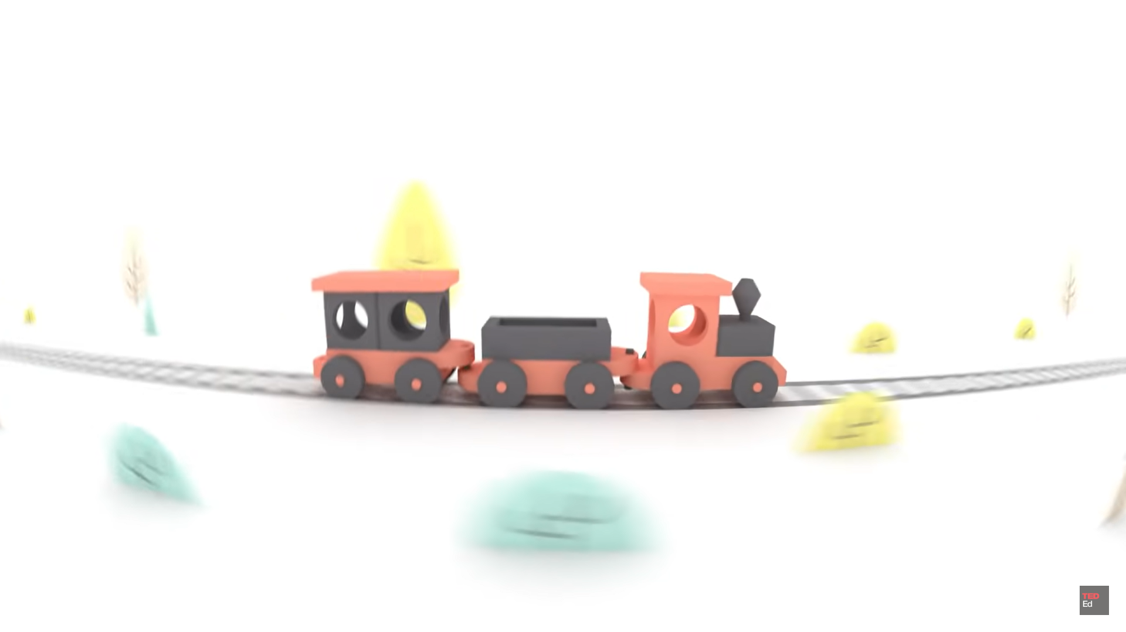
What is a dilemma?
Watch: Would you sacrifice one person to save five? - Eleanor Nelsen https://www.youtube.com/watch?v=yg16u_bzjPE (2 min 20 sec)
Notes:
Watch Video & Activity (6 min)
Watch: Would you sacrifice one person to save five? - Eleanor Nelsen https://www.youtube.com/watch?v=yg16u_bzjPE (Watch only the first 2 min 20 sec)
This clip illustrates the basic elements of a moral or ethical dilemma. It is important to note that most often in this type of scenario, there is no completely positive solution. The person making the decision should make the decision that is “most right”.
After watching the video, learners are to complete Activity 1 (Lesson 2 – Worksheet) (Allow 5 mins for completion).
Possible answers are available in Lesson 2 – Worksheet MEMO.
Note to teacher: If you have time available, you can pose the following question or a variation thereof: Using the runaway train scenario, if you knew that the five railway workers were part of a convict work party, and the single person on the other track was an army veteran/heart surgeon/parent of small kids, how would that influence your decision?

Slide 4

Let’s Discuss…
Lying/white lies
Euthanasia
Right to life
Lobola
Initiation
Arranged Marriage
Notes:
Teaching (5 min)
Note to teacher: The following content is preparation for the Group Activity to follow. Ensure learners are in groups of FOUR to SIX (depending on class size).
We will now look at six spiritual issues/dilemmas that are prevalent in today's society. They are
Right to life
Euthanasia
Lying/Deception
Paying lobola
Cultural initiation
Arranged marriages
The right to life is the belief that a human has the right to live and should not be killed by another entity. The right to life essentially means that you have the right not to be killed, or not to have the quality of your life diminished in such a manner that it would be a huge impediment to this right.
Euthanasia is the intentional act of painlessly ending the life of a person or animal to relieve suffering from an incurable or terminal condition. It can be voluntary, with the consent of the individual, or involuntary, without their consent, and is a subject of ethical and legal debate. Currently, euthanasia is illegal in South Africa.
Telling a lie is generally wrong as it undermines trust and integrity. However, in rare cases, such as to protect someone from harm or to maintain privacy, it might be considered morally permissible. The ethicality of lying depends on the context and the consequences of the lie.
Lobola is a traditional South African custom involving the transfer of cattle or other valuable items from the groom's family to the bride's family as a bride price. This practice signifies the groom's commitment and respect, strengthens family ties, and compensates the bride's family for the loss of her labour and presence.
Initiation in South African culture refers to traditional rites of passage marking the transition from childhood to adulthood. It involves ceremonies, rituals, and teachings that instil cultural values, social responsibilities, and identity. These practices, often gender-specific, vary among ethnic groups and are deeply rooted in ancestral customs.
An arranged marriage is a union where families, rather than the individuals themselves, select the partners. This tradition, prevalent in many cultures, often considers social, economic, and familial compatibility. Though participation varies, some modern versions allow the individuals to consent or reject the proposed match.
Each of these dilemmas has a negative side, but also a positive motivation that can be applied. As a group, you will be expected to consider both sides of the argument.

Slide 5





Critically analysing an issue
Recognise the issue.-
Define the problem
Who does it impact?
Laws, facts, principles
Courses of action
Notes:
Group Activity (10 + 4 min)
Before discussing these issues, it is important to understand how to effectively critically analyse a moral dilemma. When critically analysing a moral issue, it is important to approach the issue systematically.
You must recognise that there is an issue and that it is never simple or one-sided.
Define the problem as you understand it.
Who does the issue impact and who is involved? (This implies that even if someone's rights are violated and it doesn't directly impact us, we still have a responsibility to act.)
Consider what laws may say about the issue, what facts there are about the dilemma, and what moral principles are involved.
Try to find a course of action that most upholds the greater good. (Remember the trolley dilemma.)
Hand out ONE Case Study to each group (from Lesson 2 – Case Studies).
In your groups, you will look at a different case study or scenario. Be sure to nominate one person to present your group’s discussion to the rest of the class.
Answer the questions in Activity 2 (Lesson 2 – Worksheet) based on your specific Case Study.
Once learners have completed the activity, allow the groups to give feedback to the class. (Allow 4 min for feedback.)
Possible answers are available on Lesson 2 – Worksheet MEMO.

Slide 6
Respecting the opinions of others
Recognise differences
Listen with empathy
Self-monitor – particularly before you speak
Treat everyone as equal
Notes:
Reflection (2 min)
Based on today’s lesson you might have come across opinions that are very different from yours. Our goal should always be to live in a community where we respect the opinions of others and always seek to understand their perspectives. Here are four basic things that you can do to respect the differences in others’ opinions.
Recognise differences
Listen with empathy
Self-monitor – particularly before you speak
Treat everyone as equal
A wise man once said, “You can be as good as the best of people, but remember, you can also be as bad as the worst.”
In Activity 3 (Lesson 2 – Worksheet), list THREE actions you can take this week to gain a deeper understanding of individuals who hold different views on cultural practices than your own.
Possible answers are available on Lesson 2 – Worksheet MEMO.
Hand out the Content Summary at the end of the lesson.

