Slide 1
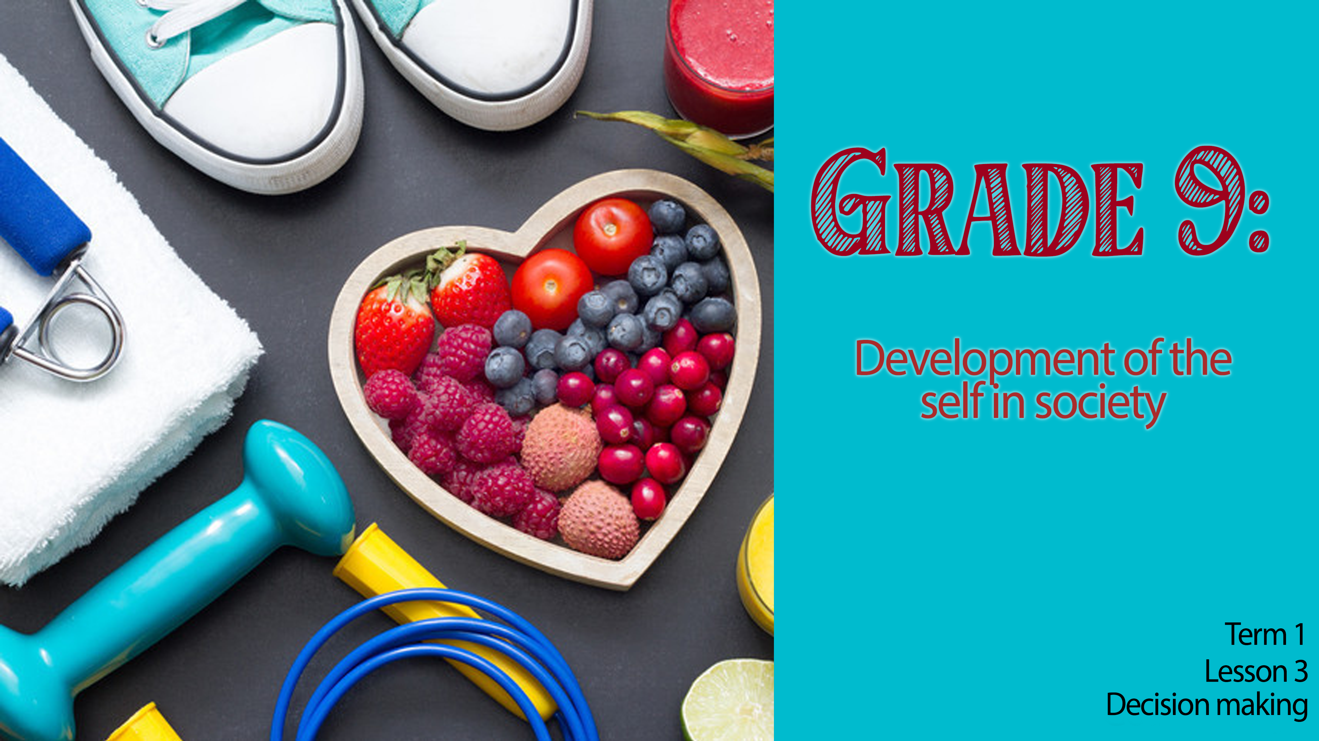

Notes:
Good day Grade 9’s! Welcome back to the final lesson in this series on lifestyle choices. In the last lesson you completed Activity 3 where you answered questions on the impact of media on your choices. We’re going to take a few moments for you to look at the answers to those questions and comment on your own Lesson 2 - Worksheet.
In this time work through the Activity 3 answers (Lesson 2 - Worksheet MEMO) with the learners and allow them an opportunity to correct their work. Don’t spend longer than 5 min.
Hand out copy of Lesson 2 - Worksheet MEMO – for learners to refer to when 5 min is up.
Today we will look at how to make informed decisions and how to be confident and firm in making them. This will help you stay true to yourself rather than folding under the pressures of fitting in with your family, community and friends that might have a negative influence on you.
Let’s get started!

Slide 2

Informed decision-making skills
Informed decision-making skills
R | Recognise the problem and what options you have.
E | Educate yourself on all the possible choices you have.
L | Listen to other people’s advice and learn from your past experiences.
A | Act according to your priorities.
X | Expect the unexpected. If your decision does not have the outcome you planned, look at your options.
Notes:
Today we are going to focus on learning about the skills needed to make difficult decisions and then how to be assertive and communicate your choice to the person.
We will encounter the following terms in today’s lesson. Namely:
Priorities: the things that you value most.
Assertive: stand up for oneself, confident, insist on one’s rights without being disrespectful.
When you are confronted with making a decision, it is better to consider your options carefully without making an impulsive decision. You should RELAX before you decide.
Lets look at what each of these letters mean.
R- Recognise the problem and what options you have.
E- Educate yourself on all the possible choices you have.
L- Listen to other people’s advice and learn from your past experiences.
A- Act according to your priorities
X- Expect the unexpected. If your decision does not have the outcome you planned, look at your options.
Allow learners 2 min to add this acronym to their Lesson 3 – Worksheet in Activity 1.

Slide 3
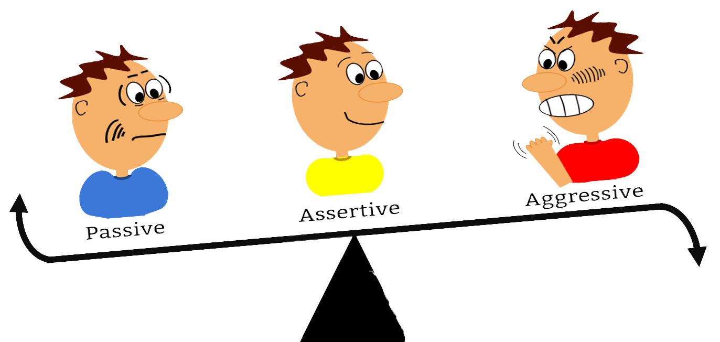
BE AWARE!
BE ASSERTIVE!
BE CONFIDENT!
Notes:
Once you have decided there will come the moment that you need to communicate your decision. This can be very uncomfortable and sometimes we try to avoid the person. However, if you can choose to be assertive rather, you will be able to communicate clearly what you have decided. Remember that we make decisions based on the information we have in that moment. We can never be sure of what the outcome will be. We can however choose how to handle the situation. Use the following tips when you have to stand firm in your decision.
Teacher Note: Explain each point that’s on Slide 3 (Take time to make sure the learners understand each concept)
Be confident- you need to trust yourself and stick to the choices you make. That way, those around you won’t be able to sway you so easily.
Be aware- know the limits and disadvantages as well as the advantages of your choices.
Be assertive- If you are confident, you’ve made the right decision then stick to it. Don’t allow unnecessary worries to make you change your mind. Speak clearly and communicate in a firm clear voice.
Let us try practice with a few scenarios:
Look at the examples of accusing language in Activity 2 (Lesson 3 – Worksheet) and see if you can change these to assertive language.
Learners to use the cues in Activity 2 to practise their assertive responses if they were put in the challenging scenarios.
Take time to think about how you would respond and write it down in the space provided.
If time allows, learners can practise / demonstrate their responses verbally by focussing on body language and tone of voice. Teacher may step in and help learners adjust their choice of words, body language or tone.
Answers for Activity 2 are provided in the Lesson 3 – Worksheet MEMO.

Slide 4

Notes:
As we draw this section to a close, now would be a great opportunity to see if you understand the content we have covered over the last three lessons.
You will now have 15 min to complete Activity 3 in the Lesson 3 – Worksheet. These questions are similar to the kind of questions you will see in a test for LO this year.
(Allow learners to work quietly for 15 min to complete Activity 3.)
Answers for Activity 3 are provided in the Lesson 3 – Worksheet MEMO.
Hand out Content Summary to learners

Slide 5

R E F L E C T I O N
Notes:
We have come to the end of this lesson and this series We have worked through goal setting over the last few weeks and making positive lifestyle choices. Today you learnt how to make decisions in difficult circumstances
Take a few moments to answer the reflection questions on Activity 4 on Lesson 3 – Worksheet
Sometimes we find it difficult to be assertive because we struggle with some of the following:
Fear of displeasing our friends
Fear of being laughed at
Fear of being rejected
Which of these points would you say you struggle with? How could you overcome this fear?
Consider a situation in your own life recently where you had to decide about lifestyle choices. Reflect on your decision. Did you make the right decision? What would you have changed now that you know the RELAX method?
Teacher Note: Encourage the class to be quite in this time. It might even help to play music. Tell the class to remain quite until you say they can talk.
There are no memo answers to these questions.

