Slide 1
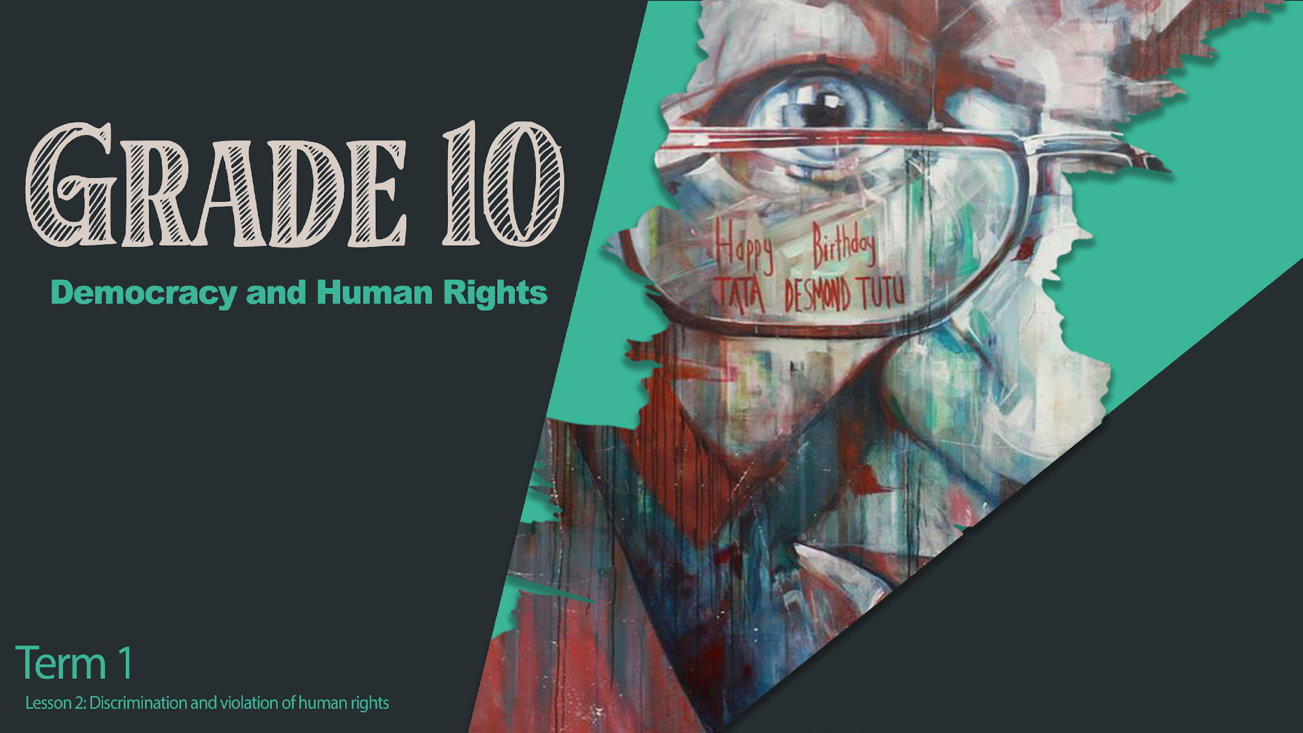
Notes:
Welcome back, Grade 10s! In the last lesson we discussed the concepts of Discrimination and Human Rights Violations and we looked at the importance of why it is so necessary to stop discrimination based on contexts such as Race; Religion; Language; Gender; Sexual Orientation and HIV/Aids Status.
We also learnt more about the Bill of Rights, The Convention of the Rights of a Child and CEDAW (The Committee on the Elimination of Discrimination against Women).
Today we will be looking at what discrimination looks like, ask questions as to why these behaviours come about and then also reflect on the impact of these behaviours on individuals and the society as a whole. As we proceed with the lesson, always reflect on how you as an individual can help those who are being targeted through discriminatory behaviour.

Slide 2


At the end of the lesson, you should be able to:
Know and talk about types of discriminating behaviour which violate human rights.
Explain why people are biased and prejudiced and why they act on these prejudices.
Think about and discuss what the effect of human rights violations are.
Notes:
At the end of this lesson, you should be able to:
Know and talk about the types of discriminating behaviour which violate human rights.
Explain why people are biased and prejudiced and why they act on these prejudices.
Think about and discuss what the effects of human rights violations are.

Slide 3
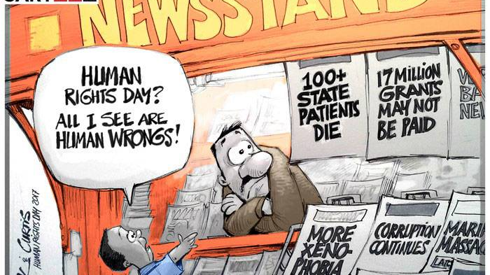

Notes:
Complete Activity 1 (Lesson 2 – Worksheet). Have a look at the cartoon – Identify FIVE types of discrimination being highlighted by the news headlines at the news stand. Check your answers with a partner to see if you got them.

Slide 4

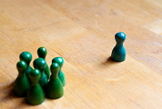
Fair vs Unfair Discrimination
Try to think of three examples where discrimination might be seen as fair and then try to think of three examples where discrimination might be seen as unfair.
Notes:
Broadly, discrimination means that people are treated differently. Sometimes there is a fair reason for different treatment of people and at other times the treatment can be unfair.
Fair discrimination might redress the injustices of the past or look to adjust imbalances in society. Ultimately this will be for the benefit of all members of society.
Unfair discrimination is unequal or abusive treatment based on unreasonable prejudice.
In your pairs, try to think of three examples where discrimination might be seen as fair and then try to think of three examples where discrimination might be seen as unfair.
Complete Activity 2 (Lesson 2 – Worksheet)
Fair could be:
Redressing imbalances by giving people opportunities that they did not have in the past.
Sports teams are required to be representative of the community they come out of.
BBEEE - Companies are required to employ and partner with previously disadvantaged people to create more opportunities.
Unfair could be:
Xenophobia - Treating foreigners as though they have no right to live in South Africa and work here.
Sexism - Reserve employment based on gender rather than skill.
Prejudice – Treating people with a disability as though they cannot do a job that they are qualified for.

Slide 5
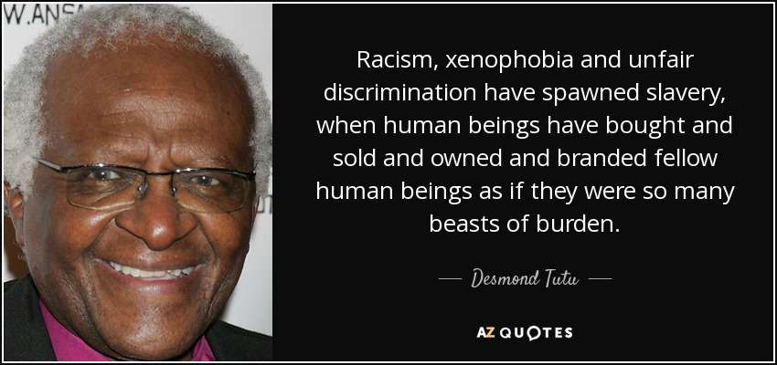
Notes:
Slavery was seen to be the worst crime against humanity and has been rejected by everybody, BUT discrimination in modern society and discriminatory practices, as Bishop Tutu expressed, can be seen as the same as slavery.
Class Discussion:
How do you feel about slavery?
How can prejudice and racism be seen to be similar to slavery?

Slide 6
Discriminatory Behaviour
Xenophobia: Prejudice against refugees and foreign nationals; hatred and fear of foreigners and strangers.
Human Trafficking: The illegal transport of people across international borders and local areas often to enslave people for low-cost labour or the sex trade.
Gender Based Violence: The unfair treatment of people because they are of a different gender/gender identity.
Homophobia: Hatred and/or discrimination of a person because they are of a different sexual orientation to you.
Corrective Rape: The sexual abuse of a person who is part of the LGBTQI+ community with the aim of enforcing conformity to gender stereotypes.
Notes:
Complete Activity 3 (Lesson 2 – Worksheet)
Look at the following definitions of discriminating behaviour and prejudicial behaviour. Focus on the words in bold and reflect on how they make you feel.
Xenophobia: Prejudice against refugees and foreign nationals; hatred and fear of foreigners and strangers.
Human Trafficking: The illegal transport of people across international borders and local areas often to enslave people for low-cost labour or the sex trade.
Gender Based Violence: The unfair treatment of people because they are of a different gender/gender identity.
Homophobia: Hatred and/or discrimination of a person because they are of a different sexual orientation to you.
Corrective Rape: The sexual abuse of a person who is part of the LGBTQI+ community with the aim of enforcing conformity to gender stereotypes.
What would you say to someone who has been subjected to one of these discriminatory actions? On your piece of paper, write down what you would say. Put this up on a wall/board in the classroom to create awareness of these issues.

Slide 7
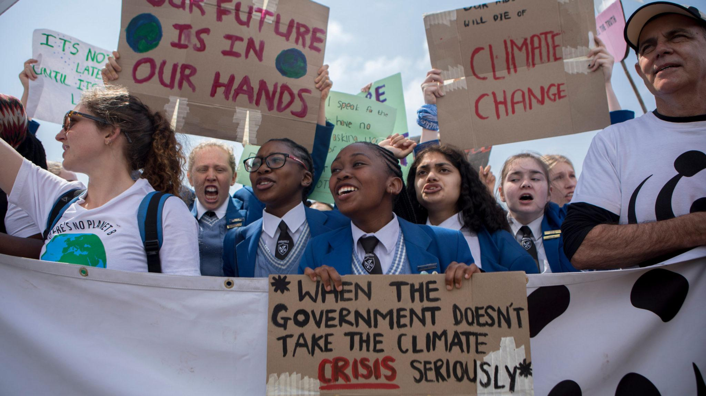
Let's Campaign!!!!!
A campaign is a strategy to bring attention to a particular issue that you want to see changed. In your worksheet is a breakdown of what a campaign entails.
This Photo by Unknown Author is licensed under CC BY-SA-NC
Notes:
In the Lesson 2 - Worksheet (Activity 4) there is a breakdown of what an Advocacy Campaign entails. This is a simple guideline but is a foundation for the knowledge needed in Grade 12.
To effectively plan a campaign, you should:
Decide on the issue that you want to focus on. This could be to target bullying in your school, or to make the school a more open space for people with mobility issues (on crutches or in a wheelchair).
Identify your target audience. In this case it will be your school population (you could direct a campaign at your parent body or local community).
Do research into your topic, understand it in depth because in order to convince others of your cause, you can’t have holes in your argument. You must have correct facts and preferably knowledge that they will not know.
Know what are the desired outcomes for your campaign. What do you want people to do in response to your campaign?
Plan your campaign – a) How do you want to present your message? (In your case – a poster);
b) What resources do you need?; c) What is your timeframe? (How long will your campaign run for?); d) How are you going to make people remember your campaign?

Slide 8

Poster
Decide on an issue relating to human rights that you want to bring to the attention of the school.
In groups of 4 or 5, you are going to plan a campaign poster to present to the class.
Your poster should let the viewer know what the human rights issue is; information / statistics relating to your HR issue; what you as learners at school can do about the issue; and any further details of your campaign.
In three weeks time, you will have an opportunity to present this to your class and evaluate your campaign.
Notes:
In three weeks time, the lesson will start with groups presenting their posters to the other groups in a round robin presentation. Groups should brainstorm topical issues that they can present on their posters. Poster topics must be shown to the teacher as it is preferable not to have groups doing the same topics. Topics should be cleared with the teacher in the next lesson. Note that this will be done in your homework time, and you will have very little time in class.

Slide 9

Group Discussion
Notes:
Each group has been given an article to read through and a set of questions to answer related to that article.

Slide 10
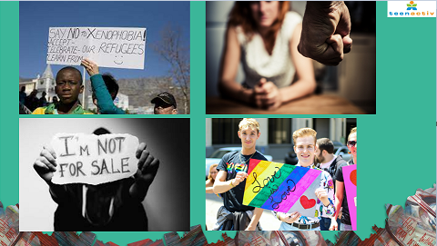
Notes:
Look at the pictures portrayed on the screen (or in Activity 6 of your Lesson 2 - Worksheet).
In the reflection block on your Lesson 2 – Worksheet (Activity 6), write a paragraph on what the impact of these human rights violations would be on the individuals and then also on their families or those closest to them.

