Slide 1

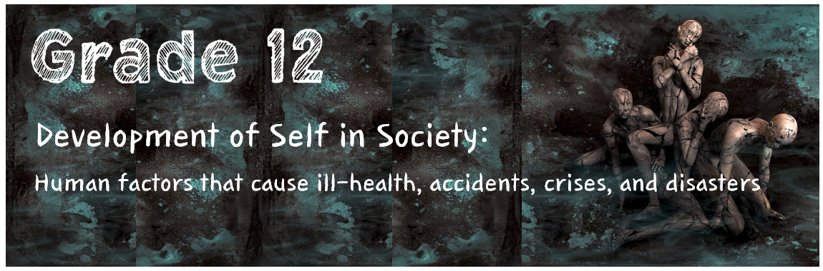
Week 2
Lesson 2 – PowerPoint
Notes:
Welcome learners and allow them to settle in. Following our last lesson we are going to continue by focusing on intervention strategies to deal with lifestyle diseases as well as the need to commit to participate in physical activities for long-term engagement to prevent lifestyle diseases.

Slide 2





Factors Contributing to Lifestyle Diseases
Eating Habits
Lack of Exercise
Substance Abuse
Risky Behaviour
Notes:
Factors Contributing to Lifestyle Diseases:
Lifestyle diseases can happen to anyone – however certain factors can put you at a greater risk for developing any of the conditions we covered last week.
Ask learners to recall some of these factors:
Eating habits: bad eating habits and an unbalanced diet cause ill-health e.g. overweight or obesity.
Lack of exercise is associated with various illnesses such as obesity, heart disease and general lack of well-being.
Smoking/tobacco use is responsible for 80% of lung cancer deaths and is linked to reduced fertility in women, risk of miscarriages, and early/stillbirths. Pneumonia and asthma are aggravated by smoking, and it can cause poor circulation and blood flow.
Substance abuse: Studies show that the smoking of marijuana is linked to mental illness including depression and anxiety, it can suppress the immune system making one more vulnerable to illness and disease.
Unsafe sexual behaviours: Women WHO have early sexual (before the age of 18) and with many sexual partners have a higher risk of developing cervical cancer as well as STIs like HIV and AIDS.

Slide 3



Intervention strategies to deal with lifestyle diseases:
Prevent Adapt Abstain
Notes:
Now, let us take a look at some intervention strategies to deal with lifestyle diseases.
Ask learners to mention strategies that they can think of before sharing the following:
Intervention Strategies:
Protect people from tobacco smoke by banning smoking in public areas, raising taxes on tobacco and using warning messaging about the danger of tobacco use on product packaging.
Educate people on healthy lifestyles, STIs including HIV, early detection, regular screening, and visits to the clinic.
Promote testing for HIV.
Create community awareness about nutrition and promote backyard gardens.
Limit access to alcohol by banning alcohol advertisements and raising taxes on alcohol.
Reduce salt intake by avoiding foods with a high salt content.
Replace trans-fat in food with polyunsaturated fat.
Explain the concept of control and management: If you control something, it means you manage it so that it does not become a crisis or disaster. For example:
To avoid contracting/to control the spread of TB you can open the windows and let fresh air come into your home.
Help and encourage people to follow the treatment instructions and take their medication.
To prevent heart attack or stroke if you have hypertension, you can eat healthy e.g. less salt, less fats and follow a healthier diet.
Do regular physical exercise.
Lose weight.
Stop smoking.
Deal with your stress by applying relaxation techniques.
Ask learners what it means to prevent, adapt or abstain and how these strategies can be implemented to ensure a healthy lifestyle.
Prevention: The best way to prevent or lower the risk of lifestyle diseases is to avoid the bad habits and behaviours that contribute to lifestyle diseases e.g. avoid consuming large amounts of sugar and salt, avoid all tobacco products, etc.
Abstain: The best way to prevent STIs is to abstain (restrain oneself from doing or enjoying something) from sexual intercourse. To prevent lung cancer, abstain from smoking.
Adapt: One may lower the risk of cancer by adapting your diet e.g. lower your meat intake or become a vegetarian; consume products that are high in omega-3 fatty acids such as fish.

Slide 4
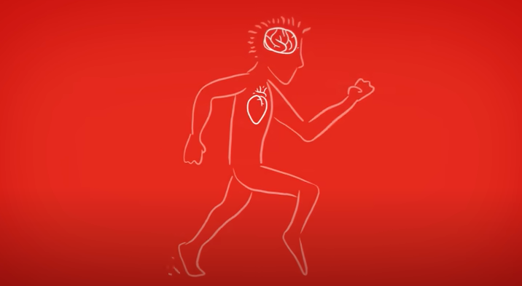

How to EASILY Kick Start A Healthy Lifestyle
WATCH: https://www.youtube.com/watch?v=Y8HIFRPU6pM
(2 min 48 sec)
Notes:
Watch: How to EASILY Kick Start A Healthy Lifestyle
https://www.youtube.com/watch?v=Y8HIFRPU6pM (2 min 48 sec)

Slide 5




Prevention and control of lifestyle diseases
Early Detection
Treatment & Care
Support
Notes:
Prevention and control of lifestyle diseases.
Discuss the following concepts with learners.
Early Detection: The earlier a disease is detected, the more likely it can be cured or managed properly. Early management can save lives and prevent or delay serious complications. Screening tests can be done to detect health problems even before symptoms appear. This can be done through medical examinations or self-examination. For example:
Although hypertension is a chronic disease for which there is no cure, the earlier it is detected, the better one can manage it.
Another example is cancer, where there is good success rate of survival with early detection.
HIV testing can lead to early treatment of those who are infected and may prevent them from spreading the disease to others.
Treatment: Treatment is medical care e.g. surgery, medication and therapy that deals with diseases so that someone can feel better or become healthy again. Treatment aims to cure the disease or to reduce/ease the symptoms. Lifestyle changes such as changing one's diet, exercising, and taking part in activities to reduce stress are usually recommended in combination with medical treatment.
It is important that people have access to treatment and follow their treatment as per recommendation. If the course of medication is interrupted e.g. medication for TB and HIV, one can develop resistance (decrease in effectiveness) to medication and cannot be treated with the said medication.
Care and Support: People must get the correct care and support to continue their treatment programme.
Clinic sisters, social workers, psychologists, and community support groups form part of care and support programmes. Patients’ needs are assessed, and a care plan is created. Patients should be educated about the disease and be referred to the correct services and support groups to help not only the patient but also their families. Organisations are also involved in care and support e.g. South African National AIDS Council which assists in testing and treatment.

Slide 6
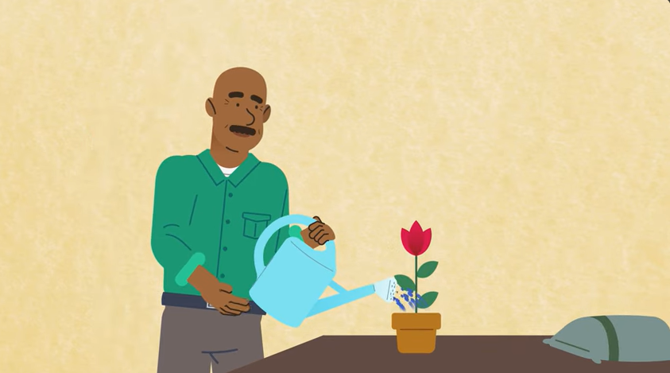
Teens: My Self-Care
Watch: https://www.youtube.com/watch?v=fmpAdsuavOg (2 min 56 sec)
Notes:
A part of intervention strategies is about looking after yourself and your health – we often hear of self-care, but how can we implement that?
Watch: Teens: My Self-Care https://www.youtube.com/watch?v=fmpAdsuavOg (2 min 56 sec)
Ask learners to share if they have any self-care practices that they apply in their daily lives.

Slide 7
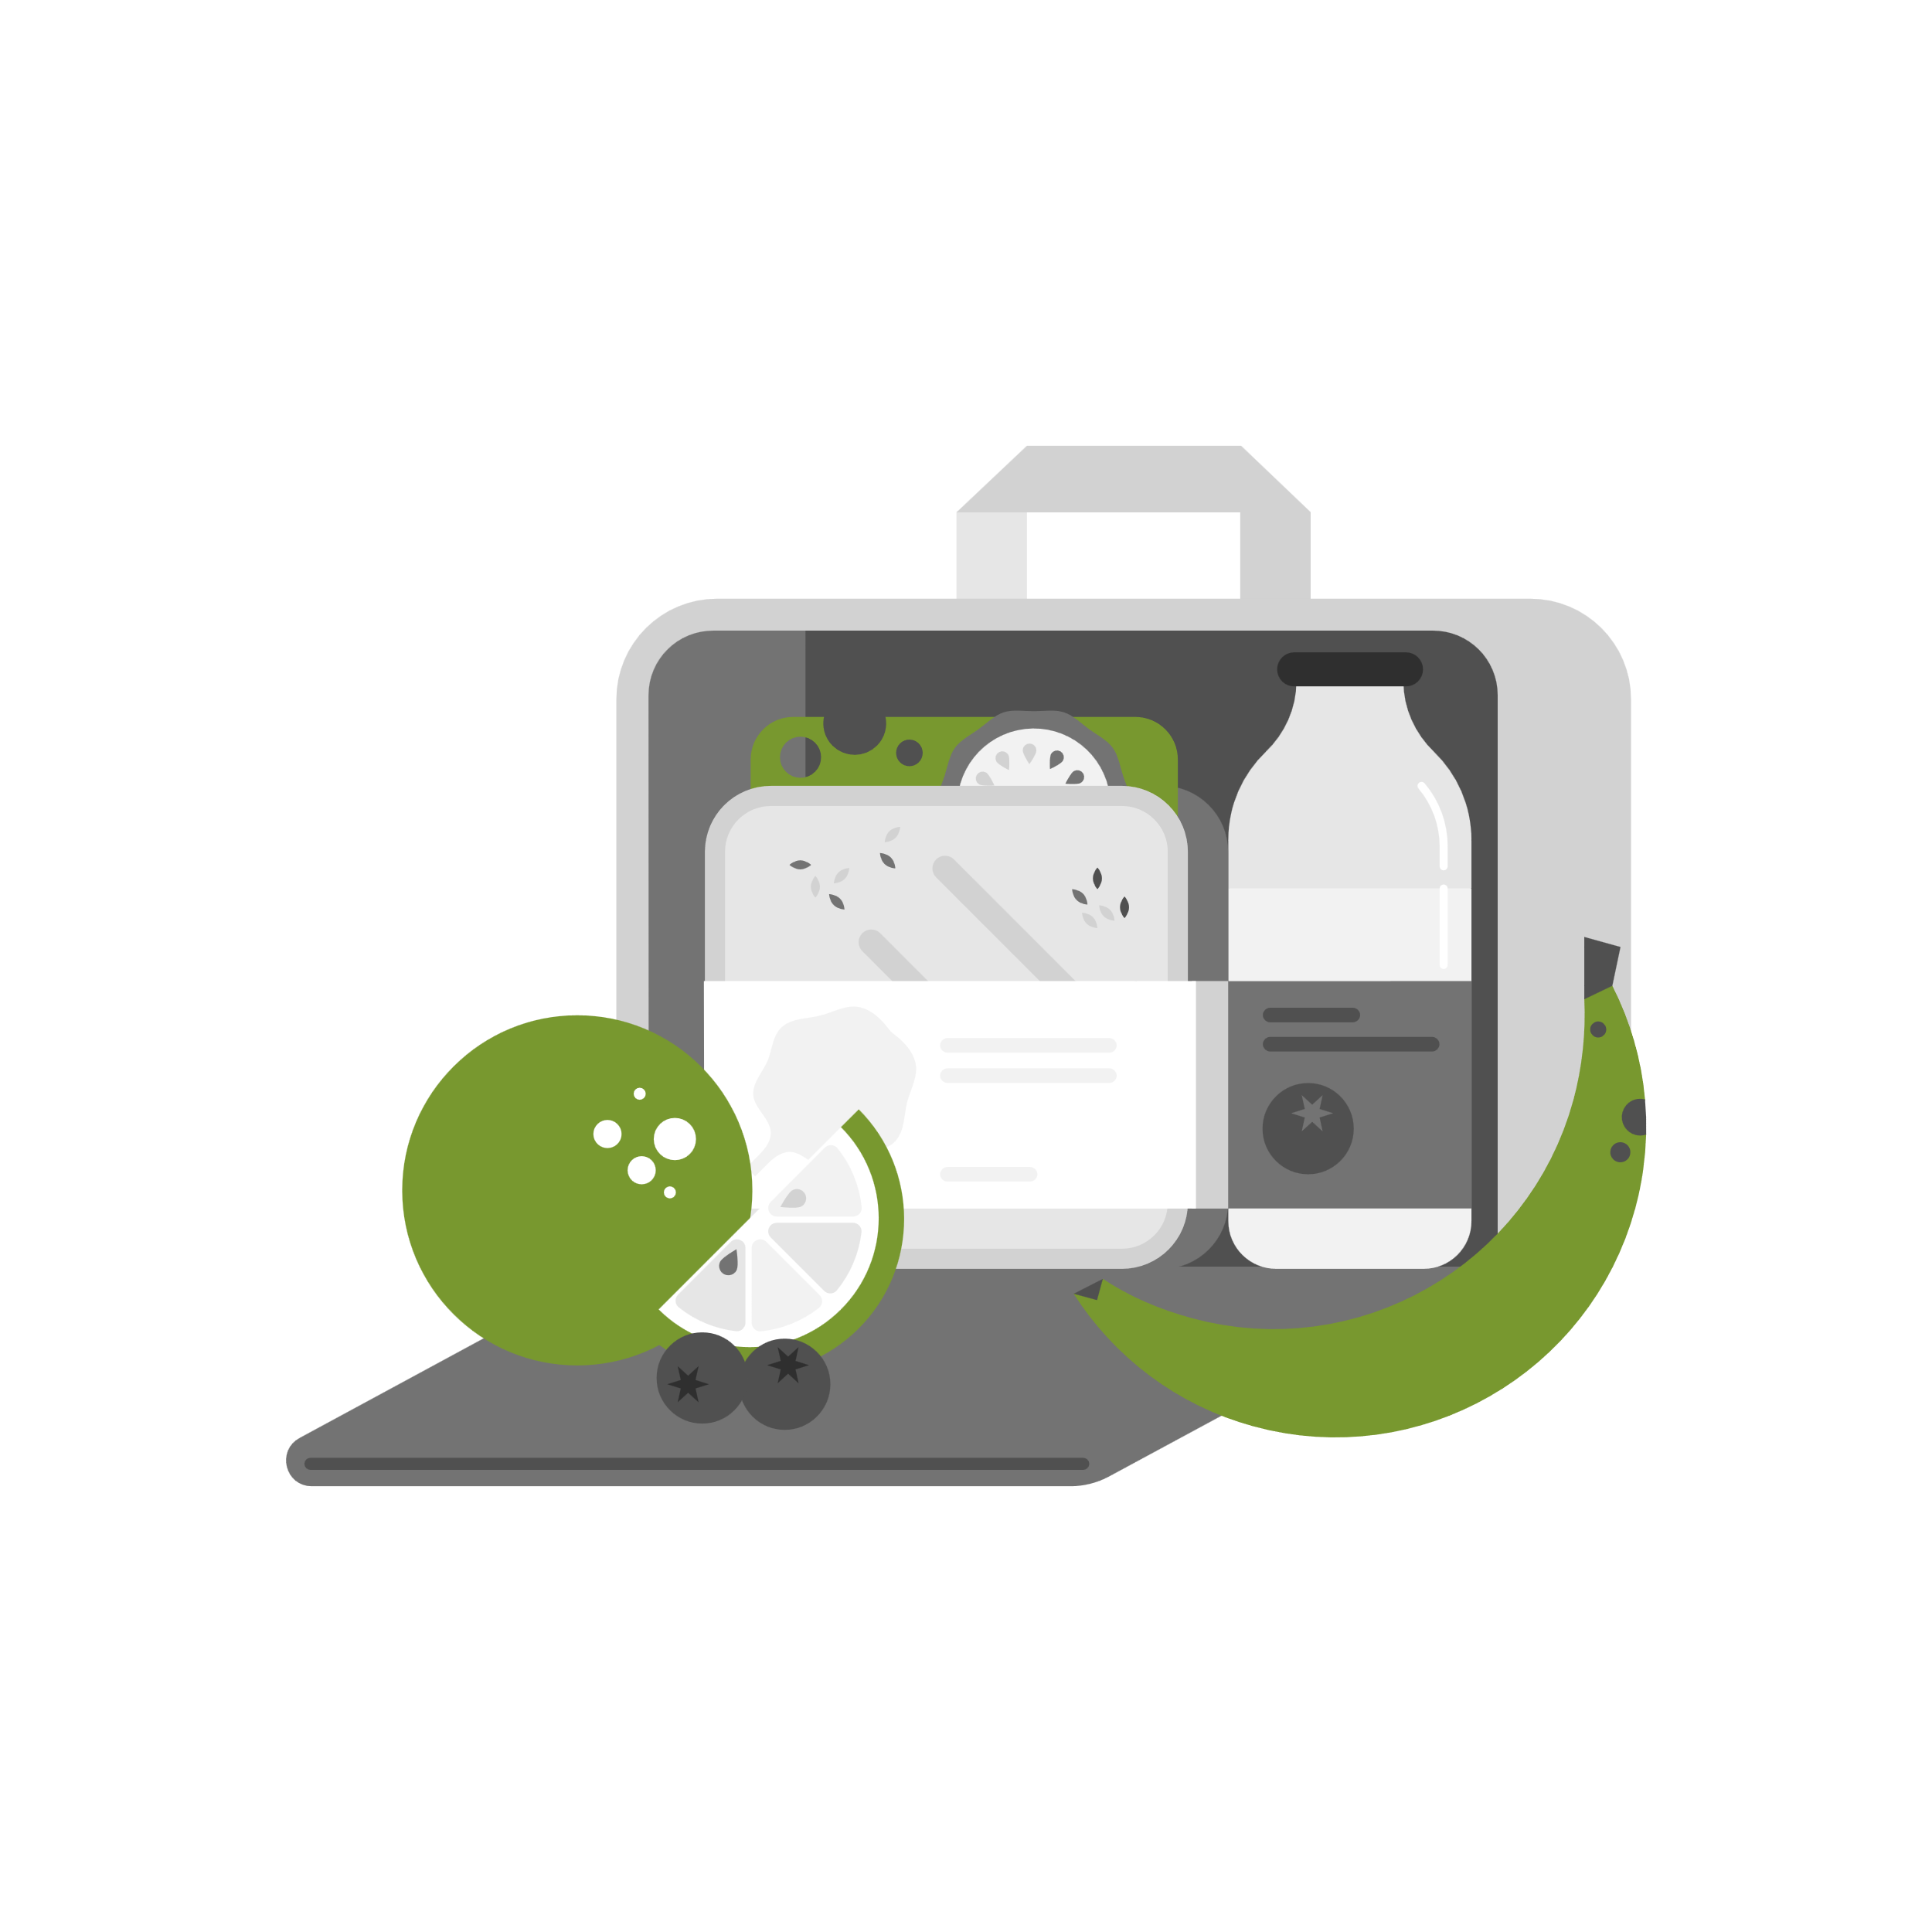
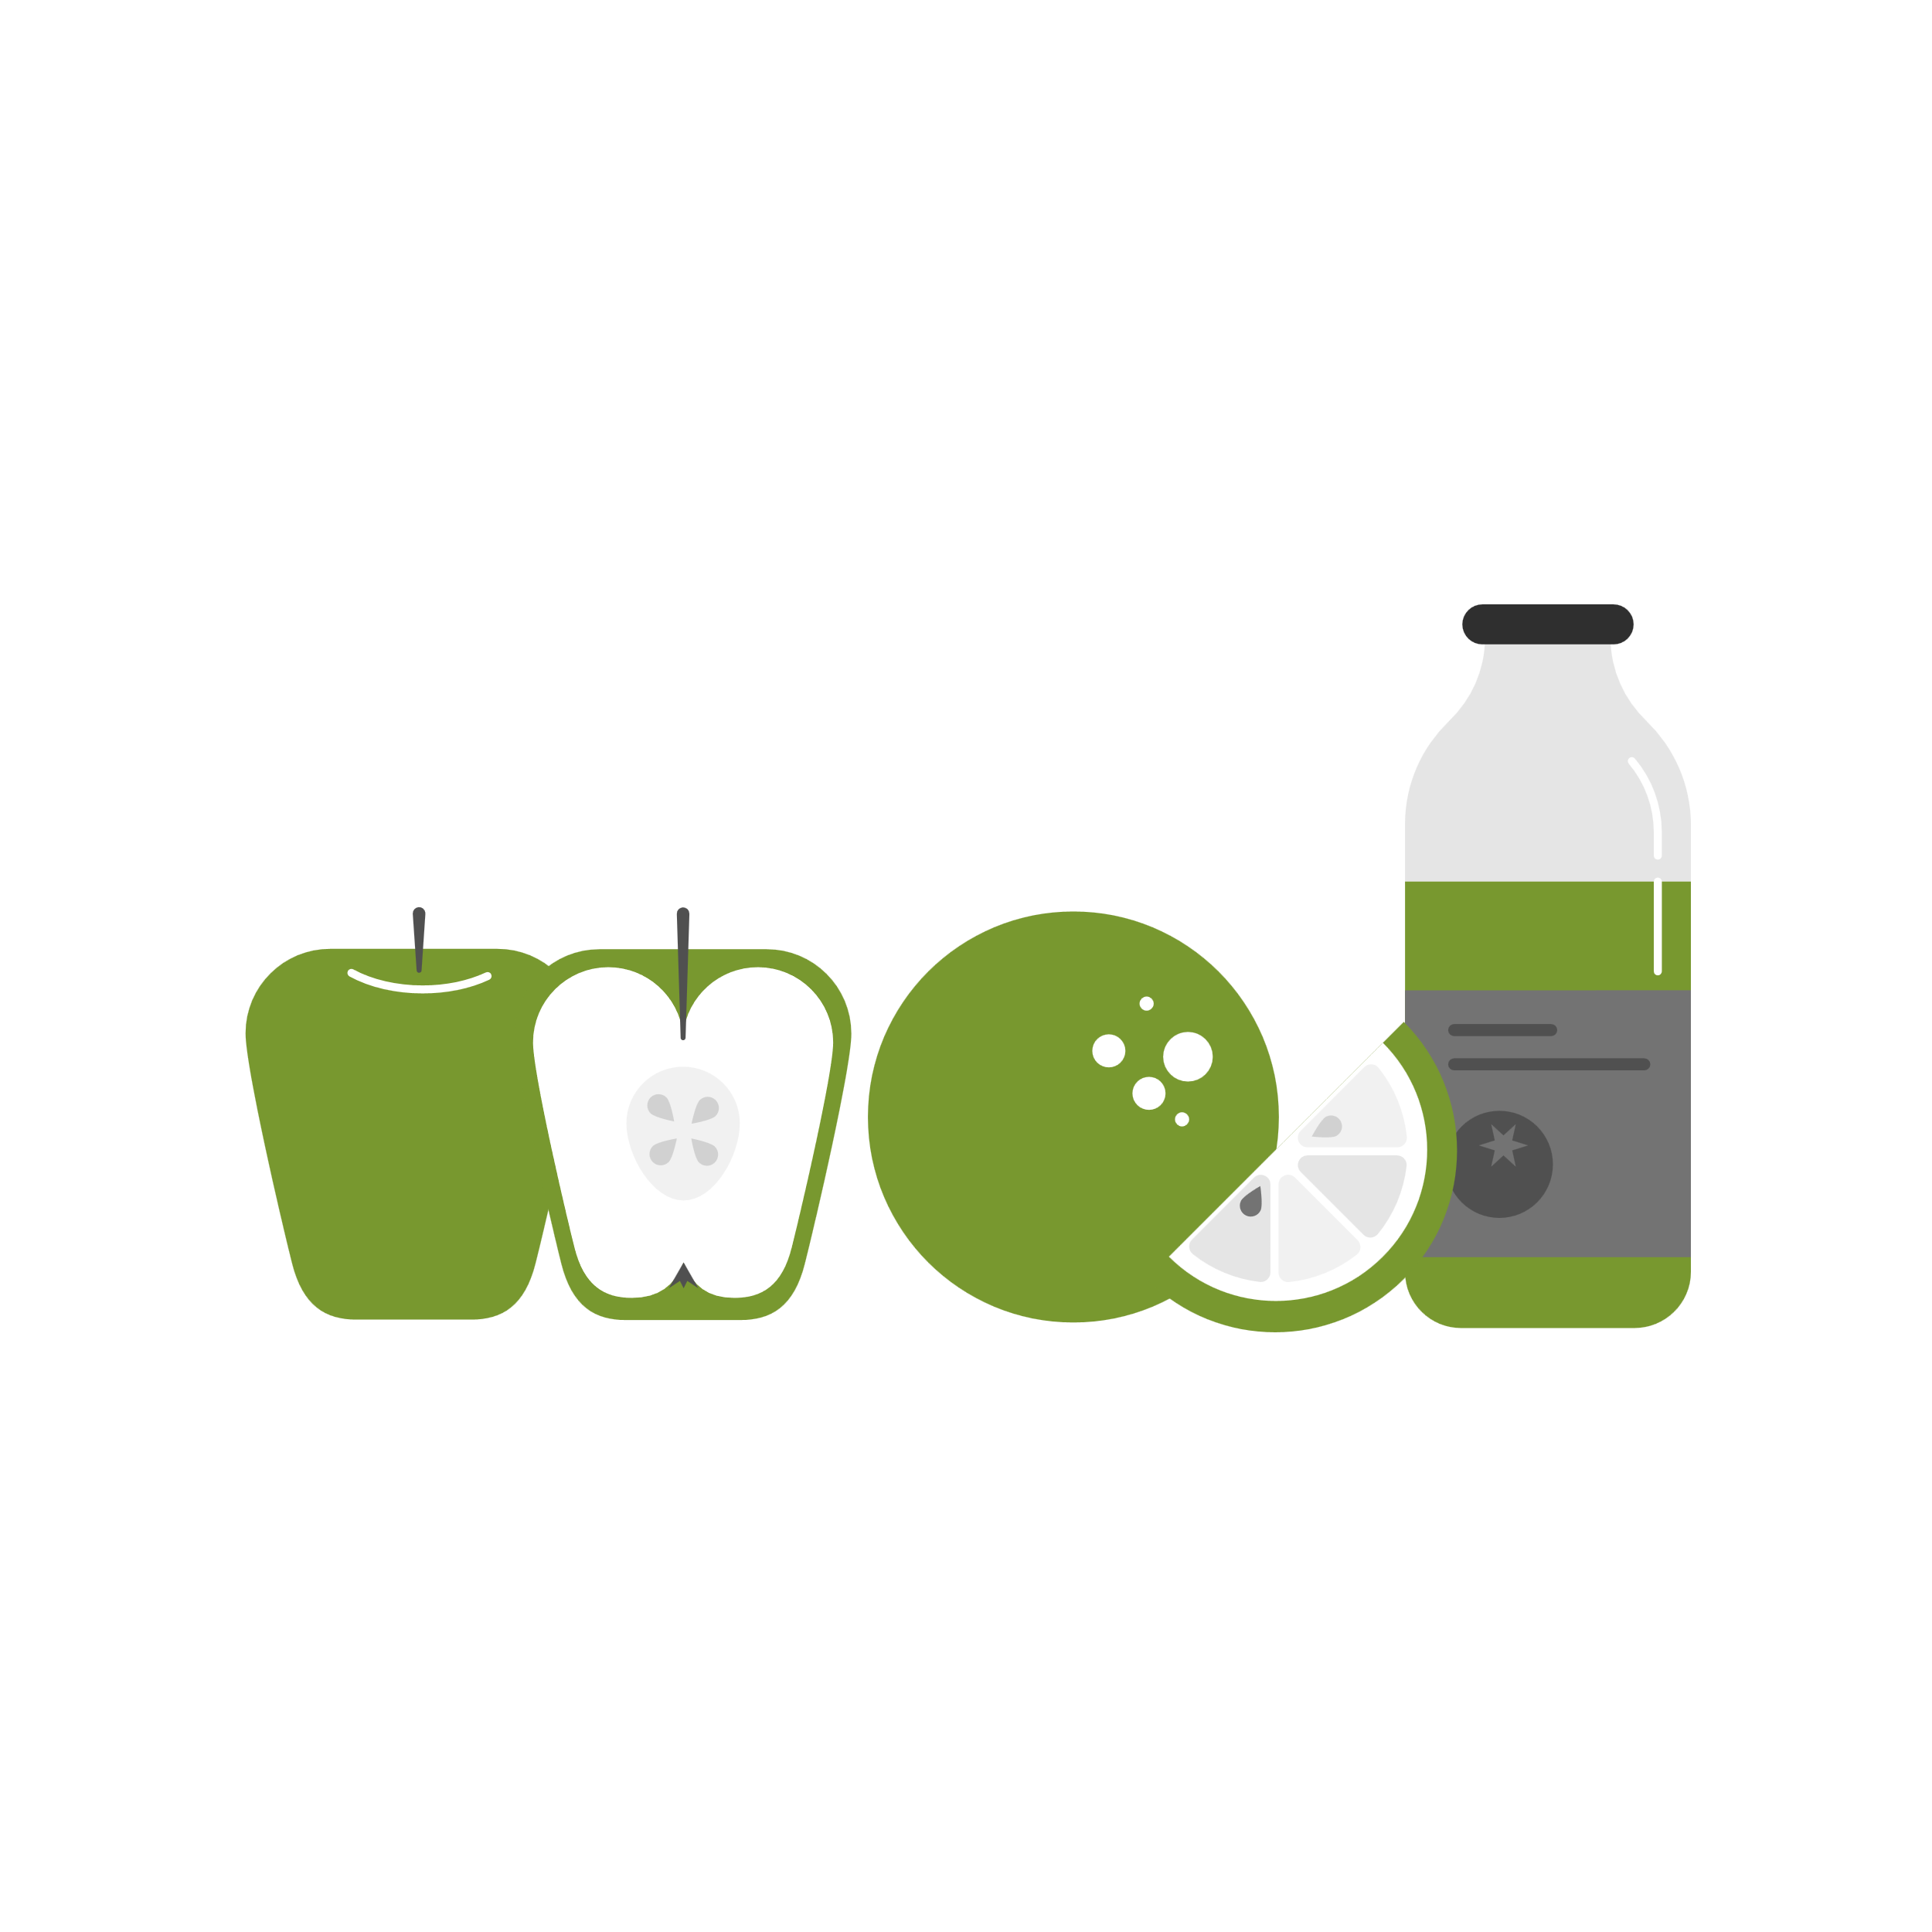

Develop AN action plan: treatment, care & support for people suffering from lifestyle diseases
Notes:
Develop an action plan for the treatment, care and support for people suffering from lifestyle diseases.
Developing an action plan can help people turn their visions into reality and increase efficiency and accountability. An action plan describes the way you will meet objectives through detailed action steps that describe how and when these steps will be taken.
Ask learners to give suggestions about what steps people can take in developing an action plan.
Preventing and managing chronic disease often requires patients to make healthy lifestyle changes and adjustments to their daily routines. While some might feel overwhelmed by the thought of altering an already busy schedule, it is important to note that lifestyle changes don’t have to be major or difficult.
Medical conditions, illness or injury are frequently stressful and may disrupt our lives. A healthy diet, regular exercise, sleep and social support can relieve or manage the symptoms of illness or injury and help improve recovery.
Taking a positive view can also make a huge difference in recovery from illness.
Ask learners to give suggestions about what you can do to help and support others suffering from an illness.

Slide 8

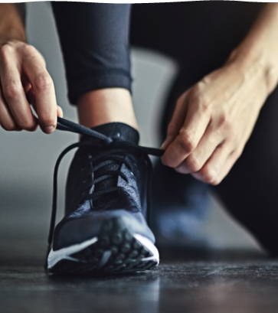
Benefits of long-term participation in physical activity
Notes:
Benefits of long-term participation in physical activity: There are many benefits to exercise – the most common ones are:
Reduced Stress: One of the most common mental benefits of exercise is stress relief. Working up a sweat can help manage physical and mental stress. Exercise also increases concentrations of norepinephrine, a chemical that can moderate the brain's response to stress. Working out can reduce stress and boost the body's ability to deal with existing mental tension.
Boosting of "Happy" Chemicals: Exercise releases endorphins, which create feelings of happiness and euphoria. Studies have shown that exercise can even alleviate symptoms of depression. For this reason, doctors recommend that people suffering from depression or anxiety (or those who are just feeling blue) exercise frequently. Working out for just 30 minutes a few times a week can instantly boost your overall mood.
Improvement of Self-Confidence: on a very basic level, physical fitness can boost your self-esteem and improve your self-image. Regardless of weight, size, gender or age, exercise can quickly elevate a person's self-worth (perception of themselves). Exercising in the great outdoors can increase self-esteem and Vitamin D acquired from the sun can lessen the likelihood of experiencing depressive symptoms.
Alleviation of Anxiety: Natural chemicals (endorphins) that are released during and after exercise can help people with anxiety to calm down.
Boosting of Brainpower: Studies have shown that cardiovascular exercise can create new brain cells and improve overall brain performance. Studies also suggest that a tough workout increases levels of a brain-derived protein in the body, believed to help with decision-making, higher thinking and learning. Physical activity boosts memory and the ability to learn new things. Getting sweaty increases the production of cells responsible for memory and learning.

Slide 9

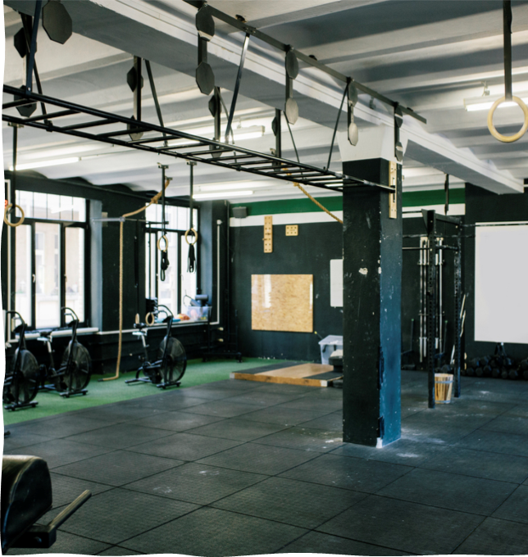
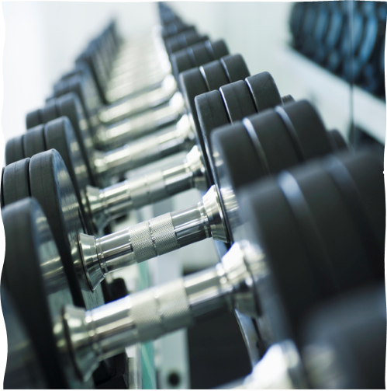
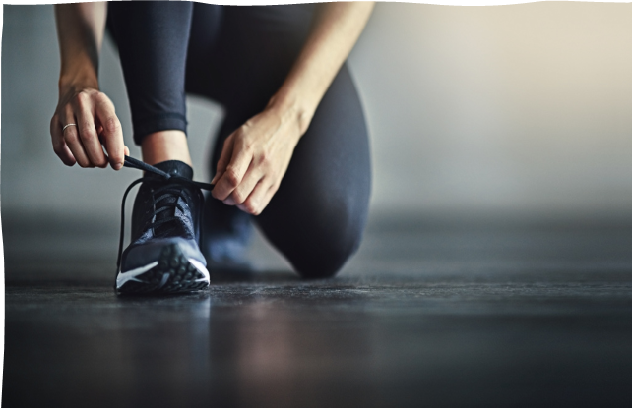
Improves:
Physical,
Mental,
Social,
Emotional Well-being
Notes:
Considering the conversation we just had, it is safe to say that exercise can improve physical, mental, social, and emotional well-being.
Ask learners to mention the benefits of exercise in the following spheres:
Physical benefits:
Stronger bones.
Protection from osteoporosis.
Reduced risk of heart attack and stroke.
Increased protection from viral diseases.
Prevention of diabetes.
Improved general health and fitness.
Mental benefits:
Clears the mind.
Keeps the mind alert.
Helps to prevent mental diseases.
Prevents negative thinking.
Social benefits:
Make and keep friends.
Helps to integrate in a new situation.
Meet people.
Prevents loneliness.
Promotes social support.
Decreases absenteeism at work due to a healthier immune system.
Reduces health costs in terms of preventing diseases.
Emotional benefits
Enjoyment
Feelings of self-worth improve.
Relaxation reduces stress.
Having fun and laughing keeps you happy.
Feeling good about yourself.
Looking forward to activities.
Prevents depression.
Prevents stress.
Personal satisfaction.

Slide 10
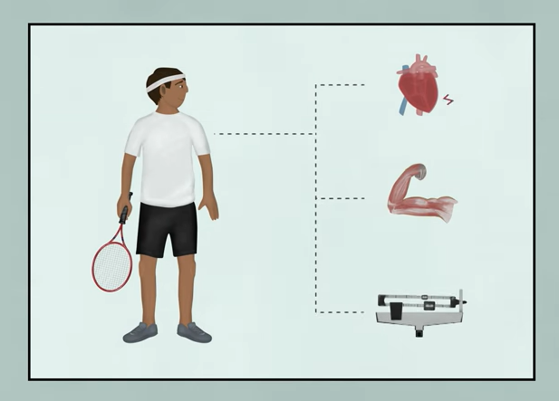
How Exercise Benefits Your Brain As Well As Your Body
Watch: https://www.youtube.com/watch?v=f3wW9cWY82A (2 min 20)
Notes:
Watch: How Exercise Benefits Your Brain As Well As Your Body
https://www.youtube.com/watch?v=f3wW9cWY82A (2 min 20)

Slide 11

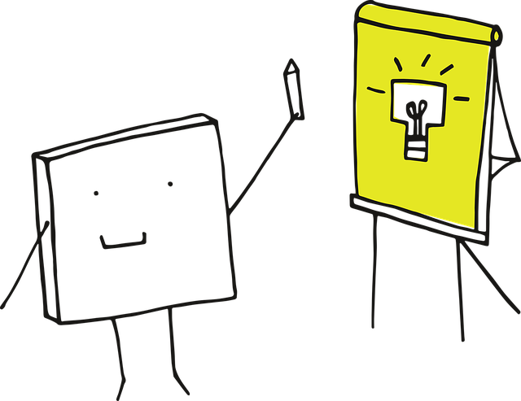
Questions?
Activity:
Lesson 2 Worksheet
Notes:
Ask learners if there are any questions, or if anything needs clarification.
Allow learners to complete Lesson 2 – Worksheet which will serve as exam practice. If they do not have sufficient time to complete the activity, please assign it as homework. Answers are available on Lesson 2 – Worksheet MEMO which can be shared with learners at the start of the next lesson.

