Slide 1
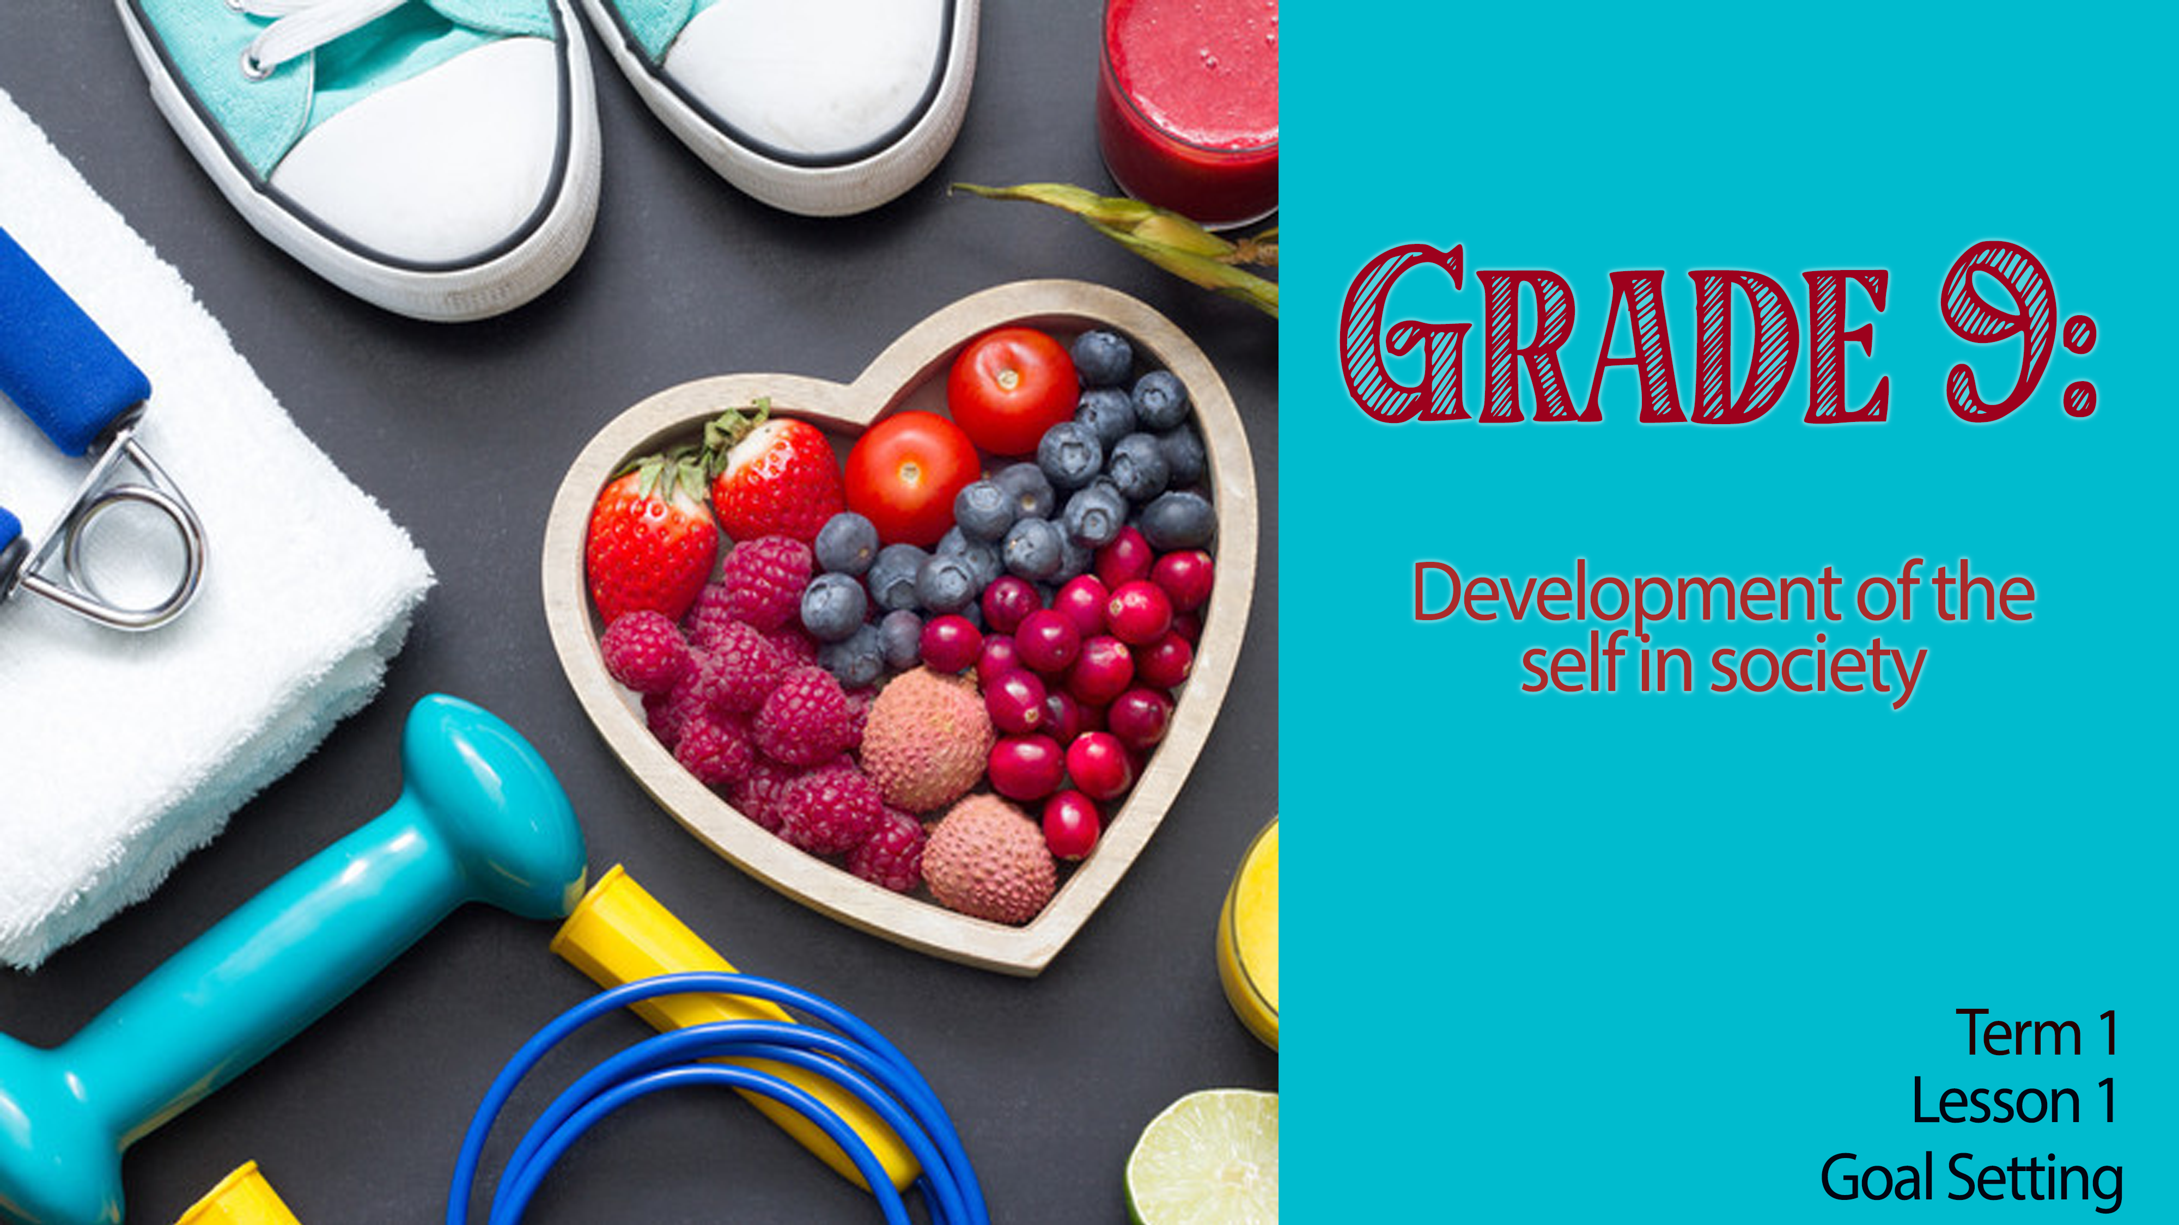

Notes:
Good day Grade 9’s! Welcome to the first lesson for Life Orientation in Grade 9. You’ve seen the Grade 8’s getting lost around school trying to find their classes. You don’t feel like the “new guy” anymore. Looking ahead at this year, it’s your last year as part of the GET phase. Later this year, you’ll be making subject choices towards the hope of going on to study or working in the career of your choice. Grade 9 is an important year. Up until now, most of your life choices have often been made for you. Growing up, your parents chose where you went to school, what you would eat for supper and even had a large influence on the kind of friends you chose at school. These choices impacted the goals you chose for your future. But many things have changed over the past year, you’re a little older and more mature.
Starting today, it is important to look ahead and choose your own goals for the future and how your personal lifestyle choices impact or are influenced by your goals.
In your groups, tell the other group members of:
- ONE life goal you had before coming to high school
- ONE life goal you have for this year.
(Allow learners about 2min to share)
Next, ask learners to share in one sentence with their group:
- How will time spent on social media impact on my ONE life goal for this year?
(Allow learners about 1min to share)

Slide 2


Values: one's personal belief of what is important in life that guides you in the decision-making process.
Peers: people of the same age.
Media: mass communication with people, such as newspapers, television, magazines and social media.
Consequences: the outcome of your behaviour.
Notes:
Lifestyle choices can be defined as the attitudes and behaviours you show in everyday life. These aspects reflect your values and have a major physical and emotional impact on your life. Remember that the word values refers to one's personal belief of what is important in life that guides you in the decision-making process.
Example: If honesty is an important value to you and you end up in a situation where lying would get you out of trouble, it would be difficult for you because honesty is so important to you. The emotional impact could be that you feel guilty about lying. The physical impact could be a headache from all the tension around the decision.
These values that we live by are influenced by different factors. If we look at this image, we could say that the influence of media, friends and peers, family, culture, religion and community impact our values and behaviour in different situations.
In your Lesson 1 – Worksheet, take a few moments to write the definitions to the terms in Activity 1.
Values: one's personal belief of what is important in life that guides you in the decision-making process.
Peers: people of the same age.
Media: mass communication with people, such as newspapers, television, magazines and social media.
Consequences: the outcome of your behaviour.
One of the tough decisions as a teenager is the choices you make about alcohol based on different influences. We will look at how you feel about alcohol and the impact it could have on your life. Start by answering the questions in Activity 2, Lesson 1 – Worksheet. (Allow 5 min to complete)

Slide 3
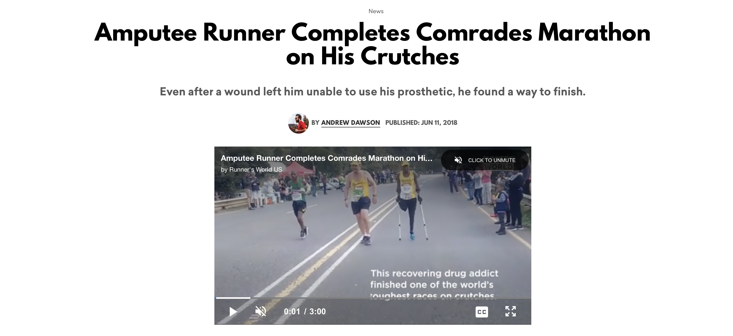
Notes:
There are times in life we make choices that have a negative impact on our lives. Many people end up stuck in a cycle of thinking life will never change. However, it takes a person who cares about others to turn someone's life around. Xolani Luvuno, 33, came back from being addicted to drugs and alcohol to change his life around.
Watch Video: Paste the below link into your internet browser to watch the 3 min clip in the thread.
https://www.runnersworld.com/news/a21267745/amputee-runner-completes-comrades-marathon-with-crutches/
Complete Activity 3 (Lesson 1 – Worksheet) and reflect on the story of Xolani Luvuno.
Teacher Note: You could use these questions as discussion points in small groups as well. Allow learners to answer individually and then to respond to their peers.

Slide 4

Violence at school
Notes:
You will have time to start this activity in class and finish it for homework. Bring it back to class in an envelope with your name and surname on it. Your teacher will return this letter/ post card to you in the last LO lesson of the year.
Write a letter to yourself on this postcard that you will read at the end of the year. Be specific and include details of the goals that you would like to achieve this year. You can include short term goals.
(Remember: Short-term goals are defined as accomplishments that take 3 months to a few years. Long-term goals are usually completed in 3 to 5 years, or longer).
Choose to focus on the following areas:
Relationships with friends/family
Academic goals
Sports/Health goals
Value goals
Finish off your letter with an oath to yourself that you won’t make bad choices this year that will impact you achieving your goals.

Slide 5
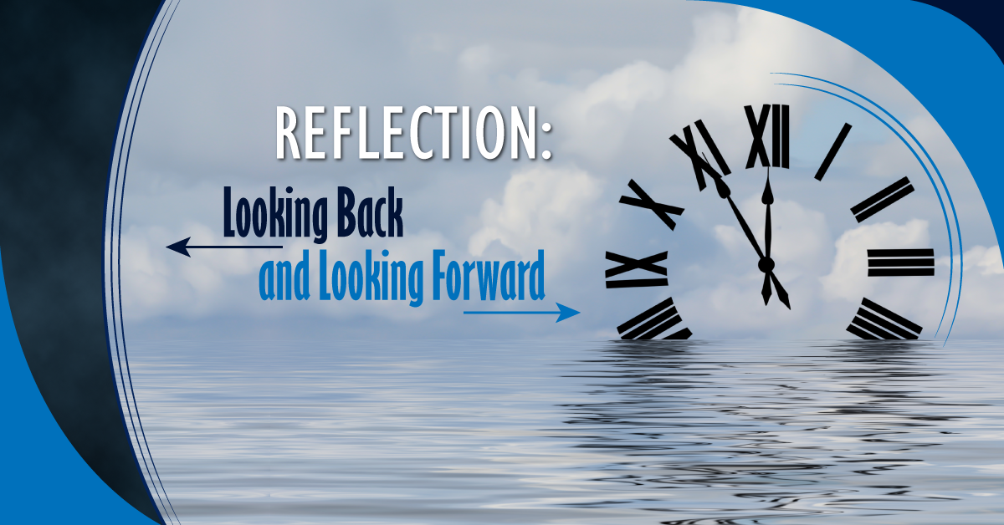
R E F L E C T I O N
Notes:
We have come to the end of this lesson. Take a moment to reflect on the content we have covered today. Answer the reflection questions on Lesson 1 – Worksheet in Activity 5.
Encourage the class to be quite in this time. It might even help to play music. Tell the class to remain quite until you say they can talk.).
There are no memo answers to this activity.

