Slide 1
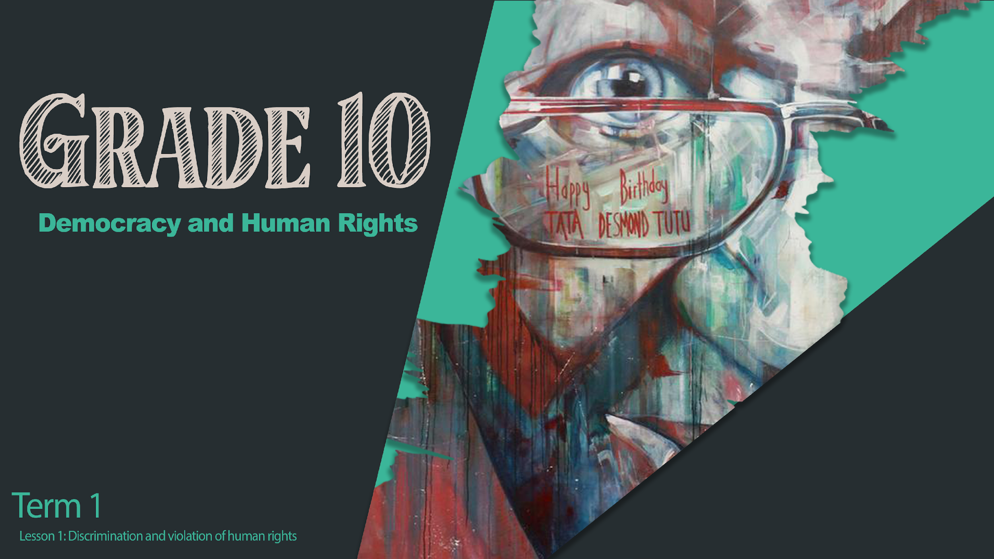
Notes:
Welcome back Grade 10s. We are moving on to a very important section of work in terms of understanding the society around us and how it functions so that we are able to live in it respectfully. In Grade 9 you would have been made familiar with the concept of Human Rights and the responsibilities that we have as citizens in South Africa to uphold the rights enshrined in our Constitution (Grade 9 Term 1 Week 4-5).
Please do not see human rights as an irrelevant system, only for adults and governments. Always ask yourself:
- “How well do I understand my fundamental human rights?” and
- “What can I do to protect these rights and the rights of others?”.
Lastly and most importantly, always ask yourself:
- “Is there anything that I have done or said that has or could lead to the violation of anyone else’s rights?”

Slide 2

Lesson 1 LEARNING OBJECTIVES
During this lesson you will be able to:
  Define DISCRIMINATION and HUMAN RIGHTS VIOLATIONS
  Understand the importance of the South African Bill of Rights; The Convention on the Rights of the Child, and The Committee on the Elimination of Discrimination against Women (CEDAW)
  Recognise different forms of discrimination and Human Rights Violations.
Notes:
During this lesson we will seek to define what discrimination is and what violations of human rights look like. We will also reflect on our communities, schools, even households and look to recognise different forms of discrimination and violations of human rights within those environments. We will also look at three documents to help us understand human rights:
The South African Bill of Rights;
The Convention on the Rights of the Child; and
The Committee on the Elimination of Discrimination against Women.

Slide 3
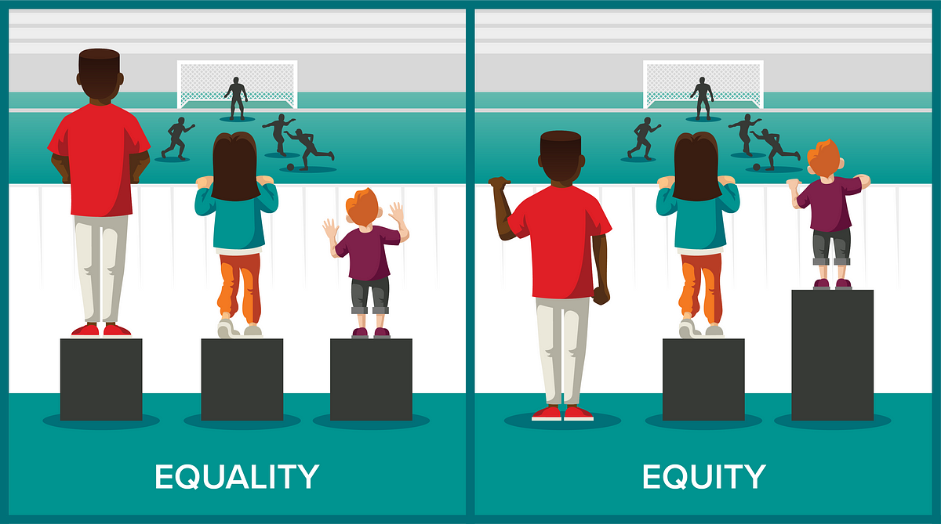
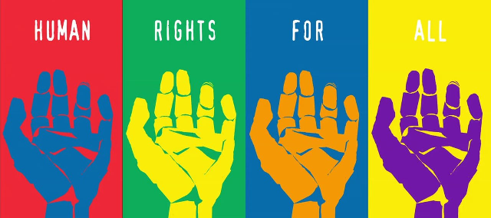
Do you know what these terms mean?
Fairness
Rights
Safety
Equality
Future
Property
Notes:
Let us see what your understanding is of these topics. Remember it is perfectly acceptable to not know the answers and if you are struggling with a definition. As an example, try to think about something that you might have heard or read in the media. As you see the following concepts, in the block on Activity 1 (Lesson 1 – Worksheet), write down words or ideas that come to mind. You will have 4 minutes to complete this activity.

Slide 4
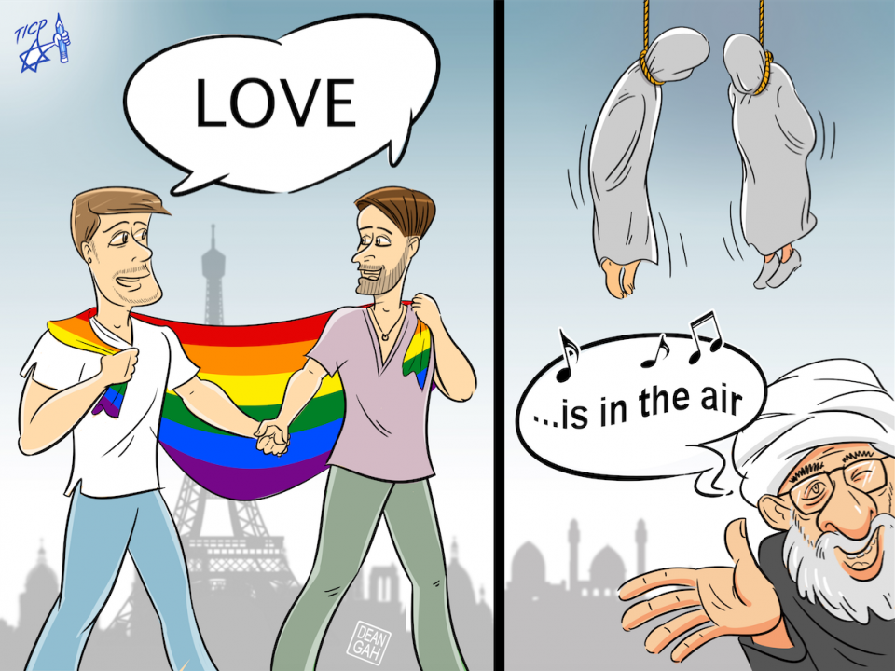

Why is this image offensive?
Notes:
Let’s look at this image on the slide. Why would this be offensive? How have these guys' human rights been violated? (Some might get upset; encourage learners to communicate why they are upset.)
Can you see that this is offensive to the LGBTQI+ community? They are being discriminated against and executed in Iran, but accepted in France. This is wrong! We can see that basic human rights are meant to treat all people equally. The problem is that this does not happen this way all over the world.
South Africa follows the Bill of Rights which is a constitutional document that communicates the human rights that all South Africans are required to follow by law. This means that South Africans should not discriminate against others. Remember, to discriminate means to treat people in an unfair/unjust way based on the type of person they are, especially on the grounds of ethnicity, age, sex, or disability. By violating human rights means to prevent/deprive a person of the rights given to them by law, whether by doing something to him/her or by not (i.e. neglecting) doing something for him/her.
We as human beings have a responsibility to protect Human Rights. We need to stop or report where we see or hear of a person’s (or people’s) rights being abused.
It is exceptionally important to realise that as individuals we have a responsibility not only to stop abusing human rights, but to actively bring attention to where we perceive human rights to be neglected or abused.
Human rights are rules to help everybody live together in peace, safety and happiness. When people ignore or abuse these rights, they violate them.
Human Rights can be violated because of:
Race
Language
Religion
Gender
Sexual Orientation and even
HIV Status

Slide 5
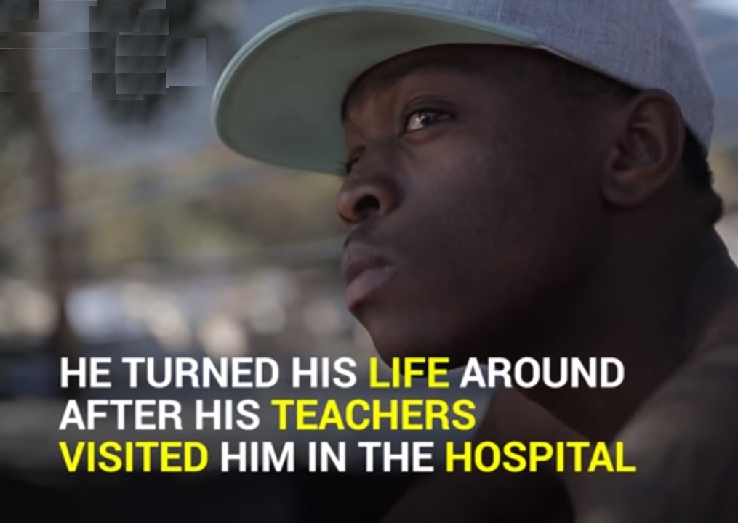
Odwa’s Story
Watch the Following Clip: https://www.youtube.com/watch?v=Z5VeOr-JqxU
Notes:
We are going to look at three different examples of challenges faced by young people in our world. There are a couple of basic questions in your worksheets in Activity 2 (Lesson 1 – Worksheet) to answer as you are watching the video. But as you watch, try to reflect on what discrimination you might see and try to understand what someone living in those conditions might be going through.
At the end of each video, you will be asked to answer the questions set on the video, but you will have a space on the classroom wall to put up a note, written on a clean sheet of paper or a post-it, on what you would say to someone experiencing the difficulties faced by the people in these videos.
Odwa’s Story – Video
https://www.youtube.com/watch?v=Z5VeOr-JqxU
Video: 2:31 minutes – 2 minutes to answer questions
State TWO challenges that Odwa experienced in his community?
Discuss how TWO of these challenges can be seen as a violation of human rights?
Write on your post-it… What would you say to someone like Odwa who experienced the difficulties in this video.

Slide 6
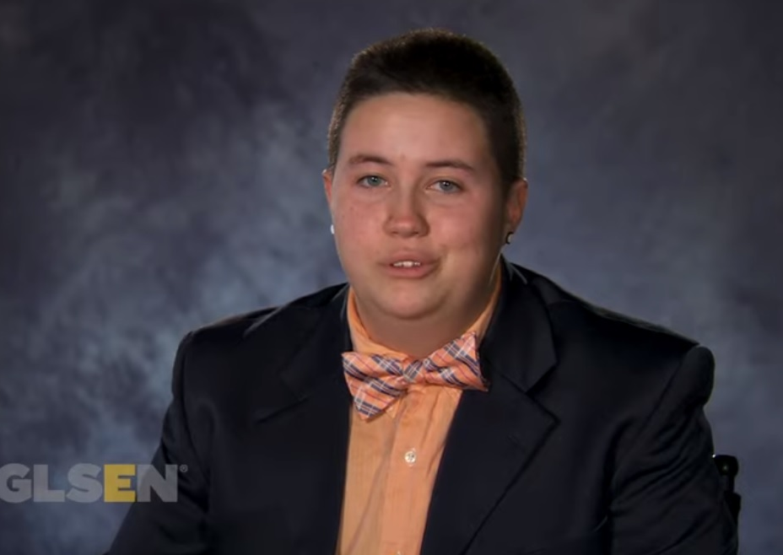
GLSEN
https://www.youtube.com/watch?v=iAwJQYs7pKM
Notes:
Glsen – Video
https://www.youtube.com/watch?v=iAwJQYs7pKM
Video: 2:44 minutes – 2 minutes to answer questions
State TWO challenges the LGBTQI+ community face on a daily basis?
Discuss TWO strategies that teachers and fellow learners could do to help the LGBTQI+ community feel safe.
Write on your post-it… What would you say to someone like GLSEN who experienced the difficulties in this video.

Slide 7
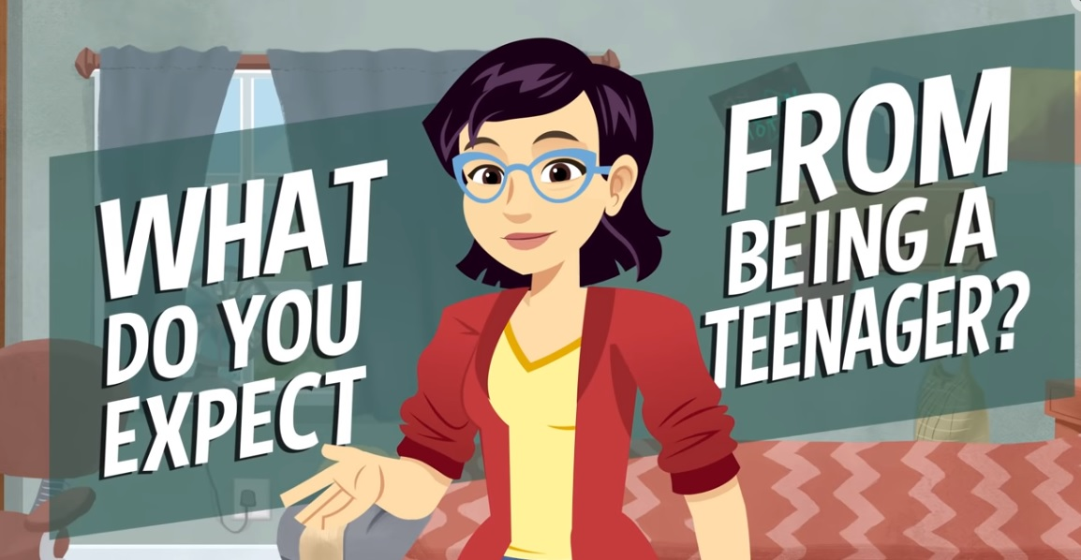
Teens and Abuse https://www.youtube.com/watch?v=aOwmLMnZwi4
Notes:
Teenagers and Sexual Abuse – Video
https://www.youtube.com/watch?v=aOwmLMnZwi4
Video: 3:52 minutes – 2 minutes to answer questions
State TWO challenges that teens have to deal with on a daily basis.
Discuss TWO ways in which parents and friends could help teens to cope with these challenges.
Write on your post-it… What would you say to the teenagers in this video?
As you can see from this activity, there is so much that every person can do to prevent violations of human rights and to support those who have been discriminated against.

Slide 8

The Bill of Rights: Chapter 2 of Our Constitution
Dignity
Equality
Democracy
Freedom
The purpose of the Bill of Rights is to protect the basic human rights of all the citizens (and residents of South Africa). It stops discrimination and unequal treatment. It makes sure that there are fair laws which makes sure that all South Africans can live together in freedom, equality and dignity. It makes sure that the government is held accountable and that they uphold democracy, equality and justice in South Africa.
Notes:
As we mentioned earlier in the lesson, human rights are so important that they have been included in our Constitution. The Bill of Rights is based on four basic principles – Dignity; Equality; Democracy and Freedom. It is important to realise what the Bill of Rights does. Have a look at the bold words.
Write these words into the spaces provided in Activity 3 of your Lesson 1 – Worksheet.
Fill in the missing words as we read through the paragraph in Activity 3:
The purpose of the Bill of Rights is to protect the basic human rights of all the citizens (and residents of South Africa). It stops discrimination and unequal treatment. It makes sure that there are fair laws which makes sure that all South Africans can live together in freedom, equality and dignity.
It makes sure that the government is held accountable and that they uphold democracy, equality and justice in South Africa.
This means that all South Africans have a say in how the country is governed.

Slide 9
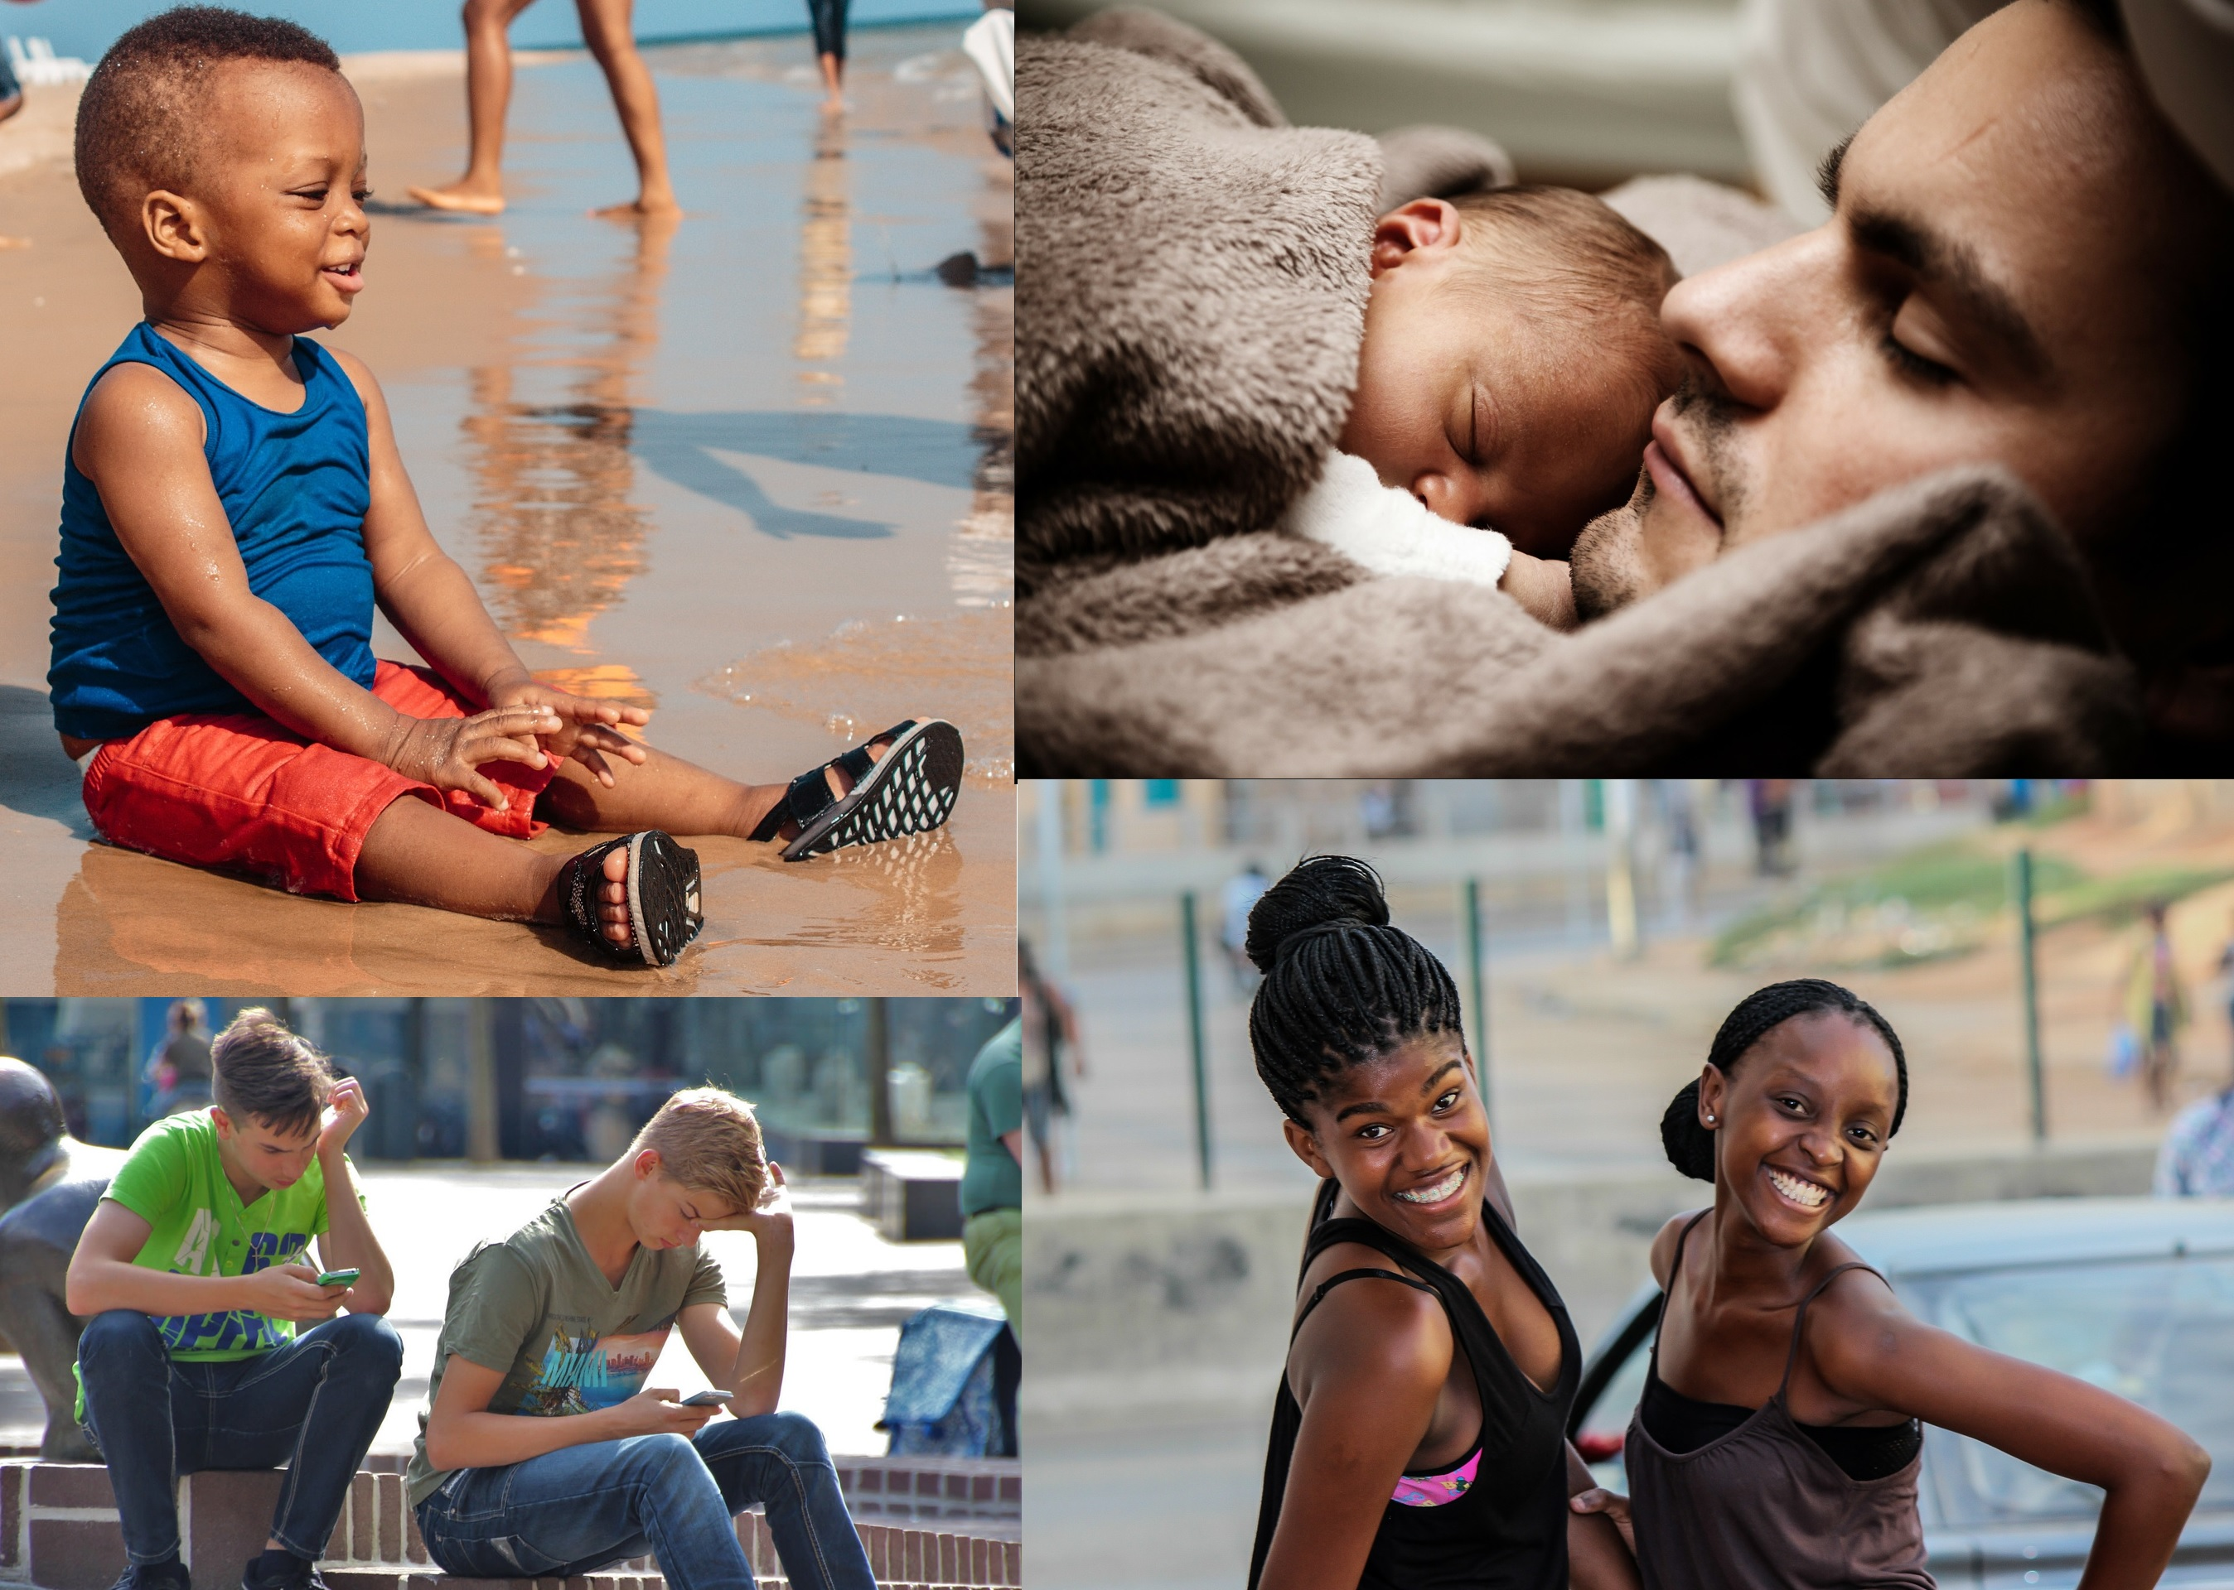
Convention of the Rights of the Child
In 1989, world leaders made a historic commitment to the world’s children by adopting the United Nations Convention on the Rights of the Child – an international agreement on childhood.
This Agreement aims to protect children from abuse and exploitation.
Notes:
The Convention of the Rights of the Child aims to protect children from abuse and exploitation (Exploitation is when people use children for tasks that children should not be exposed to, e.g. child labour in factories.)
In 1989, world leaders made a historic commitment to the world’s children by adopting the United Nations Convention on the Rights of the Child – an international agreement on childhood.
This agreement aims to protect children from abuse and exploitation.
Why do you think it is important to have a document just for the rights of children?

Slide 10

C.E.D.A.W
Guides the work of UN Women in achieving gender equality and empowering all women and girls.
Notes:
CEDAW (Committee on the Elimination of Discrimination Against Women) is also a United Nations Organisation Committee. CEDAW is often described as the international bill of rights for women and is one of the key international agreements that guides the work of UN women in achieving gender equality and empowering all women and girls.
It was necessary because in many countries women do not have the same rights as men and / or have historically been seen as second-class citizens. There were also many incidents of abuse against women.
To what extent do you think South Africa has achieved these goals? Why do you think that?

Slide 11

R E F L E C T I O N
Notes:
As we come to the end of this lesson, reflect on the following questions in Activity 4 (Lesson 1 – Worksheet).
Explain why you think the protection of rights is important?
Why is it so important that when we talk about human rights, we must also talk about the responsibility to uphold these rights?
Homework (Activity 5)
In Activity 5 (Lesson 1 – Worksheet) is a list of rights (from the Bill of Rights).
Choose FIVE of the rights listed and ask your parent/guardian/caregiver what they mean to him / her / them.
Now write down what your responsibility is in protecting these rights.

