Slide 1


Notes:
Welcome back Grade 10s. It’s our final lesson in this series of Democracy and Human Rights. I know many of you are excited to show your fellow classmates your wonderful campaign. Before we get started, let's just listen to a few rules as to how this lesson will run.
Firstly, you will be given 3 min to set up your Campaign Poster and any other things you have arranged to explain your campaign. Choose an area in the classroom where you will set up. Decide on a group name if you haven’t got one so the class knows which group to vote for.
We will have half the class at their stations and the other half of the class will move around and visit each of the campaigns. It is important that you ask questions of each group so that you will understand what human right(s) each group has chosen to address. You will each be given one small piece of paper. Each person will have one vote.
Right, let's start. You have 3 min to set up.

Slide 2

Notes:
Now that you have set up, in your group, determine the TWO questions you will add to the Activity 1 (Lesson 5 – Worksheet) to evaluate the effectiveness of the other groups’ campaigns.
Let’s begin! Groups 1-4? You will go to your stations and be ready to answer questions from the other groups. Each group will visit one group at a time. Set a timer (stopwatch) for 2 min per group visit. This is all the time they will have to talk to the group and evaluate the effectiveness of this campaign. After two minutes, you need to move to a new group. Groups 1-4 remain with your respective campaign posters until session 2.
8 min will make up session 1
Now allow 1 min for the changeover as the second group gets ready.
8 min for session 2.
After you’ve been through all the groups, choose your favourite group and vote. Merely write the name of your favourite Campaign Poster group on the piece of paper and pass on to the teacher.
The winning group will be announced at the end of the lesson.
Well done, Grade 10s. I am very impressed with the quality and creativity of the various campaigns.

Slide 3
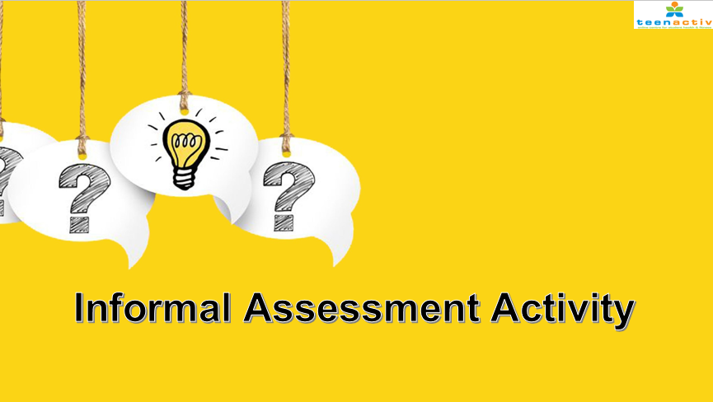

Notes:
You will now have time to practice with some questions that will help prepare you for the Controlled Test at the end of Term 2.
Complete Activity 2 (Lesson 5 – Worksheet).
The class will be quiet as though it’s test time. Try your best to answer the questions without your notes.
Hand out the Content Summary

Slide 4

R E F L E C T I O N
Notes:
We have come to the end of this series! The winning campaign team is __________. You have all done so well!
For homework, reflect on what you have learnt by completing Activity 3 (Lesson 5 – Worksheet).

