Slide 1
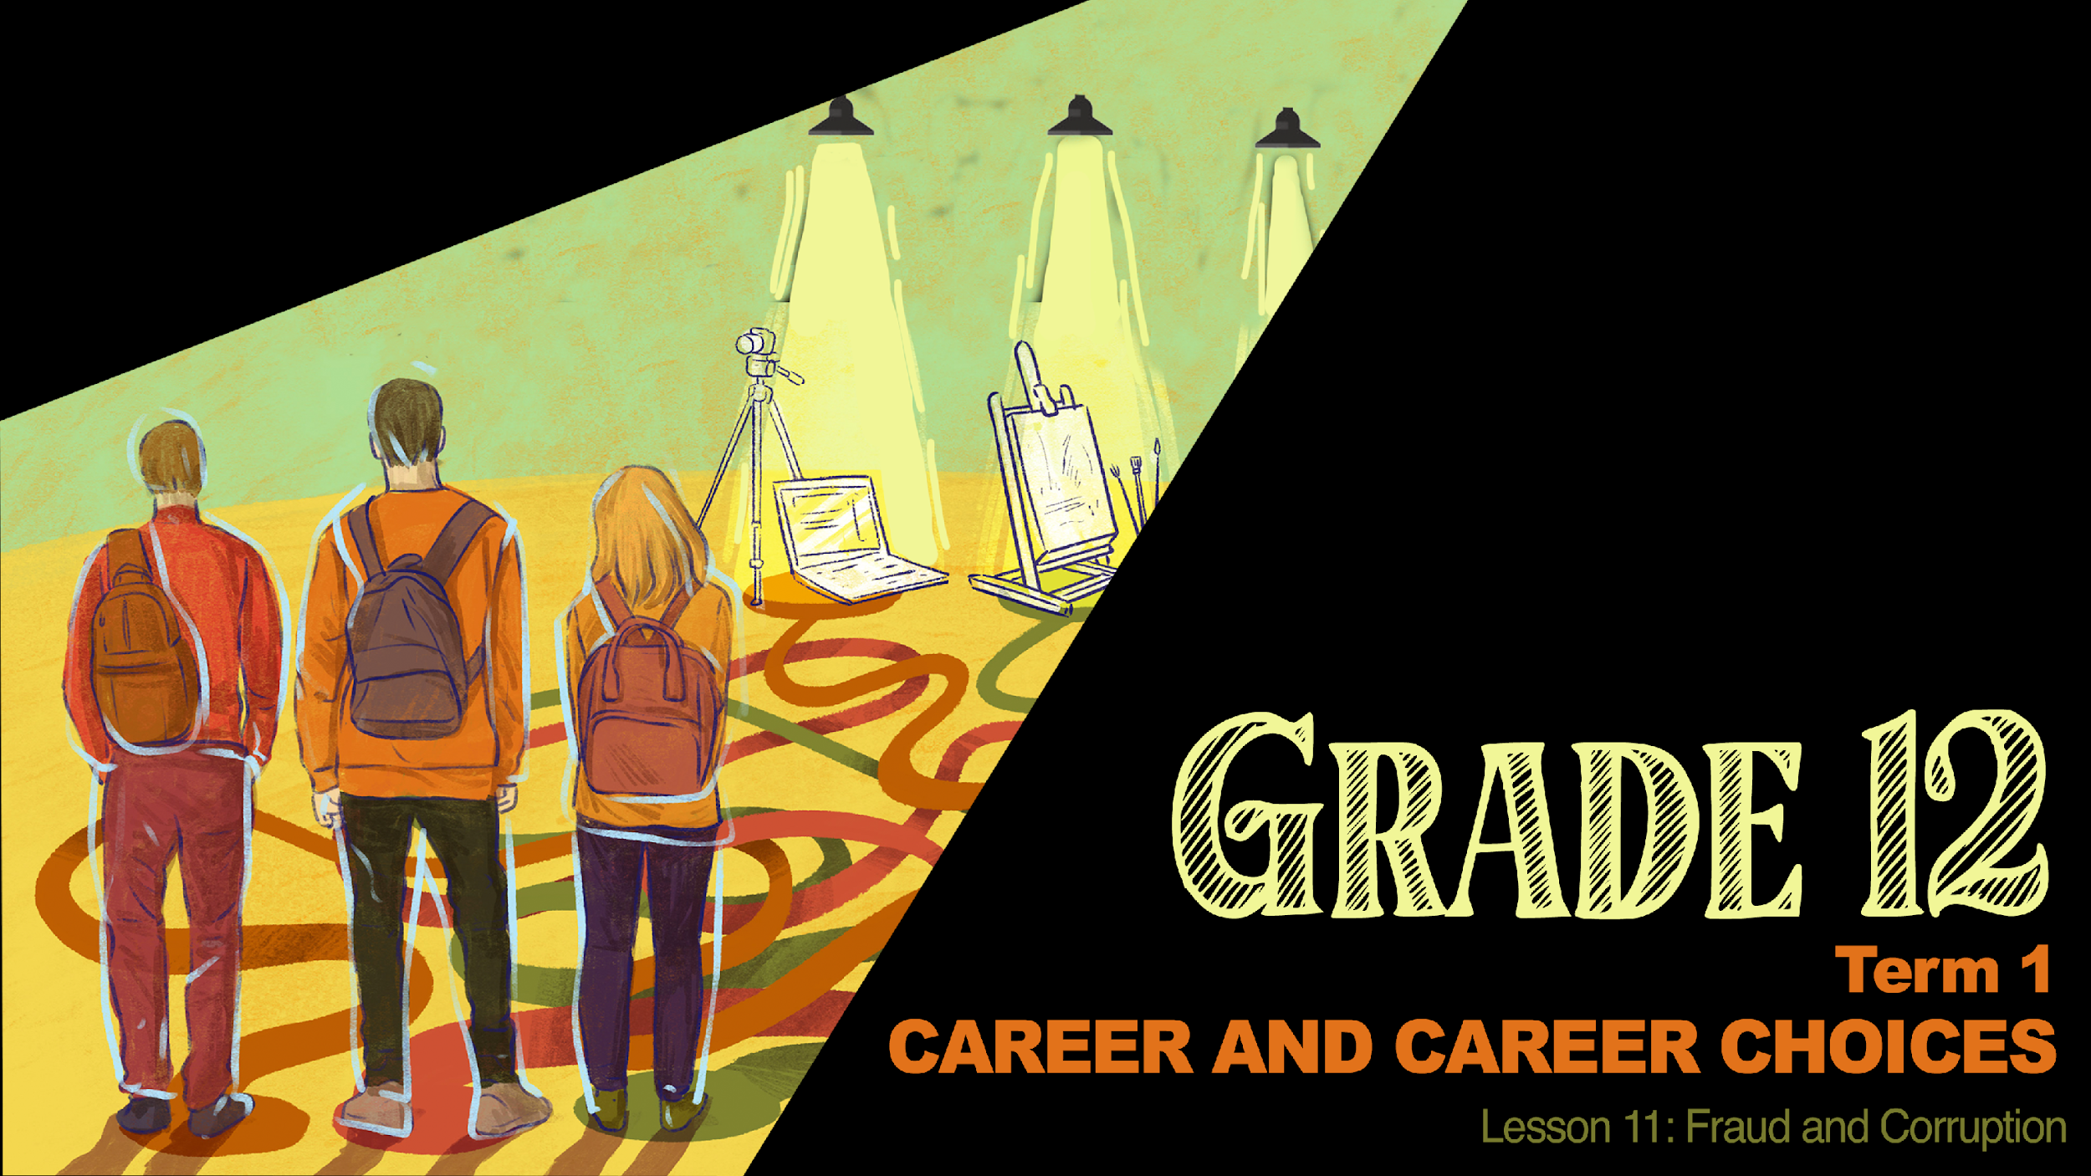



Slide 2


Slide 3
Corruption impacts:
Individuals
Companies
Communities
The Country

Slide 4
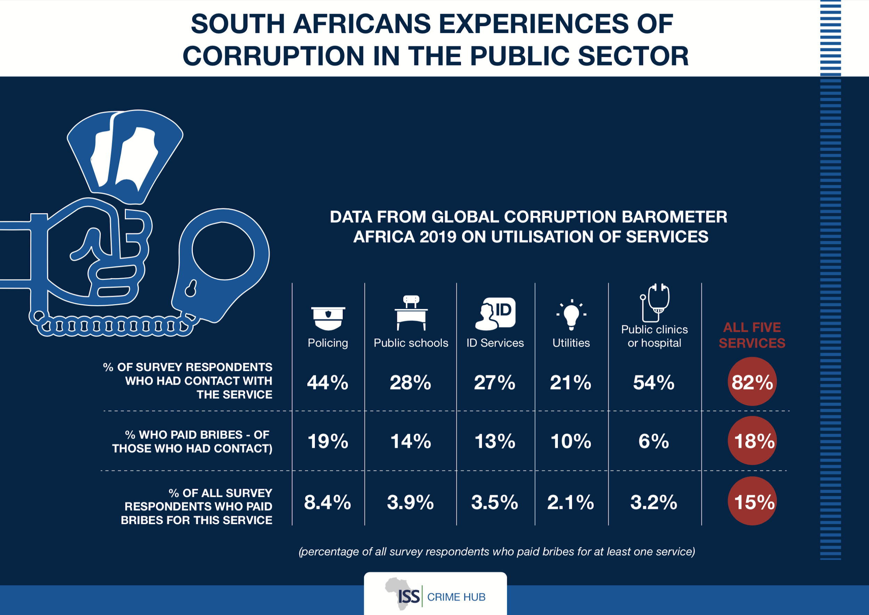

Slide 5
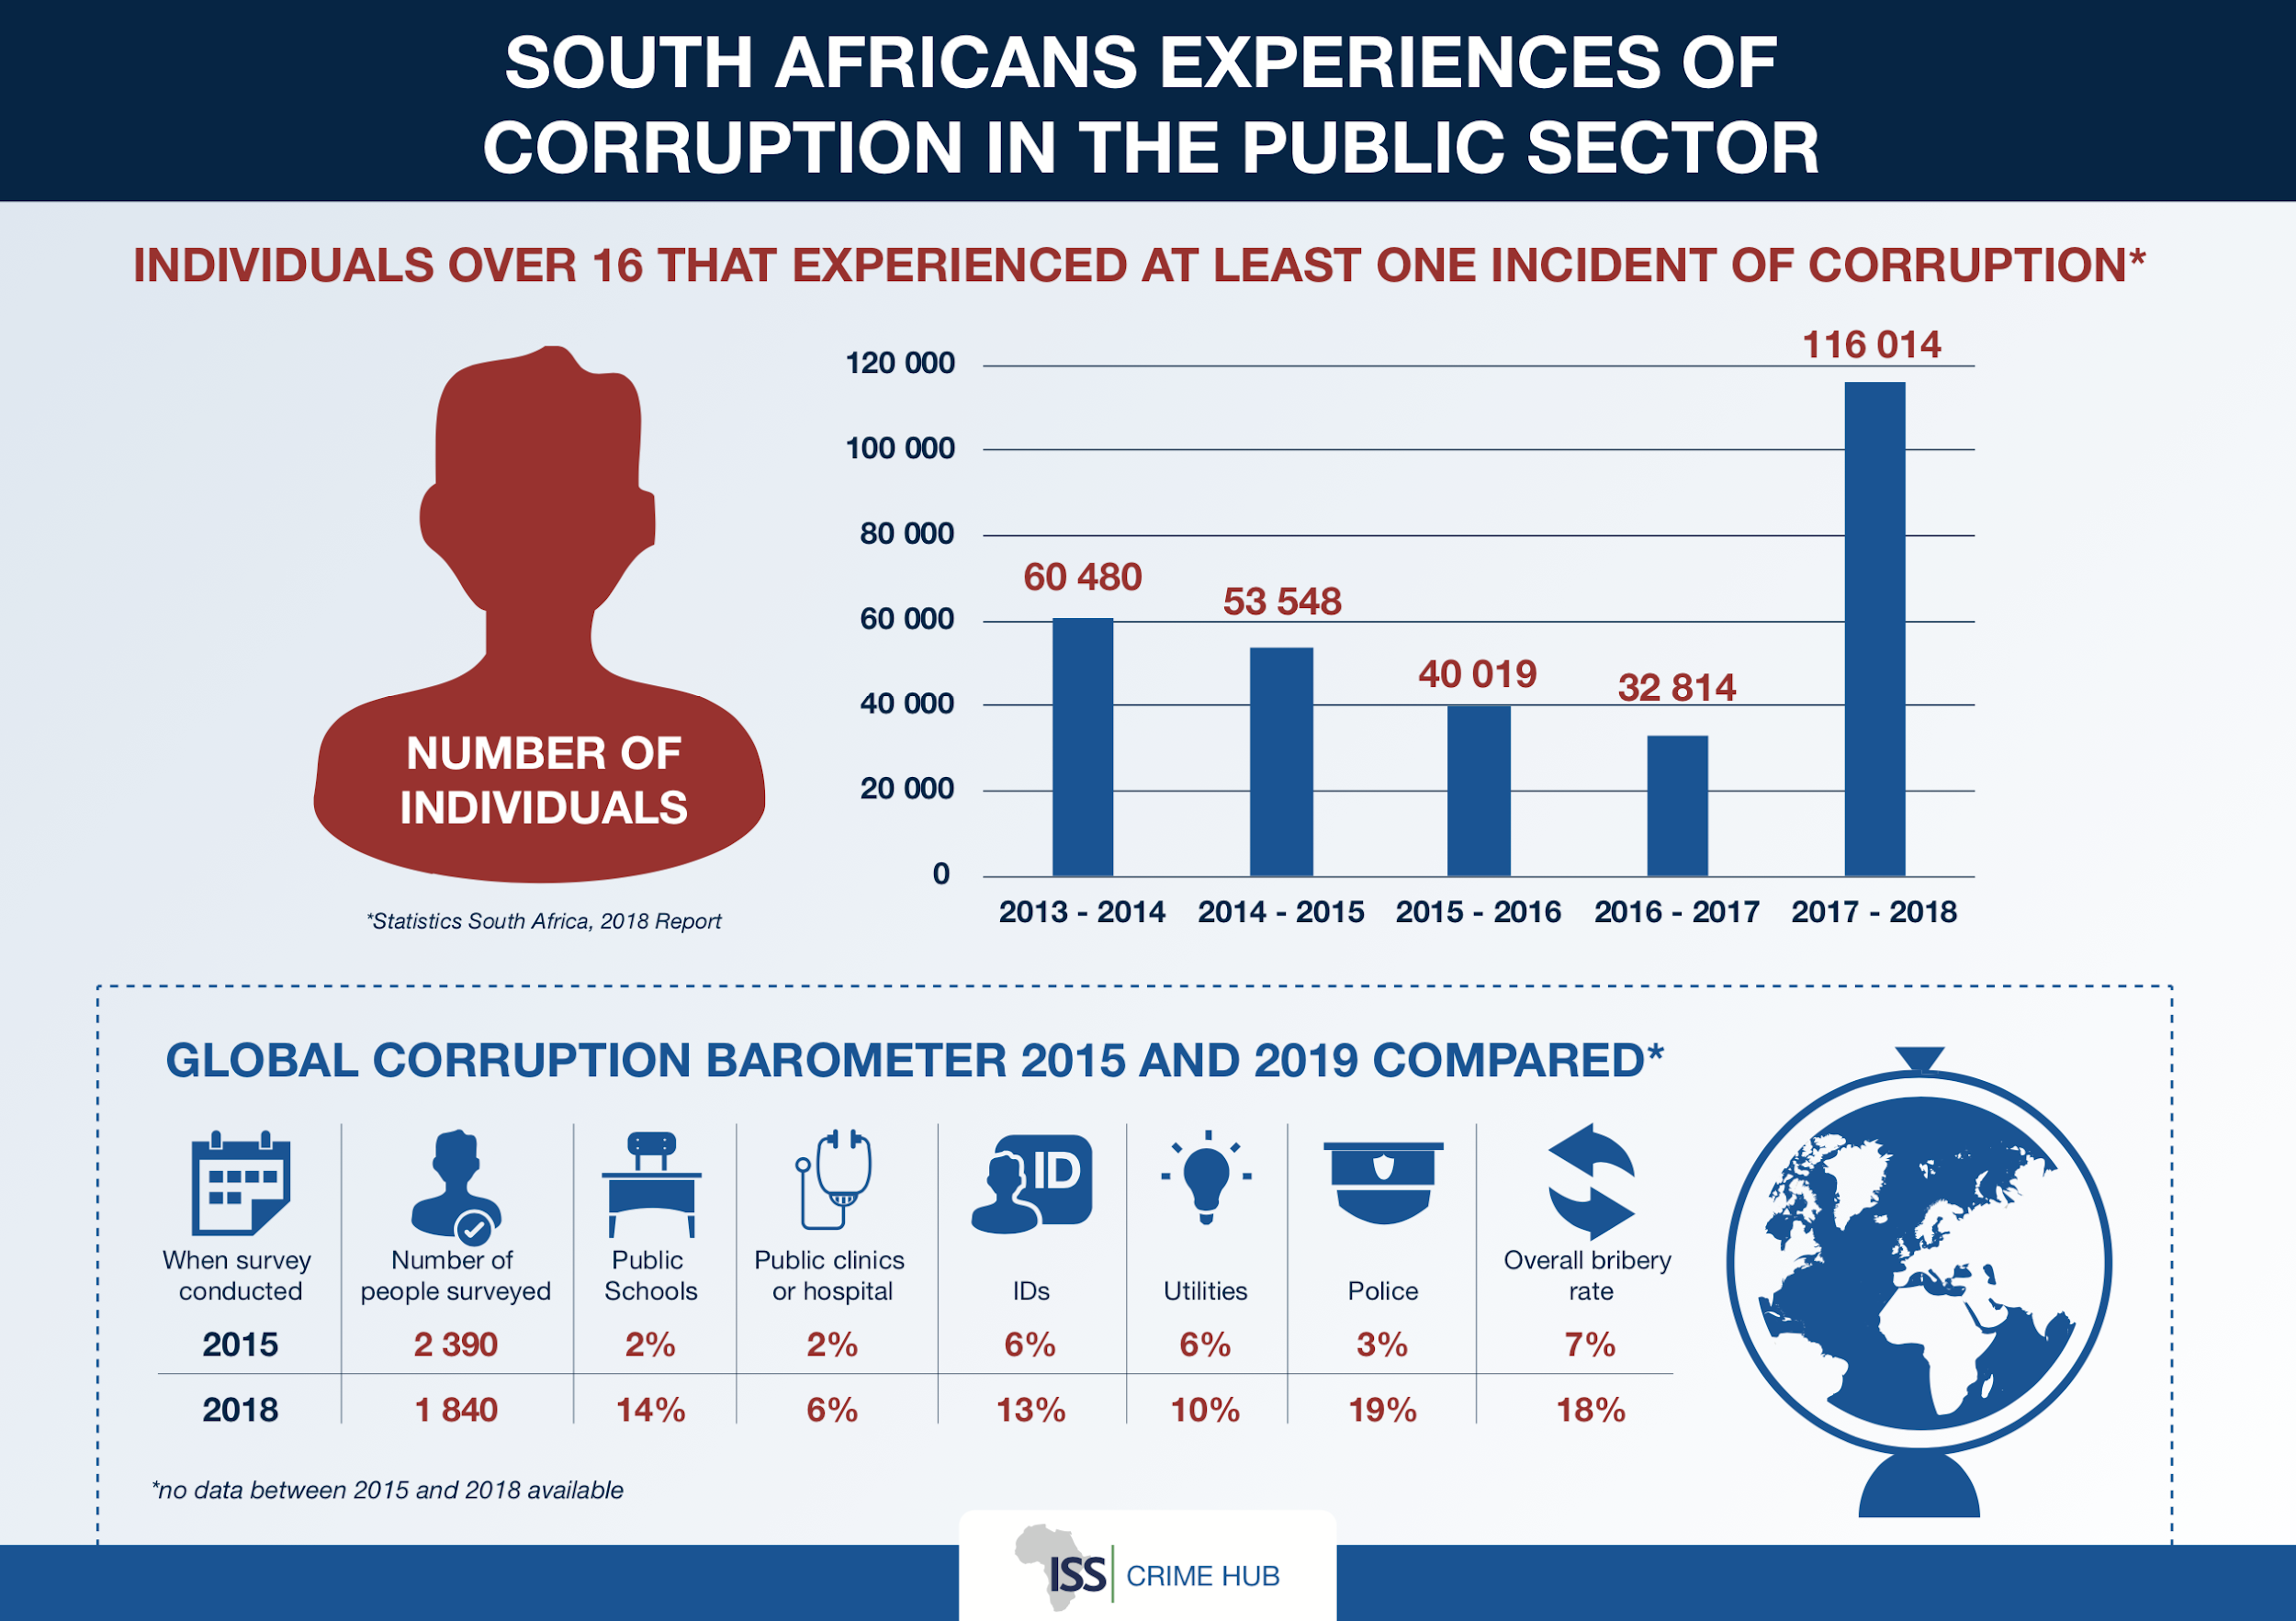

Slide 6
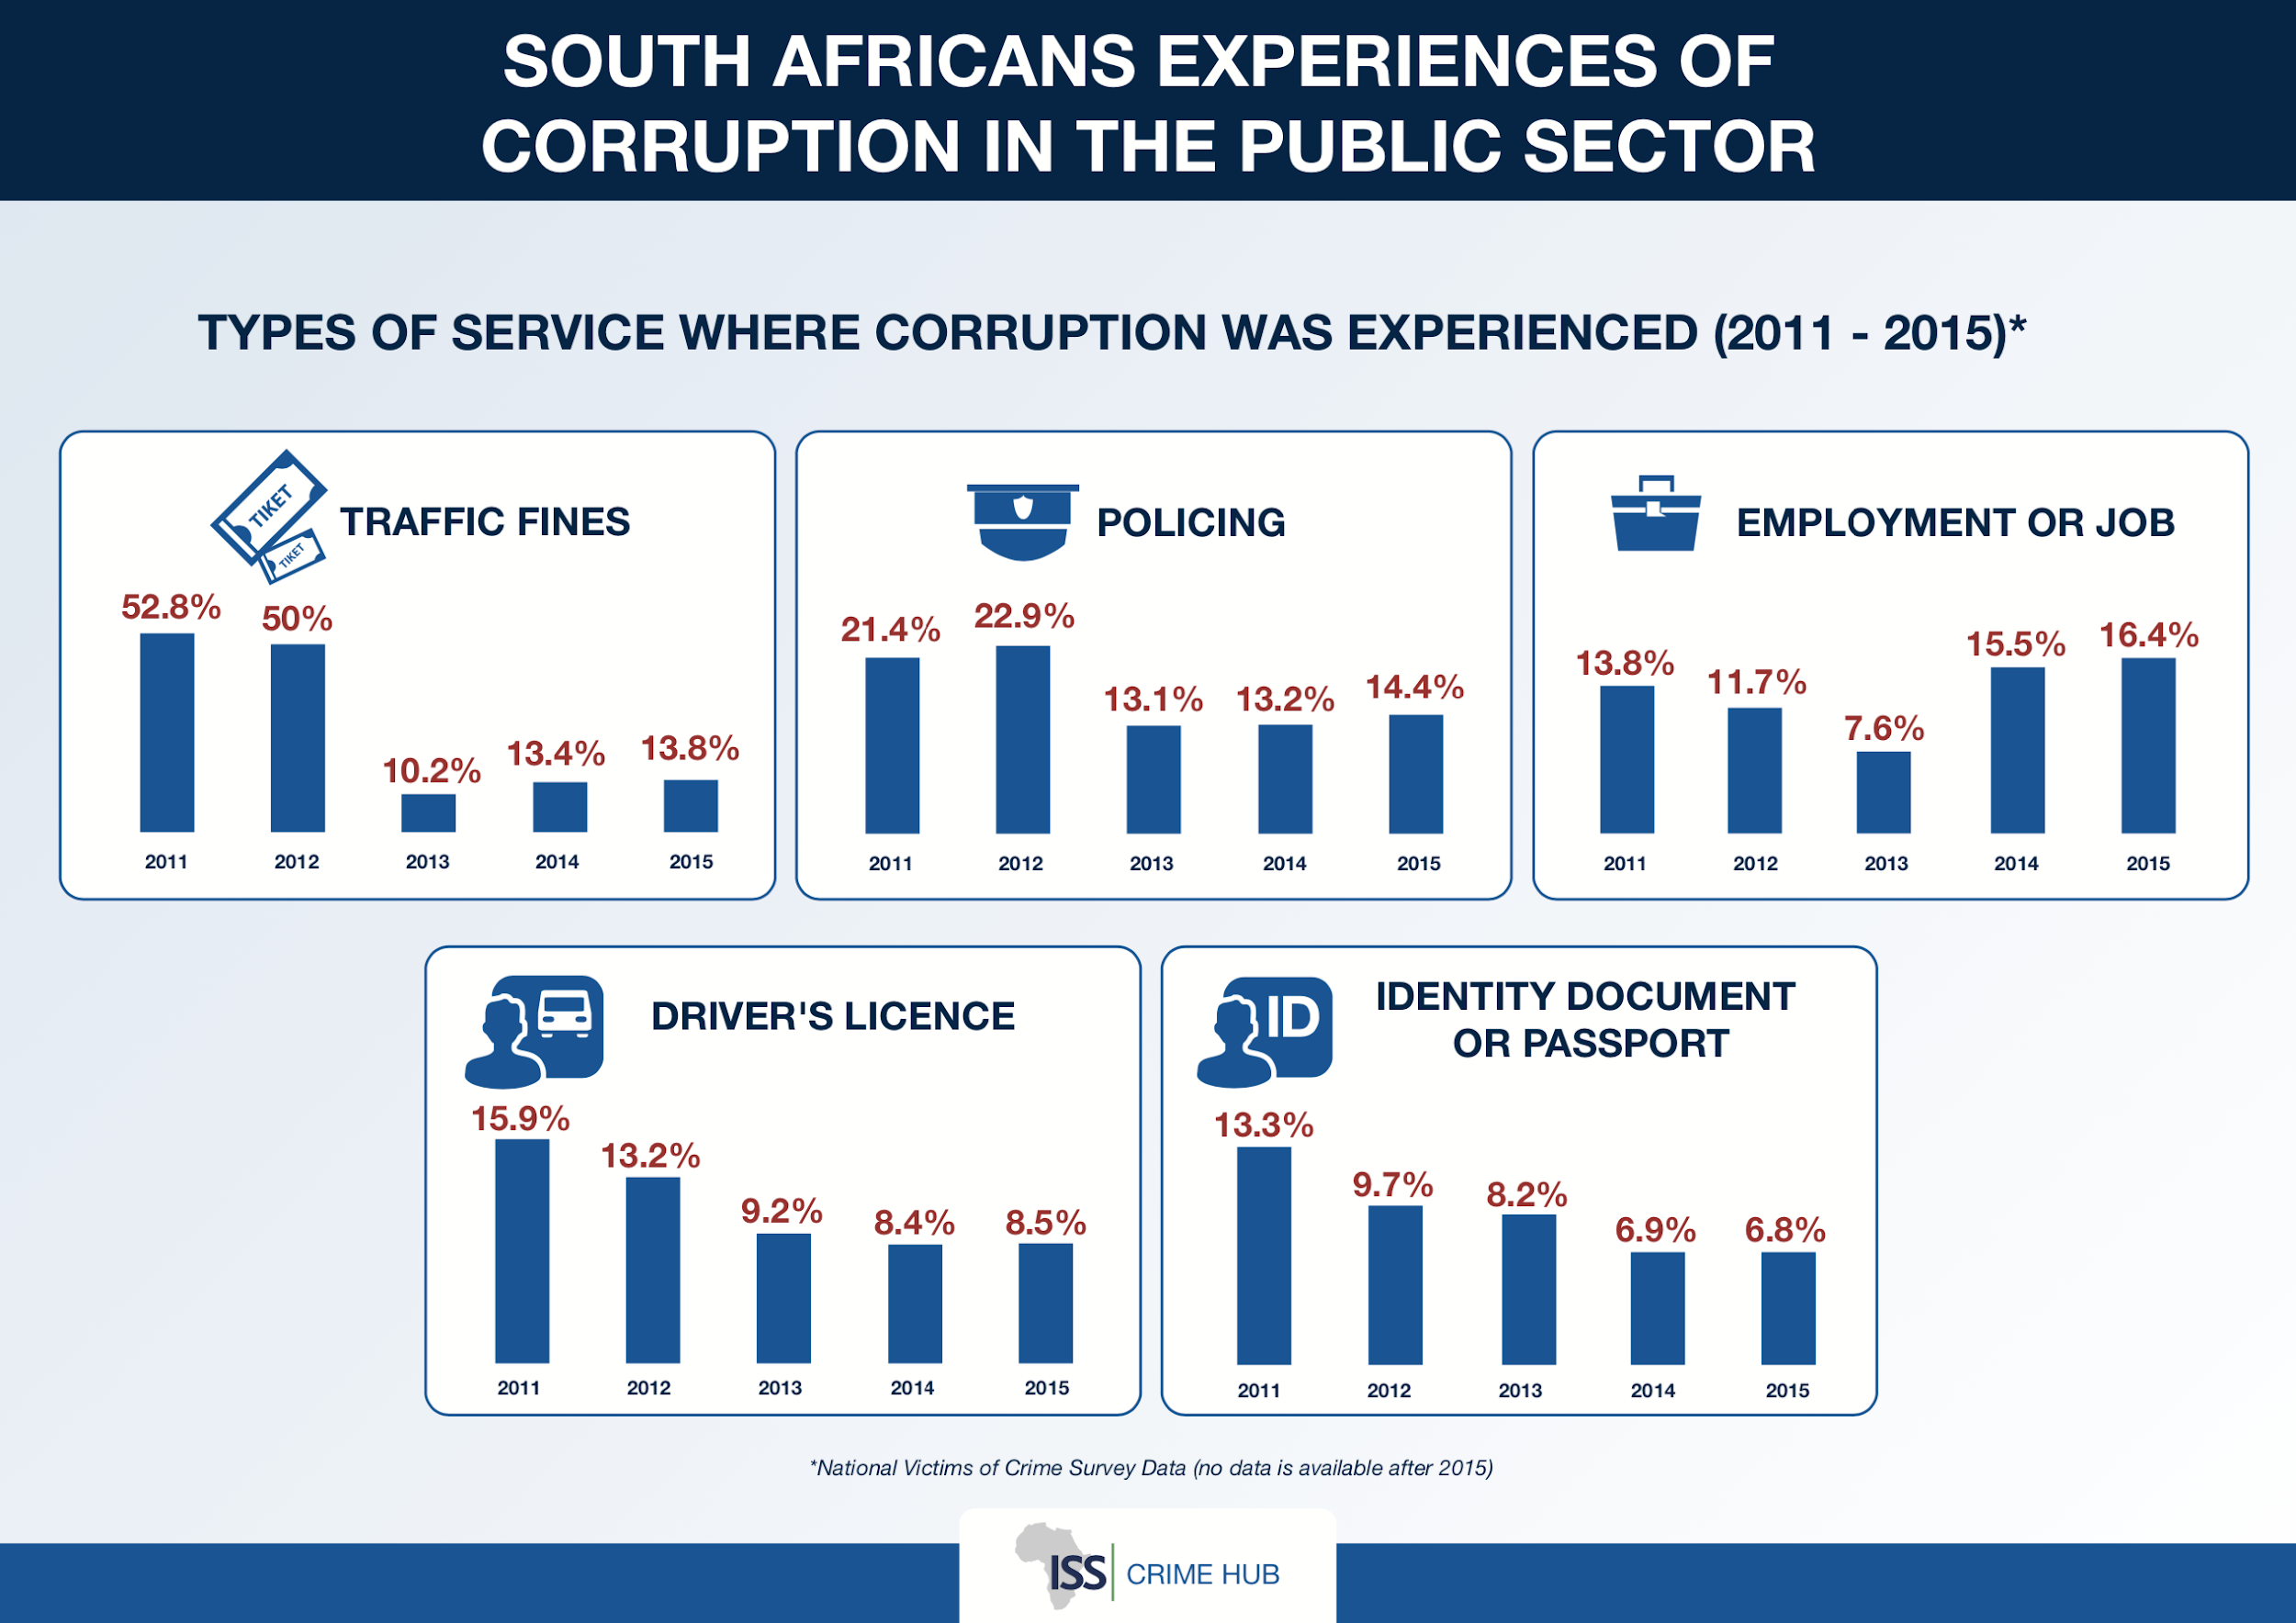

Slide 7
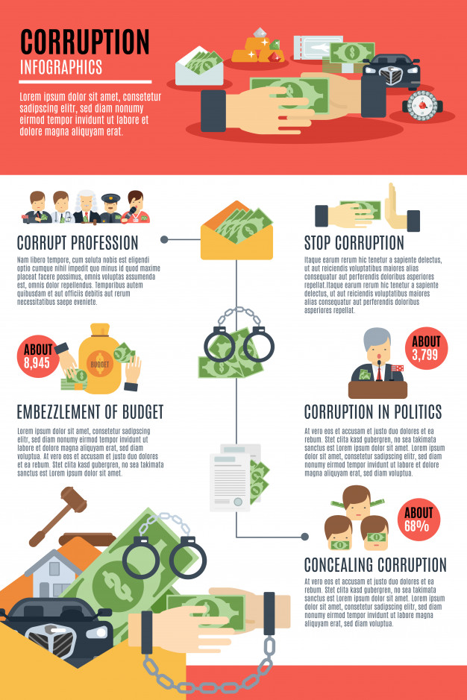
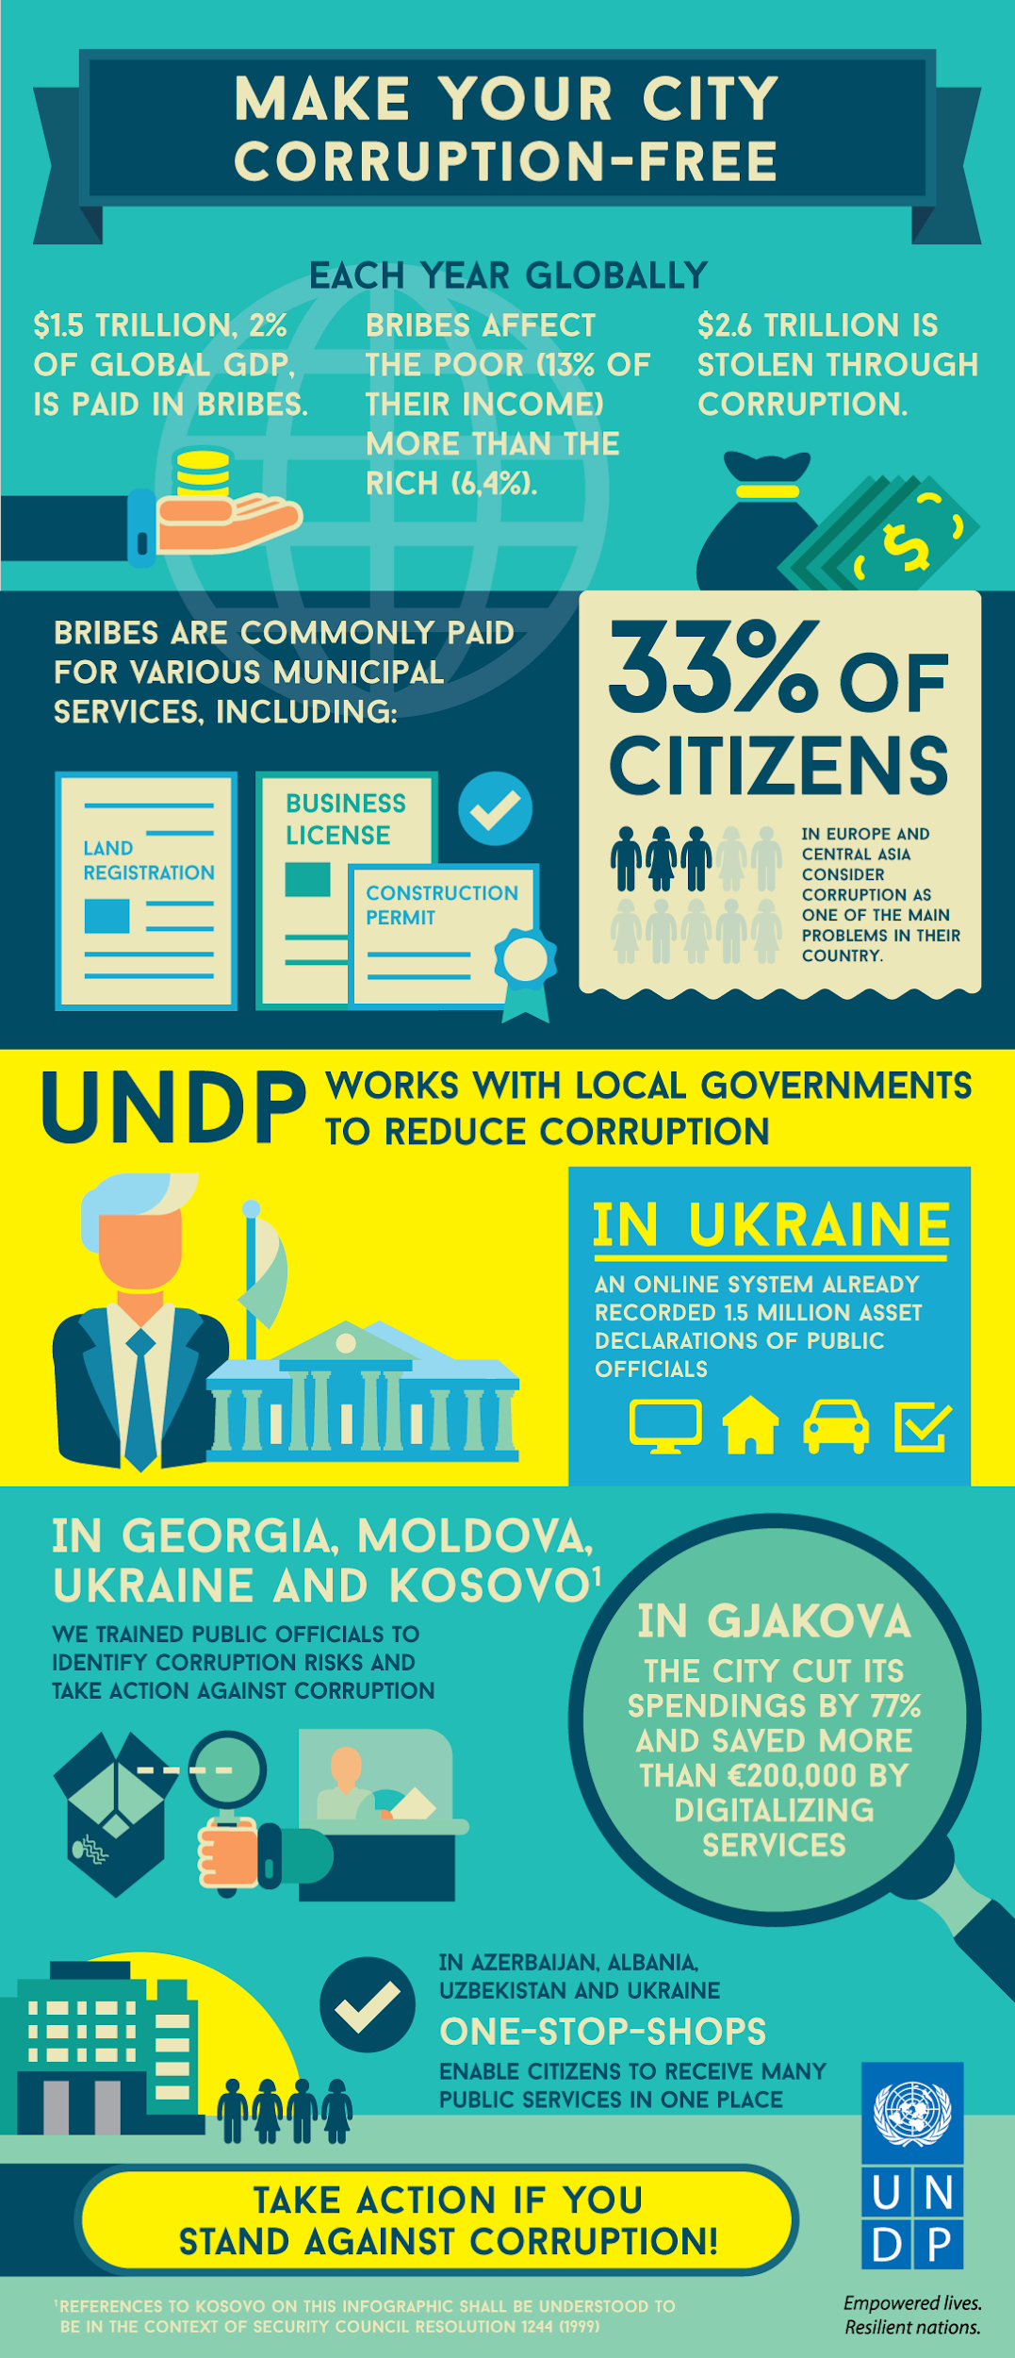
Corruption in South Africa
The Problem…
The Solution…

Slide 8
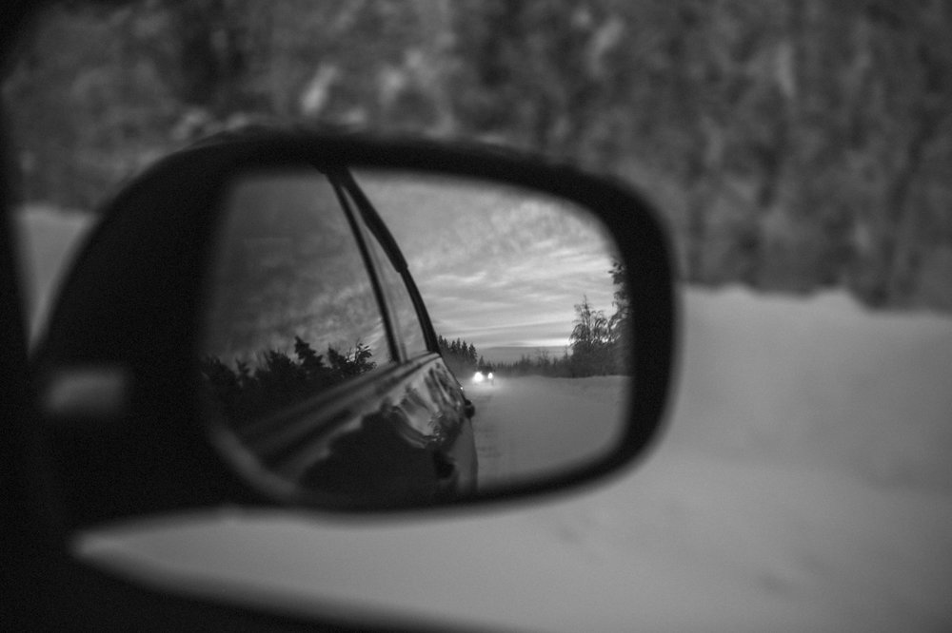
INDIVIDUAL REFLECTION
Why do you think teenagers avoid reporting corruption which they see amongst their peers like cheating in an exam?
How could you become a leader / activist that says NO to corruption amongst your peers and people in your local community?

