Slide 1


Notes:
Welcome back Grade 10s. I hope you were inspired by the people we covered in the last lesson. Sometimes we think we need to be famous or have lots of money to make a difference in the lives of others. Remember that you can make a positive difference (i.e. positively influence) in the lives of the people you encounter in your neighbourhood and in your school.
In the next lesson, your groups will present their campaigns in an exciting lesson. Today you will hear about other campaigns and what they have done. We’ll also give you some time later to finish planning the final aspects of your campaign.

Slide 2


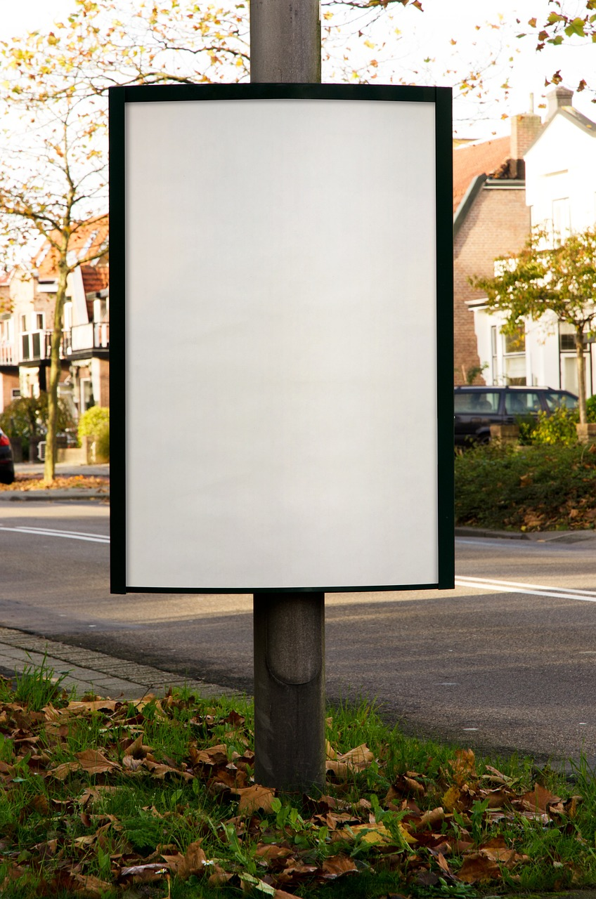
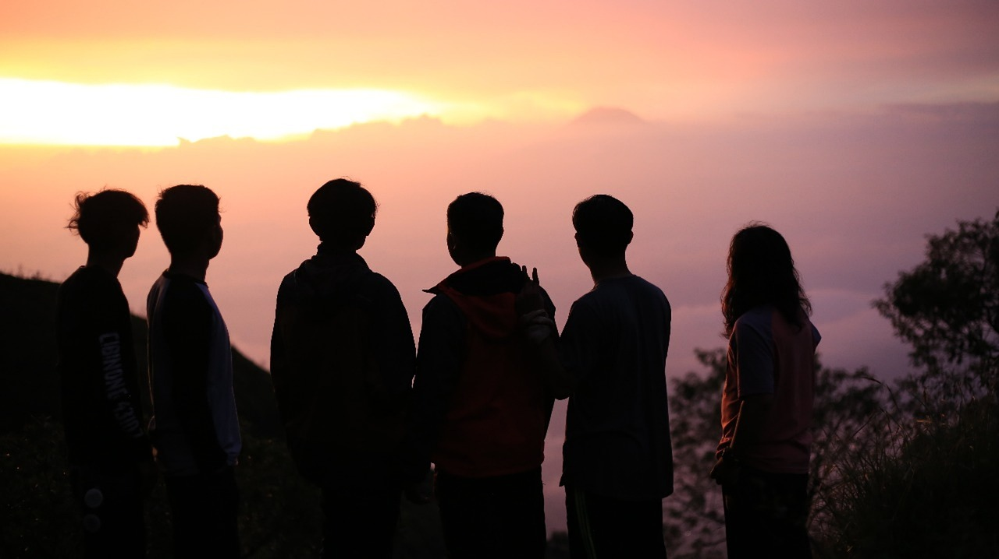

Lesson Outcomes
Evaluate South African Campaigns addressing Human Rights Violations.
Evaluate South African Campaigns that promote Nation Building.
Reflect on your own contribution to Human Rights Causes.
Notes:
In today’s lesson we will begin to:
Evaluate South African Campaigns addressing Human Rights Violations.
Evaluate South African Campaigns that promote Nation Building.
Reflect on your own contribution to Human Rights Causes.

Slide 3
In Groups of THREE
Reflect on some of the heroes that you encountered in the previous lesson. Share why they made an impact.
Now share about other Human Rights Heroes you may have encountered – these may be members of your community or even family that have done good for other people.
If someone in your group has told you of someone or an event that inspires you, write it down quickly. It is important to remember.
Notes:
Let’s start by looking again at some of the campaign's heroes from the last lesson promoted. In your groups, share with one another.
Reflect on some of the heroes that you encountered in the previous lesson. Share why they made an impact in South Africa?
Now share about other Human Rights Heroes you may have encountered – these may be members of your community or even family that have done good for other people.
If someone in your group has told you of someone or an event that inspires you, write it down quickly. It is important to remember.
Give each person in the group an opportunity to share.

Slide 4



https://www.mandeladay.com
Initiatives and Campaigns
Notes:
As we mentioned earlier, we’re going to look at campaigns that address human rights violations and evaluate their effectiveness. Before we start, I want you to look at this slide and look around the class and tell me the first thing you notice. Correct! The use of the colour orange. A campaign can get people to support their cause just by wearing a specific colour of clothing. How does it make you feel that just by wearing the orange clothes (or wearing orange wool around your wrists) I gave you, people will believe you support this campaign? (Allow learners to respond.)
In your groups, discuss the following questions on the Mandela Day Campaign. Write your agreed upon answers in Activity 1 (Lesson 4 – Worksheet).
Let’s start by looking at this campaign that addresses Human Rights Violations:
What is the purpose of this campaign?
State TWO ways in which you can participate in the Mandela Day Campaign.
State TWO ways in which the campaign attracts your attention.
Discuss ONE way in which this campaign has made a difference in specific communities.
Assess the effectiveness of the campaign.

Slide 5

https://www.sagoodnews.co.za/wp-content/uploads/2021/09/HeritageDay_ThisIsUs.pdf
Notes:
Let’s start by looking at this campaign that addresses nation building:
What was the purpose of this campaign?
State TWO ways in which you can participate in the This is Us Campaign.
Explain how they attract your attention.
Discuss how the effectiveness of the campaign can be measured.

Slide 6


Notes:
Let’s look at these two posters.
We can see that even though these two posters are different, they both communicate about women. The one focuses on women leading and the other on women suffering.
In your groups, discuss the differences between these two posters and write your answers in Activity 2 (Lesson 4 – Worksheet).

Slide 7
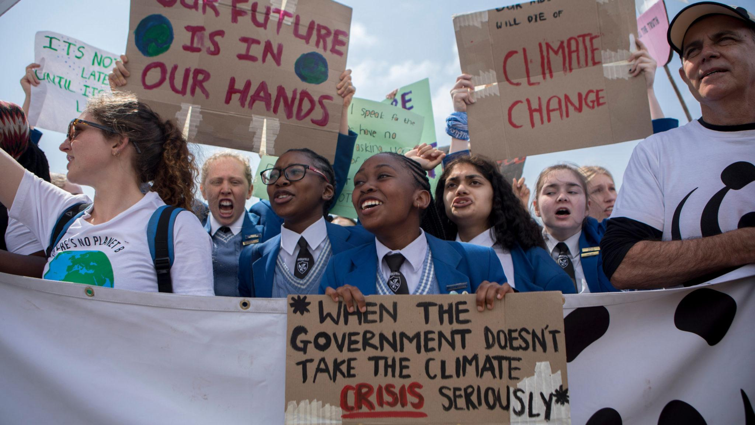
Let's Campaign!!!!!
This Photo by Unknown Author is licensed under CC BY-SA-NC
Notes:
Over the last two lessons, you have been working with your group on a Campaign Poster that you’ll present next lesson (Lesson 5). Part of the presentation of your campaign will also be an evaluation of your own campaign and that of your peers. Everyone in the class will have an opportunity to vote for the best Campaign Poster.
Let’s recap on the instructions you were given:
Decide on an issue relating to human rights that you want to bring to the attention of the school.
Your poster should let the viewer know what the human rights issue is; information / statistics relating to your HR issue; what you as learners at school can do about the issue; and any further details of your campaign.
Your instructions for your poster included:
Logo and poster design
Research
Media (What media are we going to use?)
Are we going to use other items? (ribbons, buttons; fliers)
Who will present the campaign?
You will have some time now to finish off your planning for the implementation of your campaign in the next lesson. Based on what you learnt today, evaluate the effectiveness of your poster. Discuss with your group any final changes that you should make.

Slide 8

R E F L E C T I O N
Notes:
This lesson has looked at your role in evaluating the effectiveness of the campaigns to address human rights. The skill of reflecting and evaluating is a life skill!
As we come close to the end of this series of lessons, reflect on how confident you feel about understanding the work that has been covered. Complete Activity 3 (Lesson 4 – Worksheet).

