Slide 1




Term 3: Lesson 4
Notes:
Introduction (1 min)
Welcome back Gr12s! This is our last lesson for Careers and Career Choices. This lesson will focus on work ethics and societal expectations as well as the value of work in our everyday lives.

Slide 2
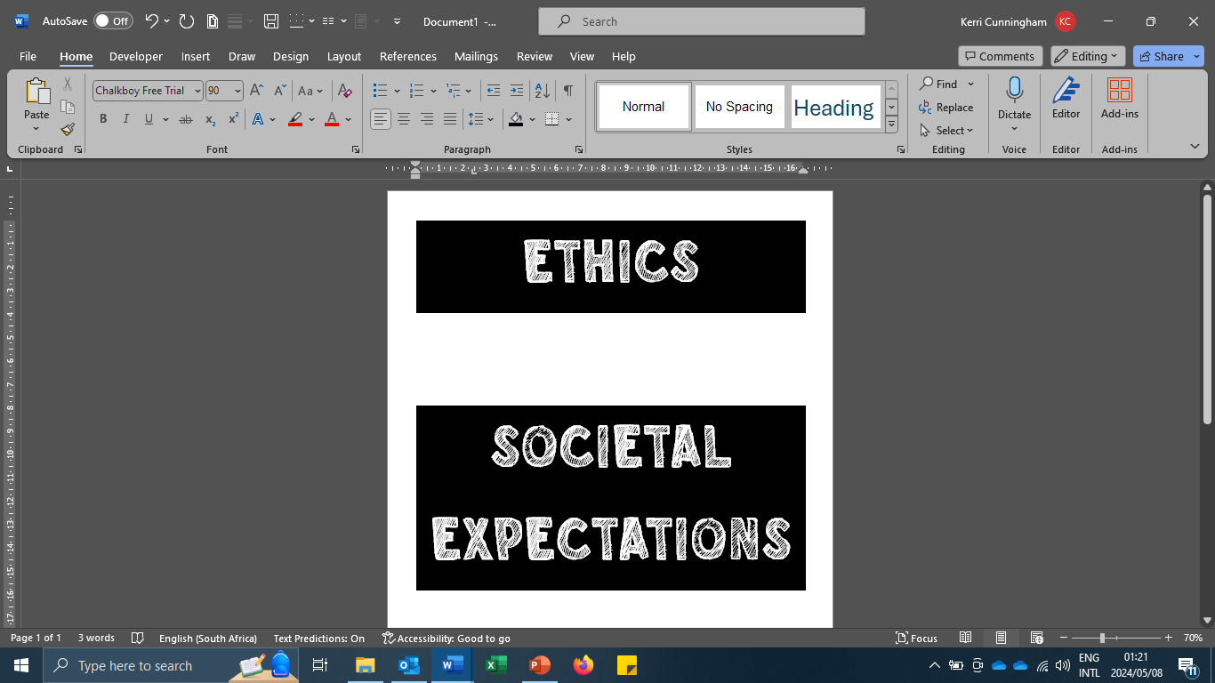
Notes:
Introduction (3 min)
Ask learners to explain what they understand under the terms "societal expectations" and "ethics".
Ethics guide us to tell the truth, keep our promises, or help someone in need. There is a framework of ethics underlying our lives daily, helping us make decisions that create positive impacts and steering us away from unjust outcomes. In other words, it refers to the principles and values that guide an individual's behaviour, such as honesty and integrity.
Societal expectations are the norms, beliefs, and standards that society collectively holds regarding how individuals should behave, including their conduct at work. These expectations may vary across cultures and communities but generally influence how people interact, communicate, and fulfil their responsibilities in the workplace.

Slide 3


Ethics in the Workplace –
A Good Work Ethic
Watch: https://www.youtube.com/watch?v=b_n6i1ug0tQ (2 min 11 sec)
Notes:
Watch Video & Discussion (7 min)
Watch: Ethics in the Workplace - A Good Work Ethic https://www.youtube.com/watch?v=b_n6i1ug0tQ (2 min 11 sec)
Ask learners to discuss the following question with the person sitting next to them: What role does personal character play in shaping one's work ethic?
Allow a few minutes for feedback. Answers may include:
-Individuals with strong character values, such as honesty and trustworthiness, are more likely to exhibit a robust work ethic.
- Those with a strong character take ownership of their actions and responsibilities at work, consistently striving to meet their obligations and contribute positively to their team.
- Employees who are punctual, diligent, and consistent in their performance help create a stable and productive work environment.
- Individuals with a strong character often display a positive attitude and perseverance, even in the face of challenges.

Slide 4
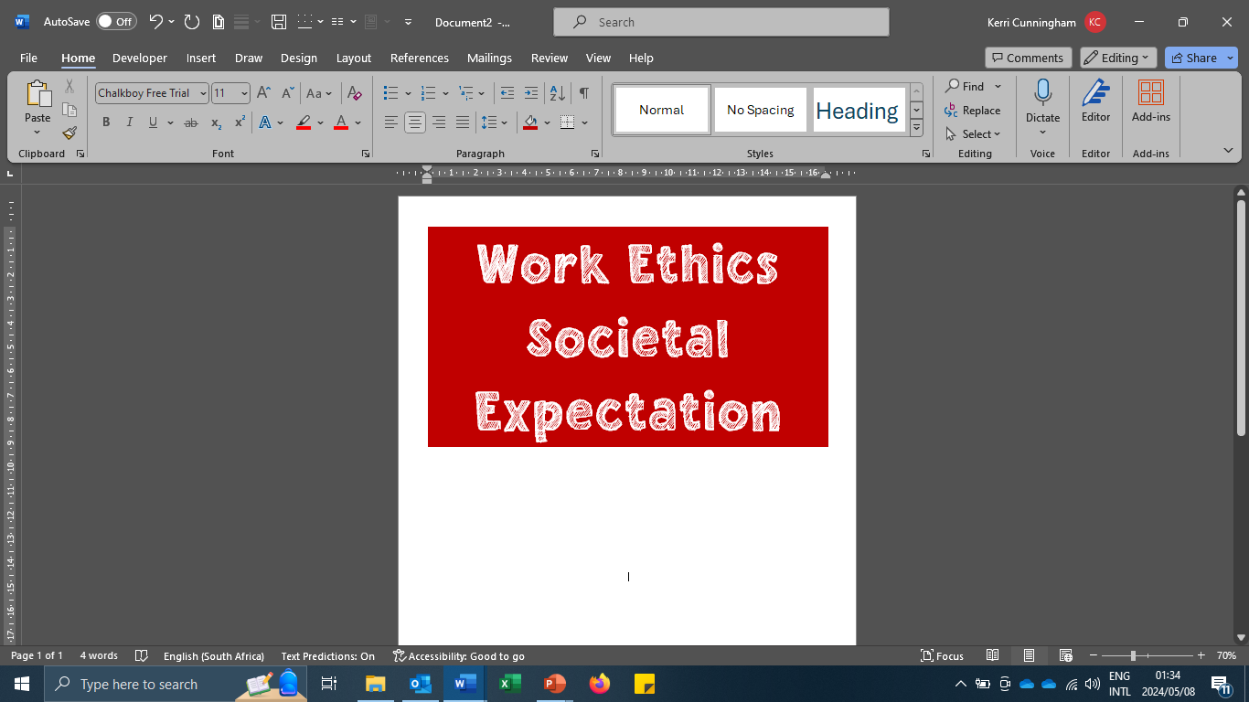

Notes:
Teaching & Discussion (4 min)
Work ethics deals with a worker’s attitude towards his or her job and employer. You can compare it with your attitude towards your school and your responsibility towards your schoolwork.
It involves attitudes, behaviour, respect, honesty, accountability, communication, and interaction with other people.
It can be compared with how you approach your studies, respect your teachers and fellow learners and make your school a better place.
Good work ethics refers to a positive attitude and commitment to your work, or in your case your school.
Work ethics demonstrate the decisions you make about what is right and acceptable against what is wrong and unacceptable. Work ethics come from within a person and give others a picture of your values, culture, and upbringing.
People with good work ethic are likely to keep their jobs and be successful at work. They will also benefit from their good ethics by coming in line for promotion.
The skills of having good work ethics are referred to as soft skills e.g. the willingness to learn and to be taught by a senior or supervisor, the ability to get along with other workers, the behaviour and attitude of the worker towards the company, being on time and being at work without taking leave or sick leave unnecessarily or without proper reason.
Good work ethics start the moment you apply for a job. You will show this by submitting a neat, complete, and well-organised application without any mistakes.

Slide 5

Notes:
Teaching & Discussion (4 min)
Work Ethics and Societal expectation:
Societal expectation refers to what the society and people in your community expect of others sharing the community with them. It is about how people expect other people to behave and how to treat each other.
It can almost be compared with our basic human rights in our constitution, like the right to be treated with respect, to be safe, to be treated with dignity and not judged unfairly.
It also refers to our environment and how we expect others to treat and protect it. When you enter the world of work, people in the workplace will have certain expectations of you and the way you behave.
Each society and community will have its own expectations based on the culture, values, and religion of the society.
When you apply for a job, you should make sure your personal values and beliefs fit in with the expectations of society.

Slide 6

Value of Work
Notes:
Teaching & Discussion (2 min)
Ask learners to give their opinion on the following questions: Does our work bring value to our lives? Should it bring value to our lives or is it just a job so we can pay the bills? (Allow 3 minutes for discussion).
Slide 7: Let's watch a video by Stan Lee (Marvel comic book writer).
Watch: Stan Lee - Do Meaningful Work https://www.youtube.com/watch?v=iyY28MywuoE (0 min 38)
What is your takeaway from this short video? Do you think what Stan Lee had to say is meaningful? (Allow 3 minutes for discussion).

Slide 7

Stan Lee –
Do Meaningful Work
Watch: https://www.youtube.com/watch?v=iyY28MywuoE (0 min 38 sec)
Notes:
Teaching & Discussion (3 min)
Let's watch a video by Stan Lee (Marvel comic book writer).
Watch: Stan Lee - Do Meaningful Work https://www.youtube.com/watch?v=iyY28MywuoE (0 min 38)
What is your takeaway from this short video? Do you think what Stan Lee had to say is meaningful? (Allow 3 minutes for discussion).

Slide 8
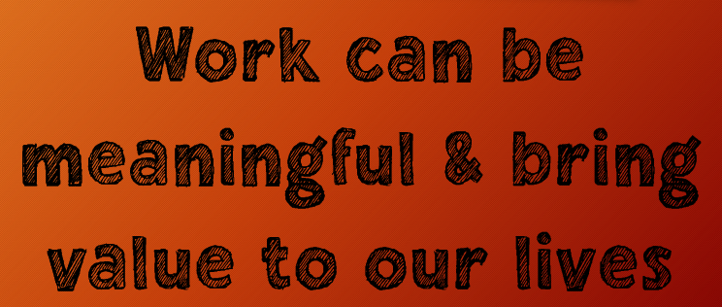
Notes:
Teaching & Discussion (3 min)
Work is not only about earning money. It gives us purpose and meaning and helps us to live a fulfilled life. It gives meaning to life because it allows you to:
- grow and develop in yourself (self-esteem, skills, confidence, etc.).
- get a sense of purpose and an opportunity to contribute to society.
- set and achieve goals that add meaning to your life.
- use your talents and abilities to make a difference in the world.
- grow and develop to reach self-actualisation (achieve your potential).
- build social connections with colleagues and clients, which can lead to lasting friendships and professional networks.
Practically, work provides individuals with a means to earn a living, support themselves and their families, and contribute to the economy. It fosters productivity, innovation, and the creation of goods and services essential for society's functioning.
Work can offer a sense of purpose, fulfilment, and personal growth. It allows individuals to utilise their skills, talents, and creativity, leading to a sense of accomplishment and self-worth. Work also plays a crucial role in shaping one's identity and social connections, providing opportunities for collaboration, learning, and building relationships.
Ultimately, the value of work extends beyond mere economic transactions; it is intertwined with human dignity, well-being, and the overall fabric of society.

Slide 9
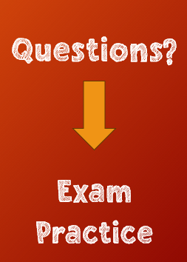

Notes:
Individual Activity (12 min)
That brings us to the end of this lesson series. Before you start your exam practise – are there any questions regarding the content we covered in the past four weeks?
Hand out Lesson 4 – Worksheet and Content Summary.
In preparation for the upcoming LO CAT, please complete Activity 1 in Lesson 4 – Worksheet. Whatever you cannot complete during this lesson, must be completed for homework.
Answers are available on Lesson 4 – Worksheet MEMO which can be shared with learners at the start of the next lesson.

