Slide 1
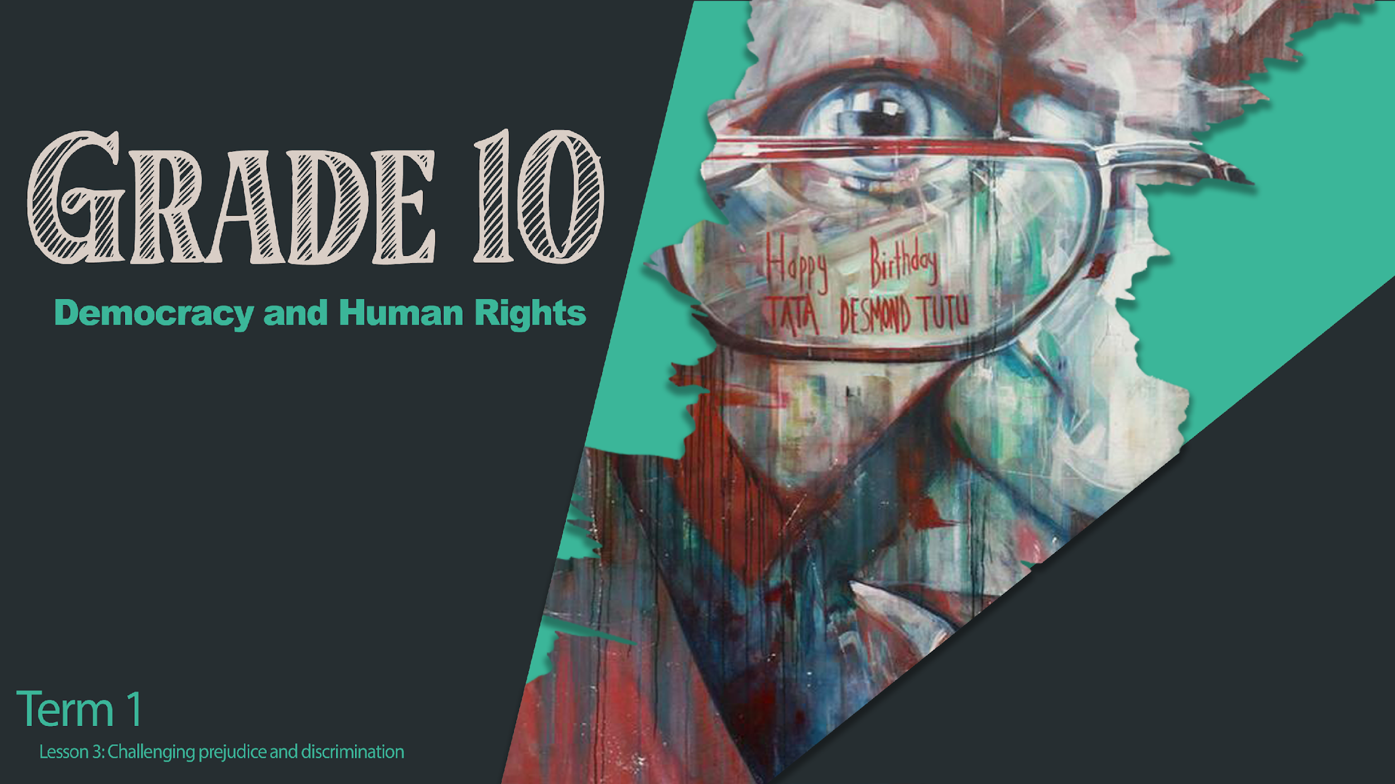
Notes:
Welcome back to the third lesson in our series on Democracy and Human Rights.

Slide 2

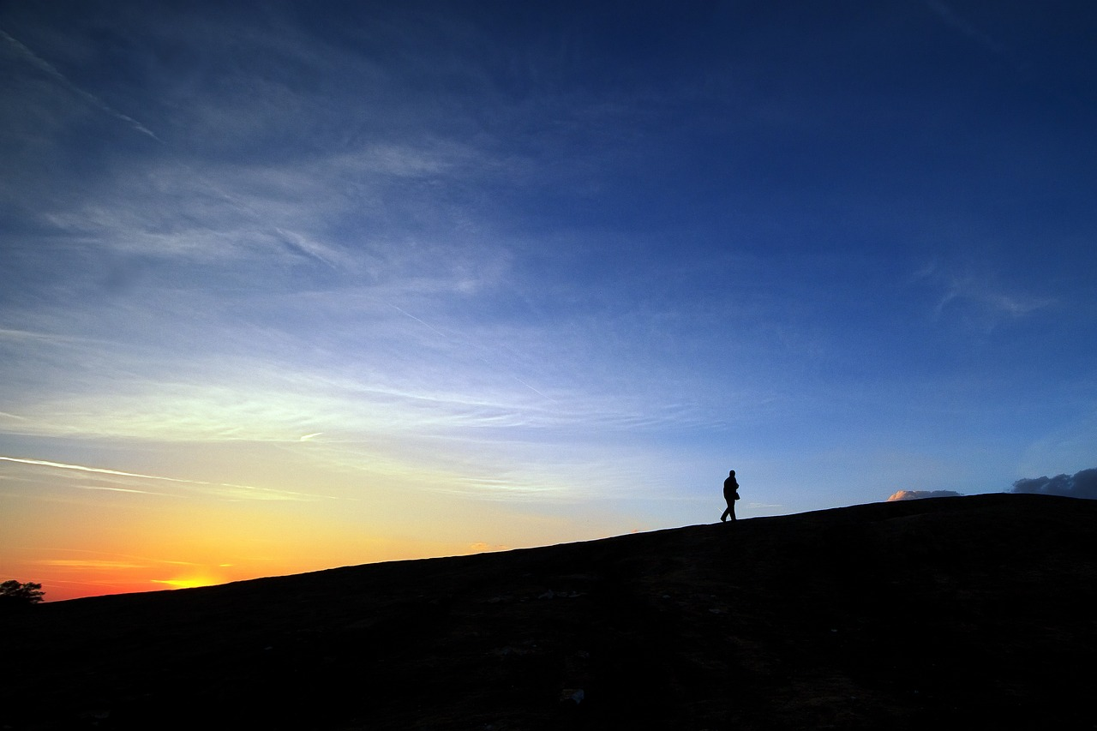
Learning Outcomes
Look at Human Rights Champions and what drives them to step up and make significant contributions
Touch base with the Campaign Planning!
Notes:
In the previous lesson, we grappled with human rights violations and discussed what the victims of these violations go through. It is so important that we view each other with understanding and empathy.
Quickly share with the person sitting next to you: What you would like people to remember you for?
Today we will be looking at Human Rights Champions and what drives them to step up and make / made significant contributions. Furthermore, we’ll be touching base regarding the Campaign Planning (for Lesson 5).
Trust you will be inspired today and will want to leave your own legacy of hope in the years to come.

Slide 3
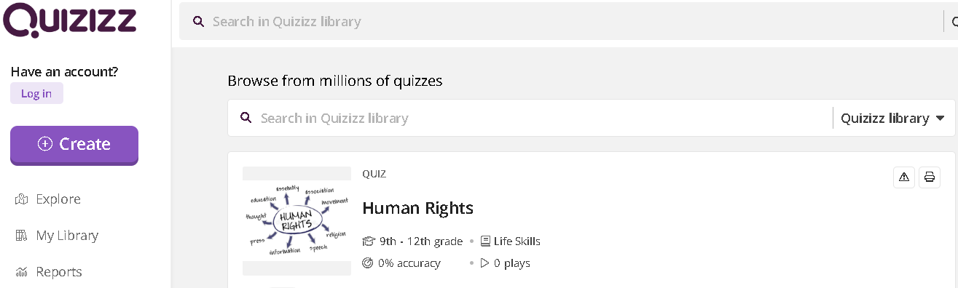
Let us see what you can remember for the previous sessions: Follow this link to answer the quiz:
https://quizizz.com/admin/quiz/65058c10bcb5e839e1ffb768?source=quiz_share
Notes:
Answer the quiz questions to see what you remember from our previous lessons. This shouldn’t take longer than 6 minutes. Complete Activity 1 (Lesson 3 – Worksheet).

Slide 4
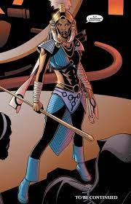
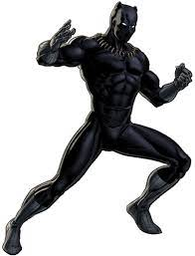

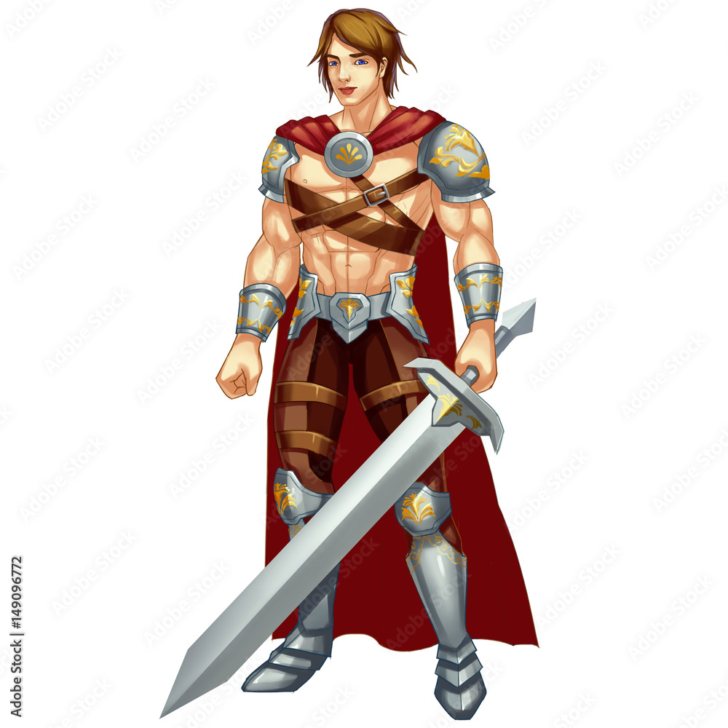


What is your idea of a Hero?
Notes:
Everybody’s idea of a hero is different, but if you had to think about it, there are personal qualities that we would look for in a hero. What are some of those qualities?
Complete Activity 2 (Lesson 3 – Worksheet).

Slide 5
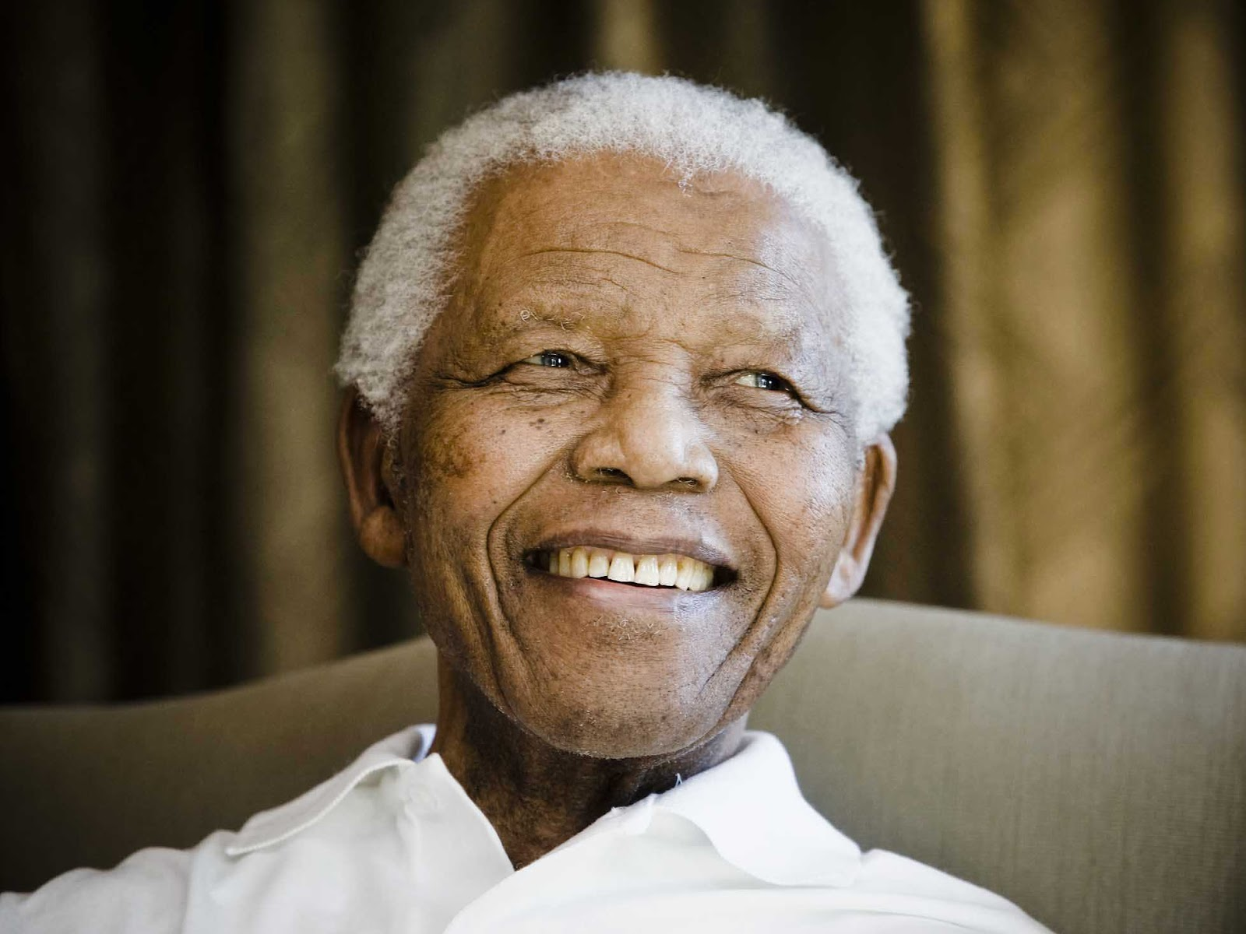
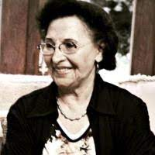
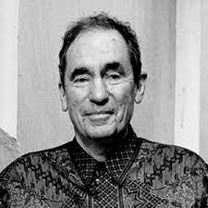
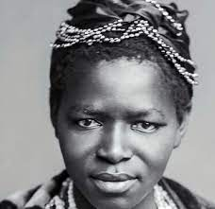
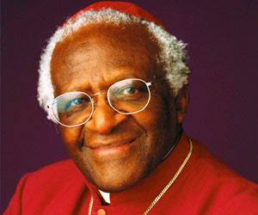
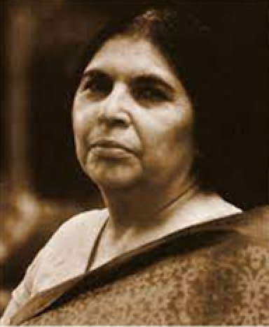
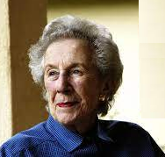
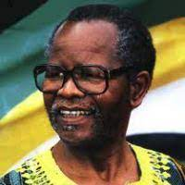
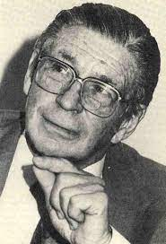
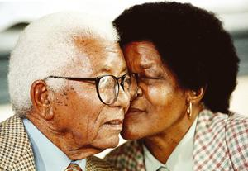
Human Rights Champions
Notes:
Because of our difficult past in South Africa, there are so many people who sacrificed their time, their lives and their careers so that we might enjoy freedom, equality and human rights. They deserve our greatest respect. Amongst these champions are Nelson Mandela, Albie Sachs, Charlotte Maxeke, Desmond Tutu, Sophie Williams-De Bruyne, Fatima Meer, Oliver Tambo, Walter and Albertina Sisulu, Beyers Naude and Helen Suzman.
However, no nation will ever be completely free and completely fair and so this lesson we will be looking at three Human Rights Champions who live in our world today.
Their passion for serving people inspires us to do a little more every day.

Slide 6
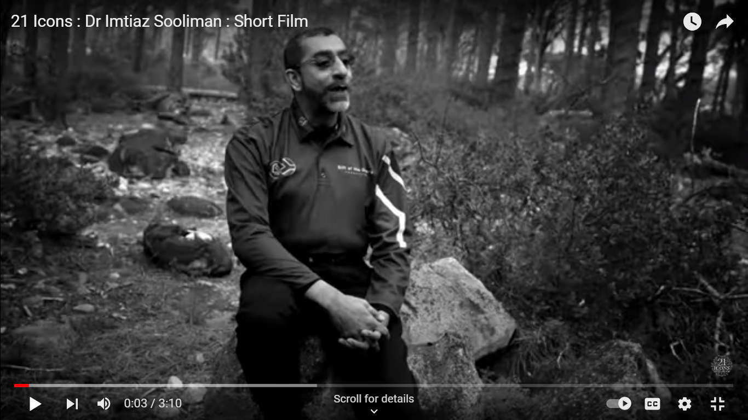

Dr Imtiaz Sooliman
https://www.youtube.com/watch?v=U4JAqwqdfjw
Notes:
Learners will complete questions on Activity 3 (Lesson 3 – Worksheet) for the next few video clips.
Intro 1 min / Video 3:10 min / Activity Response 4 min (Total Time: 8 min 10s)
Intro: Dr. Imtiaz Sooliman is a renowned South African philanthropist and humanitarian who has dedicated his life to making a positive impact on the lives of those in need. Sooliman founded the Gift of the Givers Foundation in 1992, a non-governmental organisation that has since become one of the largest disaster relief organisations in Africa. Under his leadership, the foundation has provided critical aid and support to millions of people affected by natural disasters, conflict, and poverty across the globe. A medical doctor by profession, Sooliman combines his medical expertise with his humanitarian passion, often leading medical teams to disaster-stricken areas to provide immediate healthcare and relief.
Watch: https://www.youtube.com/watch?v=U4JAqwqdfjw

Slide 7
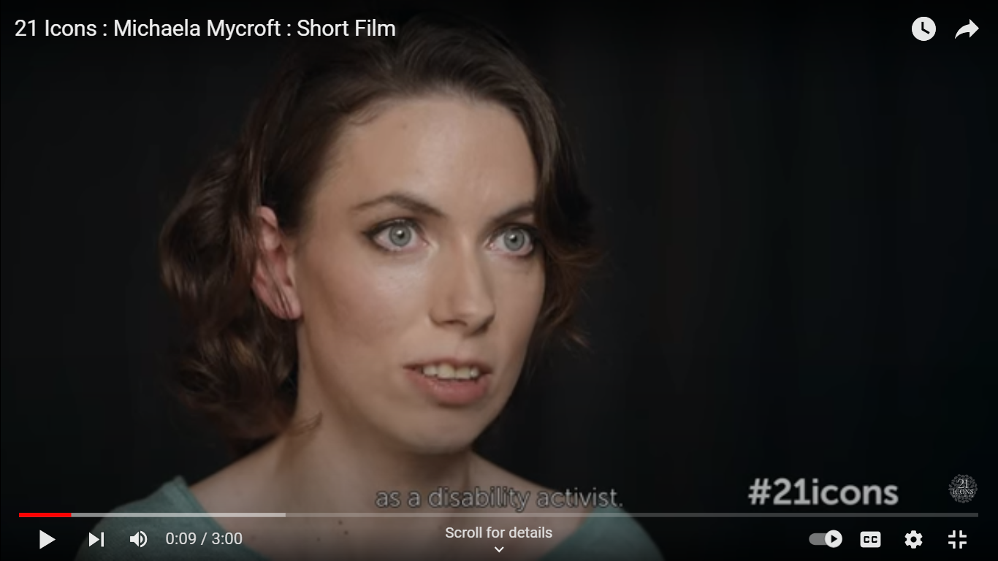

Michaela (Chaeli) Mycroft
https://www.youtube.com/watch?v=SuRlW4LPJdo
Notes:
Teacher Input 1 min / Video 3 min / Activity Response 3 min (Total Time: 7 min)
Intro: Michaela Mycroft is a South African disability activist and lawyer known for her tireless advocacy for the rights of people with disabilities. Born in 1994 with cerebral palsy, she overcame numerous challenges to become a prominent figure in the disability rights movement. Mycroft co-founded the organisation, "The Chaeli Campaign" in her teenage years, which focuses on empowering children with disabilities through various initiatives. She has received numerous awards and recognition for her work, including the prestigious International Children's Peace Prize. Mycroft's dedication continues to inspire positive change worldwide.
Watch: https://www.youtube.com/watch?v=SuRlW4LPJdo

Slide 8
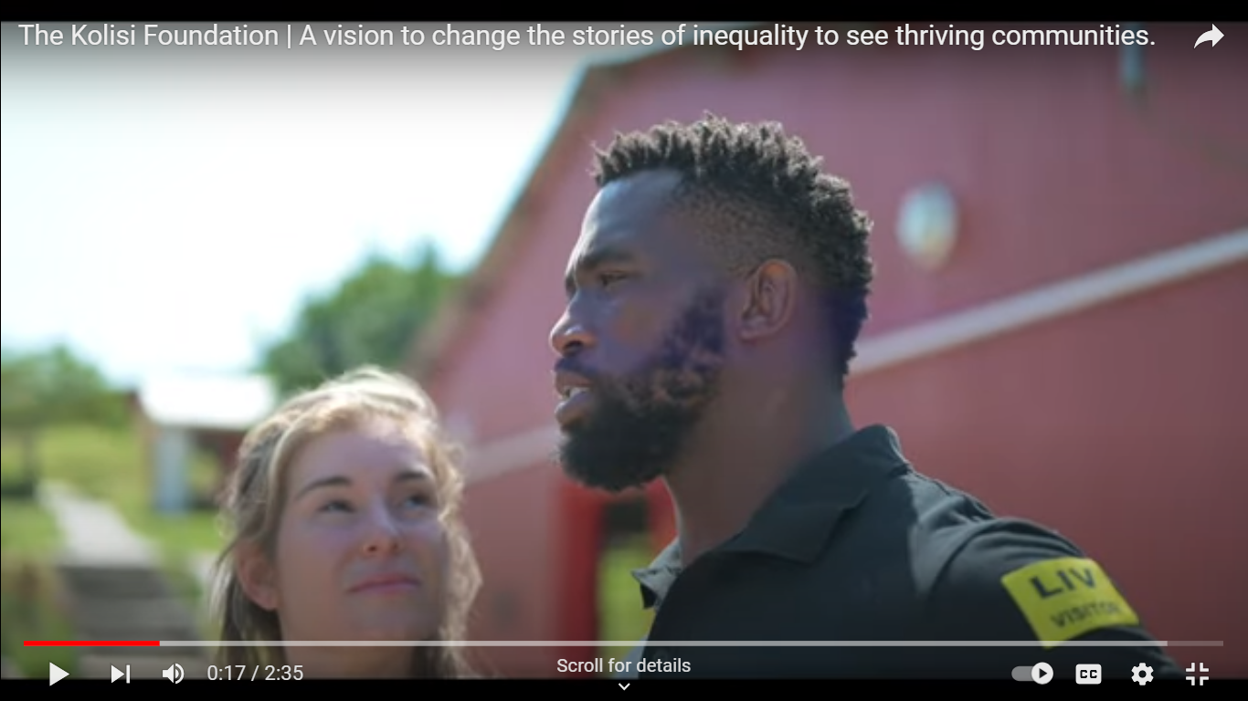
Rachel and Siya – Kolisi Foundation
https://www.youtube.com/watch?v=GbxQ-1aM828&t=9s
Notes:
Intro 1 min / Video 2:35 min / Activity Response 3 min (Total Time: 6min 35s)
Intro: In this clip, you will see the work of Rachel and Siya Kolisi and their foundation. Siya Kolisi is famous for being a South African Rugby Captain who won the World Cup Rugby Tournament both in 2019 and 2023. Back in 2019, Siya and Rachel decided that they wanted to use their public profile to help people who struggle in South Africa, particularly amongst the poor communities. The Kolisi Foundation targets food shortages, access to education and sport, and gender-based violence as part of their outreach.
Watch: https://www.youtube.com/watch?v=GbxQ-1aM828&t=9s

Slide 9

How is your campaign coming along?
Plan your team roles and responsibilities.
Plan a time to collaborate on your poster.
Fill out the campaign profile during the week.
Notes:
Last lesson we initiated a Campaign Poster to be presented in two lessons’ time (i.e. Lesson 5). In your groups you needed to brainstorm a suitable topic / issue for your poster and campaign.
Use the next 4 minutes to put together your plan of action. Look at the Checklist in Activity 4 of Lesson 3 – Worksheet and plan your team’s roles and responsibilities.
Also discuss how you want to make your campaign stand out and be original – E.g. think about the red ribbon to show awareness / support for people living with HIV.
You will also need to evaluate the effectiveness of each groups’ campaign, so be prepared to vote in two lessons time.

Slide 10

R E F L E C T I O N
Notes:
As we come to an end of this lesson, reflect on the following on Activity 5 (Lesson 3 – Worksheet).
1. Who or what in the three videos inspired me the most?
2. What do I think is the greatest quality of a Human Rights Champion?
3. What small action can I start DOING today?

