Slide 1
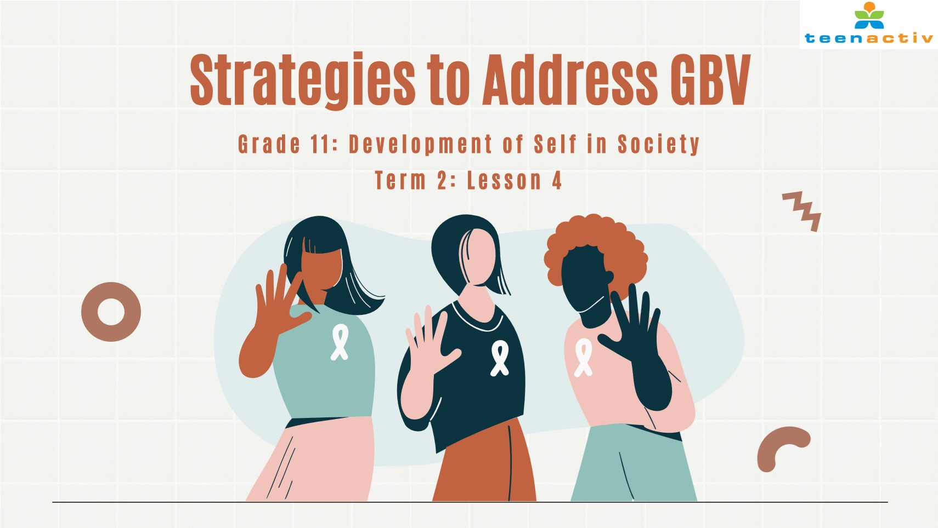

Notes:
Introduction (4 min)
Greet learners. Allow learners to settle down and get their learning materials ready.
Ask learners to recall the some of the effects of GBV from last week’s lesson, you can ask them to address the following:
Impact on individual, family and society
Societal disintegration
Tell learners that today’s lesson will focus on strategies to address, reduce and prevent GBV.

Slide 2
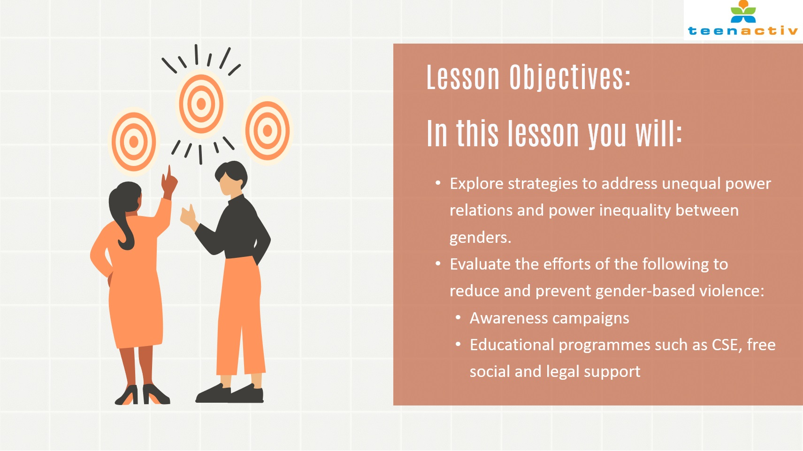
Notes:
Introduction (1 min)
Share the learning objectives of the lesson on the slide.

Slide 3

Notes:
Presentation and Activity (Part 1) (10 min)
Ask learners to think of and share how the institutional strategies on the slide could help address unequal power relations. Throughout the discussion learners should complete Question 1.1 of Activity 1 (Lesson 4 – Worksheet).
Education and awareness programmes could promote gender-sensitive education to challenge traditional gender norms and stereotypes. Raise awareness about the harmful effects of unequal power relations from an early age. This will foster a more inclusive and equitable society. (Make sure learners understand what equitable means: to be fair and impartial, ensuring that everyone is treated justly and receives what they need or deserve according to their individual circumstances.)
Legal reform could promote gender equality, protect individuals from discrimination, and ensure equal opportunities in all aspects of life, including the workplace and family. This will provide a basis for addressing and preventing discrimination.
If workplaces adopt and enforce gender-inclusive policies, such as equal pay measures, flexible working arrangements, and anti-discrimination policies. This will foster a culture of fairness and equality.
Empower programmes should empower women economically, socially, and politically. This includes initiatives to enhance women's education, job skills, and leadership capabilities, which will lead to a more balanced distribution of power.
There should be an increase in the representation of women in leadership positions across various sectors, including government, business, and academia. This will reflect a broader range of perspectives and experiences which challenges existing power imbalances.
Good to know: Introduce learners to the concept of ESG, which stands for Environmental, Social, and Governance criteria. ESG provides a framework for stakeholders to assess how well an organisation is addressing risks and opportunities in these areas. By focusing on the last four bullet points, organisations can enhance their adherence to the social and governance aspects of ESG, thereby becoming more attractive to investors who prioritise sustainability. Given South Africa's history of social inequality and environmental issues, ESG is particularly crucial in this context and is gaining popularity as a guiding framework.
Communities should be engaged in conversations about gender equality, encouraging dialogue that challenges traditional beliefs and promotes inclusive attitudes. This will create a supportive environment for change at both individual and community levels.
Media literacy programmes can teach individuals, especially young people, to critically analyse and challenge gender stereotypes portrayed in the media. This will lead to more informed and conscious media consumption.
Encourage the involvement of men and boys as allies in the fight for gender equality. Programmes that promote positive masculinity and challenge toxic masculinity can contribute to changing societal attitudes. This can lead to a collaborative environment where men contribute to dismantling gender stereotypes and advocating for gender equality.

Slide 4

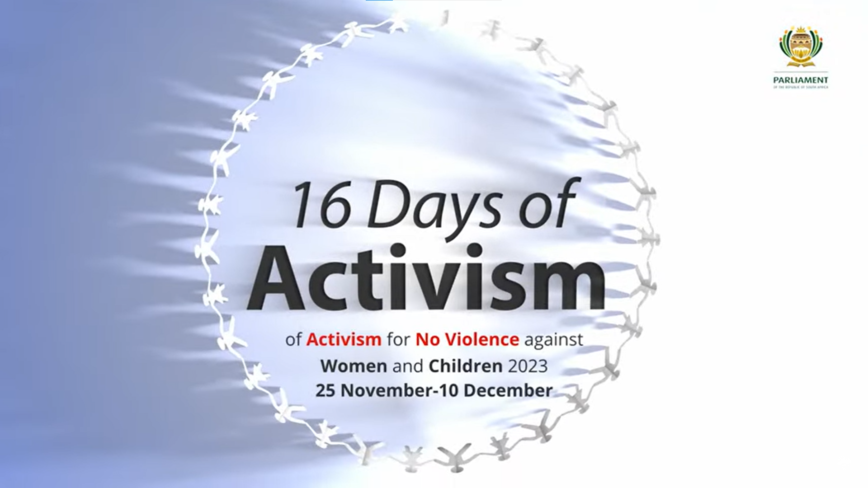
GBV Awareness Campaigns
WATCH THIS VIDEO
https://www.youtube.com/watch?v=LZCaEjKymJg&t=92s (1 min 38 sec)
Notes:
Presentation & Activity (Part 2) (5 min)
Explain that GBV awareness campaigns play a crucial role in reducing and preventing GBV by addressing various aspects of the issue.
While watching the video on 16 Days of Activism for No Violence Against Women and Children, they should try and identify the roles that GBV campaigns play in addressing the issue.
Ask for feedback from the learners. Allow them to brainstorm other roles that were not mentioned in the video. During this discussion, learner should note their answers in Question 1.2 of Activity 1 (Lesson 4 – Worksheet).
Note to learners that there are two other GBV campaigns on page 12 of their Content Summary (which will be handed out later) that they can explore in their own time.

Slide 5

Notes:
Presentation & Activity (Part 3) (1 min)
Explain that there are also education and support programmes that help address, prevent and reduce GBV. These programmes can be governmental or private. In the next two slides two such programmes will be discussed in a bit more detail.

Slide 6

Emphasises Effective Communication Skills
Education Around Sexual & Reproductive Health
Challenges Traditional Gender Roles
Builds Self-esteem and Empowerment
Teaches Importance of Consent
Helps Recognise Signs of Abusive Behaviour
Comprehensive Sexuality Education (CSE)
To ensure that learners do not get confusing and misleading messages on sex, sexuality, gender and relationships.
To provide individuals with knowledge, skills, and attitudes that contribute to healthier relationships, communication, and understanding of consent.
Notes:
Presentation & Activity (Part 3) (5 min)
Throughout the discussion of this slide, learners should complete Question 1.3 of Activity 1 (Lesson 4 – Worksheet).
Ask learners what they think the aims of CSE would be before revealing the correct answer on the slide.
Ask learners to give examples of the “knowledge, skills and attitudes” that would be taught through CSE before revealing the answers.

Slide 7

Notes:
Presentation & Activity (Part 3) (5 min)
Briefly discuss the functions of private GBV support organisations using POWA as an example.
POWA is a South African, feminist, women’s rights organisation established in 1979. They provide free counselling, sheltering, skills development opportunities, legal services, sector capacity building and strengthening as well as public awareness and education to assist abused women. POWA also engages in advocacy to ensure the realisation of women’s rights and thereby improve women’s quality of life.
Note to learners that they can read more about what this organisation offers in their Content Summary.
Hand out the Content Summary, and note the following additional information that they can consult in their own time:
QR-code to organisations that provide social and legal support to GBV survivors (page 13)
Emergency contact numbers (page 13)
A guide to helping survivors of GBV (page 15)

Slide 8

Notes:
Informal Assessment (9 min)
Learners can start completing the Informal Assessment Activity 2 (Lesson 4 – Worksheet) for the remainder of the lesson, but they will not have sufficient time to complete the activity. Assign the activity as homework. Learners can use their Content Summary to answer the questions which are based on the entire lesson series on GBV. It is vital for learners to practise answering these test-type questions. Answers available on Lesson 4 – Worksheet MEMO which can be shared with learners at the beginning of the next lesson.

