Slide 1

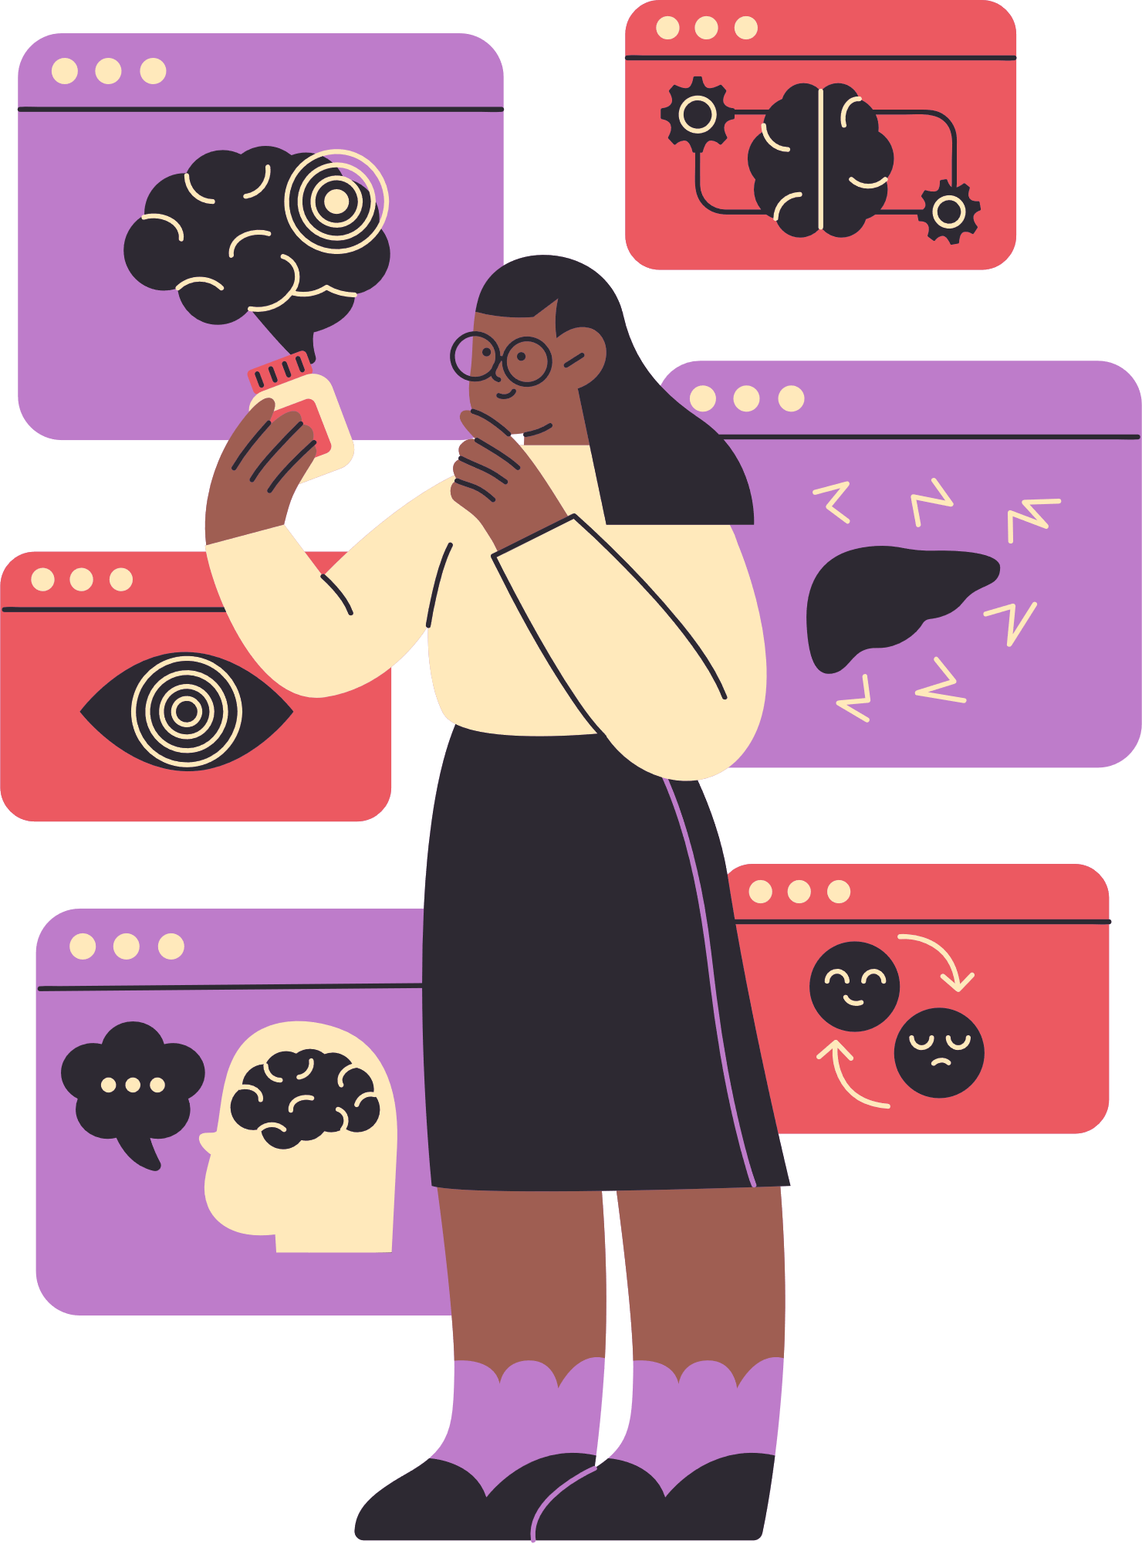
Grade 8
Health, Social & Environmental Responsibility
Behaviour to
Stop and Avoid Substance Abuse
Term 2: Lesson 2
Notes:
Introduction
Greet learners. Allow learners to settle down and get their learning materials ready.

Slide 2
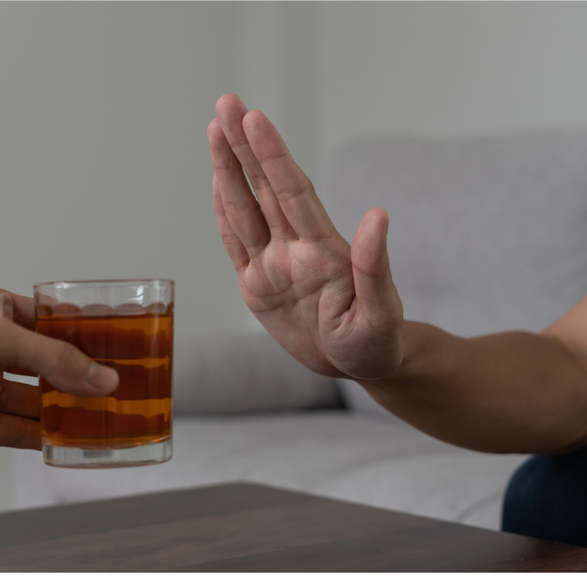
What will we learn?
  Social factors that contribute to substance abuse including community and media.
  Appropriate behaviour to stop and avoid substance abuse: Refusal and decision-making skills.
  Long and short-term consequences of substance abuse: Link to crime, violence and educational outcomes.
  Rehabilitation options: Where to find help, care and support.
Notes:
Introduction (3 min)
Ask learners to recall some of the social factors that contribute to substance abuse that they identified in the previous lesson.
Today’s focus will be: Appropriate behaviour to stop and avoid substance abuse: refusal and decision-making skills.

Slide 3


How can Substance Abuse be
Stopped or Avoided?
MEDIA
COMMUNITY
SCHOOL
PERSONAL
Notes:
Pair Activity (2 min)
Now that learners understand how social factors can contribute to substance abuse, explain to them that three areas we looked at in the previous lesson can also contribute to the prevention of substance abuse.
Learners will brainstorm behaviours that the media, community and school can apply to help protect teenagers against substance abuse.
Later in the lesson, learners will look at how their personal behaviour can protect them against substance abuse.

Slide 4
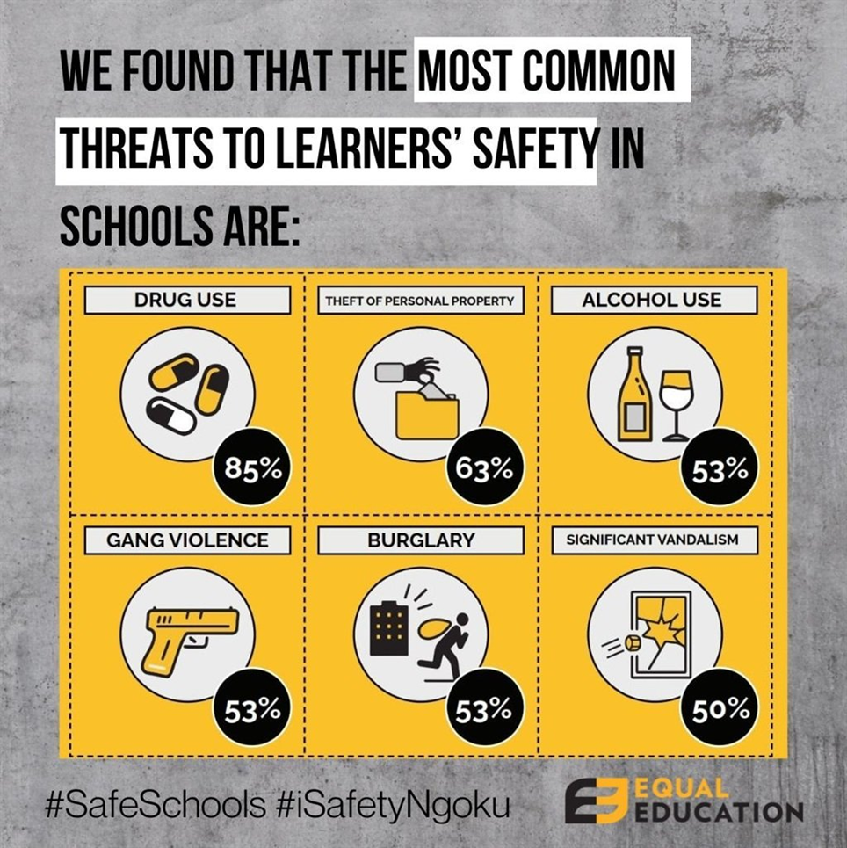
School
Notes:
Pair Activity (5 min)
Learners study the statistics from a recent study done by Equal Education.
In pairs, learners need to brainstorm FOUR ways in which SCHOOLS can stop or prevent substance abuse amongst teenagers – Question 1 in (Activity 1) (Lesson 2 Worksheet).
Ask for immediate feedback from learners, and then move on to the next slide.
Possible answers available in Lesson 2 – Worksheet MEMO.

Slide 5

Community
UNENGAGED AND UNINVOLVED
Studies in South Africa have repeatedly shown the link between young people who have nothing to do and troubled social behaviour, including drug abuse and violence.
A former gang member from Bophelong in Gauteng indicated:
“Our homes are too small; they are suffocating us. There are no facilities for young people in this area, young people have nothing to do… We need facilities or else we join gangs and do drugs just to forget about our circumstances.”
Notes:
Pair Activity (5 min)
Read through the extract with learners.
In pairs, learners need to brainstorm FOUR ways in which COMMUNITIES can stop or prevent substance abuse amongst teenagers – Question 2 in (Activity 1) (Lesson 2 – Worksheet).
Ask for immediate feedback from learners, and then move on to the next slide.
Possible answers available in Lesson 2 – Worksheet MEMO.

Slide 6
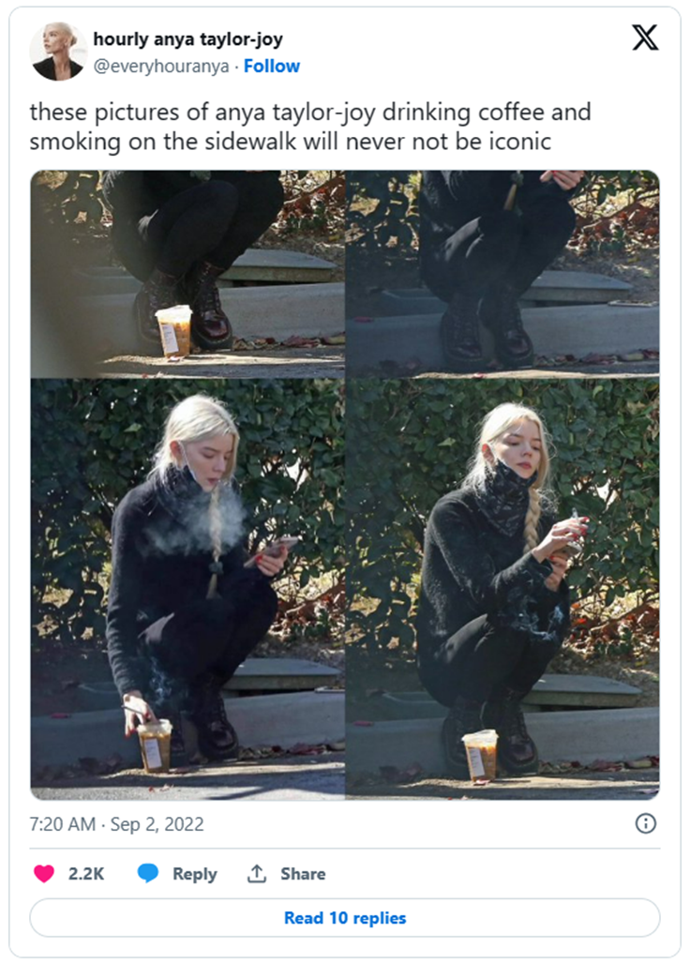
Media
GEN Z MIRROR CELEBRITY SMOKING HABITS
The apparent increase in smoking among Generation Z is likely a combination of celebrity influence and a care-free outlook on life. Guardian writer, Alaina Demopoulos, recently wrote about the increasing number of young celebrities photographed smoking.
She noted one photo of actress Anya Taylor-Joy (from the Netflix series, The Queen's Gambit) drinking coffee and smoking on a footpath, which was described as "iconic". Another Tweet featuring influencer Kylie Jenner said, "heroin chic and skinny is back in".
Young fans now want to "project this sort of party girl, early 2000s image".
Notes:
Pair Activity (5 min)
Read through the extract with learners.
In pairs, learners need to brainstorm FOUR ways in which THE MEDIA can stop or prevent substance abuse amongst teenagers – Question 3 in (Activity 1) (Lesson 2 – Worksheet).
Ask for immediate feedback from learners, and then move on to the next slide.
Possible answers available in Lesson 2 – Worksheet MEMO.

Slide 7
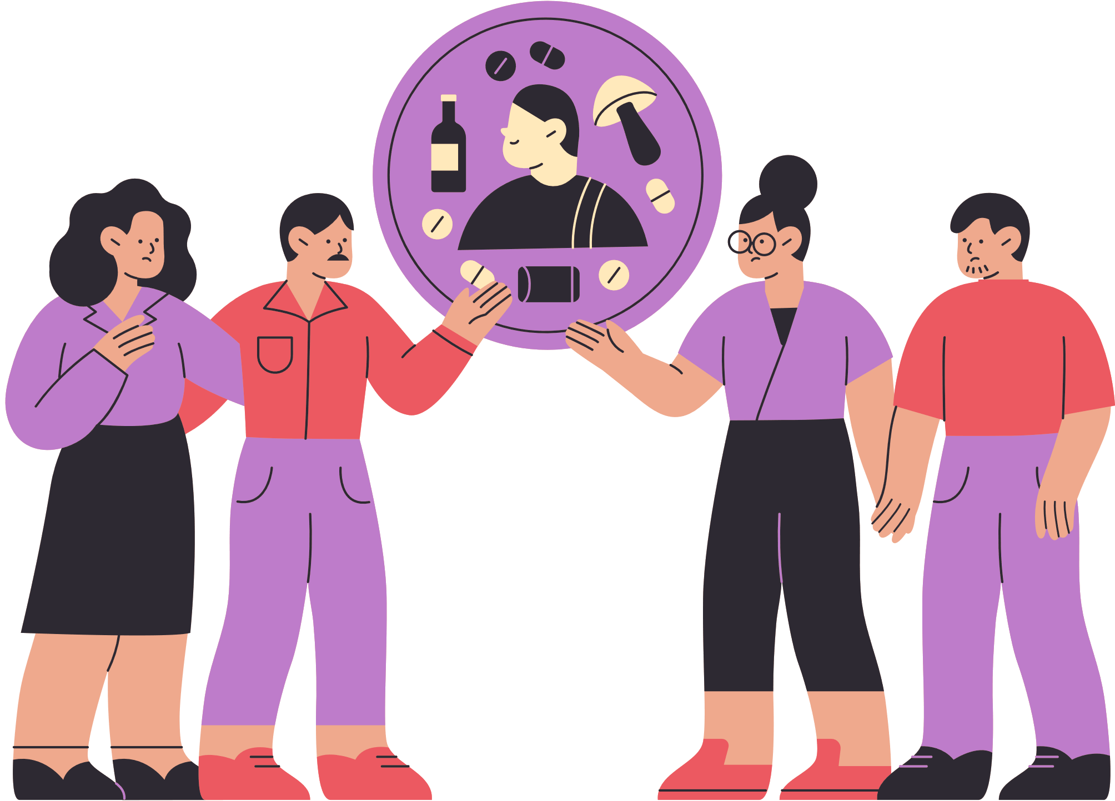
Decision-Making Skills
Assertive Refusal Skills
Abilities that help you to choose solutions to challenges.
Strategies to say “no” in a confident, honest and respectful way when a person is being pressured to do something they don’t want to.
Notes:
Teaching (2 min)
Explain to the learners that although they are surrounded by social factors that can motivate them to use substances, it's important to understand that the decision to participate in such behaviours is ultimately up to them.
Many teenagers don’t want to use drugs or alcohol, but they struggle to turn down their friends. They’re worried their friends will think they’re “not cool” or the worst, “not want to be friends anymore”.
Ask learners if they can explain the difference between positive and negative peer pressure. (Negative peer pressure - When friends make you feel like you have to do something to fit in. Positive peer pressure - when your friends encourage you not to use substances because they care about your health and well-being.)
To manage these situations, they can use refusal and decision-making skills to either avoid or stop substance use and abuse. (Explain these two terms – make sure that learners know what assertive means - being assertive is being confident, honest and respectful without being hurtful or mean.)

Slide 8




Think Before You Act
Gather Information
Identify Your Values
Set
Goals
Notes:
Teaching (4 min)
Decision-making skills: Being able to make smart decisions is important, especially when it comes to substances. It helps you make choices that keep you safe and healthy. Before you think about using substances, there are important things to think about to make the right decision.
Talk through the following things that learners should consider before making the decision to engage in substance use – make sure to focus on the explanation of bolded terminology.
Think before you act: Think about the potential outcomes. Ask yourself, "What might happen if I use this substance?" Consider the immediate effects, such as impairment (loss of function or ability, mental or physical) and the long-term consequences like addiction, health issues and strained relationships. Thinking before you act can help you avoid making choices that you might later regret.
Gather Information: Make informed choices by gathering information about the substance you might encounter. Understand their effects on the body and mind. Educate (emphasise this important skill/strategy) yourself about addiction (when your body obsessively craves a substance) and recognise that even a single use can lead to dependency (when a person is physically dependant on a substance for day-to-day functioning) for some substances. Seek reliable sources of information, such as educational websites, books or conversations with trusted adults.
Identify your values: Consider what is important to you, such as your health, relationships, academic or sports goals, and your moral principles (guidelines that people live by to make sure they are doing the right thing). Understand how substance use aligns with or contradicts your values. For instance, if you want to be a great sportsperson, recognise how substance use may compromise (to bring into danger by foolish or reckless behaviour) that value. Your values should guide your choices when faced with the temptation of substance use.
Set goals: Establish clear and achievable goals for yourself, whether they relate to your education, sports or personal development. Recognise that substance abuse can hinder your progress towards these goals. Prioritise your aspirations (a strong hope or ambition to achieve great things) over temporary pleasure. Avoiding substance use is an important step toward personal growth and success.

Slide 9
Plan | Example Responses
Give an Excuse | "I can’t stay; I have to go help my dad with something." "That stuff makes me sick."
Firm but Polite Refusal | "No, thanks. I'm not into that." "I'm good, but thanks for offering."
Deflect with Humour | "No thanks, I need all the brain cells I can get." "Doesn’t that stuff stunt your growth? I’m too short already!"
Focus on Goals | "I'm working towards my academic goals, so I can't risk it." "I want to stay healthy for the soccer finals coming up."
Express Personal Values | "I don't believe in using [substance], it goes against my values." "I have other ways to have fun that don't involve [substance]."
Offer Alternatives | "I’m good. Wanna go play some rugby?" "No thanks. Let’s go grab some food.“
Ask for Support | "I'm trying to avoid [substance], and I'd appreciate your support." "Can we all just enjoy the evening without [substance]?"
Exit the Situation | "I need to head home now, so I'll pass on [substance]." "I'm not feeling well, so I'll catch you later."
Explain the Danger | "No thanks. That stuff is so bad for you." "Haven’t you heard about the kids who died from doing that?”
Notes:
Teaching (4 min)
Assertive refusal skills: When you find yourself in a situation where you feel pressured to participate in substance use, you need to practice assertive and respectful ways to decline without feeling uncomfortable. Here are a few planned responses you can use in such situations:
Learners can read through the table of example responses.
You don’t need to read every response. Simply highlight a few of the responses.
Remind learners that they covered such refusal skills briefly in an activity in Term 1 Week 7-9 on Relationships. This is an expansion on that. Ask learners if anyone can recall the activity and expand on it a little.

Slide 10
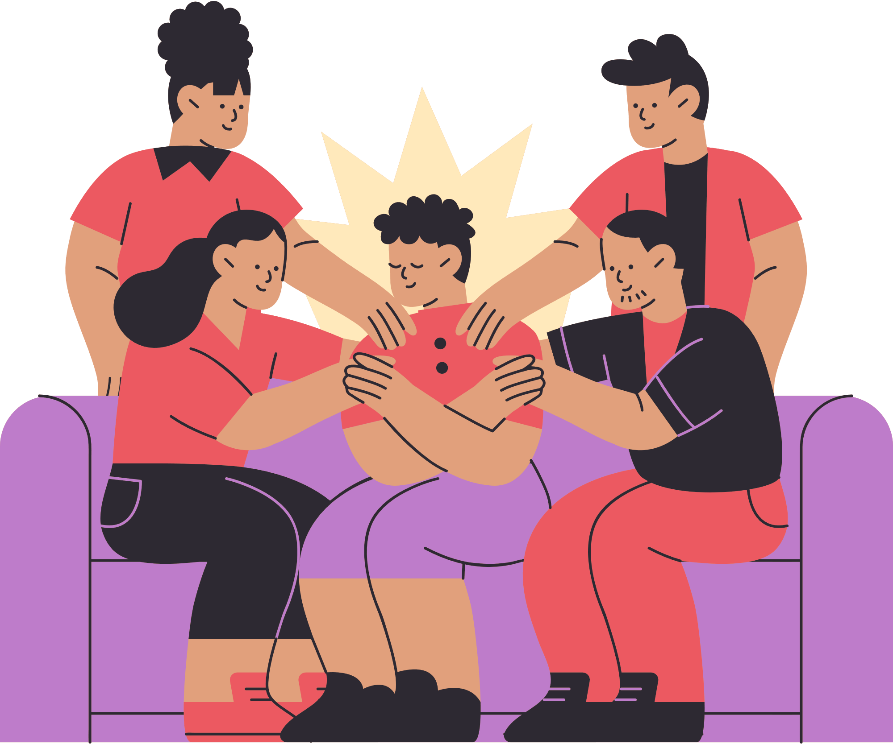
Practical ways to stop and avoid substance use
Notes:
Class Discussion (3 min)
Ask learners to think of activities that they could do instead of using substances. They could also include the benefit of the activity. (This allows them to practise formulating statement and qualifier answers. See first answer as an example below.)
Answers may include the following:
Participating in sport and exercise promotes physical health and helps stress reduction.
Pursue creative hobbies such as drawing, painting, writing and music to express yourself.
Being a part of clubs allows you to socialise, build friendships and develop a sense of belonging.
Getting involved in volunteer work provides you with a sense of purpose and accomplishment.
Spending time with friends in activities that do not involve substances, such as going to the movies, playing games, or doing outdoor activities.
Think critically about the media that you consume; don't accept everything you see as the truth.

Slide 11
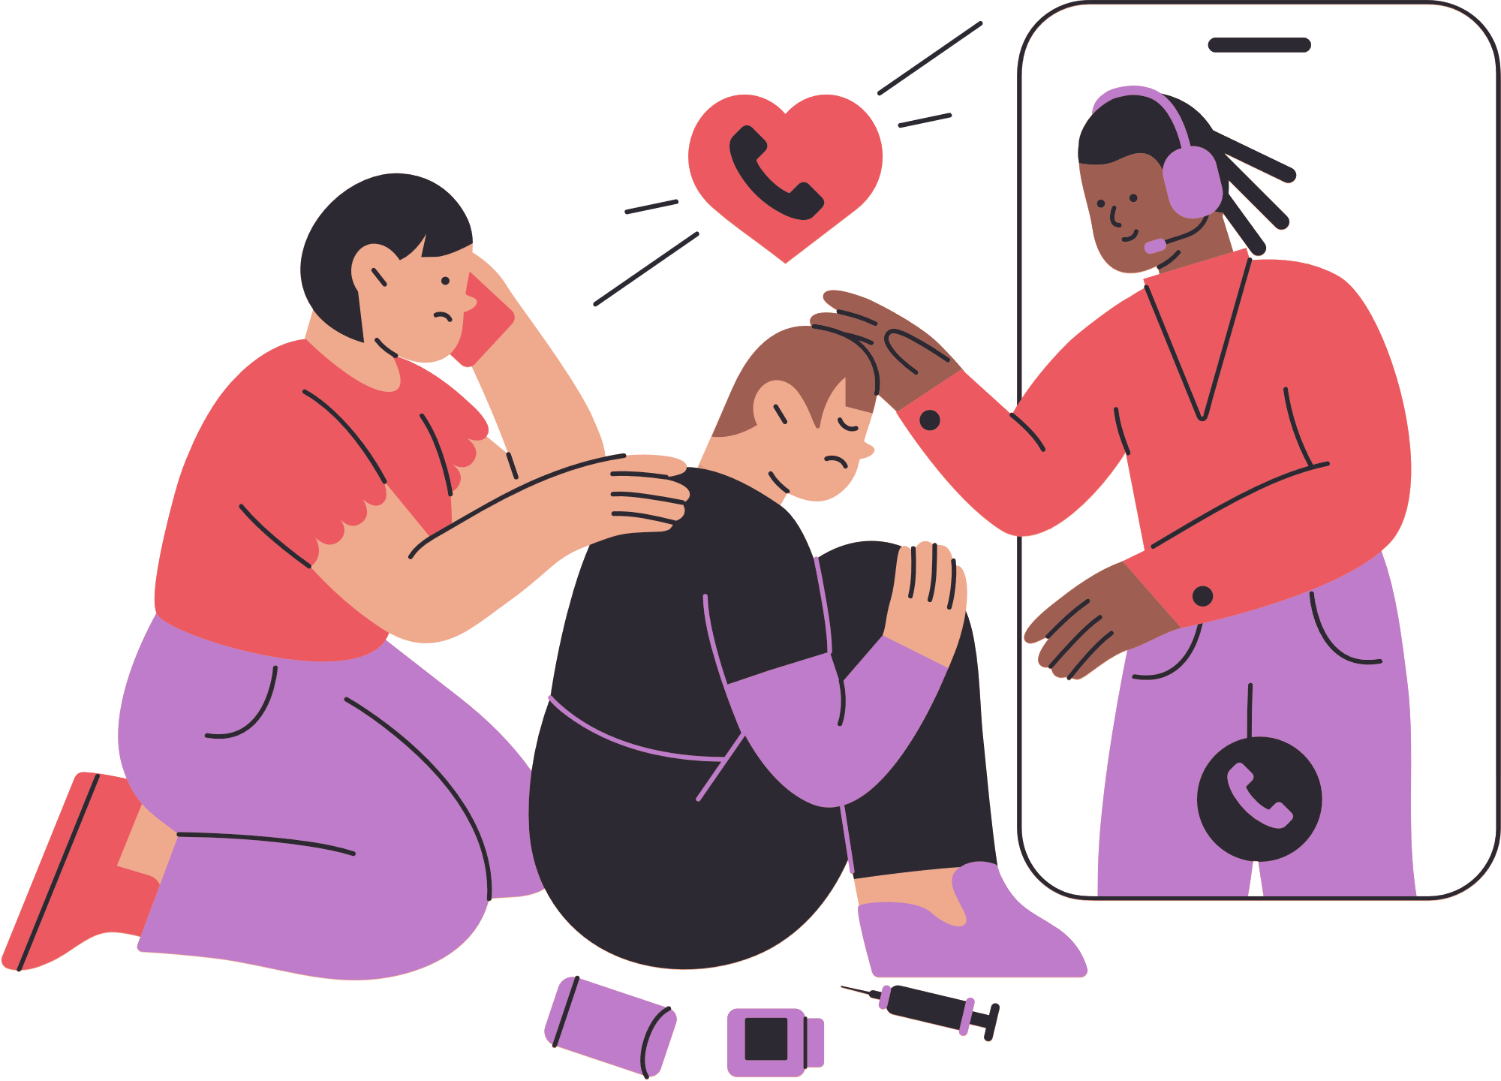
Reflect on Today's Lesson
Notes:
Reflection (7 min)
Wrap-up the lesson and ask learners to think about what they have learnt in this lesson.
Learners complete the reflection activity in (Activity 2) (Lesson 2 – Worksheet):
Learners are given a scenario where they are invited to use substances and they need to complete a personal plan to avoid this substance usage. They will use decision-making skills to determine whether this is the right choice for them.
Learners need to complete this activity for HOMEWORK if they run out of time in class.

