Slide 1


Notes:
Slides 1-2: Intro (5 min)
Learners need to be divided into groups of FOUR for this lesson.
Note to teacher: This lesson will be divided into two parts. In the first part, the Grade 12s will reflect on their own study schedule, results from last year, the TED talk (https://www.youtube.com/watch?v=Na8m4GPqA30) they had to watch and plan a schedule. This lesson will challenge learners based on what they remember from Grade 11 in the 2nd part through a game. You will need to hand out the content summary for this section.
Welcome to our ONE study lesson that we will cover this term. Most of the content we will be covering today was already covered in Grade 11. However, I’m sure many of you have forgotten what you learnt last year. So today’s lesson will recap some of last years content in a fun way. You need to listen carefully and interact in order to be ready for the game later on.
Let’s get started!

Slide 2

Who was happy with their results at the end of grade 11?
Notes:
Slide 2: Class Discussion
Let’s get an idea just by a show of hands:
Who was happy with their results at the end of Grade 11?
Who feels that they could have improved if they had studied harder?
Who has already made goals to do better this year?
If you received the same results at the end of this year, would you receive your NSC?
Maybe some of you are not quite as happy with your results at the end of last year and would like to see some changes this year. So how do you go about making those changes at the beginning of this year so that you meet your goals at the end of the year?

Slide 3
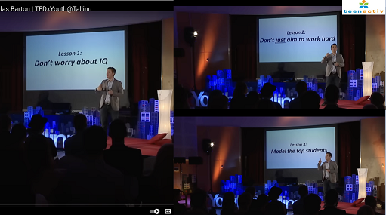
Notes:
Slide 3: Group Discussion (7 min) and Individual Schedule Audit (5 min)
You were required to watch this clip for homework on “What the top students do differently?” https://www.youtube.com/watch?v=Na8m4GPqA30
Douglas Barton made some strong statements to help students reflect on what the top students across different countries are doing that gives them the top results. In your groups, work through the questions in Activity 1 (Lesson 1 – Worksheet).
(Allow 5 min for learners to work in their groups.)
One of the skills mentioned in this clip is that of creating a study plan or study schedule. We learnt that a study plan needs to start by first looking at your day and putting in the time of other activities like meals, sport, homework, etc. This approach makes the study programme more realistic. Sometimes it seems difficult to work out where to find more time to study. We now need to do an audit on our time to see where we are wasting time. This will give you a clear idea of what you are spending your time on. Complete Activity 2 in Lesson 1– Worksheet.

Slide 4

SQWABBLE
Notes:
Slide 4: 14 min SQWABBLE GAME
In Grade 11, we covered a large portion of the content you need to know for this section in Grade 12. Now I’m sure some of you will be a little rusty and struggle to remember, so we’re going to play a game to help you remember. Before we start, can anyone remember what the VARK learning style means?
Visual learners learn best by seeing.
Auditory learners learn best by hearing.
Reading/writing learners learn best by reading and writing.
Kinaesthetic learners learn best by moving and doing.
Our SQWABBLE game is going to use these learning styles to help others guess what term is on the card. This is how the game works:
Each group will receive a pack of cards. Each person will work through all the terms on one card. You will first read the category on the top of the card to the group. This will guide the group as to which category on the content summary they need to look through for the answer.
The card will have a letter in a circle e.g.
- If the card has a V on it, you will need to draw and illustrate all the terms on the card.
- If there is a K, you will need to move / dance while you are explaining terms on the card.
- If there is an A, you need to sing or rap explaining the terms on the card.
- If there is an R, you may simply explain using charades the terms on the card to your group.
Remember, you are not allowed to use the term on the card in any explanation.
There are FOUR categories, namely Study Styles, Time Management, Exam Writing and Study Plans. The members of your group will have the Content Summary to help them figure out which of the terms is on the card.
Each person in the group will need to present. Remember, although this will be fun, it’s still a learning activity. Here we go!
(Note to teacher: You will need to manage the time of this activity by allowing each person only 1 minute per card for their two terms. As soon as the group has guessed the two terms correctly, they need to put their hands up. You can keep score with points in terms of the winning group for each round. The game will then start again with the next person. There are TWO cards per person in each group, which should take the time to just over 10 minutes. Maybe bring a few apples to hand out to the winning group at the end of the game or think of another suitable reward.)
For the game you will need:
Scrap pieces of paper per group and pens
One pack of SQWABBLE Cards per group

Slide 5
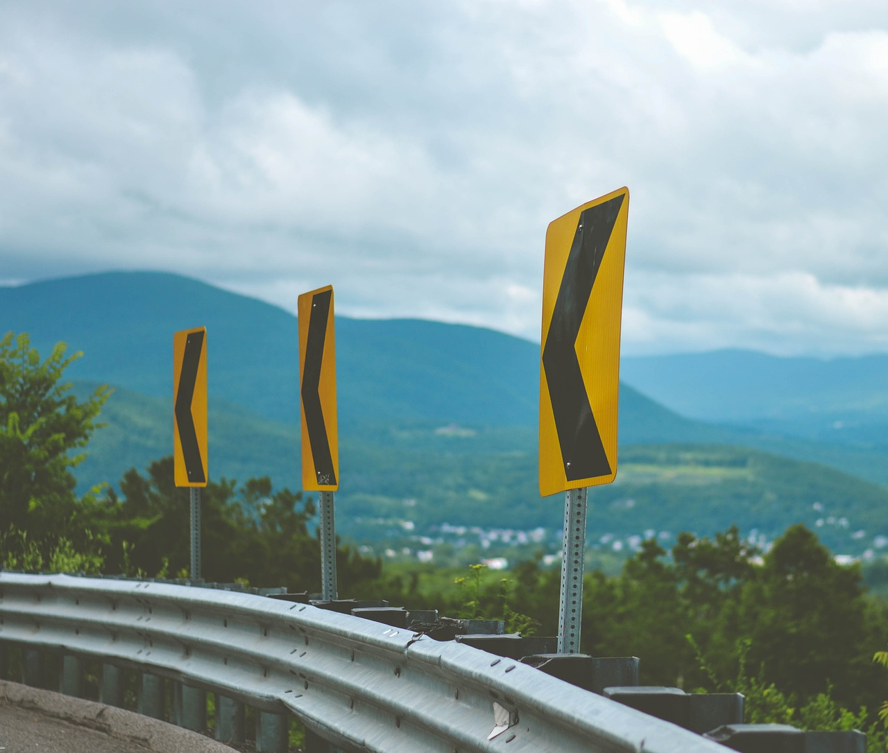
Let’s recap…
Study plan
Study styles
Time Management
Exam Writing
Notes:
Slide 5: Teaching (5 min)
The main categories we covered in this game are the same categories you will need to know and discuss in future tests and exams. We have looked briefly at:
A study plan which is an organised schedule outlining study times and learning goals. A study plan is a schedule that sets aside dedicated time each week for studying.
We looked at study styles like the VARK Model, which stands for visual, aural/auditory, reading/writing, and kinaesthetic.
We looked into time management and how to become more confident, organised, and learn more efficiently. Effective time management skills are necessary for managing all the requirements of a high school learner.
And lastly, we read one can be anxious for examinations, but that such anxiety can be reduced when tackling an exam with a calm and rational posture. Exams do come with stress and anxiety, but it takes diligence to master the necessary skills to handle such situations better.

Slide 6

Notes:
Slide 6: Homework (2 min)
Let’s now look at Activity 3 (Lesson 1 – Worksheet). We will not have sufficient time to finish the activity during this lesson. Complete the activity for homework and bring your answers to class next week.
This activity will give you an opportunity to work through a question that prepares you for the way in which this topic can be assessed in a test or exam.
Refer to the Content Summary as it will assist you in answering the questions in Activity 3.

Slide 7

Notes:
Slide 7: Reflection Activity (2 min)
As we come to the end of this lesson, we have one final quick Reflection Activity to complete.
Enhancing your study habits starts by reflecting on what areas you need to improve on. Complete the Reflection Activity (Activity 4) on your Lesson 1 – Worksheet.

