Slide 1


Notes:
7min- Slide 1-3
Note to Teacher- This lesson will take on a different approach to learning. Arrange the class before learners arrive in FOUR groups where ONE chair faces the remainder of the group.
The actor / actress from that Scenario (1-4) will sit in that chair. Inform these group leaders BEFORE the lesson where they will sit. When the class comes in, ask them to only take out their LO notebook and hand out the
Lesson 2 - Worksheet for this lesson.
Learners will record the discussions on the Lesson 2 - Worksheet and use the information they collect to write their evaluation essay for homework. Slides 1 - 3 will be teaching, preparing them for the remainder of the lesson.
Welcome back Grade 11’s! We spent our last lesson refreshing our knowledge on the different religions in South Africa and how they each promote peaceful living in society. There are times that even though you have your belief system you encounter a difficult situation and struggle to make a decision. We call this a dilemma which means that there are valid reasons for two opposing actions. Making a decision in this context cannot be done lightly.

Slide 2
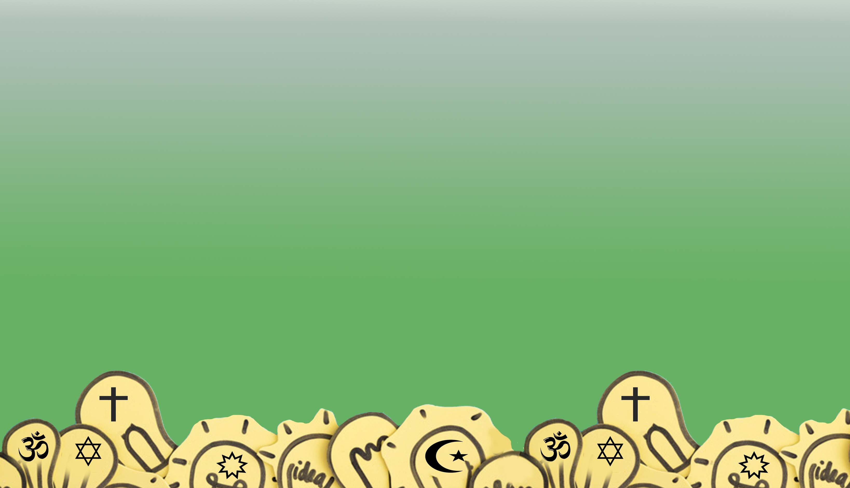
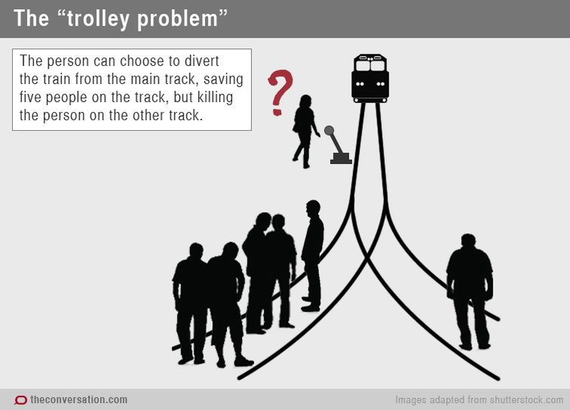
Notes:
Slide 2:
Let’s explain the moral dilemma like this:
A person is confronted with a hypothetical life-or-death decision where a train is about to run over five people on a track. The person can turn a switch that will divert the train from the main track. This will save the five people on the track, but it will kill the person on the other track. There is also the added concern of, are there people in the train and how many of them are there?
Now, what would you do?
Would you turn the switch and save five people but be responsible for the death of one person?
Or would you do nothing?
Ask learners to respond and give a reason for their answer.
Note to Teacher: You can even add some “heat to the discussion” by saying the group of five people include:
3 previous prisoners convicted of gender violence and
2 heart surgeons. One of the surgeons is a single parent father of four children.
Can you see that there is no easy solution? There are arguments for both sides of the train track. What we believe as well as our emotional response to the people in the situation will have an impact on what we choose. Life is full of difficult decisions like this to make.
Examples of these include pregnancy and euthanasia

Slide 3
In South Africa according to the Bill of Rights, everyone has a RIGHT TO LIFE. This is the right not to be killed.
EUTHANASIA is the act of killing someone who is very sick or injured in order to prevent any more suffering.
Notes:
Slide 3:
Let’s recap the following terms before we look at our four scenarios.
On Lesson 2 – Worksheet complete Activity 1
In South Africa according to the Bill of Rights, everyone has a RIGHT-TO-LIFE. But a law has also been passed that allows women to terminate the life of their unborn child - abortion. There is a dilemma between law and belief for some people.
Euthanasia is the act or practice of killing someone who is very sick or injured, in order to prevent any more suffering.
** Note to Teacher: In June 2022, the United States Supreme Court overturned its previous ruling from 1973 – ending the constitutional right to abortion.
This is a good example of how even great legal minds could differ on the same issue – delivering a pro-abortion ruling in 1973 and then an anti-abortion decision in 2022.

Slide 4

Notes:
Slide 3: 7mintes a group (total 28min- 2min moving time)
Note to teacher: Teachers must facilitate and remind learners that we all differ in our opinions because we come from different backgrounds / beliefs / religions / cultures. BUT we must not label / make fun / avoid friends because their opinions are different to ours.
Today you are going to get a chance to respond to these difficult situations. You will be sitting in groups with one person in the group sharing their moral dilemma with you.
Imagine that you are a group of the wisest advisors in the world and this person has sought you out to solve their dilemma. Your group is made up of people from different religious backgrounds and moral values. You must consider those values and beliefs when proposing a solution. You will have 7 minutes per group to discuss and make notes on Activity 2 on your Lesson 2 - Worksheet.
Once the seven minutes are up, the group will move to the next group on their right and listen to a different moral dilemma. Each group will move FOUR times this lesson, collecting information on the different scenarios. Watch your time. An alarm will sound at the end of each 7min session, move quickly and start straight away.
Good luck advisors!
Note to teacher - you will be keeping track of time and moving between the groups and listening to the discussions but also checking and encouraging participation from the more “silent” group members. Watch the time so there is at least 5 min left for the Activity 3 Reflection.

Slide 5


What have you learnt about yourself and your beliefs about “the right of life”?
What advice would you give a friend on the decision-making process when encountering a dilemma?
Notes:
Slide 5: 3min
Being confronted with difficult real-life situations can make you feel a bit overwhelmed. Take the last few minutes and reflect on the following two questions in
Activity 3 (Lesson 2 - Worksheet)
What have you learnt about yourself and your beliefs regarding “the right-to-life”?
What advice would you give a friend on the decision-making process when encountering a dilemma?
There are no memo answers to these questions. Make sure in this time the class is quiet.

