Slide 1



LEARNING FOR LIFE and how to fund it
World of Work, Lesson 1

Slide 2

What comes to mind when you see the words?
LIFELONG
LEARNING
Notes:
Activity 1: Brainstorm and share what comes to mind when we think about these two words.
Write the responses on the board and then sort them into “Positive” “Negative” and “Neutral” word connotations.
What is the difference between learning and education?

Slide 3
What do you think is the difference between:
LEARNING &
EDUCATION
Notes:
Activity 2: What is the difference between learning and education?

Slide 4

So, what do you think Lifelong learning is?
Lifelong learning is the "ongoing, voluntary, and self-motivated" pursuit of knowledge for either personal or professional reasons or both.
Notes:
Share the definition of Lifelong learning

Slide 5


“Lifelong Learning - Like a tree, we are either growing or dying, there is no in-between.”
Notes:
Do you agree with the statement or not? Why or why not?

Slide 6

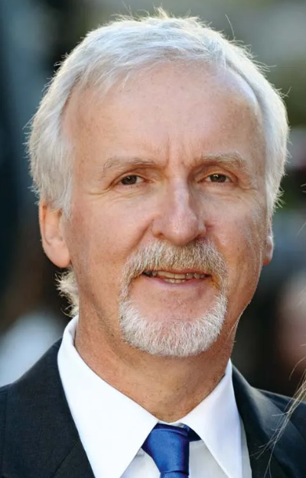
GROW
James Cameron
Film Director
Notes:
Read the story of Doreetha Daniels, nearing 100 years old. Ask what kinds of characteristics of a lifelong learner she displays.
Make a list of other characteristics of a lifelong learner.

Slide 7


https://www.youtube.com/watch?v=cqRoGpSGFwk&t=3s
GOALS
Notes:
Read the story of Doreetha Daniels, nearing 100 years old. Ask what kinds of characteristics of a lifelong learner she displays.
Make a list of other characteristics of a lifelong learner.

Slide 8
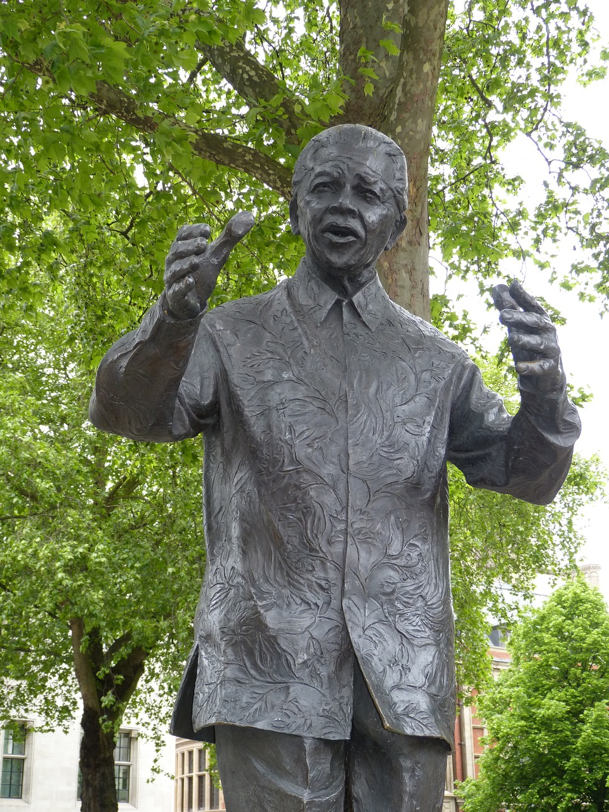

“Education is the most powerful weapon which you can
use to Change the World.”
Nelson Mandela
Mandela believed that education was a force of good and called on all South Africans to treasure knowledge and never stop learning.
GROW
Notes:
Shared reading: Read the details (on this slide) of our own great LIFELONG LEARNER.
Through this brief look at a statement by Nelson Mandela and three quotations about his belief about learning and education, we want to again identify the characteristics of a lifelong learner and how lifelong learning can also be life-wide – not confined to just formal spaces but all experiences – and the characteristic of embracing learning from things we experience. And also life-deep learning – that learning is about knowledge, experience, and growth and development as people.
.

Slide 9

MONEY DOESN’T GROW ON TREES

Slide 10
More than half (or 51%) of youth aged 18–24 claimed that they did not have the financial means to pay for their tuition. Furthermore, 18% of those aged 18–24 who were not attending educational institutions indicated that their poor academic performance prevented them from participating. This is according to the “Higher Education and Skills in South Africa” report released by Statistics South Africa
The report, which uses data from the General Household Survey (GHS) 2017, indicates that only 33,8% of youth aged 18–24 were attending educational institutions. Among those, 22,2% were attending school while 11,6% were attending post-school educational institutions.
More than half of youth have no money to pay for their tuition | Statistics South Africa.
[Adapted from https://www.statssa.gov.za/?p=12040 ; Accessed on 6th August 2023]
MONEY DOESN’T GROW ON TREES
Notes:
Read the statistics and let’s try to brainstorm some ideas for a student finding themselves in this position.
Each group will take ONE of the options and will fill in their worksheet – try to create a definition of that form of funding,
Mention positives and negatives of that type of funding.
Share these answers with one another.

Slide 11



}
Loan
NSFAS
Scholarship
Bursary
Learnership
Work
INVESTMENT IN GROWTH
Notes:
Each group will take ONE of the options and will fill in their worksheet – try to create a definition of that form of funding,
Mention positives and negatives of that type of funding.
Share these answers with one another.
There are also answers in the Content sheet and a list of study scholarships, loans, burasaries and internships are available in the lesson cont

Slide 12
