Slide 1


Notes:
5+5min- Slide 1-2 Intro & Group Discussion
Welcome back to the last few lessons of your Grade 11 year! I wonder if you have ever found yourself thinking questions like:
“Where did we all come from?” or “Why are we here on earth?”
It’s perfectly normal to think and question about life and the origins of life. These questions of trying to explain the world around us is called a belief system.
Let me explain it this way. (Point to a chair in the class) how many of you believe that if I sit on this chair, it will hold my weight and not fall over? Why would you believe this?
Can you see that your past experiences of a chair have an impact on the fact that you don’t question your belief that the chair can hold my weight?
So where do you think your belief system comes from? Let’s hear from the class … (allow learners to respond to the class.)
Some possible responses could be:
Church
Family and the environment we grew up in / live
Friends
Media (famous people)
Experiences good and bad
… allow for other responses
In most instances our belief system is impacted by what we believe. A religion is a set of beliefs about the cause, nature and purpose of the universe. Religion could also be the belief in and worship of a superhuman controlling power, especially a personal God or gods / a particular system of faith and worship. It’s usually based on the idea that God created the universe. A religion has traditions, ceremonies and sacred texts.
Can you remember the major religions of South Africa we covered in Grade 10? (allow learners to respond.)
Judaism
Christianity
Hinduism
Islam
African Christianity (Zionism)
Buddhism
Bahá’í Faith
There are actually many similarities between the different religions in South Africa. Too often we focus on the differences. We live in a society in South Africa that values freedom of choice which means we choose our religion. We need to learn to live respecting one another for their choices and tolerate the differences.

Slide 2
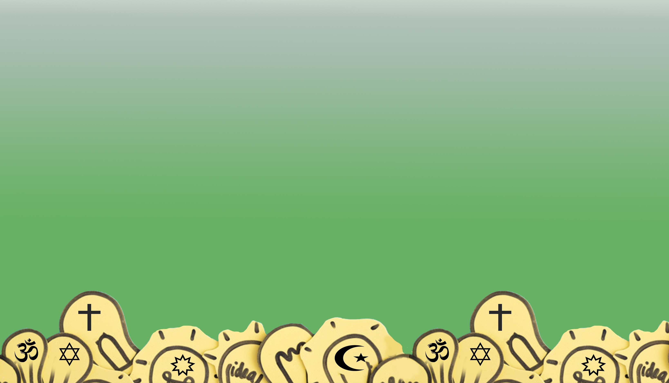
What we believe impacts how we behave.
Agree?/ Disagree?
Notes:
Slide 2: Discuss in Group
We know that religion impacts what we believe. But would you agree or disagree with the statement.
What we believe impacts how we behave.
In your groups of FOUR, discuss this statement. Write down your THREE most convincing arguments. (Allow time for each group to give feedback)
We could say that our beliefs (or norms) do impact our behaviour (or values).
If we had to look at one of the aims of all religions, it would be to live in peace and harmony together. As mentioned earlier, this means learning to tolerate one another and looking for common ground.

Slide 3
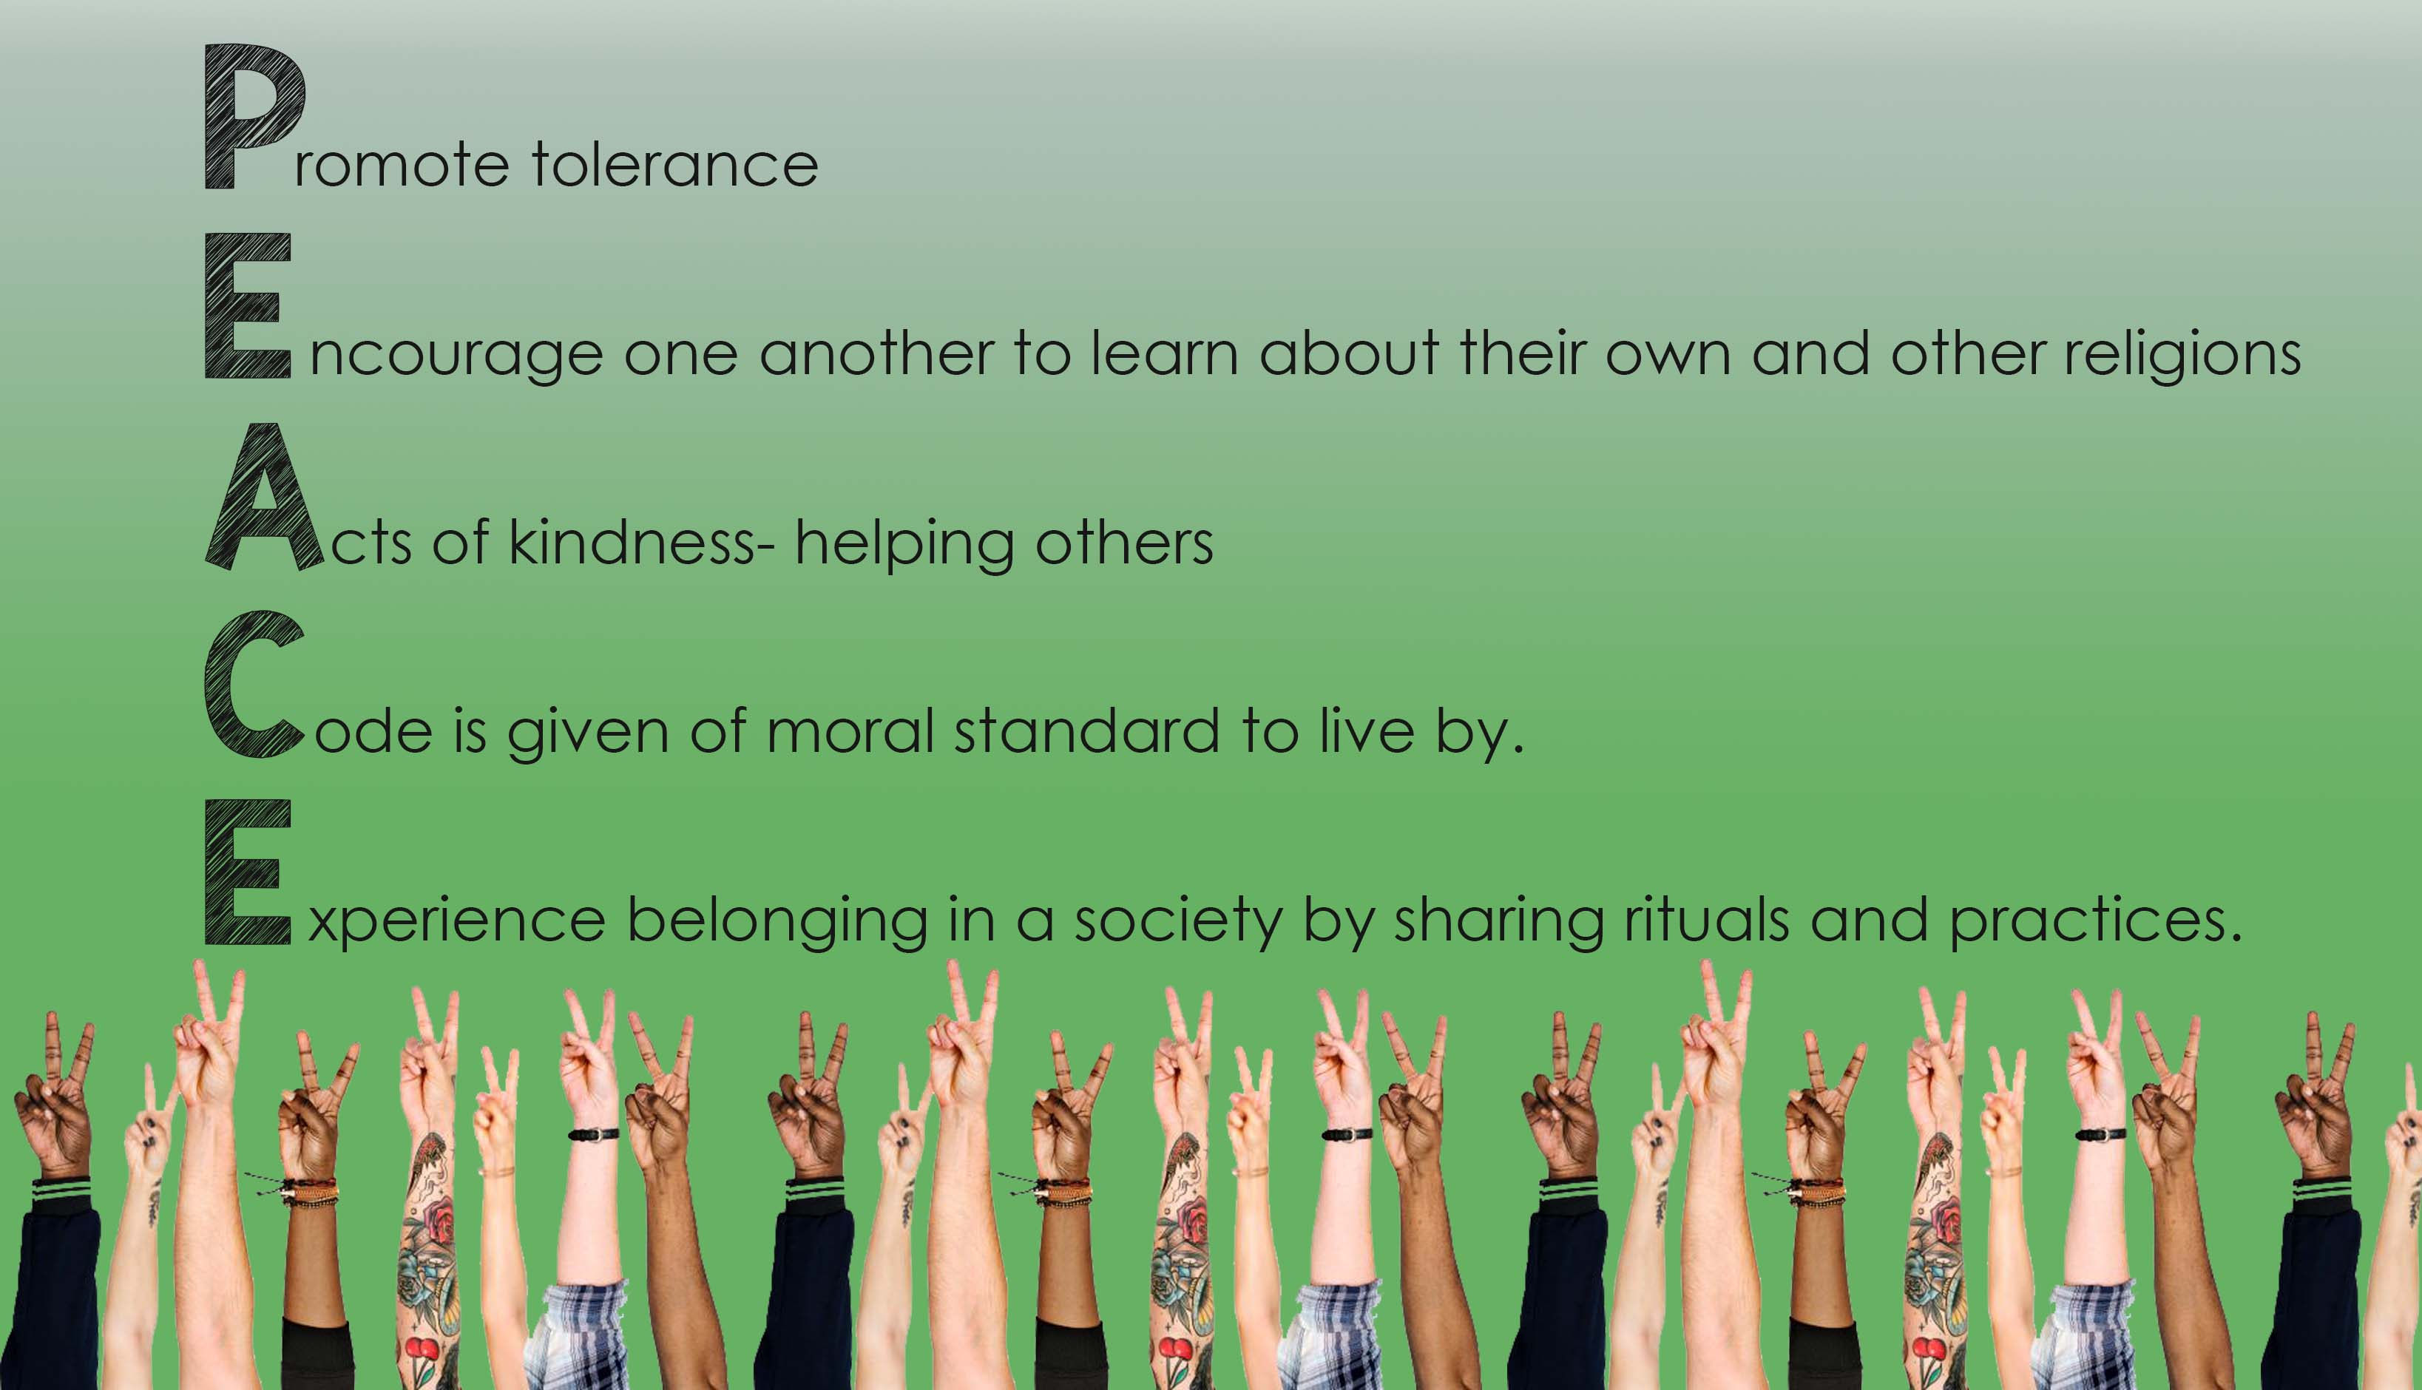
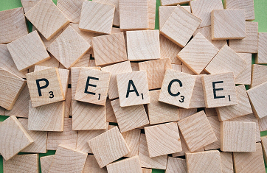
Notes:
Slide 3: 3min reflecting
On Lesson 1 – Worksheet complete Activity 1 – the description of PEACE.
South Africa’s diverse religions and belief systems contribute towards harmony by believing in PEACE:
Promoting tolerance (Note to teacher - this term “tolerance” has often been attached to negative connotations. You could ask learners their opinion. What other term is better used? E.g. respect…)
Encouraging one another to learn about their own religions as well as those of the people around them.
Acts of kindness- helping others
Code is given of a moral standard that people respect and choose to live by
Experience belonging in a society by sharing rituals and practices.
When you reflect on your own religion can you see how PEACE is a part of it? These shared values bring a society together. In a harmonious society, people live in peace, regardless of culture, socio-economic status, language, nationality or race.

Slide 4
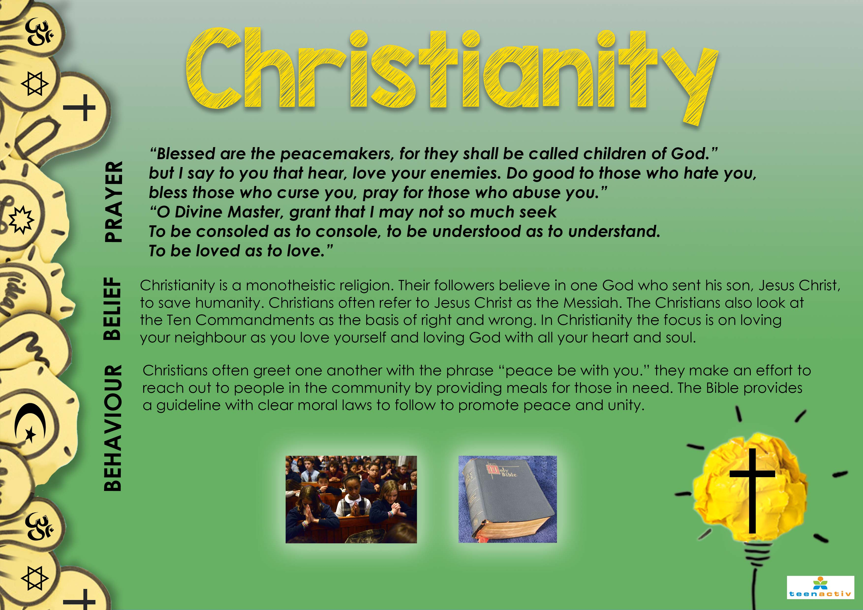
Notes:
Slide 4-8: 10min
Let’s take a look at each of these religions in a little more detail to see the impact of how belief impacts behaviour in a society.
Note to teacher: ONLY hand out Lesson 1 - Religion Notes AFTER going through this section via the PowerPoint slides 4 - 8. The handout covers the same material.
Don’t focus on the prayers on each slide. Learners will have the notes to refer to in the next activity. Briefly touch on points from each religion.
Christianity:
Prayer:
“Blessed are the peacemakers, for they shall be called children of God.”
but I say to you that hear, love your enemies. Do good to those who hate you,
bless those who curse you, pray for those who abuse you.”
“O Divine Master, grant that I may not so much seek
to be consoled as to console, to be understood as to understand.
to be loved as to love.”
Belief:
Christianity is a monotheistic religion. Their followers believe in one God who sent his son, Jesus Christ, to save humanity. Christians often refer to Jesus Christ as the Messiah. The Christians also look at the Ten Commandments as the basis of right and wrong. In Christianity the focus is on loving your neighbour as you love yourself and loving God with all your heart and soul.
Behaviour:
Christians often greet one another with the phrase “peace be with you.” They make an effort to reach out to people in the community by providing meals for those in need. The Bible provides a guideline with clear moral laws to follow to promote peace and unity.

Slide 5
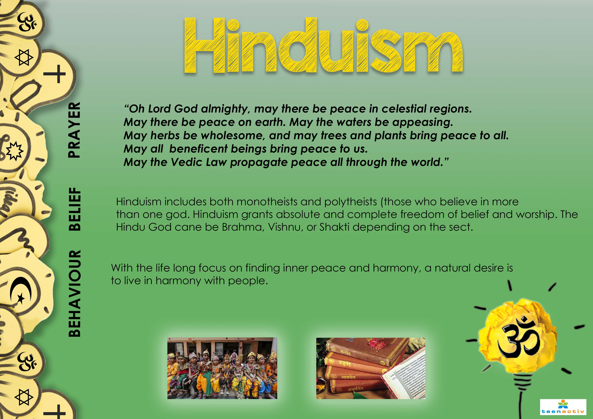
Notes:
Slide 5:
Hinduism
Prayer:
“Oh Lord God almighty, may there be peace in celestial regions.
May there be peace on earth. May the waters be appeasing.
May herbs be wholesome and may trees and plants bring peace to all.
May all beneficent beings bring peace to us.
May the Vedic Law propagate peace all through the world.”
Belief:
Hinduism includes both monotheists and polytheists (those who believe in more than one god). Hinduism grants absolute and complete freedom of belief and worship. The Hindu God can be Brahma, Vishnu, or Shakti depending on the sect.
Behaviour:
With the lifelong focus on finding inner peace and harmony, a natural desire is to live in harmony with people.

Slide 6
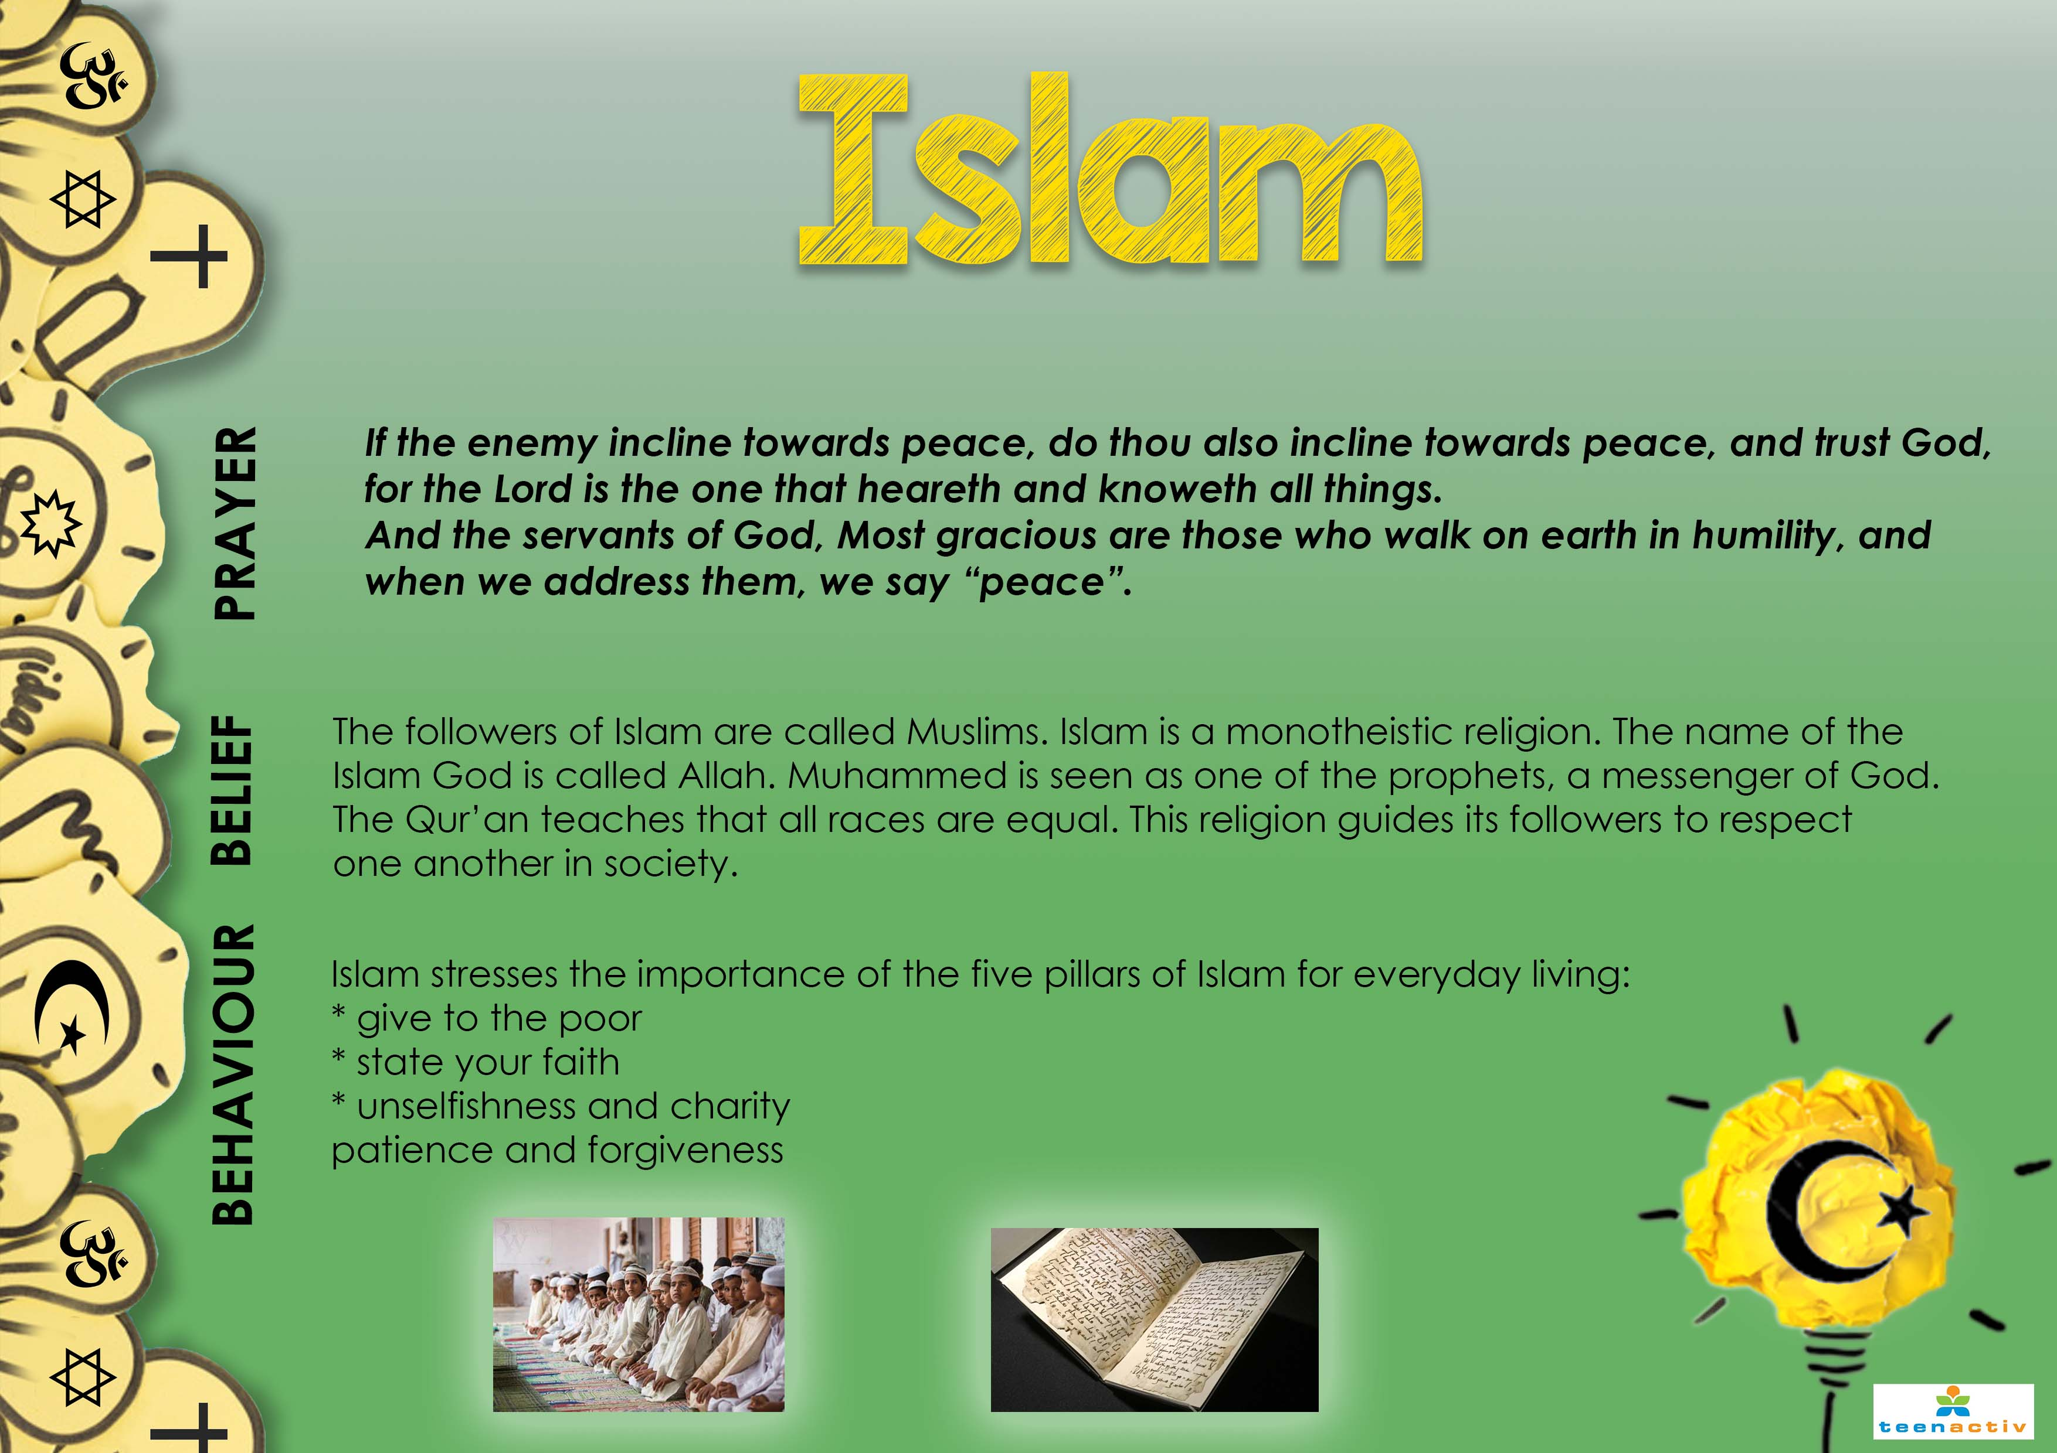
Notes:
Slide 6
Islam
Prayer:
Lord is the one that heareth and knoweth all things. And the servants of God, Most gracious are those who walk on earth in humility, and when we address them, we say “peace”.
Belief:
The followers of Islam are called Muslims.
Islam is a monotheistic religion. The name of the Islam God is called Allah. Muhammed is seen as one of
the prophets, a messenger of God. The Qur’an teaches that all races are equal.
This religion guides its followers to respect one another in society.
Behaviour:
Islam stresses the importance of the five pillars of Islam for everyday living:
* give to the poor
* state your faith
* unselfishness and charity
* patience and forgiveness

Slide 7

Notes:
Slide 7
African Christianity
Prayer:
Praise ye Lord, Peace be with us. Say that the elders may have wisdom and speak one voice. Peace be with us. Say that the country may have tranquillity. Peace be with us. And the people may continue to live in harmony.
Belief:
This church follows many of the same rules and laws as the Christian church.
However, there are some of their own rules as well.
* they believe your religious faith has the power to heal you.
* they respect traditional African religious beliefs and the beliefs around the power of the ancestors.
* church prophets give instructions to its members and the people must obey to be healed from sickness.
Behaviour:
There is the belief that a moral person is one who lives well with others and has harmonious relationships with all in the community. Peace is linked to a normal way of life, where order, harmony and balance are important.
Religious leaders and family members lead by practicing peace in their homes and community.

Slide 8
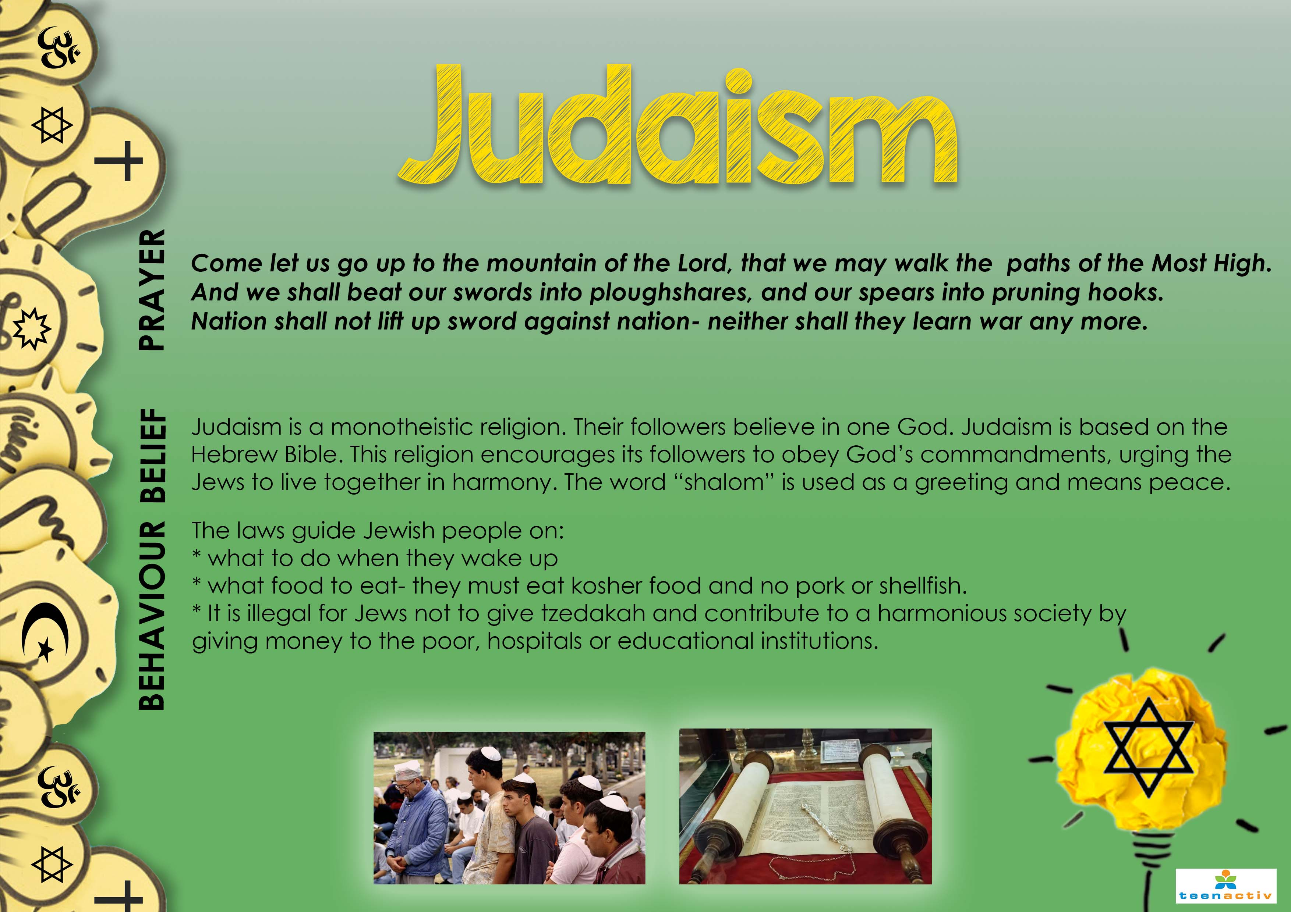
Notes:
Slide 8
Judaism
Prayer:
Come let us go up to the mountain of the Lord, that we may walk the paths of the Most High. And we shall beat our swords into ploughshares, and our spears into pruning hooks. Nation shall not lift up sword against nation- neither shall
they learn war anymore.
Belief:
Judaism is a monotheistic religion. Their followers believe in one God. Judaism is based on the Hebrew Bible. This religion encourages its followers to obey God’s commandments, urging the Jews to live together in harmony. The word “shalom” is used as a greeting and means peace.
Behaviour:
The laws guide Jewish people on:
* what to do when they wake up
* what food to eat- they must eat kosher food and no pork or shellfish.
* It is illegal for Jews not to give tzedakah and contribute to a harmonious society by giving money to the poor, hospitals or educational institutions.

Slide 9
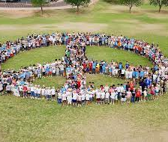
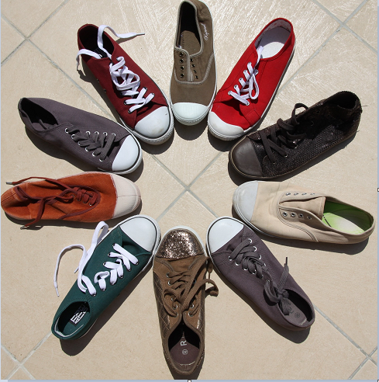
Complete Activity 2 in your worksheet on your own.
Notes:
Slide 9: 10min
On Lesson 1 – Worksheet complete Activity 2.
Learners have 10min to complete this activity on their own. In this activity, each learner will need to consider the following:
“You are on the school RCL and have been asked to write a ½ PAGE proposal to amend the school’s Code of Conduct. This amendment is to promote peace and respect at school amongst learners of different religions. This proposal should include a list of behaviours you believe would encourage peace in the school.“

Slide 10
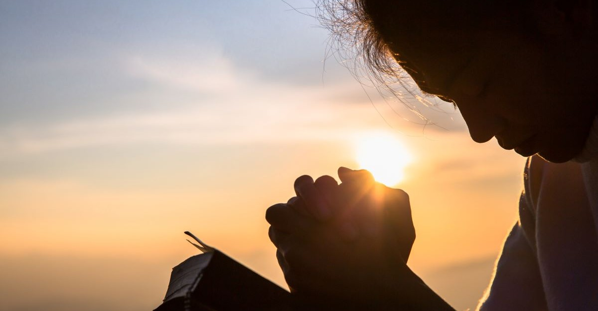

In the last few minutes of this lesson, use the time to reflect on “What you believe?” in Activity 3.
Notes:
Slide 10: 7min
During the lesson today, there would have been several moments that you had to think about what you believe. We mentioned earlier that our beliefs impact our behaviour. In other words what we do reveals our values and true beliefs.
In the last few minutes of this lesson, use the time to reflect on “What you believe?” in Activity 3 (Lesson 1 – Worksheet)
Remember there is no right or wrong to these answers as each person has different beliefs.
There are no memo answers to this activity.
Make sure in this time the class is quiet. You can even play an instrumental song to encourage a quieting down and reflecting.
Note to Teacher- REMEMBER to identify FOUR learners who will be your FAMOUS actors/ actresses that will be interviewed in the next lesson. Assign each of them ONE of the four scenarios so that they can do some research on the role that they will play. Tell them that they are going to be interviewed and will need to respond to their scenario. Hand out the Lesson 2 – Scenario 1-4 activity to these FOUR learners.
The other learners in the class will complete Activity 4 on Lesson 1 – Worksheet as a homework activity.

