Slide 1



Lewenslange Leer en hoe om dit te befonds
Wêreld van Werk, Les 1

Slide 2

Waaraan dink jy as jy die woorde Lewenslange Leer sien?
LEWENSLANGE
LEER
Notes:
Activity 1: Brainstorm and share what comes to mind when we think about these two words.
Write the responses on the board and then sort them into “Positive” “Negative” and “Neutral” word connotations.
What is the difference between learning and education?

Slide 3
Wat dink jy is die verskil tussen:
LEER &
ONDERRIG
Notes:
Activity 2: What is the difference between learning and education?

Slide 4

So, wat dink jy is lewenslange leer?
Lewenslange leer is die "deurlopende, vrywillige en selfgemotiveerde" strewe na kennis vir persoonlike en/of professionele redes.
Notes:
Share the definition of Lifelong learning

Slide 5
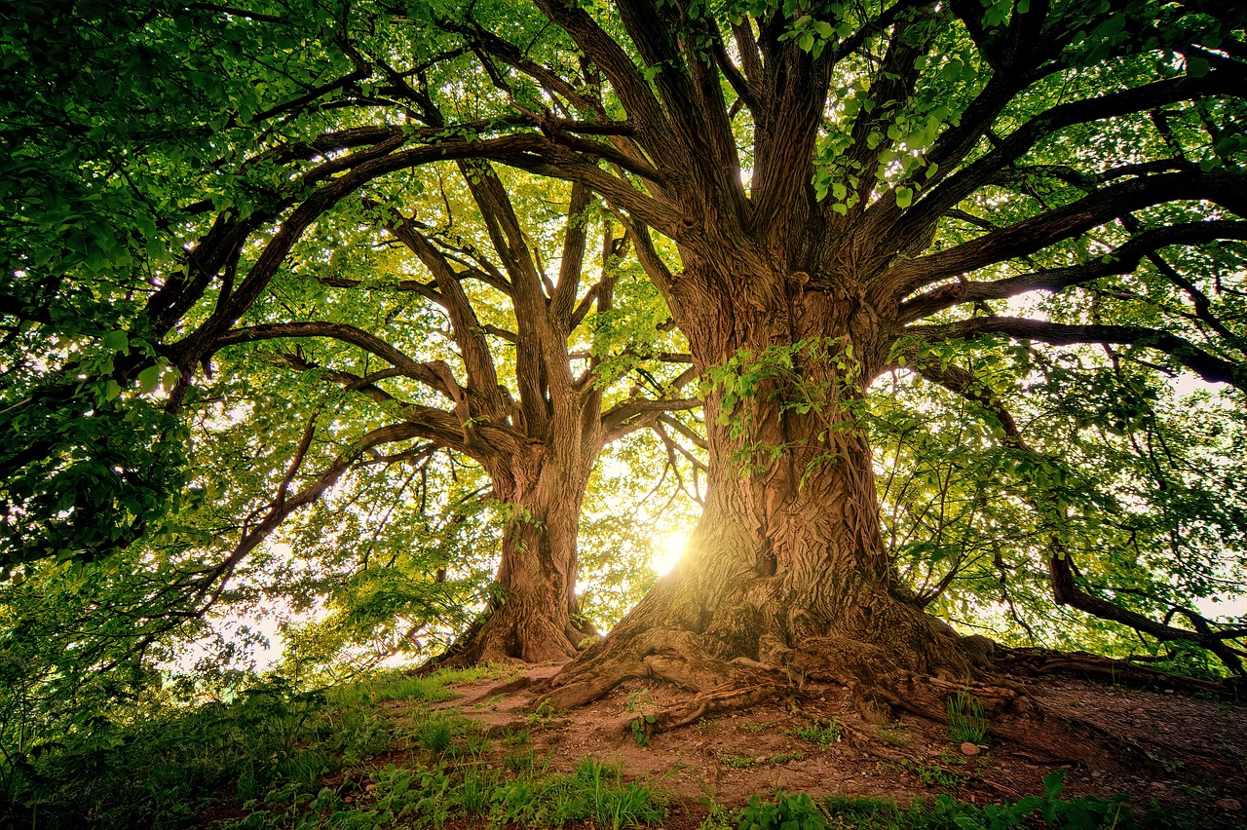
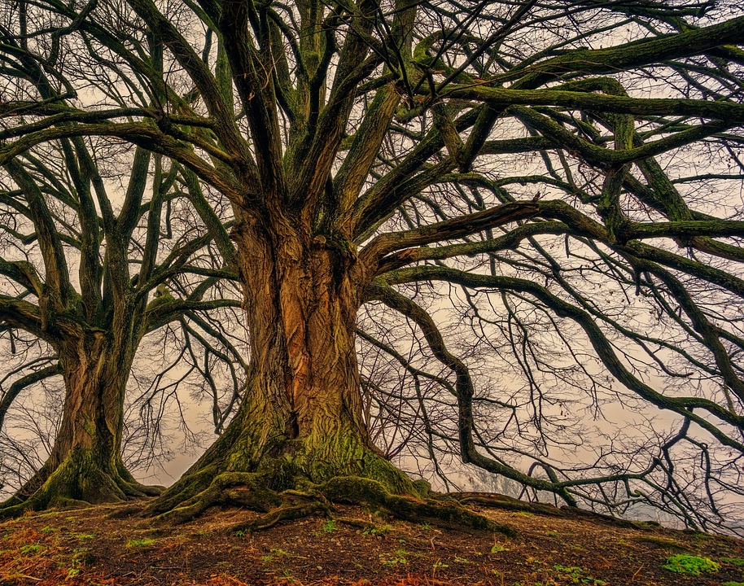
"Lewenslange leer is soos 'n boom, hy moet groei andersins sterf hy, daar is nie ‘n middeweg nie."
Notes:
Do you agree with the statement or not? Why or why not?

Slide 6

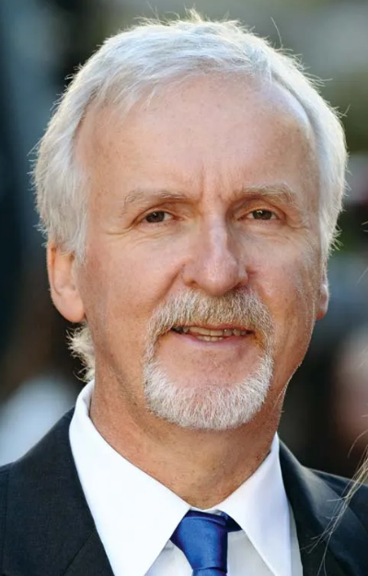
GROEI
James Cameron
Filmregisseur
Notes:
Read the story of Doreetha Daniels, nearing 100 years old. Ask what kinds of characteristics of a lifelong learner she displays.
Make a list of other characteristics of a lifelong learner.

Slide 7


https://www.youtube.com/watch?v=cqRoGpSGFwk&t=3s
DOELWITTE
Notes:
Read the story of Doreetha Daniels, nearing 100 years old. Ask what kinds of characteristics of a lifelong learner she displays.
Make a list of other characteristics of a lifelong learner.

Slide 8
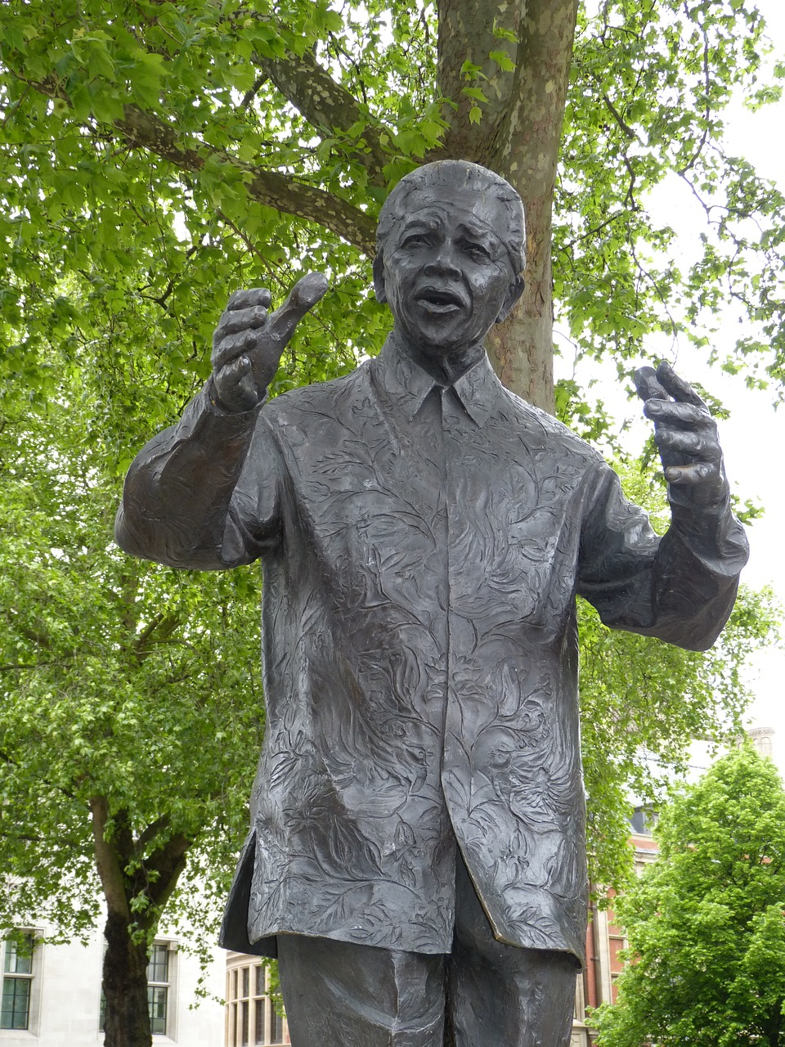

"Onderwys is die kragtigste wapen waarmee die wêreld verander kan word."
Nelson Mandela
Mandela het geglo dat onderwys positiewe verandering kon aanbring en het 'n beroep op alle Suid-Afrikaners gedoen om kennis te koester en nooit op te hou leer nie.
GROEI
Notes:
Shared reading: Read the details (on this slide) of our own great LIFELONG LEARNER.
Through this brief look at a statement by Nelson Mandela and three quotations about his belief about learning and education, we want to again identify the characteristics of a lifelong learner and how lifelong learning can also be life-wide – not confined to just formal spaces but all experiences – and the characteristic of embracing learning from things we experience. And also life-deep learning – that learning is about knowledge, experience, and growth and development as people.
.

Slide 9

GELD GROEI NIE AAN BOME NIE

Slide 10
Meer as die helfte (51%) van jeugdiges tussen 18 en 24 jaar beweer dat hulle nie die finansiële middele het om vir hul onderrig te betaal nie. Verder het 18% van diegene tussen 18 en 24 jaar wat nie onderwysinstellings bygewoon het nie, aangedui dat hul swak akademiese prestasie hulle verhinder het om daaraan deel te neem. Só sê Statistieke Suid-Afrika se "Higher Education and Skills in South Africa"-verslag wat deur Statistieke Suid-Afrika vrygestel is.
Die verslag, wat data van die Algemene Huishoudelike Opname (GHS) 2017 gebruik, dui aan dat slegs 33,8% van jeugdiges tussen 18 en 24 jaar opvoedkundige instellings bygewoon het. Onder hulle het 22,2% skoolgegaan terwyl 11,6% naskoolse onderwysinstellings bygewoon het.
[Verwerk vanaf: https://www.statssa.gov.za/?p=12040 ; Toegangsdatum: 6 Augustus 2023]
GELD GROEI NIE AAN BOME NIE
Notes:
Read the statistics and let’s try to brainstorm some ideas for a student finding themselves in this position.
Each group will take ONE of the options and will fill in their worksheet – try to create a definition of that form of funding,
Mention positives and negatives of that type of funding.
Share these answers with one another.

Slide 11



}
Lening
NSFAS
Meriete Beurs
Beurs
Werk
Vakleerlingskap
BELEGGING IN GROEI
Notes:
Each group will take ONE of the options and will fill in their worksheet – try to create a definition of that form of funding,
Mention positives and negatives of that type of funding.
Share these answers with one another.
There are also answers in the Content sheet and a list of study scholarships, loans, burasaries and internships are available in the lesson cont

Slide 12
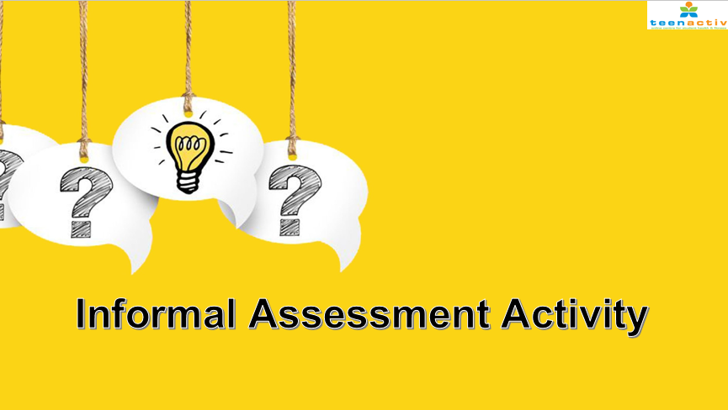

Informele Assessering

