Slide 1


Notes:
3min- Slide 1-3
Welcome back to the last lesson in this series and at the same time the last lesson of your curriculum for the year. You will have opportunity today to practice some questions that line up with the kind of questions you would see in your end-of-year assessment.
In our last two lessons we looked at religions in South Africa and how they promote peace as well as moral dilemmas that arise and how our beliefs impact the decisions we make.
Turn to the person on your right and mention TWO things you learnt about dealing with moral dilemmas. (Ask if anyone would feel comfortable sharing with the class.)

Slide 2

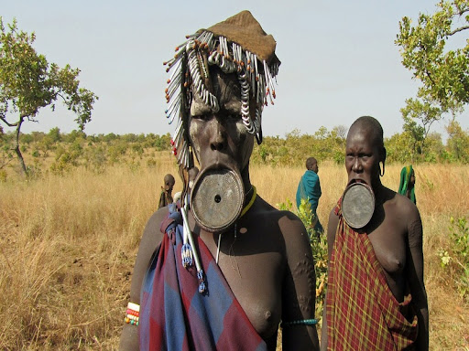
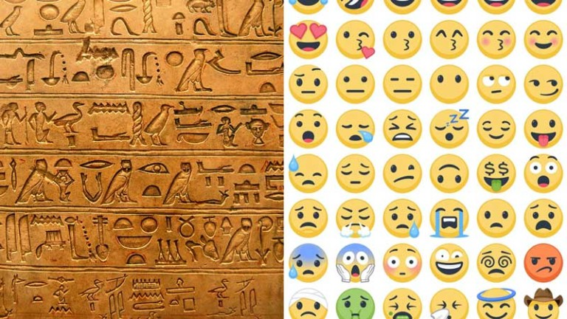
EMOJIGLYPHS
Notes:
Slide 2-3: 7min – teaching and discussion
Today we are going to look at some interesting cultural practices and traditions. Often these traditions might seem strange to us if it is not something we practice in our religion or culture. We need to show one another respect and understanding regardless of our differences.

Slide 3
“11 year old child married to a 40 year old man through arranged marriage”
“42 teenage boys die in the bush from circumcision.”
“13 year old teen girl pregnant with 4th child. Catholic school discourages contraception.”
Notes:
Slide 3:
Teacher Note: Divide the class into THREE groups for this activity. Allow each group to discuss their thoughts on each of the below headlines. Each group should have one spokesperson to give feedback to the class. Allow only 4min for discussion and 3min for feedback.
Lets take a brief look at each of these headlines.
“11 year old child married to a 40 year old man through arranged marriage”
In certain religions its acceptable for arranged marriages that will financially and in terms of social status benefit the family. Parents decide who the daughter will marry and can arrange this marriage from very young.
“42 teenage boys die in the bush from circumcision.”
Male circumcision is included in the initiation rites of some cultures. Traditionally its performed by an elder and the boys need to remain outside in the bush for a period of time. Sadly, in several instances, this procedure is often performed by someone untrained and with unsterile equipment. The result has sometimes been amputation or death.
“13 year old teen girl pregnant with 4th child. Catholic school discourages contraception.”
Some religious groups take a very strong stand on sex before marriage and therefore do not educate children on the outcomes of sex. The result is they don’t know about contraception and fall pregnant when they become sexually active.

Slide 4

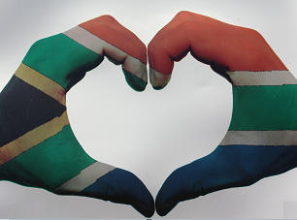
It would be easy to take a strong moral stand and disagree with these different traditions but we need to be respectful and communicate in a respectful way.
Notes:
Slide 4: 15min
It would be easy to take a strong moral stand and disagree with these different traditions, but we need to be respectful and communicate in a respectful way.
People have opinions about most things. Sometimes they are very strong opinions. It is a sign of maturity to respect others’ opinions and beliefs.
E.g. you love to eat meat but your best friend is vegan.
Remember you don’t need to respect any unlawful opinion that is unacceptable according to the constitution and Bill of Rights.
Eg. Someone in your class enjoys making derogatory comments behind other people’s backs about their race. In South Africa we respect one another and do not discriminate against one another because of race, gender, colour, ethnicity, social origin, sex, religion or language.
Here are a THREE simple tips on listening to others’ opinions:
Do not just say “You are wrong”
Do not interrupt a person sharing their opinion.
Try to think of the other persons point of view.
You will now have an opportunity to complete Activity 1 of Lesson 3 – Worksheet.
Possible answers for Activity 1 have been recorded in the Lesson 3 – Worksheet MEMO

Slide 5
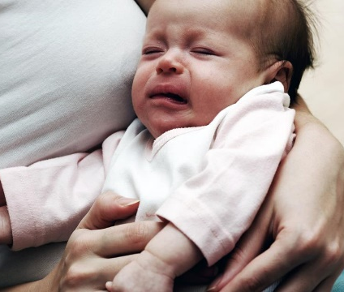
What would you do?
15 year old teenage girl drowns her new born baby”.
A young woman gave birth to a baby who was born brain-damaged and paralysed. The baby could not even move his mouth. She understood her baby would never recover and drowned her baby in the hospital bath.
Notes:
Slide 5: 8min +4min feedback
You will now have an opportunity to n your groups to discuss each of the following questions in response to this news headline:
Read through the news headline below and then discuss the different questions in your groups. You will have opportunity to give feedback to the class.
On your Lesson 3 - Worksheet, discuss the questions outlined in Activity 2.
In your groups discuss the following questions about euthanasia and this moral dilemma. Make notes to provide feedback to the class.
Explain the different types of euthanasia. What is your opinion about the acceptability of euthanasia?
Provide THREE reasons why this woman may feel the need to kill her child.
What might be the possible psychological consequences for a person who chooses to use euthanasia to end the life of a loved one.
Notes to teacher: Allow learners 6min to discuss. Many of these issues are spiritual issues and dilemmas which makes it personal. Discussions could get heated. Encourage respect for one another's varied opinions. The main purpose of these discussions is to 'clarify the learners' own values and beliefs: taking a stand, be firm in your own beliefs, BUT be understanding, respecting and accepting others' beliefs, decisions and religions.
Possible answers for Activity 2 have been recorded in the Lesson 3 – Worksheet MEMO
Let’s get started.

Slide 6

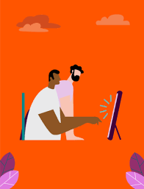
Write a short paragraph on what you have learnt over these three lessons about respecting someone with a different religion to you.
• How social media negatively
impacts communication of
different opinions?
Notes:
Slide 7: 3min
Allow time for learners to take a moment to reflect on what they have learnt about themselves today in class. Answer the questions in Activity 3 on Lesson 3 – Worksheet
• Write a short paragraph on what you have learnt over these three lessons about respecting someone with a different religion to you.
• How social media negatively impacted communication of different opinions?
There are no memo answers to these questions. Make sure in this time the class is quiet. You can even play an instrumental song to encourage a quieting down and reflecting.

