Slide 1
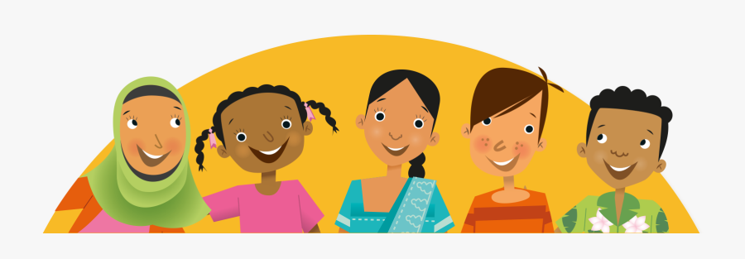


Understanding DIVERSITY:
Enriching South African Society
Lesson 2

Slide 2
South Africa’s story:
In South Africa, there is no one single heritage or culture and it is very difficult to define the “South African People” based on a set of distinct characteristics or identities. The cultures, languages and ethnic origins of South African people are exceptionally diverse and dynamic. This is what makes South Africa such an interesting and unique place
to visit.

Slide 3
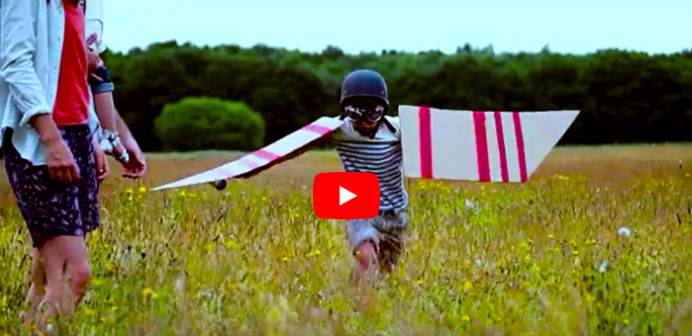
Brand South Africa showcases the diverse South African people https://www.youtube.com/watch?v=GbV7YDhWoag

Slide 4
Enriching our Society
The way we treat people and our attitudes towards them is based on what we have learnt and how we have been raised. Being aware of other cultures helps us to respect beliefs and other ways of doing things that may not be our own. Recognizing other cultures is part of respecting their practices and beliefs.

Slide 5
Did you know
Cultural diversity encompasses a whole range of human characteristics including, but not limited to, age, gender, racial classification, ethnicity, religion, socioeconomic class, ability, national origin, geographical location, political orientation, physical size, and appearance. These factors influence the cultural experiences and backgrounds of individuals and groups.

Slide 6
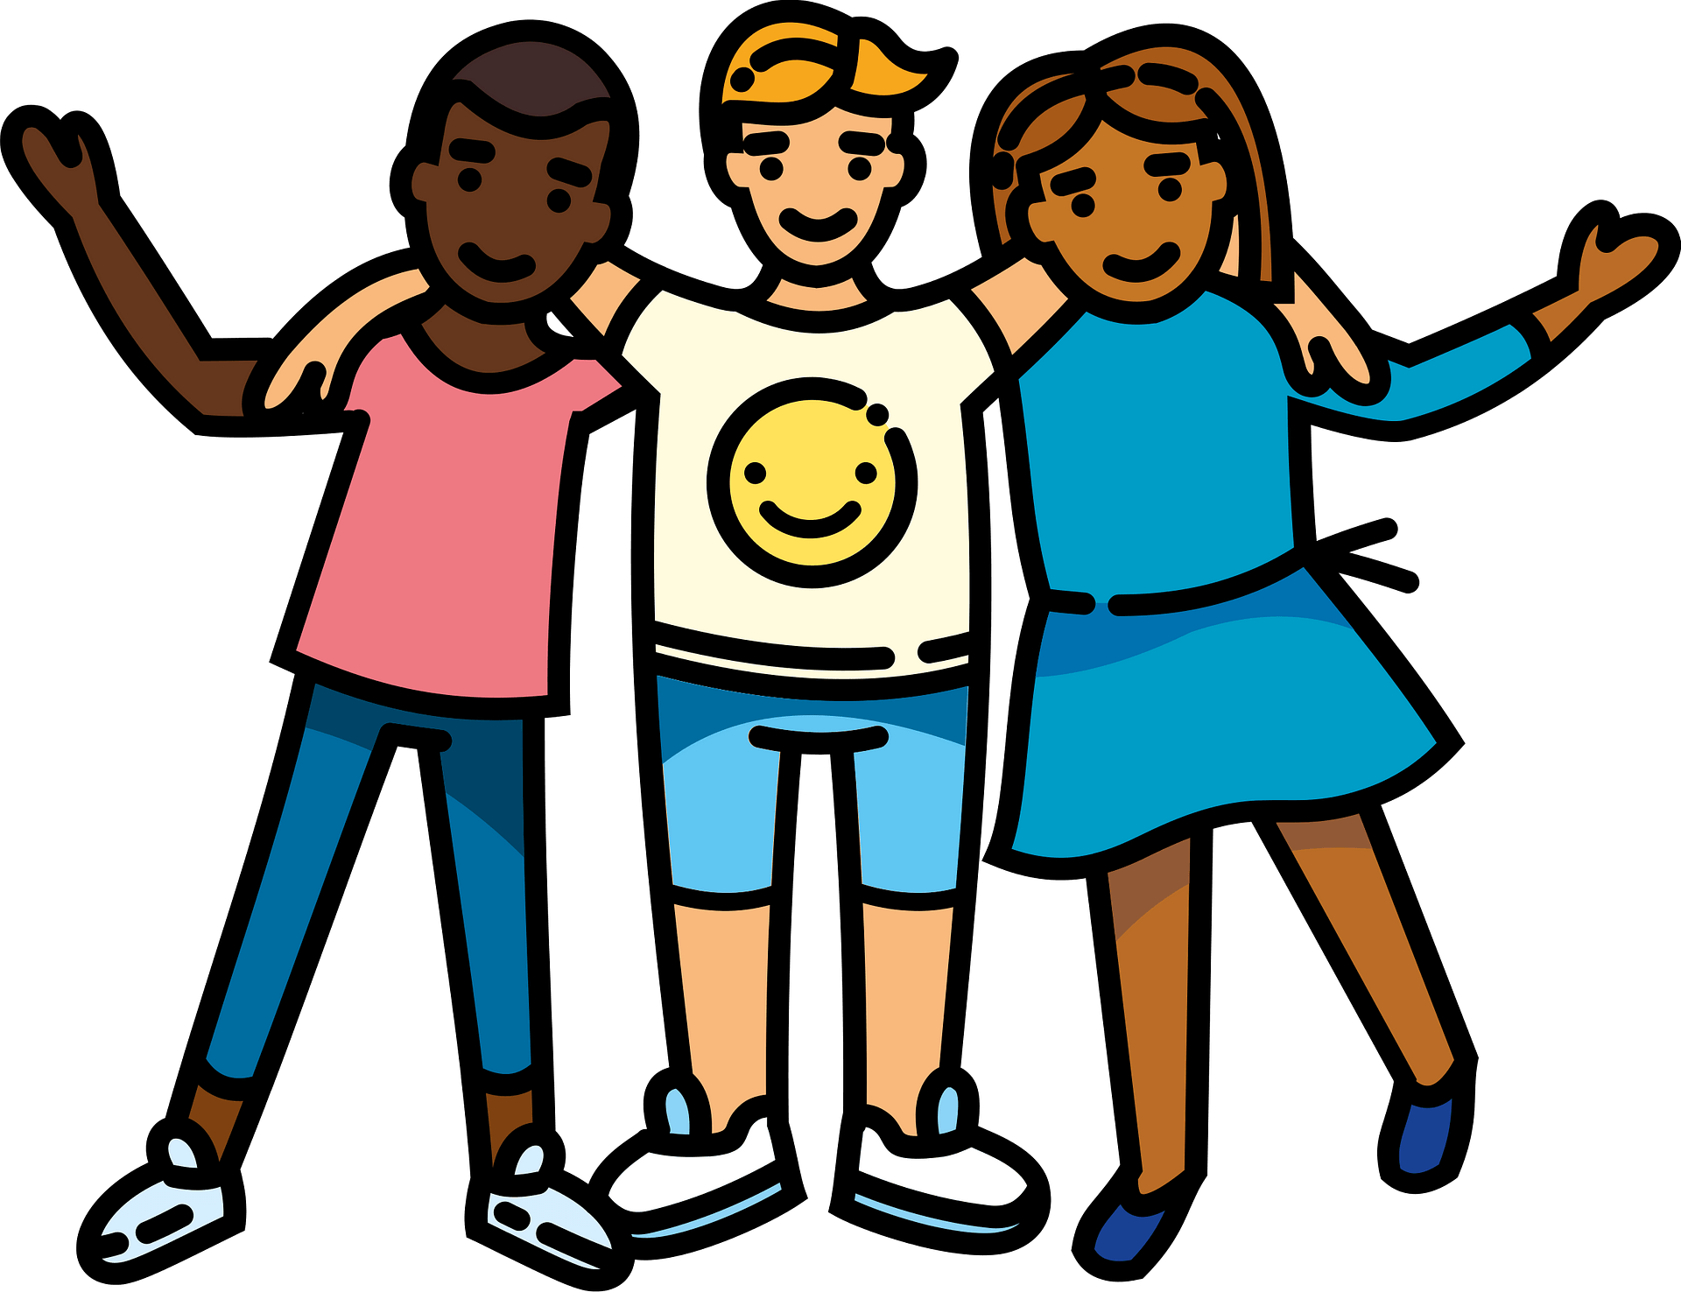
Today, most people view diversity positively because it gives people the chance to experience different things outside of what they are normally accustomed to.

Slide 7
Cultural diversity is important because it affects everyone:
Shapes how we see the world.
Provides a lesson for each of us.
Gives us an opportunity to learn about those around us.
Learning about other cultures helps us understand different perspectives.
Cultural diversity also makes our country stronger and better able to compete in the new global economy.
People from diverse cultures bring language skills,
new ways of thinking and creative solutions to
difficult problems.

Slide 8
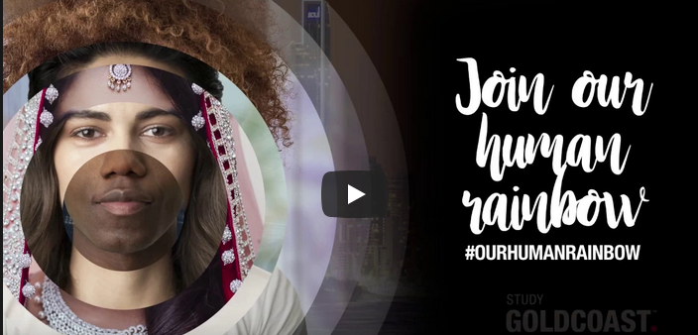
.
Embracing Diversity
https://www.youtube.com/watch?v=afPzn8qB8tA

Slide 9
But let’s not forget
Something that is considered inappropriate behaviour in one culture may be perfectly appropriate in another.
Diversity can affect a person in a negative way. For example, a person may start to feel as if they can't turn to close friends or family because they do not hold the same traditions as everyone else.
Another factor in a less diverse student population is bullying. Students who are different are often targets for bullying. Frequently, when people lack knowledge of things that they are not accustomed to, they are quick to judge or stereotype and make ignorant decisions.

Slide 10
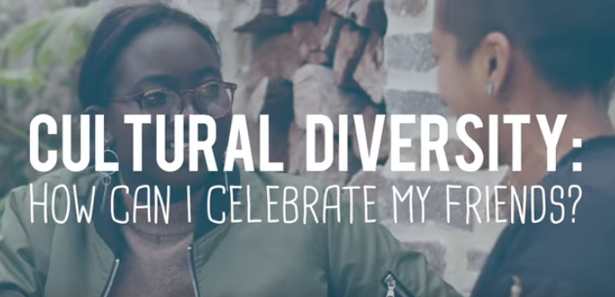
CULTURAL DIVERSITY
How can I celebrate my friends?
https://www.youtube.com/watch?v=RqE47pTcAIk

Slide 11
Diversity makes our country richer by making it a more interesting place to live.
Respecting differences means being accepting of others.
When you respect other people's differences - you demonstrate that you understand that not everybody lives their lives according to your views and experiences.
It is important to take the time to get to know somebody before jumping to conclusions.

Slide 12
How can YOU be more supportive and respectful?
Increase your level of understanding about other cultures by interacting with people outside of your own culture.
Avoid imposing values on others that may conflict or be inconsistent with other cultures.
When interacting with others who may not be proficient in English, recognize that their limitations in English proficiency in no way reflects on their level of intellectual functioning.
Recognize and understand that concepts within the helping profession, such as family, gender roles, spirituality, and emotional well-being, vary significantly among cultures and influence behaviour.
Intervene in an appropriate manner when you observe others engaging in behaviours that show cultural insensitivity, bias, or prejudice.
Be proactive in listening, accepting, and welcoming people and ideas that are different from your own.

