Slide 1

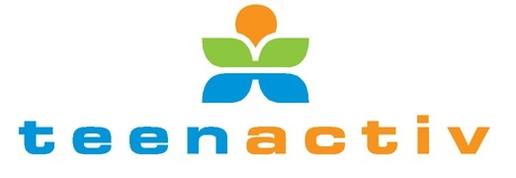
LIFELONG LEARNING
"Commit yourself to lifelong learning. The most valuable asset you'll ever have is your mind and what you put into it." -Albert Einstein

Slide 2

Lifelong Learning:
A traditional definition of lifelong learning is “all learning activity undertaken throughout life, with the aim of improving knowledge, skills and competences within a personal, civic, social and/or employment-related perspective” (European Commission [EC], 2001, p. 9).
Lifelong learners are motivated to learn and develop because they want to - it is a deliberate and voluntary act. Lifelong learning can enhance our understanding of the world around us, provide us with more and better opportunities and improve our quality of life
There are various ways in which professionals can enhance their learning - which includes learning from other people, listening to learn and actively realizing their potential. These can be used as a starting point for any professional who wants to achieve personal and/or professional development.
https://www.careerhelp.org.za/content/introduction-lifelong-learning

Slide 3


Is it that important?
There are two main reasons why professionals are encouraged to learn throughout life:
The first benefit of practising lifelong learning as a professional is for personal development - whereby you seek to realise your full potential as an individual. This is done through increasing your knowledge or skills around an area that you enjoy or perhaps you want to develop a skill that will in some way enhance your life. All this is done so you can attain meaning in your life.
Secondly, lifelong learning is applied in one's life for professional development - whereby one develops a vision of where one wants to see oneself and determines the qualities needed to get there. Therefore, employers of today look for people with transferable skills as they give an indication of one's zeal to learn and develop.

Slide 4

Technical skills become outdated as fast as we obtain them especially with the rapid change in technology these days. This makes lifelong learning more important than ever! It has become vital to stay committed to lifelong learning habits. The overall habits of lifelong learning encompass the following three principles:
PROFESSIONALS MUST DEVELOP CAREER
GOALS AND STRATEGY
It is imperative for professionals to understand their lifelong learning career goals which are guided by their personal development needs.
Even if it means going back to high school and doing your matric at the age of 60, that is also part of lifelong learning.
PROFESSIONALS MUST BE IN TOUCH WITH WHAT IS HAPPENING IN THEIR ENVIRONMENTS
Information is available all around us; we must keep our eyes and ears open. The contexts people exist in contain various opportunities for learning. These contexts have various information sources, problems that need to be solved, opportunities to connect with the environment itself and practice what has been learned.
PROFESSIONALS MUST STAY UP TO DATE
Creating a habit of reading and understanding what's going on in the world around you will keep any professional abreast with what is happening and possible gaps within different markets. Various mediums such as newspapers, online sources or social networks for example can help you start this process. This will assist you to open your worldview and gain global understanding of how world events impact our lives and therefore anticipate trends.

Slide 5
Examples and Benefits of Lifelong Learning
Examples of lifelong learning:
Benefits of lifelong learning
Developing a new skill (e.g. sewing, cooking, programming, public speaking, etc.)
Self-taught study (e.g. learning a new language, researching a topic of interest, subscribing to a podcast, etc.)
Learning a new sport or activity (e.g. joining martial arts, learning to cycle, learning to exercise, etc.)
Learning to use a new technology (smart devices, new software applications, etc.)
Acquiring new knowledge (taking a self-interest course via online education or classroom-based course)
Renewed self-motivation: figuring out what inspires you puts you back in the driver’s seat and is a reminder that you can really do things in life that you want to do.
Recognition of personal interests and goals: can even open future opportunities. You never know where your interests will lead you if you focus on them.
Improvement in other personal and professional skills: While we’re busy learning a new skill or acquiring new knowledge, we’re also building other valuable skills that can help us in our personal and professional lives.

Slide 6



Different Types of Learning:
Formal learning usually takes place in the premises of the school, where a person may learn basic, academic, or trade skills. Small children often attend a nursery or pre-primary school, but often formal education begins in elementary school and continues with secondary school.
By engaging in Lifelong Learning, you can keep up with career changes and allow for ongoing Self Development.
Informal learning is when you are not studying in a school and do not use one single learning method. In this type of education, conscious efforts are not involved. It is neither pre-planned nor deliberate. It may be learned in some marketplace area or at home.
Education goes beyond what takes places within the four walls of the classroom. We learn from experiences outside the school as well as from those within.
There are three main types of education, namely: Formal, Informal and Non-formal.
Non-formal education includes adult basic education, adult literacy education or school equivalency preparation. In non-formal education, someone (who is not in school) can learn literacy, other basic skills or job skills.

Slide 7
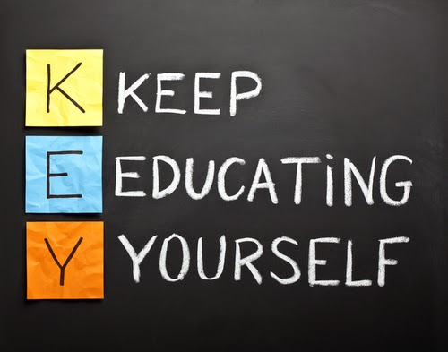

Something to think about
What is Life long Learning?
Why should we continue to learn?
Are you prepared to shape and mould your skills as things change?
What kind of learning suits you best?
Are you ready for what's out there one day?

