Slide 1


Notes:
Slide 1: 3min
Welcome back to class Grade 10’s. Let’s briefly recap the last lesson just to refresh your memory.
Can you list the FIVE religions we investigated in class in the lass lesson? (Allow time for the class to list them.)
Islam
Christianity
African Christianity
Hinduism
Judaism
What did you learn about these religions from Activity 2 (Lesson 1 – Worksheet) that you never knew before?

Slide 2
An old African adage says: “The sky is large enough for birds to fly around without one having to bump into the other.”
Notes:
Slide 2 - 5: 10min + 2min
Maybe discussing these different religions in the last lesson made you a little bit uncomfortable because they are so different to your own beliefs. Remember that although we believe different things, we are still all South Africans. And it’s important to respect one another. This is a beautiful old African adage that says: “The sky is large enough for birds to fly around without one having to bump into the other.” This means there is space to believe differently and still live together.
Before South Africa was colonised there were different indigenous groups that already had a belief system. Yes, over the years they have been influenced by Christianity, Islam and Judaism but for many African people they still hold onto their “religious African roots”. Let’s briefly take a look at the origins of the indigenous belief systems.

Slide 3
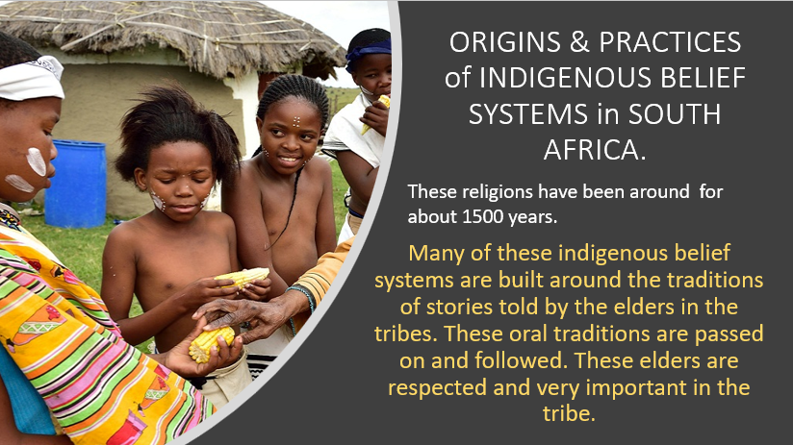

Slide 4
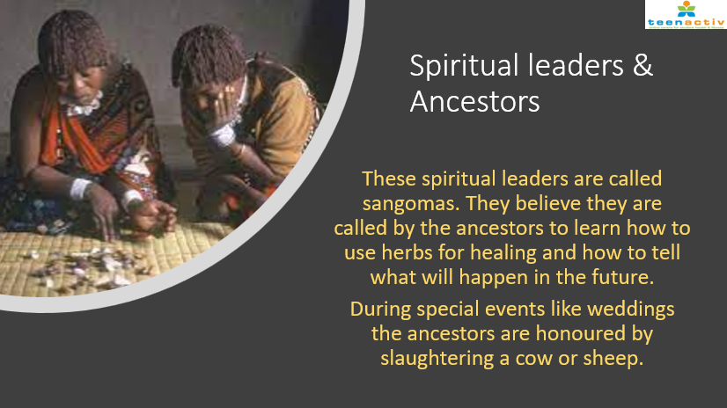

Slide 5
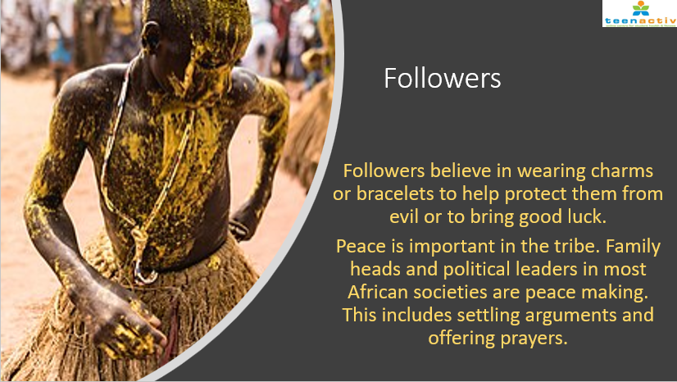

Slide 6
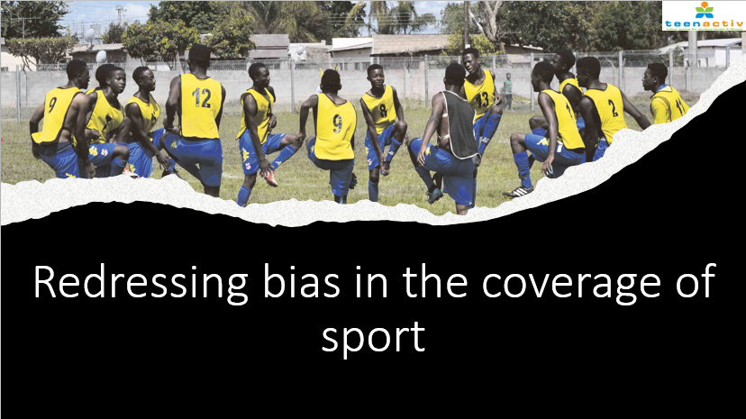

Slide 7
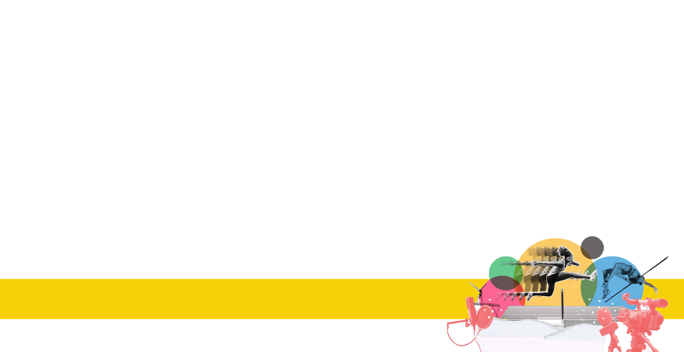
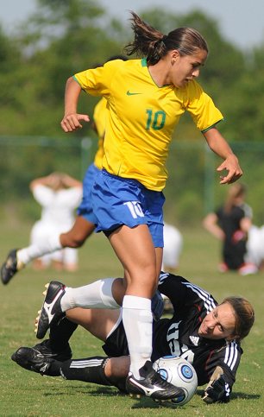
Ponytails and smiles: Pervasive language keeps sexism in Olympic sport at play
By Kara Fox, CNN
Accessed June 23, 2022
Notes:
Slide 7 & 8: 10 + 5min Individual & Group Activity
On your Lesson 2 – Worksheet (Activity 2) you will now need to read through the article on sexism at the Tokyo Olympics in 2021. In this article, the writer has mentioned several examples of where sexism existed.
Complete the answers to Activity 2 on your own. Do not waste time as you will need these answers to complete the next group activity.

Slide 8

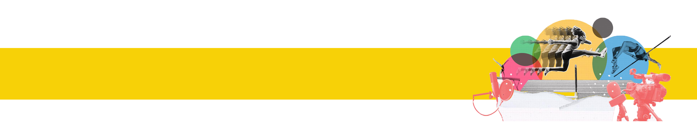
Notes:
Slide 8: 5min +2min
Now that you have investigated HOW bias has taken place in the Olympics and what groups of people were prejudiced, in your groups of FOUR you will have an opportunity now to make some changes in the coverage of sport. Your group will write a set of 10 RULES (on the Lesson 2 – Sports Coverage Poster) that need to be followed by everyone broadcasting sport at the next Summer Olympics in 2024. These rules will serve as a guideline for broadcasters all over the world.
(Note to Teacher: A suggestion would be to have each group put their poster up on a wall and allow learners to walk between the posters.) 2min

Slide 9
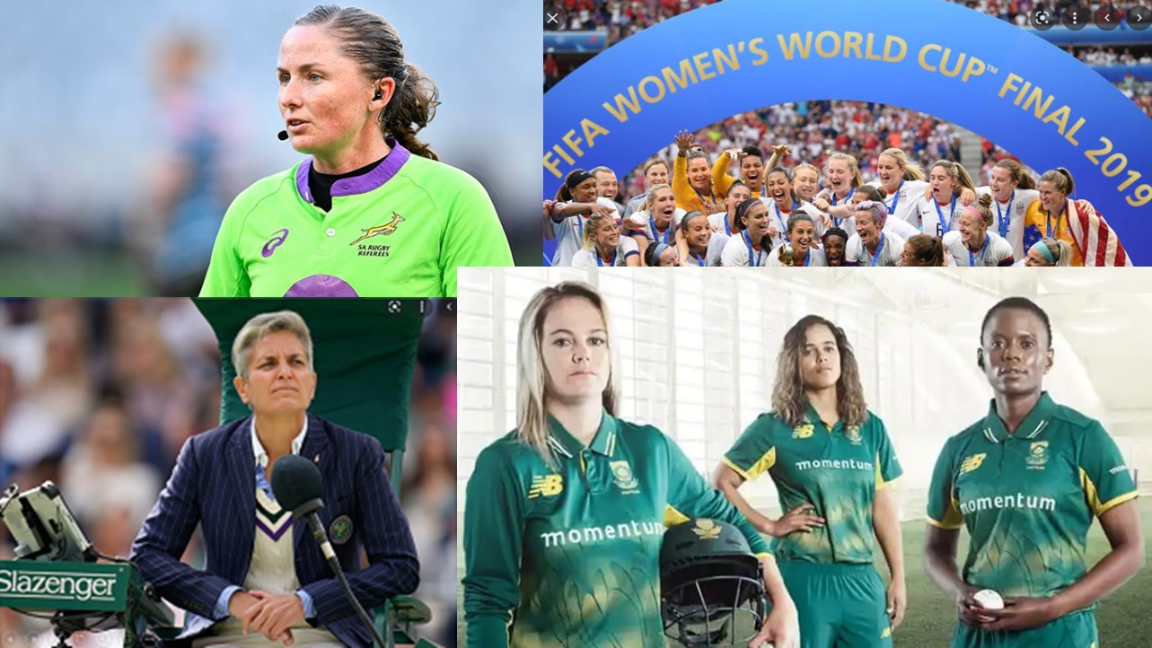
Notes:
Slide 9: 1min
Change is happening ….
Marija Cicak became the first female tennis umpire to take charge of a men's singles final at Wimbledon in 2021 – officiating the game between Novak Djokovic and Matteo Berrittini.
https://www.skysports.com/tennis/news/12110/12353153/wimbledon-2021-marija-cicak-set-to-become-first-female-umpire-for-a-mens-singles-final
The 2022 Women’s Cricket World Cup became the most engaged-with women’s event in the sport’s history reaching a total global TV audience of 104.8 million viewers and 1.64 billion total views across the International Cricket Council’s channels.
It’s the ICC’s third most engaged-with event only behind the men’s 2019 Cricket World Cup and 2021 men’s T20 World Cup.
https://frontofficesports.com/2022-womens-cricket-world-cup-generated-record-1-64b-views/
In October 2021, South Africa's Aimee Barrett-Theron made her United Rugby Championship debut, becoming the third female referee to appear in the men's rugby league that includes the Stormers, Lions, Bulls and Sharks.
https://www.news24.com/sport/rugby/unitedrugbychampionship/sa-ref-aimee-barrett-theron-to-make-her-urc-debut-20211013
FIFA in discussions to more than double 2023 Women's World Cup prize money to $100 million
"It's the first time in the history of the FIFA World Cup that companies are coming to us — like Visa — and telling us, 'We just want to put money for the women's game, because we know that there is an untapped new potential in the women's game.'
https://www.abc.net.au/news/2022-07-20/fifa-could-double-2023-women-s-world-cup-prize-money-100-million/101254868
Update: Was $110m in 2023 compared to $30m in 2019
https://sport.optus.com.au/news/womens-world-cup-2023/os59287/prize-money-fifa-womens-world-cup-2023-how-much-will-the-winners-make-each-team

Slide 10
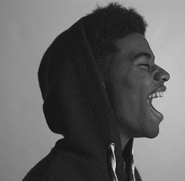
So to summarise, how do we redress bias in sport?
As an individual, speak up! Write letters to newspapers, comment on social media news outlets when you notice bias. Call in on a radio station to report bias.
Become aware of bias in sport. Watch the news and compare coverage between male and female sporting codes. Put pressure on commentators by commenting on social media platforms.
SPEAK-UP!
Notes:
Slide 10: 2min
So, to summarise, how do we redress bias in sport?
As an individual, speak up!
Write letters to newspapers, comment on social media news outlets when you notice bias.
Call in on a radio station to report bias.
Become aware of bias in sport.
Watch the news and compare coverage between male and female sporting codes.
Put pressure on commentators by commenting on social media platforms
Be someone who will SPEAK-UP!

Slide 11
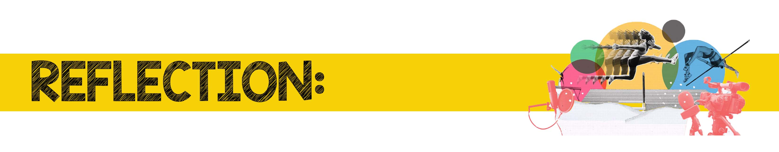

Write a short paragraph on what you have learnt today about bias in sports coverage.
How can you address stereotypes in your school sports environment?
Notes:
Slide 11: 5min
Allow 5min for learners to take a moment to reflect on what they have learnt about themselves today.
Answer the questions in Activity 3 on Lesson 2 – Worksheet
Write a short paragraph on what you have learnt today about bias in sports coverage.
How can you address stereotypes in your school sports environment?
There are no memo answers to these questions. Make sure in this time the class is quiet. You can even play an instrumental song to encourage a quieting down and reflecting.

