Slide 1


SAQA, NQF and RPL
All these abbreviations must mean something?!

Slide 2

SOUTH AFRICAN QUALIFICATIONS AUTHORITY
SAQA Explained:
The South African Qualifications Authority (SAQA) is the oversight body of the NQF and the custodian of its values and quality character.
The role of SAQA, as stipulated in the NQF Act, is to advance the objectives of the NQF, oversee the further development and implementation of the NQF, and co-ordinate the Sub-Frameworks.
Functions of SAQA:
  Oversee NQF implementation and collaborate with the Quality Councils
  Develop and implement NQF policies and criteria
  Register qualifications and part-qualifications on the NQF
  Recognise professional bodies and register professional designations
  Undertake research and collaborate with international counterparts
  Maintain the National Learners’ Records Database
  Provide an evaluation and advisory service with respect to foreign qualifications
  Inform the public about the NQF
  Provide advice to the Minister of Higher Education and Training

Slide 3
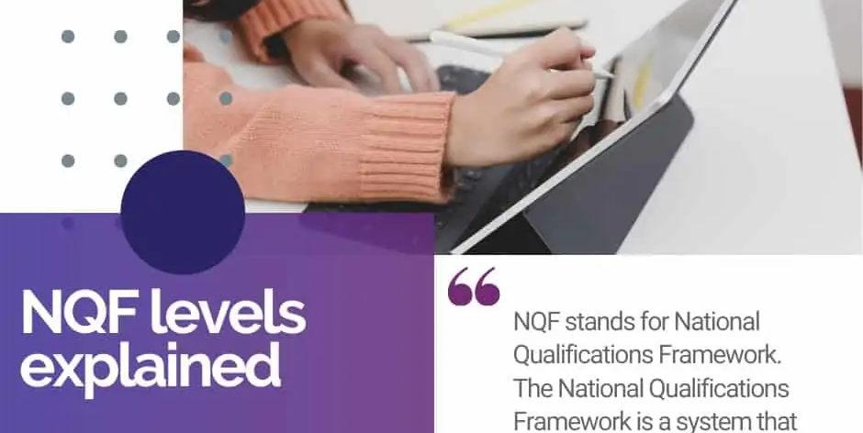
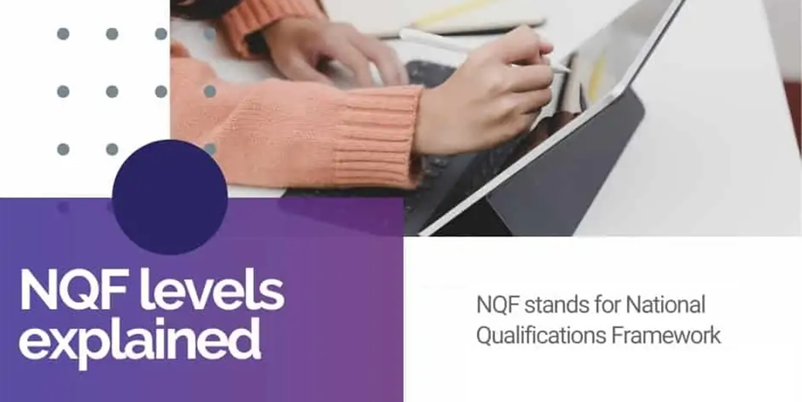
NATIONAL QUALIFICATIONS FRAMEWORK:

Slide 4

National Qualifications Framework:
NQF Explained
The National Qualifications Framework records the credits given to specific study areas and gives them an NQF level. This is done to make sure that all learning done across the country, at the same level, can be recognised.
For instance. A grade 9 certificate has an NQF level of 1. That goes for all grade 9 certificates across the country from accredited schools.
NQF levels range from level 1 (grade 9) to level 10 (doctorate degree).
With a grade 9 certificate or NQF 1 you can start studying an N1 NATED Qualification.
You can build your way to an NQF 6 without ever finishing matric.
A degree is an NQF 7 and can go up to an NQF 10 which is a doctorate.
NQF levels are a way to measure equivalent learning experiences.
https://www.matric.co.za/nqf-levels-explained/

Slide 5
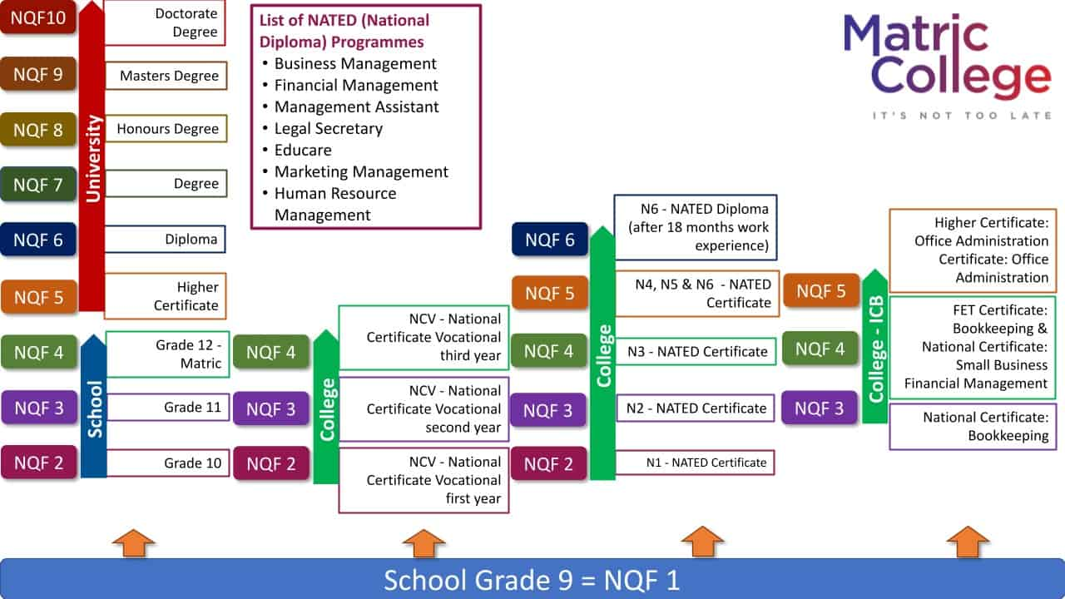
How does it all fit together?

Slide 6
NQF LEVELS BROKEN DOWN
Alternative Study Methods
Not going through traditional schooling methods, the
NQF levels are as follows:
NCV programmes
NCV stands for National Certificate Vocational. NCV
programmes start from NQF level 2 to NQF level 4
NQF 2: National Certificate Vocational first year
NQF 3: National Certificate Vocational second year
NQF 4: National Certificate Vocational third year
National Qualification (NATED) Courses
Study with a matric certificate.
Study with a matric certificate or matric equivalent certificate.
NQF levels from school to university are broken down here. These all fall under the traditional way of schooling:
School
NQF 1: Grade 9
NQF 2: Grade 10
NQF 3: Grade 11
NQF 4: Grade 12
University/College
NQF 5: Higher Certificate
NQF 6: Diploma
NQF 7: Degree
NQF 8: Honours Degree
NQF 9: Masters Degree
NQF 10: Doctorate Degree

Slide 7
RECOGNITION OF PRIOR LEARNING:
How Does it Work?
The process is simple and straightforward – your skills
will be assessed on the skills or knowledge you have, regardless of where and how it was learned. Unlike other forms of assessment, it doesn’t judge someone’s evidence of competence solely by the credentials or qualifications they have achieved, although this can form part of their claim. What RPL does is allow people to demonstrate that they can undertake specific tasks or working in certain industries based on evidence of skills and knowledge gained throughout their life. Anyone can apply for recognition of prior learning and is usually used for:
  personal development and/or certification of current skills without progression into a learning programme, if the candidate so chooses
  progression into a learning programme, using RPL to fast-track progression through the learning programme;
  promotion
  career or job change
Recognition of prior learning can be greatly beneficial and really fast-track your progress in a learning programme.
However, RPL is not automatically guaranteed.
Recognition of Prior Learning (RPL) is a process whereby non-formal learning and informal learning are measured, mediated for recognition across different contexts, and certified against the requirements for credit, access, inclusion or advancement in the formal education and training system, or workplace.
What Does Recognition of Prior Learning Mean?
In your lifetime you have obtained certain skills, qualifications, knowledge and experiences. These learning experiences could have been officially obtained via a college, university or any other accredited education body. You could have also gained this knowledge while at the workplace, doing short courses or compulsory training. Irrespective of where this learning took place, you can use the skills and qualifications you already have to gain credits within formal qualifications offered by various colleges and universities.
Recognition of Prior Learning provides an opportunity for you to identify your learning, have it assessed and formally acknowledged in the form of a qualification.

Slide 8
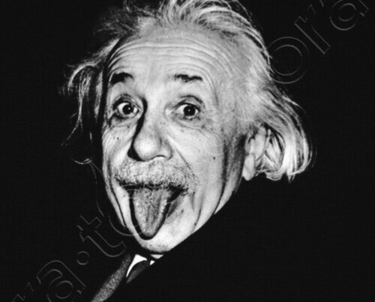
How will these apply to you?
Think about it…
What are your plans for after school?
Will you go to college? University? Are you maybe interested in learning a trade – there is a shortage of tradesmen…
What kind of qualification do you need one day? What are you interested in?

