Slide 1
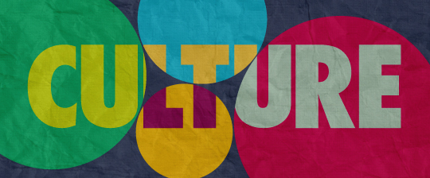
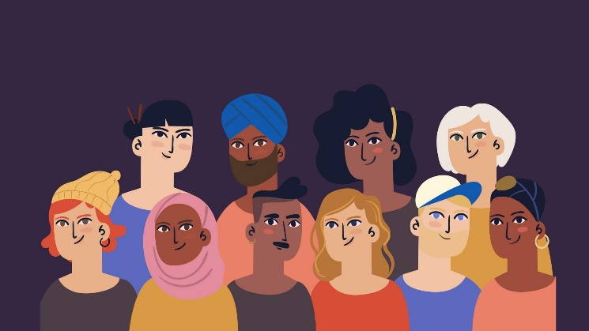
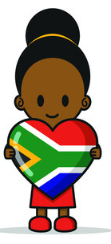

CULTURAL DIVERSITY in South Africa
Constitutional Rights & Responsibilities:
Lesson 1

Slide 2
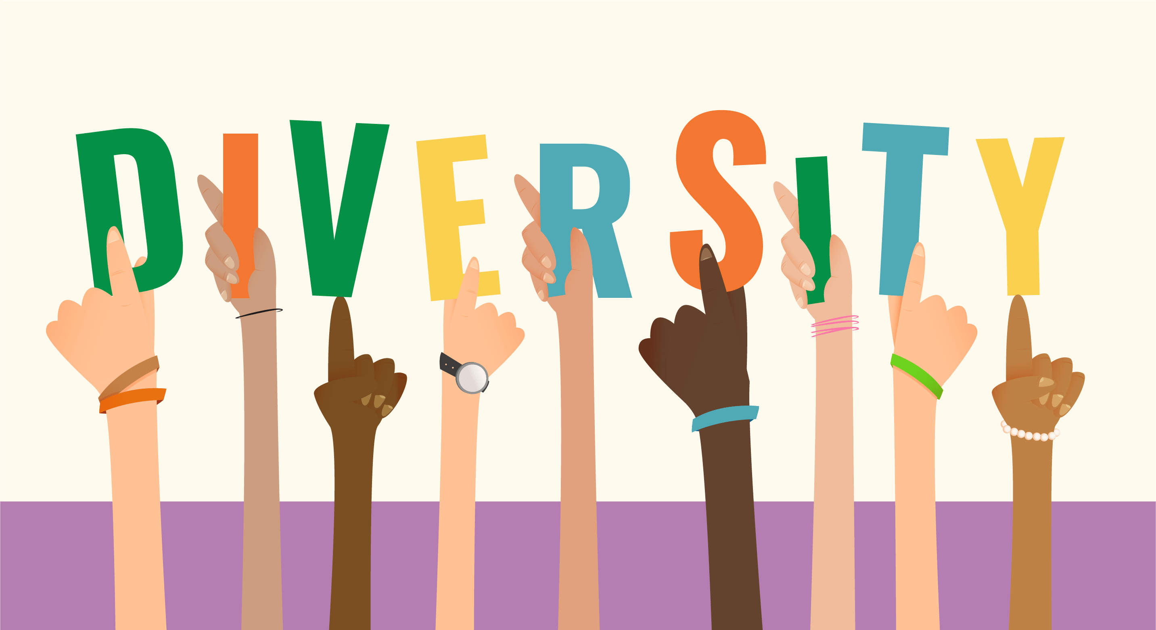
Our starting point:
Take out your activity from last week – that you received at the end of your previous lesson.
You were asked to explain what these two words meant:

Slide 3
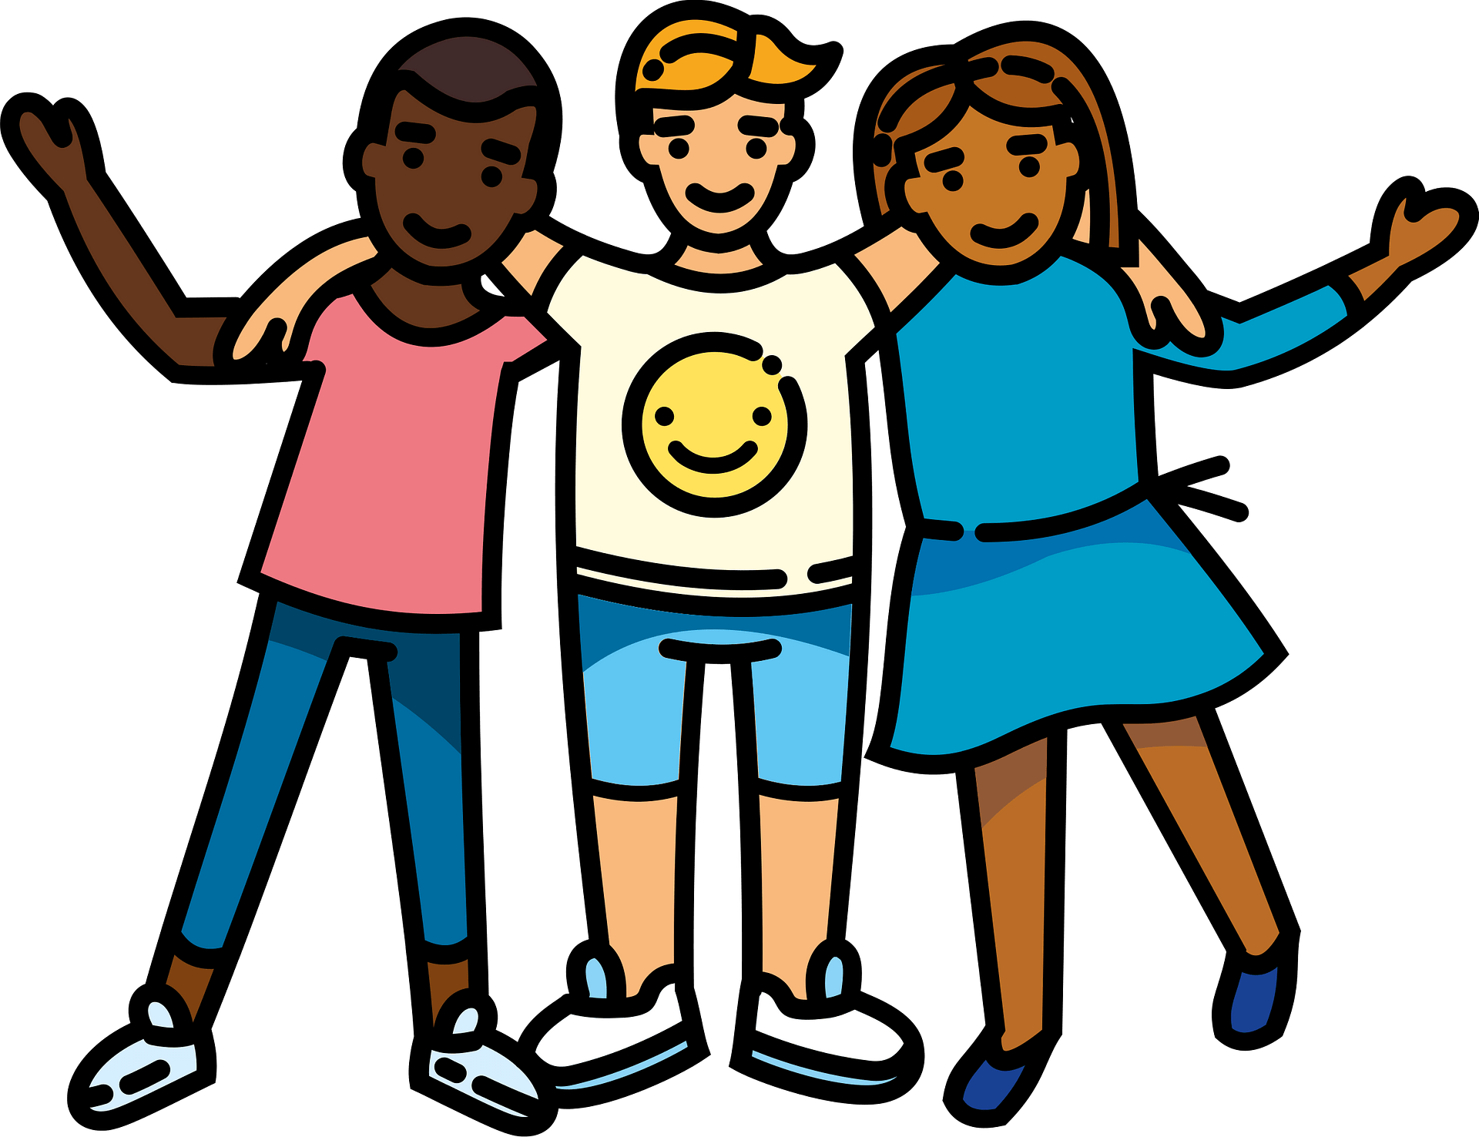
So, what do they mean?
Culture:
all the ways of life including arts, beliefs and institutions of a population that are passed down from generation to generation. Culture has been called "the way of life for an entire society." As such, it includes codes of manners, dress, language, religion, rituals, art.
Diversity:
composed of differing elements – to simplify, it means differences. If there is a diverse group of pets, for example, there might be a dog, a cat, a bird, and a lizard. People can be different in many ways. Some of the most obvious differences we may notice are age, language, culture, appearance, disabilities, race or ethnicity, and religion.

Slide 4

What is Culture all about then?

Slide 5
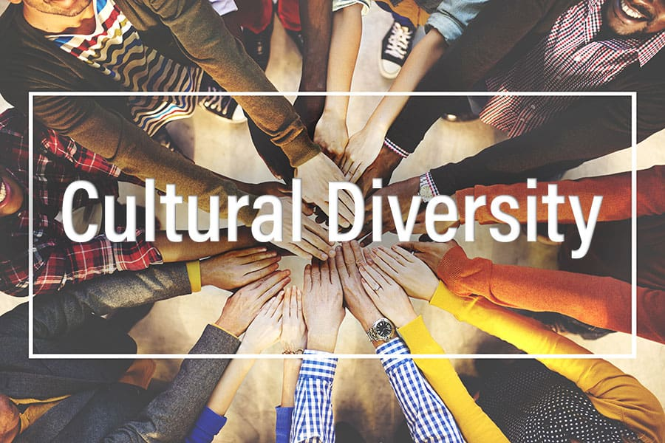
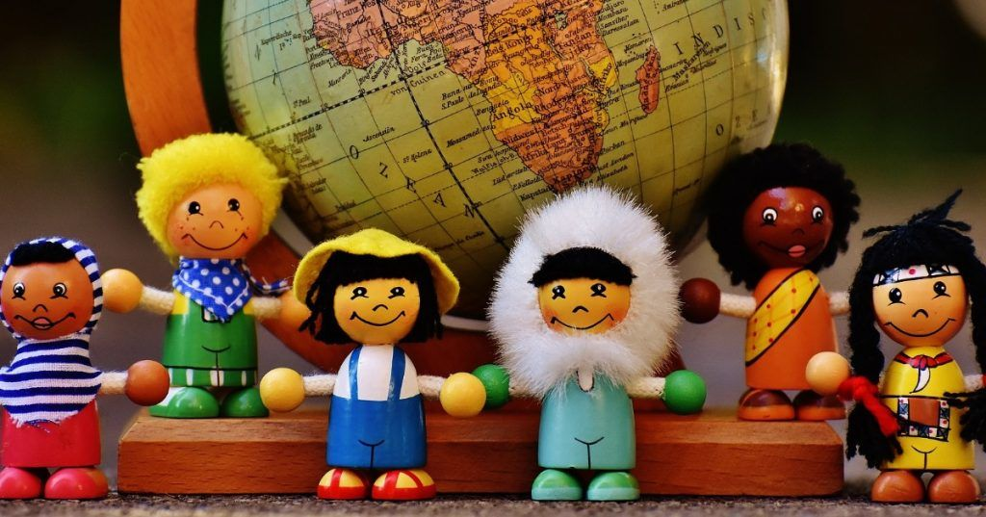
CULTURAL DIVERSITY: is the quality of diverse or different cultures, as opposed to monoculture (one culture). The term "cultural diversity" can also refer to having different cultures respecting each other's differences.

Slide 6
What about Cultural Diversity?

Slide 7
South Africa has great cultural diversity, many people are often amazed to hear the variety of languages spoken in South Arica or a priest wearing animal skins. We have an unusual mix of inhabitants, but this is what makes South Africa so great. We have many different cultural groups, languages, religions, and traditions in South Africa. We even have diversity in the food we eat and the music we listen to. We truly are a multicultural society even our national anthem includes four different languages.
The different cultural groups in South Africa are all made-up of different things, such as clothing, food, religion, family traditions, etiquette, music and celebrations.

Slide 8
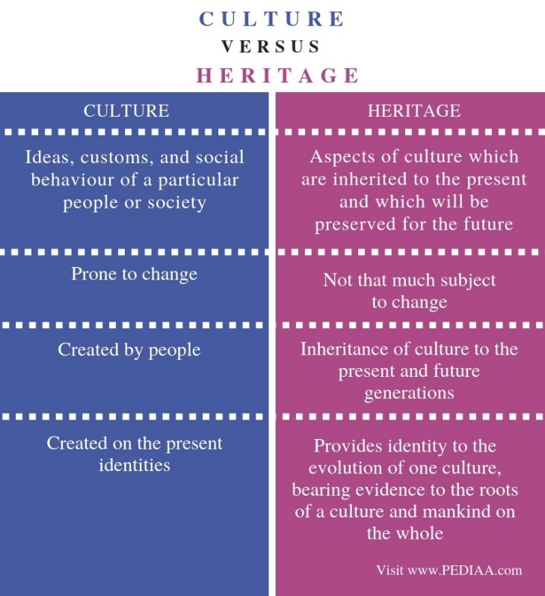
An important DISTINCTION to make:
Culture should not be confused with HERITAGE:
Heritage relates to inheritance, meaning passing of the beliefs, objects, and culture from one generation to the next, like a tradition.
Culture is the way of life for an entire society, i.e. the knowledge, ideas, customs, laws, and habits of a group of people (or society) that they accept together as their core values.

Slide 9
Diverse cultural norms and values
Cultural norms are the shared and accepted standards of behavior and ways of doing things, that are specific to a cultural group. They are also guidelines for developing your values and morals- this means your sense of what is right or wrong.
Things like eating habits, greetings, manners,
dress, medical treatment, celebrations,
relationships and religious activities are
all determined by cultural norms.

Slide 10
Diverse cultural norms and values
Cultural values are ideas about what is good, right, fair, and just. It can also be described as the difference between right and wrong.
Cultural values are a series of principles and values passed on generation after generation by our forefathers /ancestors.
Based on values, the entire community decides their way of life. Those ideas decide how a person of that culture will behave and how they will lead their lives.

Slide 11
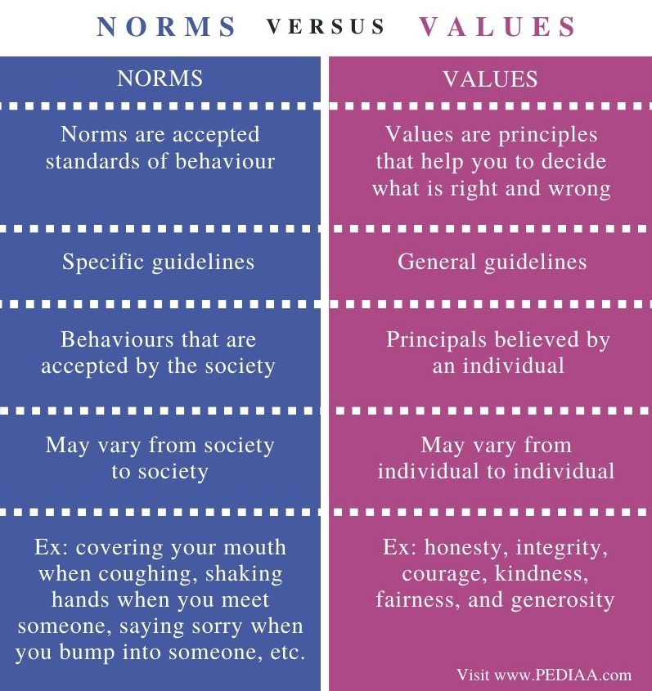
Cultural norms and values are both important and linked to one another. Norms and values guide people in many aspects of their lives. Sometimes behaviour and attitude have to change in order to adapt to or fit in with practices of a culture. Sometimes personal choices and preferences can be restricted as a result of traditions and practices of a culture.

Slide 12
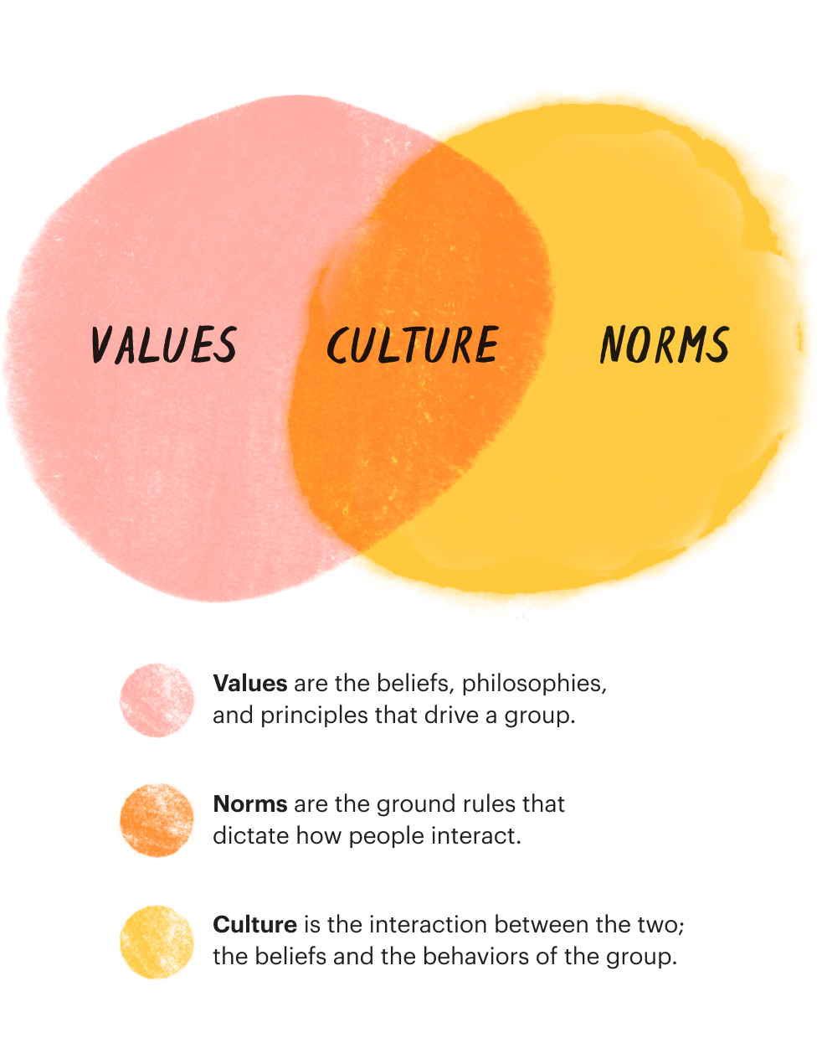
How are the two linked?

Slide 13
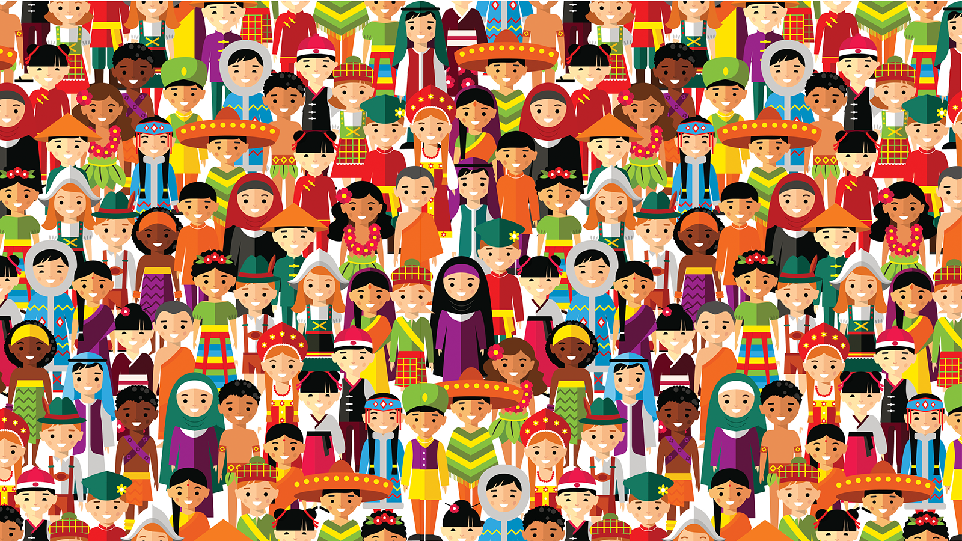
And now, your TASK for this section.

