Slide 1


Careers and Career Choices
Changing Career Landscape

Slide 2

THE Career Landscape
What does this even mean?

Slide 3

CAREER LANDSCAPE
The term CAREER LANDSCAPE sounds a bit far fetched, but actually - this is something everyone will find themselves in one day.
The CAREER LANDSCAPE is all about what jobs are out there, which jobs are on the critical list that we need more of, and which jobs or fields of work are in decline. The World of Work has changed in recent times, its not what it was 5 years ago, and very different to what was happening 10 years ago. It is what we could call dynamic – it is always changing and always evolving.
It will never be something that we can consider to be fixed and completely static.
On that note – that means that we must keep up with those changes and the new demands, in order to stay current and not get left behind. Some skills will become obsolete, others will become increasingly important. Markets will change and could become more defined. The world of work is changing and one day you will be entering that world.

Slide 4
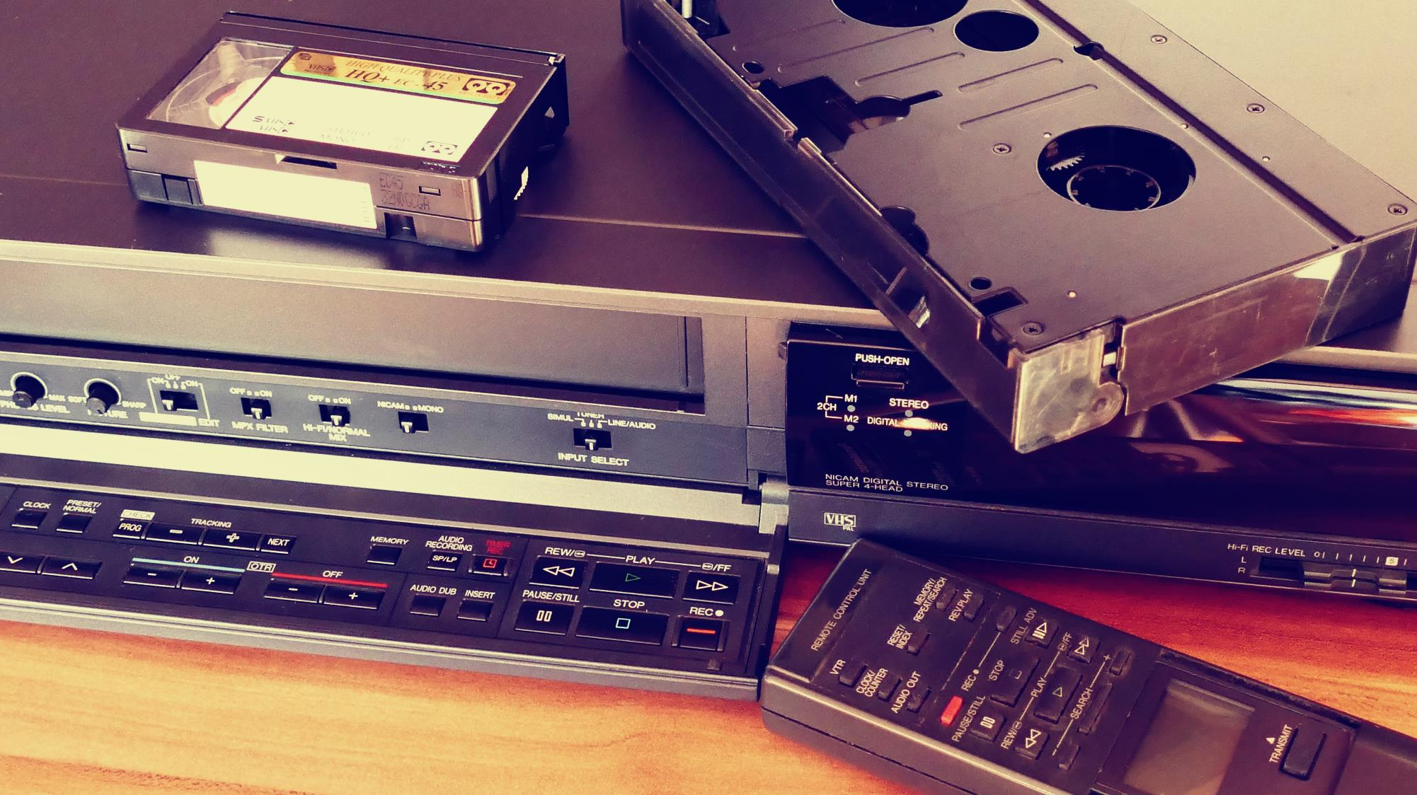





So, what has changed… Why are things so different?
The working world is changing – it changes ALL the time. Consumer habits change, technology grows and advances, automation is becoming more and more prevalent. New jobs must develop to keep up with these growing changes and demands on the workforce. Some jobs are emerging, and others are being replaced entirely.
Shifting demographics, dynamic workforces
The rise of individual choice
The technological revolution
Client sophistication and the dawn of data
Global Changes
The world has faced changes that no one would have ever thought possible. The pandemic has changed the way people work around the world.
the goal today is to be employable: to develop the skills, experience and expertise necessary to move on or up.
As a result of rapid technological change, companies today face shorter business cycles and truly global competition.
Trends like aging and declining birth rates mean the days of abundant labour are ending in much of the world.
Behavioral and intelligence tests, digital performance scorecards and better human resource information systems, companies know their people better than ever.

Slide 5




BUZZ WORDS
Scarce Skills:
Niche Market:
Scarce Skills refer to those occupations in which there is a scarcity of qualified and experienced people, currently or anticipated in the future, either (a) because such skilled people are not available or (b) they are available but do not meet employment criteria.
a small, specialized market for a particular product or service.
A niche market is a small part of a larger market that has its own specific needs, which are different from the larger market in some way. For example, the market for computers is huge but there are niche markets for student computers and gaming computers, which include different types of system requirements depending on the needs of the customer.
Employable Skills:
Employability Skills can be defined as the transferable skills needed by an individual to make them 'employable’.
These skills are what they believe will equip the employee to carry out their role to the best of their ability.
Soft Skills:
Soft skills are a combination of people skills, social skills, communication skills, character or personality traits, attitudes, career attributes, social intelligence, and emotional intelligence quotients that enable employees to navigate their environment, work well with others, perform well and achieve their goals
New terms becoming used more and more when talking about careers

Slide 6




JOB MARKET TRENDS AND DEMANDS: Declining markets
Manual vs Machine Labour
Office Environment Changes
Digitalisation
Jobs that used to be done by people can now be done by machines thanks to the advancements of technology and engineering. Automation has led to a huge change in the workforce needed to work in some industries. Think about when you learnt about the Industrial Revolution; we are now facing a Technological Revolution.
The way we communicate has also changed – if people have some type of internet / network connection they can practically work from anywhere. A coffee shop, your home, satellite offices. Today, many people work from home entirely and don’t even need to go into the office. Board meetings are held from home, meetings take place in multiple locations using software like Zoom or Microsoft Teams.
Many jobs that were once done by hand can now be done using digital equipment – desginers can design entire collections using software – from clothes to advertising, book illustrations, cartoon graphics. Shopping can be done from the comfort of your home using an app.

Slide 7

JOB MARKET TRENDS: Declining markets
The following 20 job skills are likely to see decreased demand over the next five years, largely due to automation according to Business Tech
Data Entry Clerks
Administration and Executive Secretaries
Accounting, Bookkeeping and Payroll Clerks
Accountants and Auditors
Assembly and Factory Workers
Business Services and Administration Managers
Client Information and Customer Service Workers
General and Operations Managers
Mechanics and Machinery Repairers
Material Recording and Stock Keeping Clerks
Financial Analysts
Postal Service Clerks
Sales Representatives, Wholesale and Manufacturing, Tech and Science Products
Relationship Managers
Bank Tellers and Related Clerks
Door-to-Door Sales, News and Street Vendors
Electronics and Telecom Installers and Repairers
Human Resource Specialists
Training and Development Specialists
Construction Labourers
https://businesstech.co.za/news/business/442362/these-are-the-10-best-job-skills-to-have-in-south-africa-and-the-10-worst/

Slide 8
JOB MARKET TRENDS: NEW AND EMERGING CAREERS
As we’ve discussed, things are changing – and new fields of study, career opportunities and so forth are emerging. Let’s look at a few of those new and emerging careers:
These are the best job skills to have in South Africa (according to Business Tech):
Data Analysts and Scientists
AI and Machine Learning Specialists
Big Data Specialists
Digital Marketing and Strategy Specialists
Process Automation Specialists
Business Development Professionals
Digital Transformation Specialists
Information Security Specialists
Software and Application Developers
Internet of Things Specialists
Project Managers
Business Services and Administration Managers
Database and Network Professionals
Robotics Engineers
Strategic Advisors
Management and Organization Analysts
FinTech Engineers
Mechanics and Machinery Repairers
Organizational Development Specialists
Risk Management Specialists
https://businesstech.co.za/news/business/442362/these-are-the-10-best-job-skills-to-have-in-south-africa-and-the-10-worst/

Slide 9
TOP SKILLS IDENTIFIED FOR 2025:
Analytical thinking and innovation
Active learning and learning strategies
Complex problem-solving
Critical thinking and analysis
Creativity, originality and initiative
Leadership and social influence
Technological use, monitoring and control
Technology design and programming
Resilience, stress tolerance and flexibility
Reasoning, problem-solving and ideation
Emotional intelligence
Troubleshooting and user experience
Service orientation
Systems analysis and evaluation
Persuasion and negotiation
According, to the Future of Jobs Report 2020, World Economic Forum
(http://www3.weforum.org/docs/WEF_Future_of_Jobs_2020.pdf, page 36)

Slide 10

Now Ask Yourself…
Can you define:
Scarce Skills?
Niche Market?
Do you know what they mean and can you apply them? Do you have any of these skills? Is this something you can work on?
Lets reflect…

