Slide 1
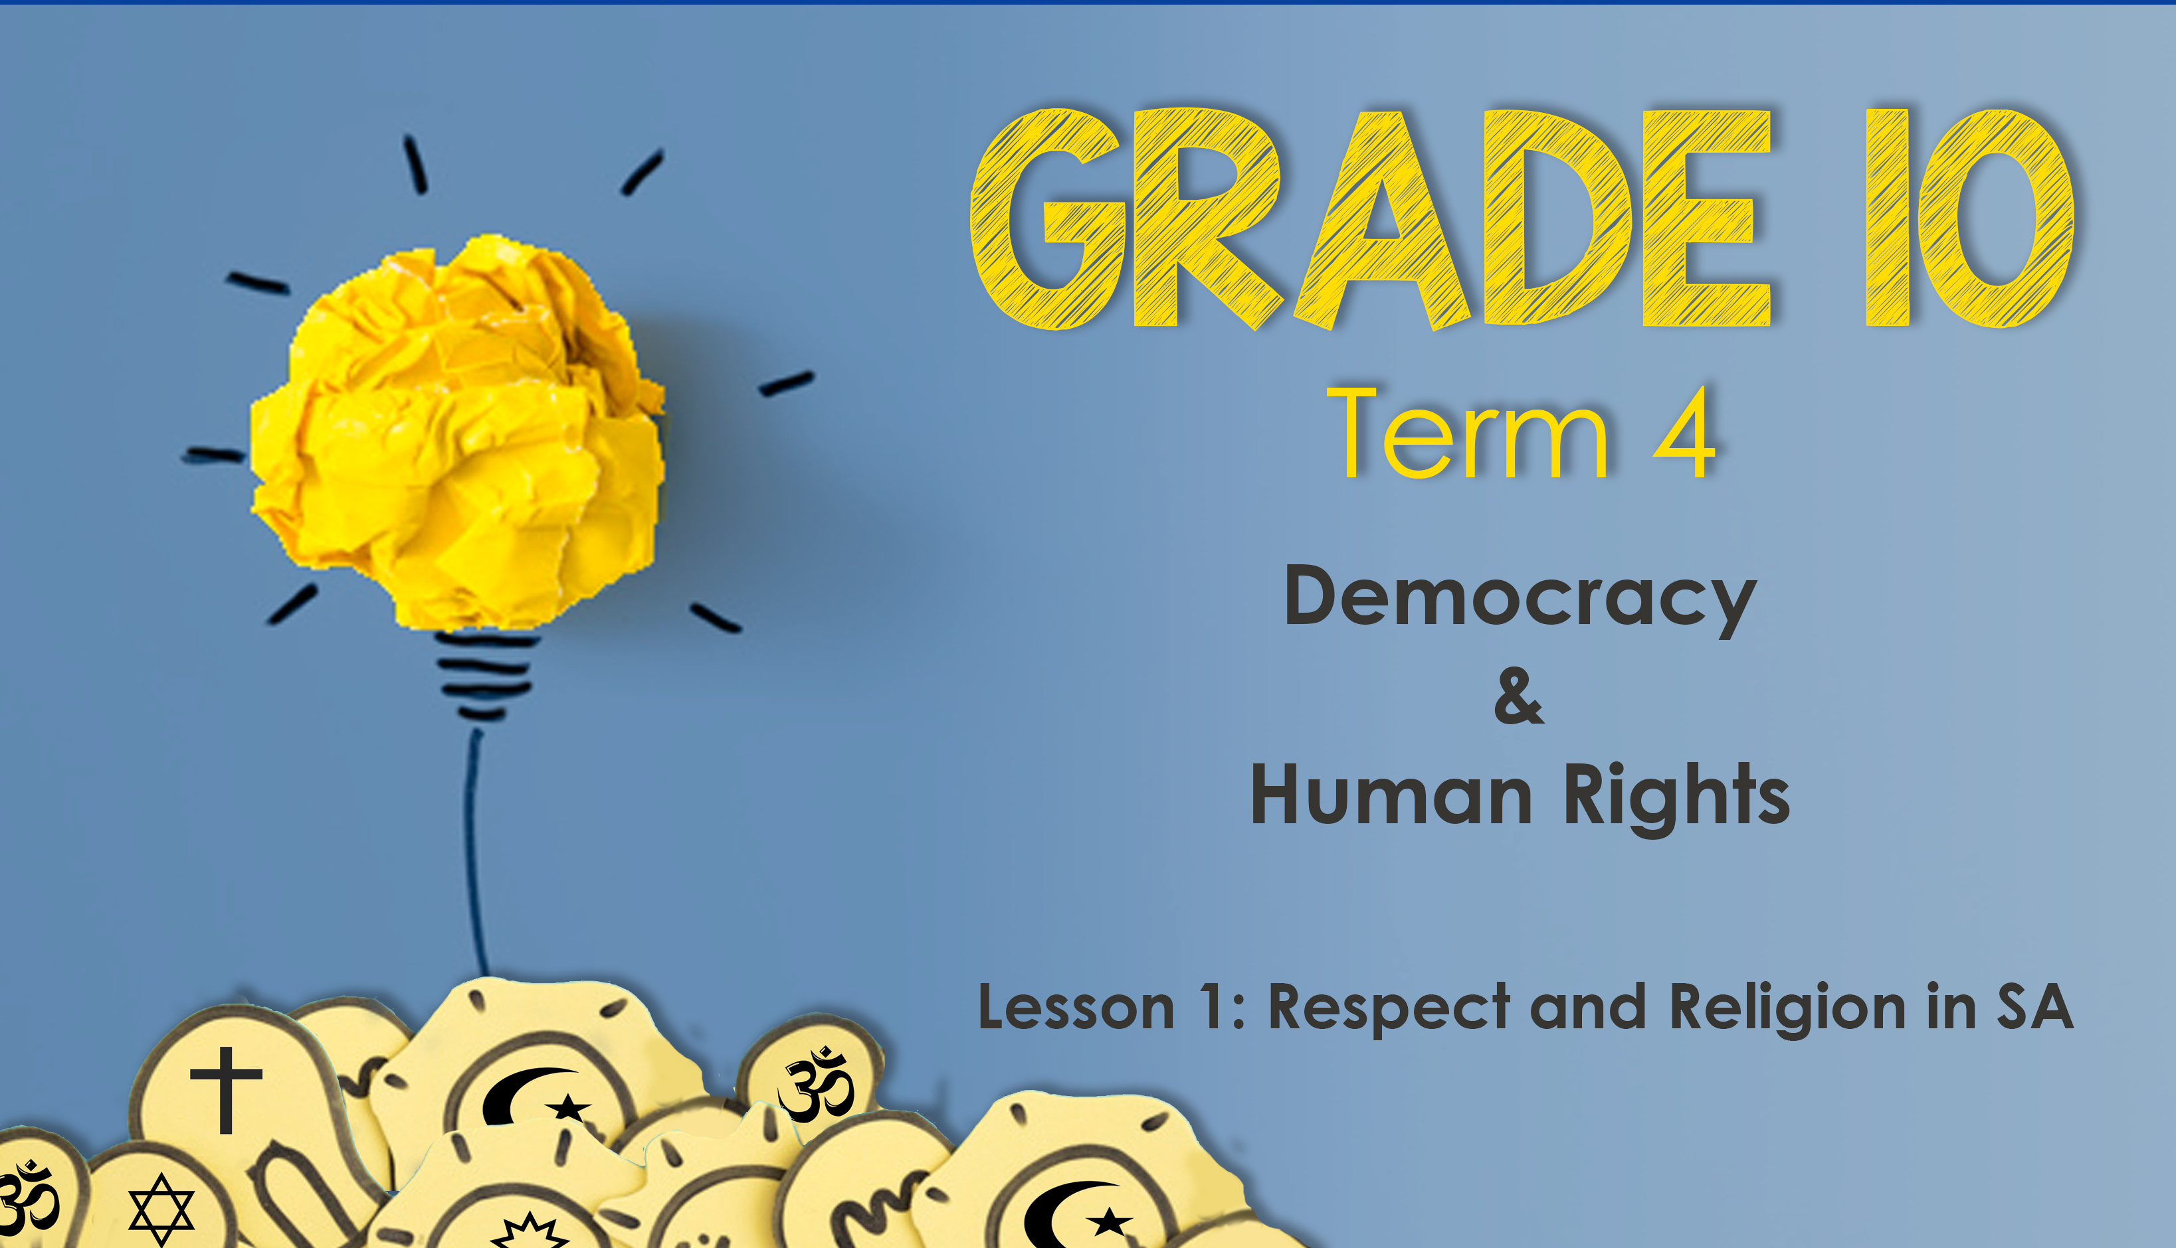

Notes:
17min- Slide 1-2
Welcome back Grade 10’s! today we will start a new series that will help you reflect on what it means to be a citizen in South Africa. As South Africans we accept the constitution of South Africa which promotes human rights. This includes the way we treat those around us who are different to us. Our focus today is to reflect on how we respect one another in a country with multiple religions. A religion defines a system of values / ideas that a group of people believe. Remember there are many people who choose not to believe in a specific religion but still carry a set of beliefs around traditions and values they have adopted. E.g. an atheist does not believe in any religion but can still celebrate Christmas where they have adopted a traditionally Christian holiday as their own family tradition.
Let’s start today by looking at what each of you believe. But we’re going to have some fun sharing!

Slide 2
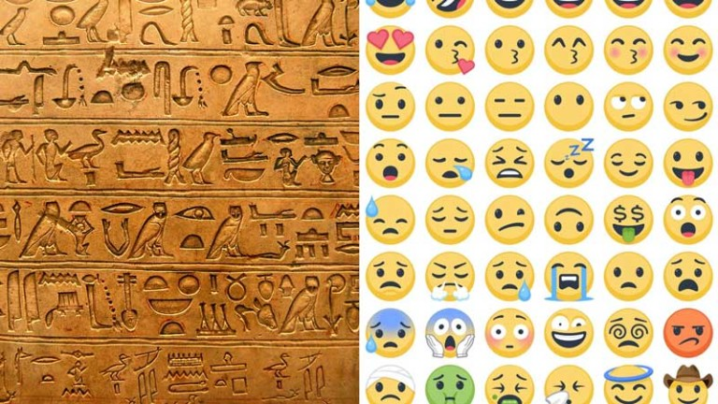
EMOJIGLYPHS
Notes:
Slide 2: 7 + 5min
For centuries humans have used symbols to communicate. The Egyptians used hieroglyphics, a collection of symbols. Today we use emojis in texting our friends rather than actual typing messages. Today you will use your emojiglyphics to tell us about your religion. Use the Lesson 1 - Poster page your teacher has handed out to complete. Use the emoji’s or create new ones to tell us about your religion. You will have 7min to create your poster and then have an opportunity to share your emojiglyphics with the rest of your group.
You will now have 5min to share with your groups the emojis on your poster. Remember to be respectful of one another even though you might not agree.

Slide 3
How many religions can you name that are represented in South Africa?
Notes:
Slide 3 + 4: 5min
Ask learners to write in their notebooks as many religions can you name that are represented in South Africa? (Allow only 2min for them to write. Ask them to check their list against those on this next slide.)

Slide 4

How many religions can you name that are represented in South Africa?
Judaism
Christianity
Hinduism
Islam
African Christianity (Zionism)
Buddhism
Bahá’í Faith
Notes:
Slide 4:
How many religions can you name that are represented in South Africa?
Judaism
Christianity
Hinduism
Islam
African Christianity (Zionism)
Buddhism
Bahá’í Faith
Did anyone have any other religions on their list?

Slide 5
Write these definitions onto your worksheet:
Traditions: ways of thinking, behaving or doing something that has been used by a particular group, family or society.
Religion: refers to an organised system of beliefs, ceremonies and rules used to worship a god or a group of gods.
Monotheistic: believing in only one God.
Ethical: following accepted rules of behaviour: that which is morally right and good.
Sect: a religious group that is part of a larger group and whose members all share similar beliefs.
Indigenous: produced, living or existing naturally in a particular region/ environment.
Notes:
Slide 5: 5min
Before we continue, lets just revise some important definitions of terms relating to religion:
On Lesson 1 – Worksheet complete Activity 1.
Religion: refers to an organised system of beliefs, ceremonies and rules used to worship a god or a group of gods.
Ethical: following accepted rules of behaviour: that which is morally right and good.
Traditions: ways of thinking, behaving or doing something that has been used by a particular group, family or society.
Monotheistic: believing in only one God.
Sect: a religious group that is part of a larger group and whose members all share similar beliefs.
Indigenous: produced, living or existing naturally in a particular region/ environment.

Slide 6
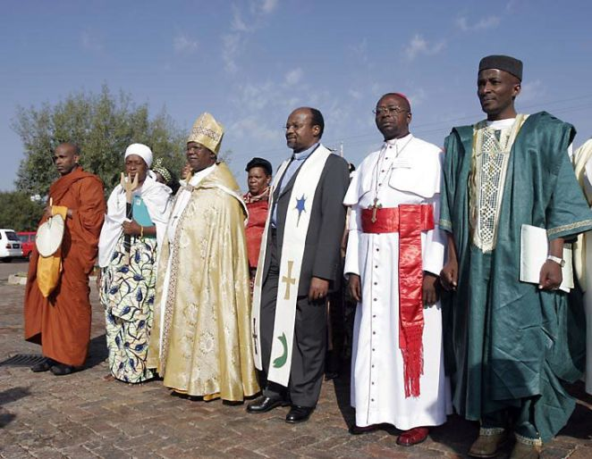

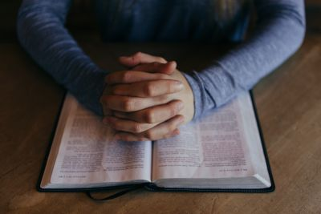

Major Religions in South Africa
Notes:
Slide 6: 10min
On Lesson 1 – Worksheet complete Activity 2. You will have access to a table with data on your Lesson 1 - Worksheet and the Lesson 1 - Religion Notes to collect your information.
(Note to teacher: The Lesson 1 - Religion Notes can be handed to each learner and placed in their notebook as part of their study material for this section. They can also be printed as posters and kept in your class. This activity will probably take much longer that 10min. Allow learners to finish it for homework. Leave time for the 3min reflection before the end of the lesson.

Slide 7

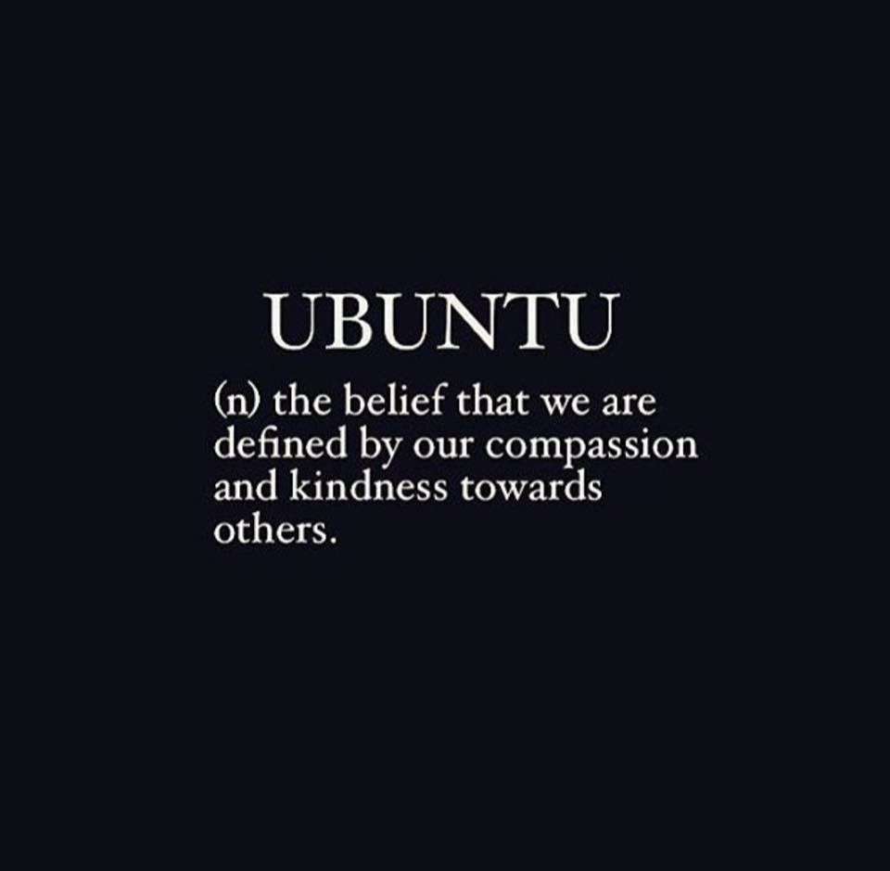
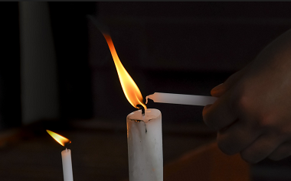
Take the last few minutes of this lesson and write an
inspirational message on the UBUNTU card that would
inspire different religious groups to live together in peace.
Notes:
Slide 7: 3min
Learners to take a moment to reflect on what they have learnt about themselves today. Each learner to write an inspirational message on an UBUNTU card
(Lesson 1 – Ubuntu Cards) that would inspire different religious groups to live together in peace.
There are no memo answers to this activity. Make sure in this time the class is quiet. You can even play an instrumental song to encourage a quieting down and reflecting.

