Slide 1


BRAND South Africa
Nation-building
Nation-building

Slide 2

What do you love about South Africa?

Slide 3
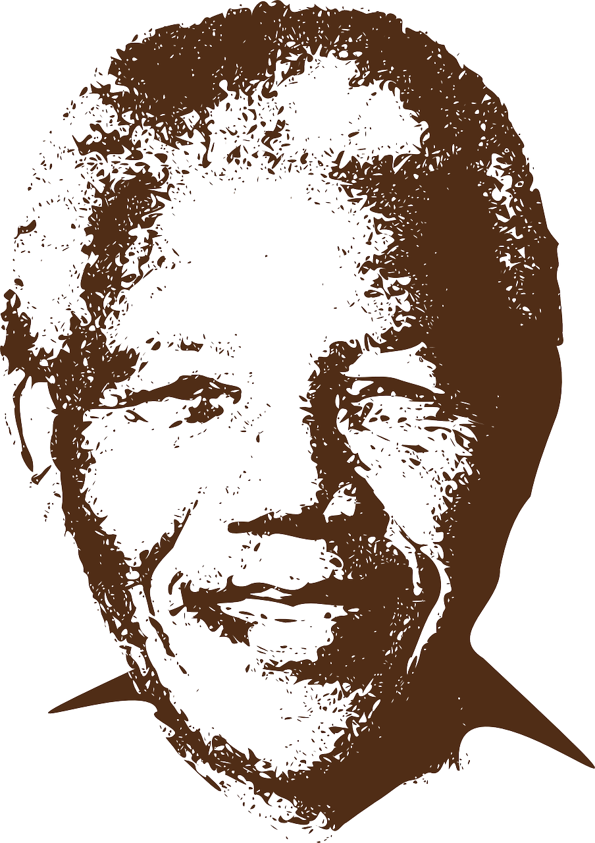
Why is
Nelson Mandela
so important
to South Africa’s
History?

Slide 4
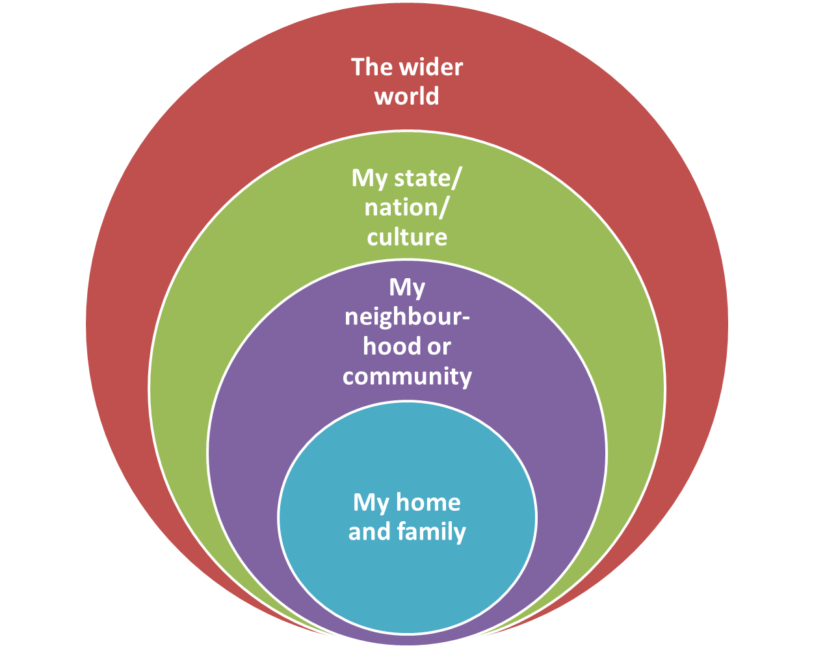
TEACHING WAYS TO PROMOTE NATION-BUILDING
IN
OUR HOMES,
OUR COMMUNITIES
AND
OUR SCHOOLS

Slide 5


Slide 6

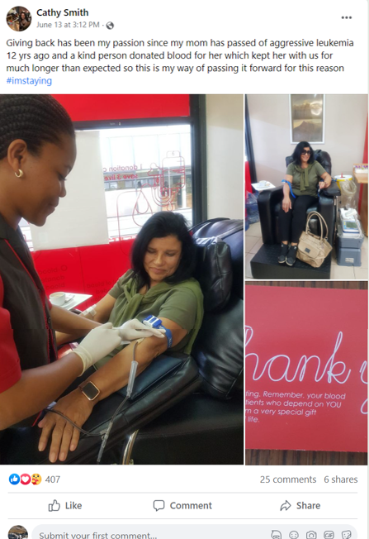
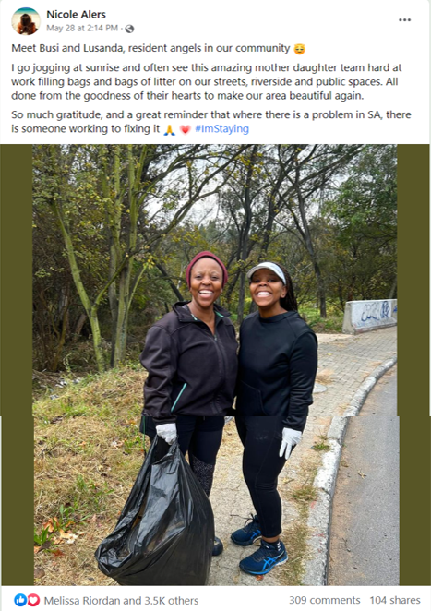

Slide 7
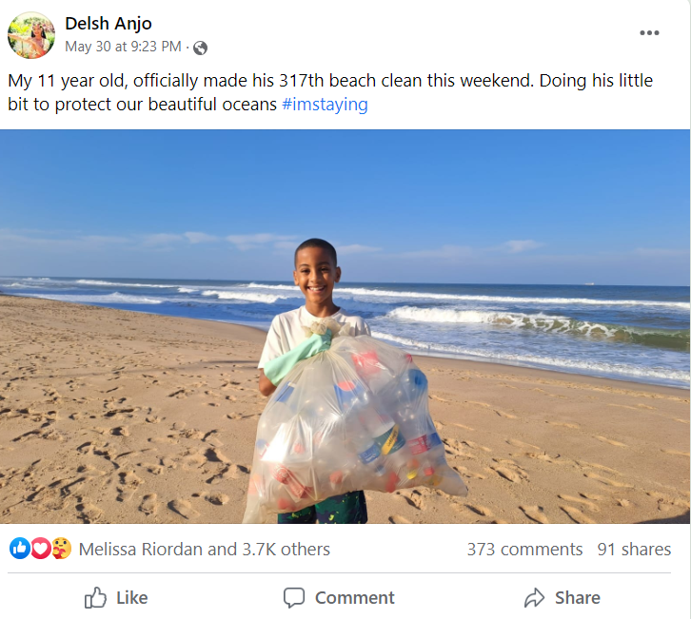
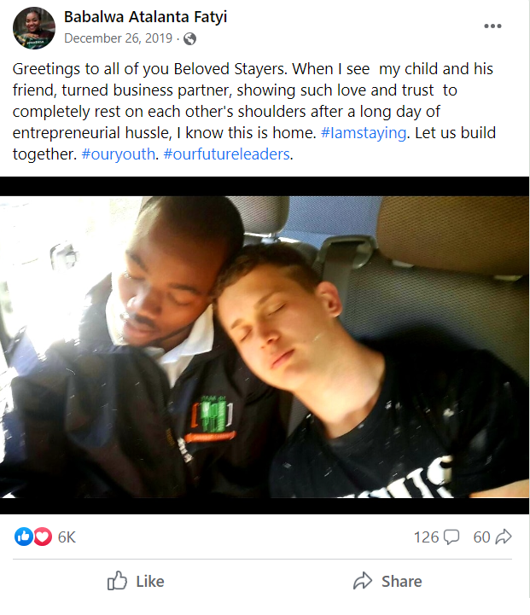


Slide 8
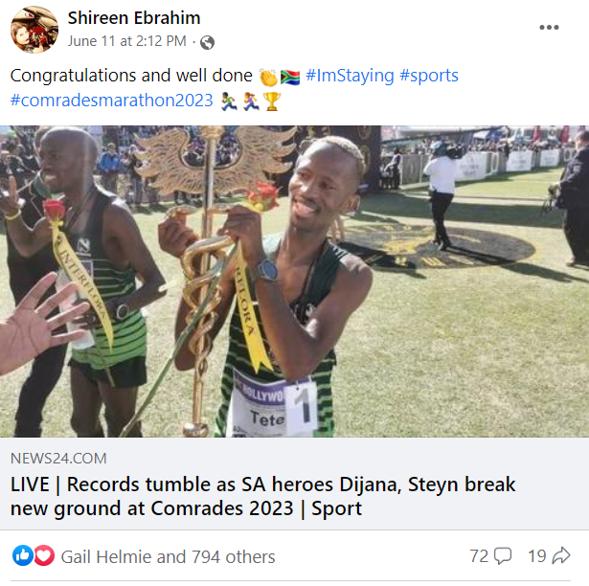
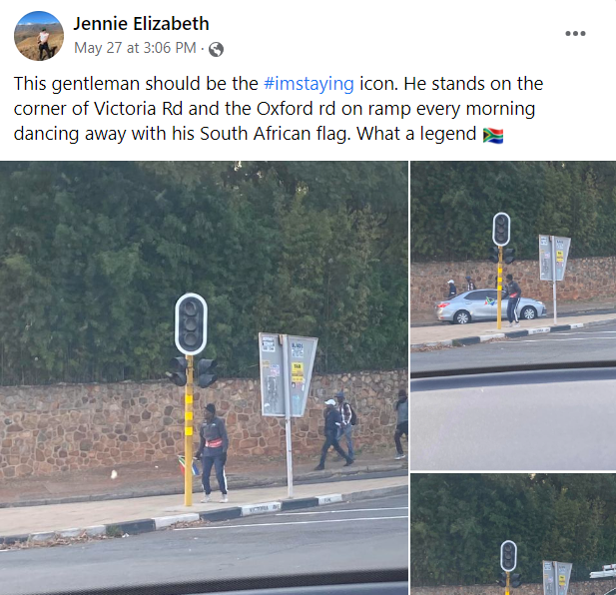


Slide 9
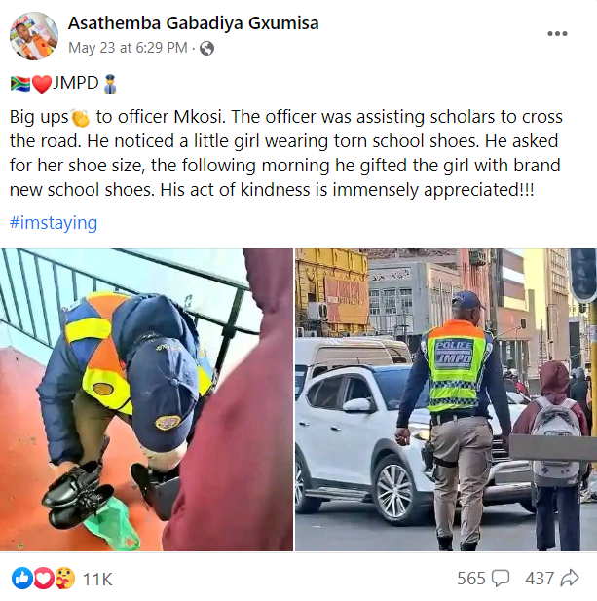
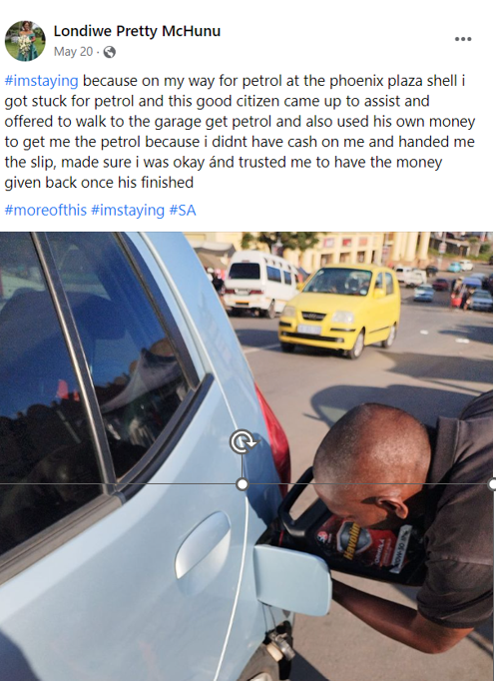

Slide 10

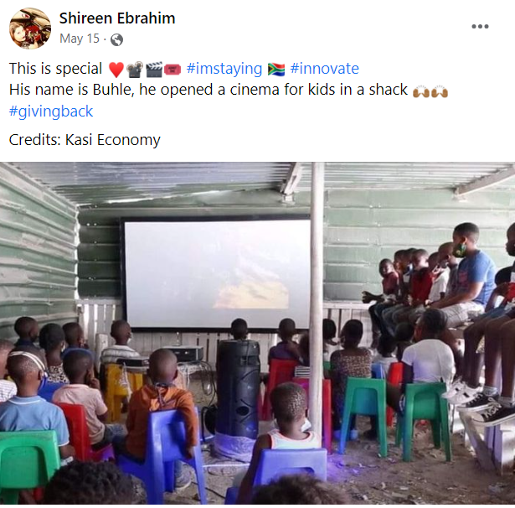

Slide 11
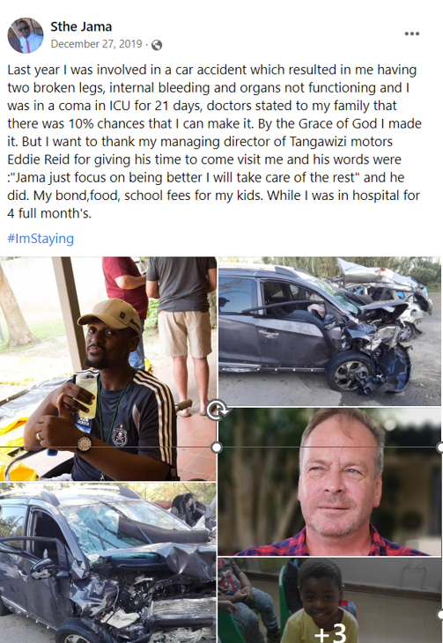
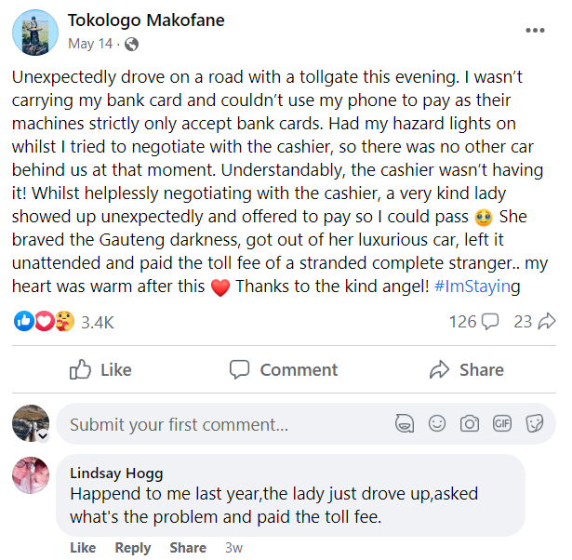

Slide 12

Notes:
Slide 5: Individual Activity 8 min +2 min (complete for homework)
With all the information fresh in your mind from your peers feedback in Activity 2, you will now need to answer the questions to Activity 3. This question resembles the kinds of questions you can expect in your assessment at the end of the year. Take this time seriously when you answer and we will go through the answers together.
(Allow learners about 8 min to answer this question. Encourage silence so they focus on their own answer rather than copying from someone else. Use the last 2 min to go through the question. If the learners need more time, allow them to finish it for homework and revise at the beginning of the next lesson.)

Slide 13


Slide 14



Slide 15


Self-Reflection Time

