Slide 1
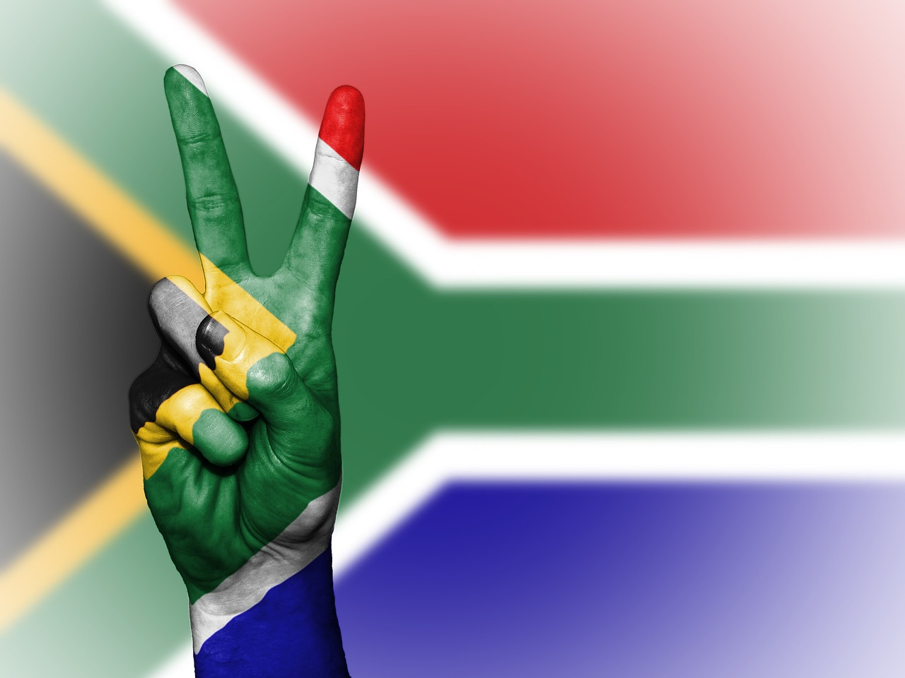

SPAN Suid-Afrika
Nasiebou
Nation-building

Slide 2

Meningstuk:
Wat maak jou lief vir Suid-Afrika?

Slide 3
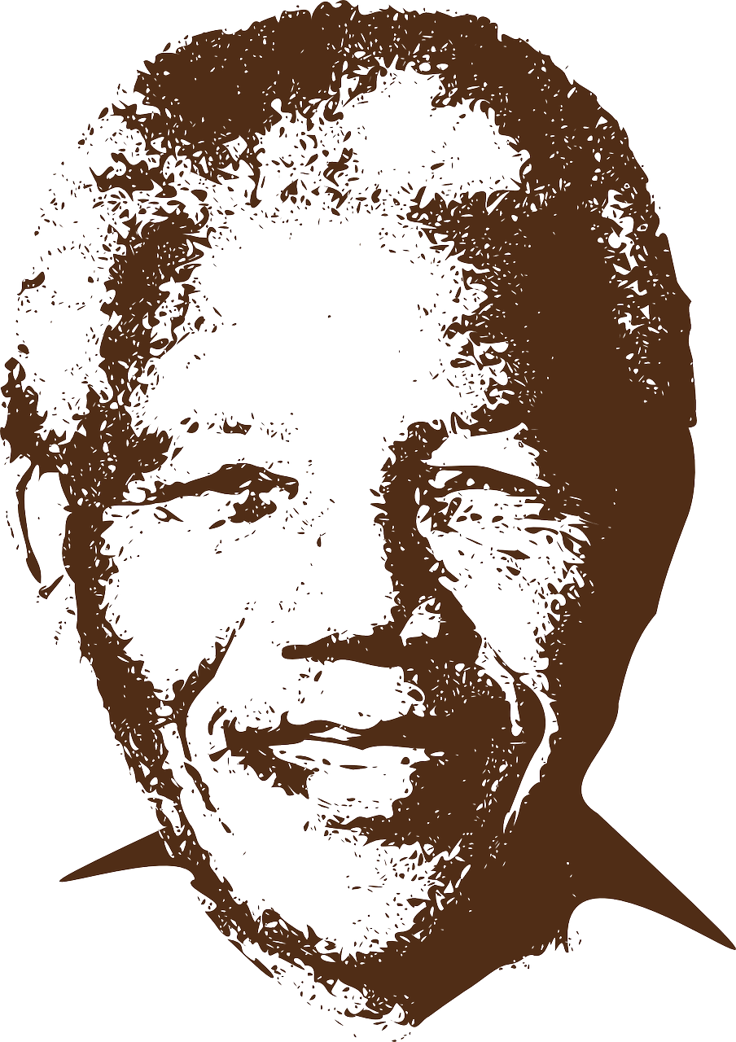
Waarom is Nelson Mandela so belangrik vir die geskiedenis van Suid-Afrika?

Slide 4
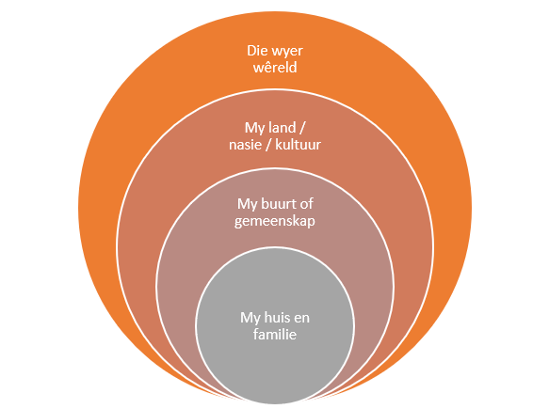
MANIERE OM NASIEBOU
IN ONS HUISE,
ONS GEMEENSKAPPE
EN ONS SKOLE
TE BEVORDER

Slide 5
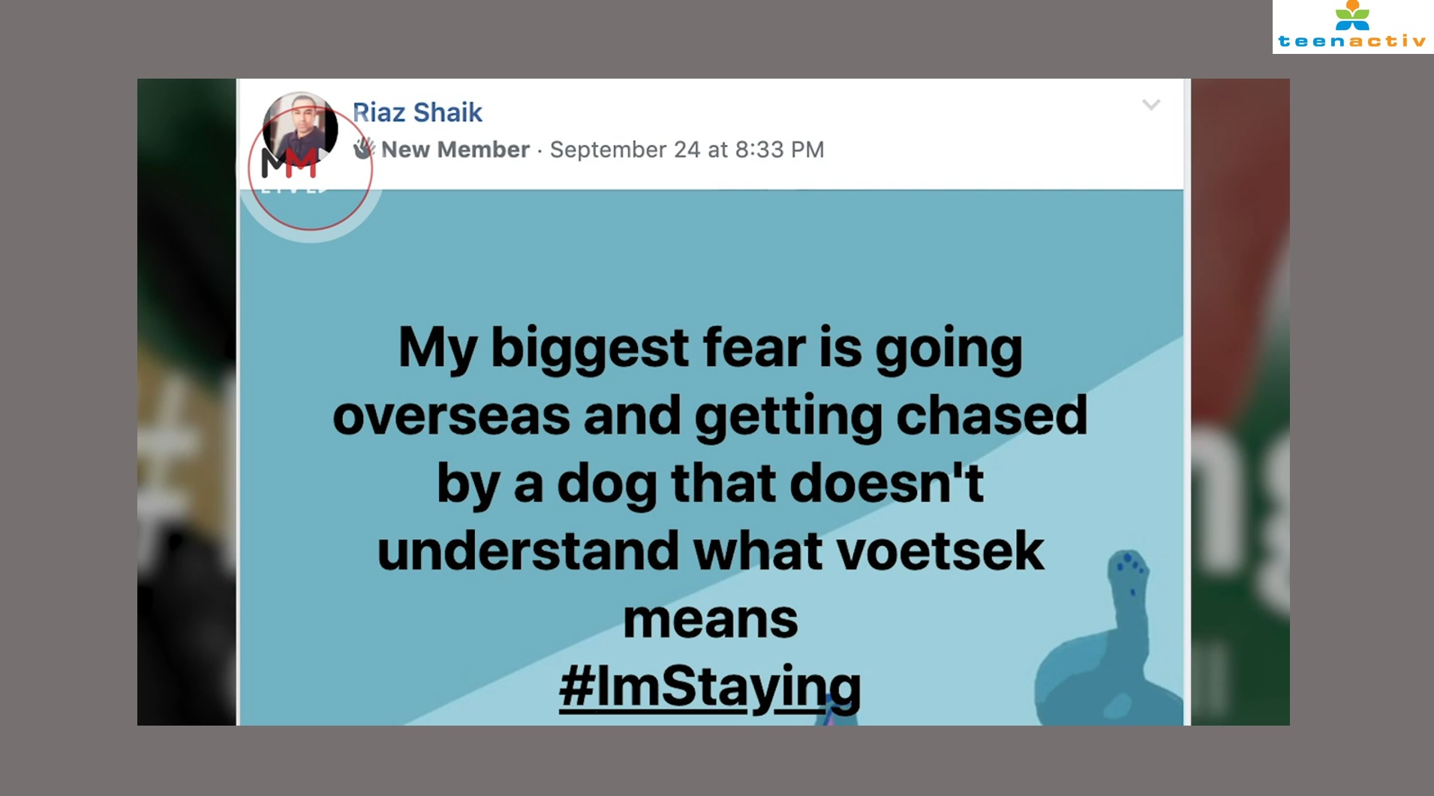

Slide 6

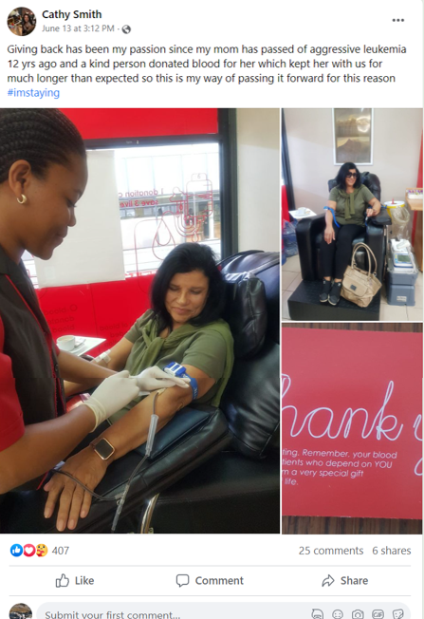
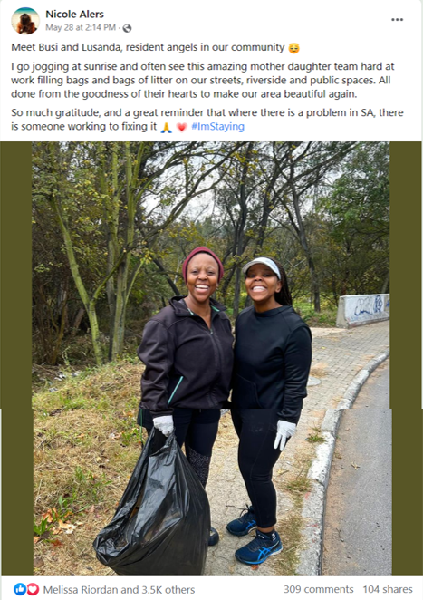
GOEIE GEDAGTES | GOEIE WOORDE | GOEIE DADE

Slide 7
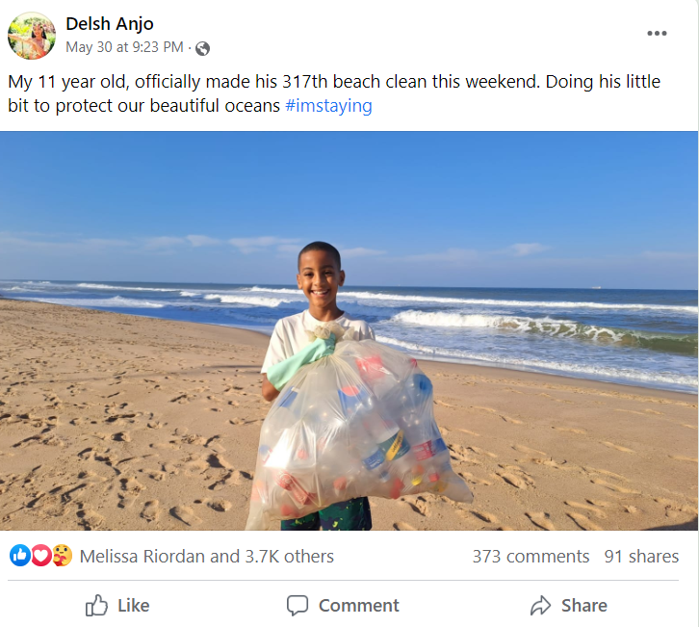
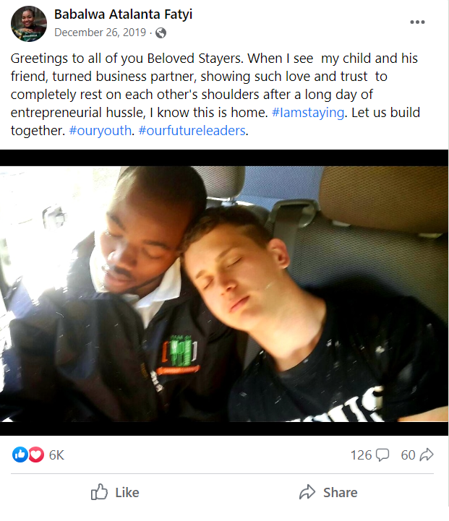


Slide 8
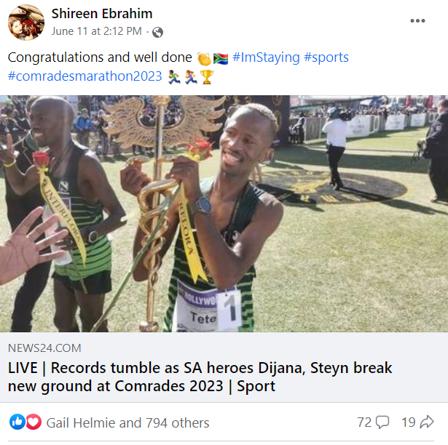
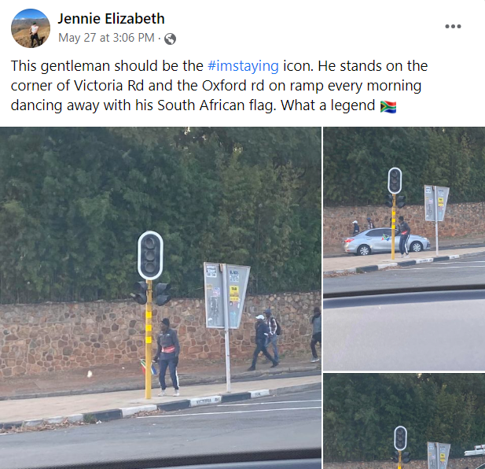


Slide 9
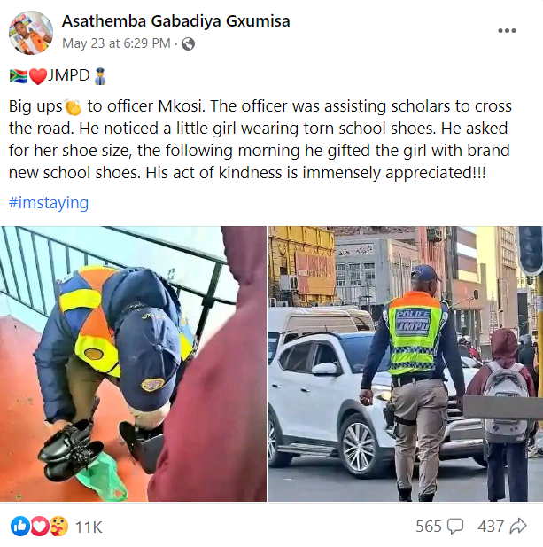
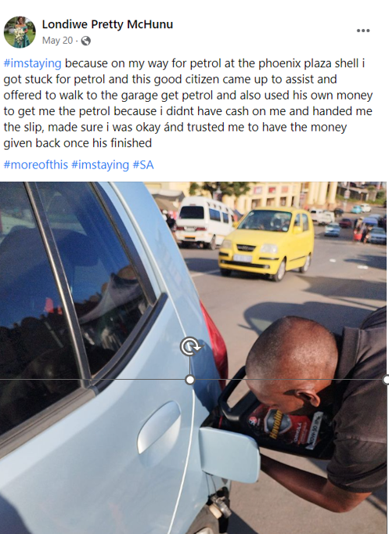

Slide 10
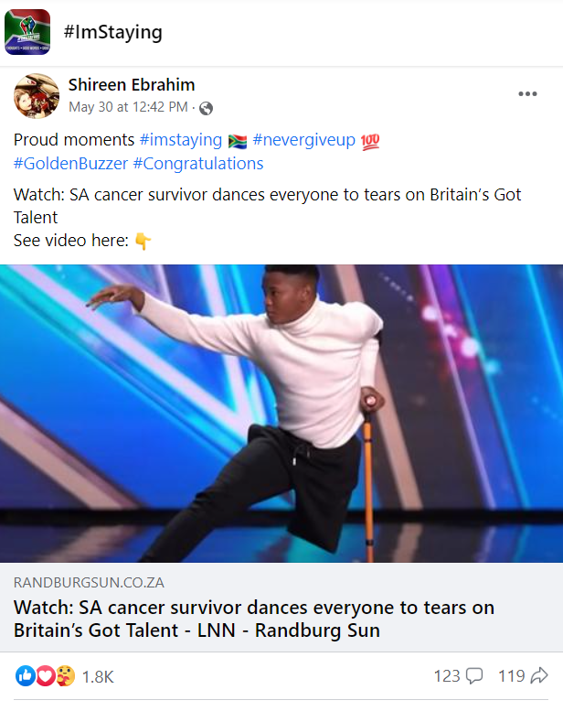
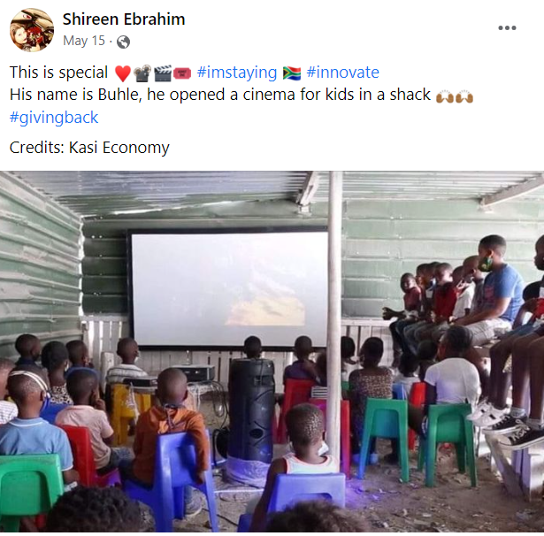

Slide 11
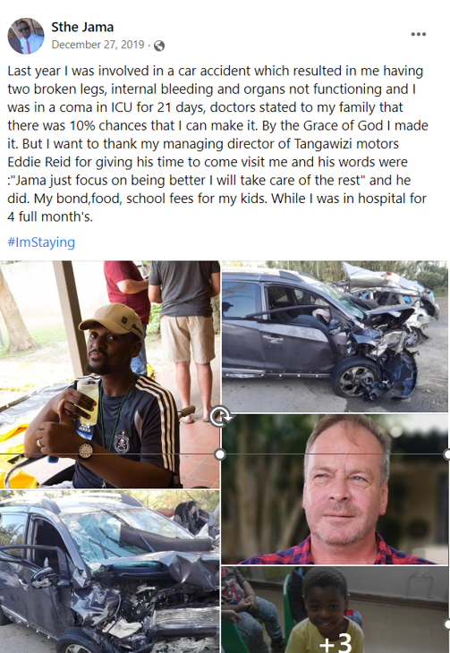
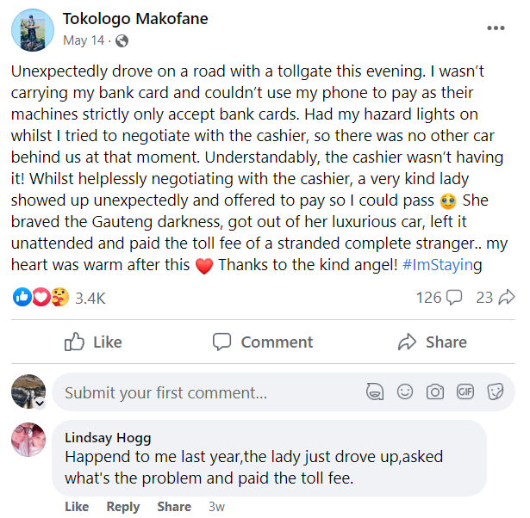

Slide 12

AKTIWITEIT
Notes:
Slide 5: Individual Activity 8 min +2 min (complete for homework)
With all the information fresh in your mind from your peers feedback in Activity 2, you will now need to answer the questions to Activity 3. This question resembles the kinds of questions you can expect in your assessment at the end of the year. Take this time seriously when you answer and we will go through the answers together.
(Allow learners about 8 min to answer this question. Encourage silence so they focus on their own answer rather than copying from someone else. Use the last 2 min to go through the question. If the learners need more time, allow them to finish it for homework and revise at the beginning of the next lesson.)

Slide 13
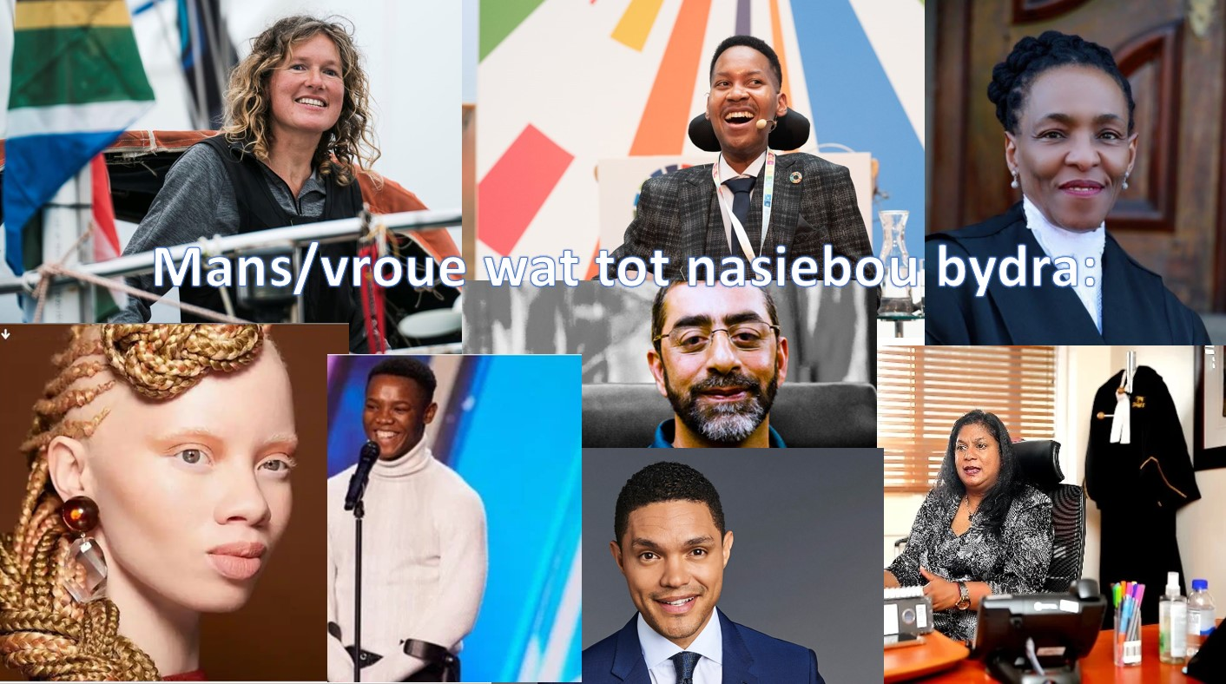

Slide 14
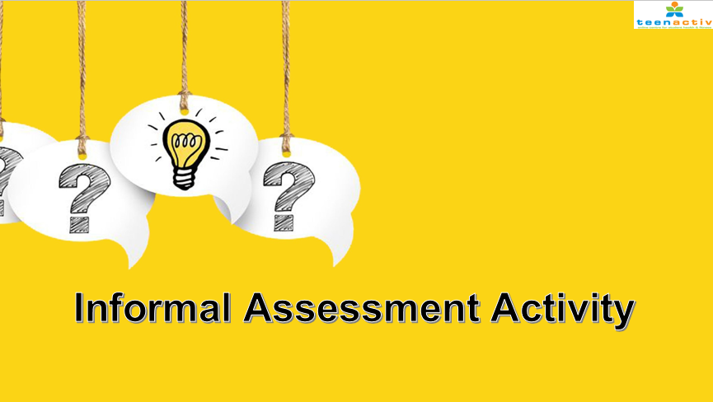

Informele Assessering

Slide 15


Tyd vir Refleksie

