Slide 1
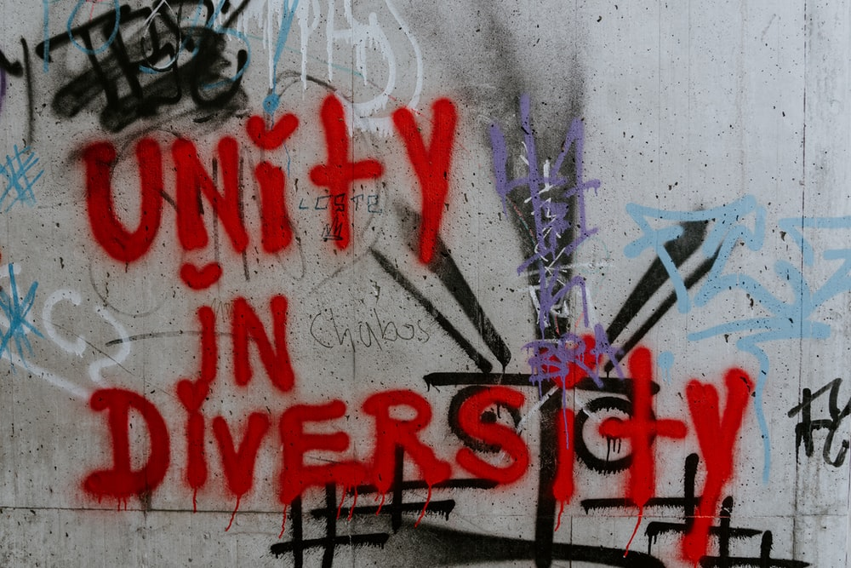


Slide 2
What does it mean? unity without uniformity and diversity without fragmentation.
It refers to harmony and peace.
EXAMPLES:
Caste, creed, race, and nationality
Physical, cultural, linguistic, and political differences are also included.
It ensures that tolerance is uniform.
It educates all people to unify and find methods to bond with one another despite their differences.
This will create an environment in which individuals can coexist harmoniously.

Slide 3
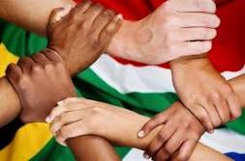
What does it mean?
.
Unity without uniformity and diversity without fragmentation.

Slide 4

Unity in Diversity is so important - it is on our coat of arms

Slide 5
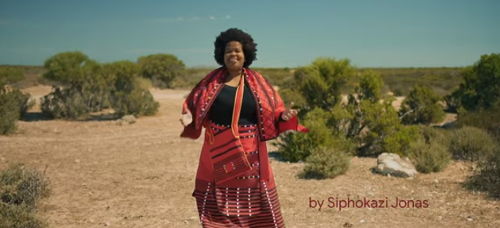
https://www.youtube.com/watch?v=pvXyST4qB5E

Slide 6
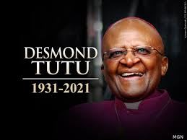
South Africa is the rainbow nation because of its cultural diversity
The more we know about one another, the more we break down the barriers that prevent people of different cultures from getting along.

Slide 7
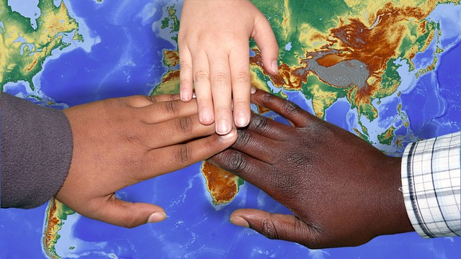
RELIGIOUS ORGANISATIONS:
The National Religious Association for Social Development was established in South Africa in 1997. One of the main reasons for this was to improve the conditions of people's lives. They are very involved in social development and welfare working with religious groups in South Africa.
They focus on things like:
Health, Early Childhood Development,
Home and Community Based Care,
Skills Training, access to information,
Housing Support and various initiatives
with Government.

Slide 8
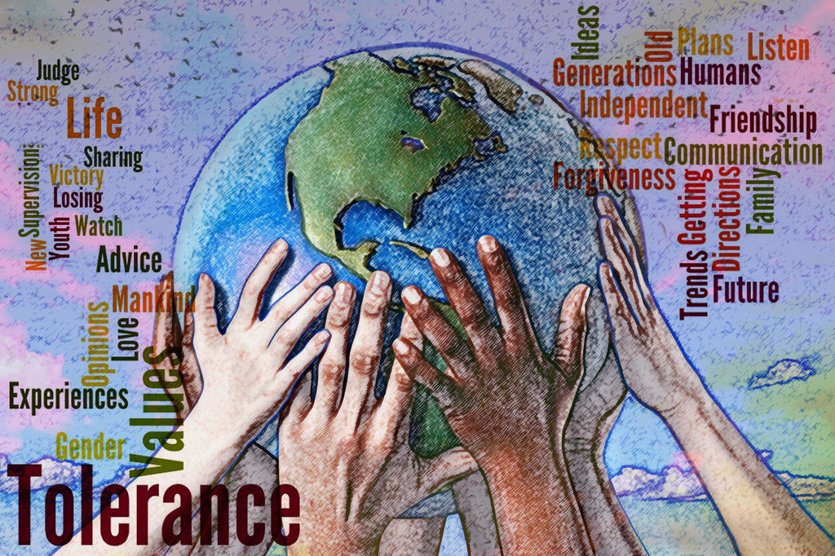
Something to think about:
Look at the words in this picture and what the picture is showing us.
What are your thoughts?
What words jump out at
you?

