Slide 1


Notes:
Slide 1: 3min
Welcome back to the last lesson in this series and at the same time the last lesson of your curriculum for the year. You will have opportunity today to practice some questions that line up with the kind of questions you would see in your end of year assessment.
In our last lesson we looked at prejudice in sport and focussed particularly on women. Can you mention other forms of prejudice?
(Allow learners an opportunity to answer) Answers could include:
Different races
Disabilities
Different figures e.g. figure skater is overweight
Recent contention is women with high testosterone levels like Casta Simenya
Prejudice is an example of one of many unfair practices in sport. Today we are going to have another look at some of the different ways in which people act unethically in sport.
Let’s get started!

Slide 2

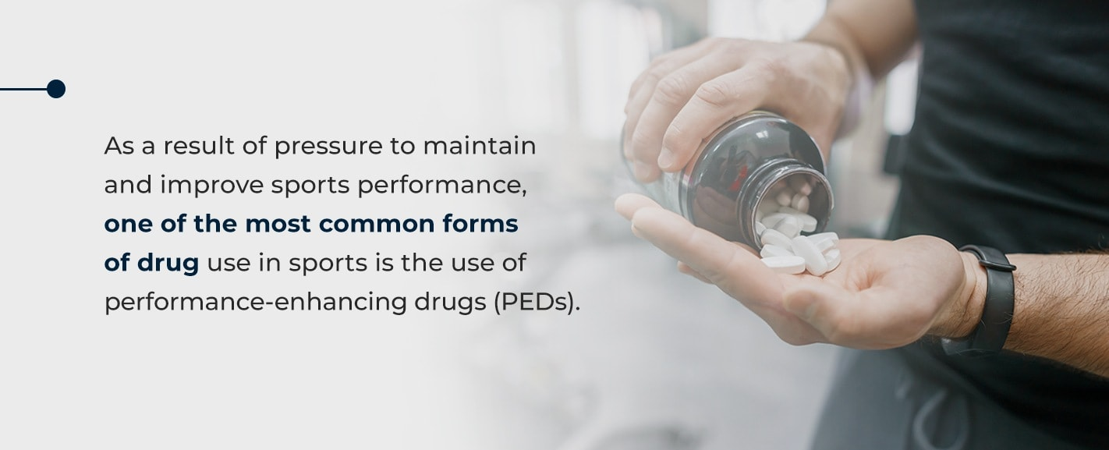
Unfair practices in sport
DRUG- TAKING
Notes:
Slide 2: 4min discussion and teaching
There has been an increase in PED’s or performance enhancing drugs in sport. Some athletes feel that the pressure to perform is too much and so they use these drugs. Steroids are a group of drugs that help people build muscles. Other drugs increase stamina and stop athletes from getting tired.
Give learners 5min to discuss these three questions:
Do you think we have a problem in school sport with learners using drugs to enhance their bodies to perform better in sport?
Can you mention sports that you think this would be a problem?
What danger do you think a person is in if they use these drugs?

Slide 3
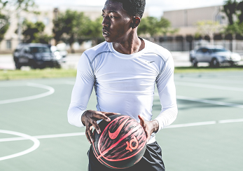
Steroids in High School Sports - Teens may experiment with steroids to build muscle and perform at higher levels in athletics, but they may be unaware of the dangers to their physical and mental health
(the recovery village)
DRUG- TAKING
Notes:
Slide 3 & 4: 10min
Steroids in High School Sports - Teens may experiment with steroids to build muscle and perform at higher levels in athletics, but they may be unaware of the dangers to their physical and mental health.

Slide 4
SIDE EFFECTS of Anabolic Steroids
Men may develop:
Prominent breasts
Shrunken testicles
Infertility
Prostate gland enlargement
Women may develop:
A deeper voice, which may be irreversible
An enlarged clitoris, which may be irreversible
Increased body hair
Baldness, which may be irreversible
Infrequent or absent periods
Both men and women might experience:
Severe acne
Increased risk of tendinitis and tendon rupture
Liver abnormalities and tumours
High blood pressure (hypertension)
Heart and blood circulation problems
Aggressive behaviours, rage or violence
Psychiatric disorders, such as depression
Drug dependence
Infections or diseases such as HIV or hepatitis if you're injecting the drugs
Inhibited growth and development, and risk of future health problems in teenagers
Notes:
Slide 4
Complete Activity 1 on Lesson 3 - Worksheet while we briefly take a look at some of the dangers of taking these drugs:
Men may develop:
Prominent breasts
Shrunken testicles
Infertility
Prostate gland enlargement
Women may develop:
A deeper voice, which may be irreversible
An enlarged clitoris, which may be irreversible
Increased body hair
Baldness, which may be irreversible
Infrequent or absent periods
Both men and women might experience:
Severe acne
Increased risk of tendinitis and tendon rupture
Liver abnormalities and tumours
High blood pressure (hypertension)
Heart and blood circulation problems
Aggressive behaviours, rage or violence
Psychiatric disorders, such as depression
Drug dependence
Infections or diseases such as HIV or hepatitis if you're injecting the drugs
Inhibited growth and development, and risk of future health problems in teenagers
(Ask learners to complete Activity 2 on Lesson 3 - Worksheet)
Knowing all these possible side effects, do you think its worth “winning at all costs?”
If it’s so dangerous, why do teenagers still take the drugs?
Recommend three ways to communicate the danger of drugs in school.

Slide 5
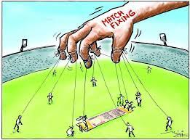
Subjective umpiring - This occurs when an unfair referee does not take the necessary action in a game and a player is unfairly hurt. The situation is then further intensified when the team aggressively gets involved and a fight breaks out. Another example could be in soccer when a player from one team is sent off for a serious high boot. A player does the same thing on the other team, but nothing happens. Remember officials should be FAIR and consistent to all the players.
Match fixing takes place when players intentionally play badly to throw a game. Usually so that those who bet on the player or team would make money. This is unfair and unethical when the aim of the game is fair competition.
Maladministration in sport – When those who are required to look after the sport, don’t administer it properly. Including:
Money is misused and wasted
Sporting events are not planned well
Corruption occurs
Notes:
Slide 5 & 6: 10min
Here are another THREE examples of unfair practices in sport.
Match fixing: Match fixing takes place when players intentionally play badly to throw a game. Usually so that those who bet on the player or team would make money. This is unfair and unethical when the aim of the game is fair competition.
Subject umpiring: This occurs when an unfair referee does not take the necessary action in a game and a player is unfairly hurt. The situation is then further intensified when the team aggressively gets involved and a fight breaks out. Another example could be in soccer when a player from one team is sent off for a serious high boot. A player does the same thing on the other team, but nothing happens. Remember officials should be FAIR and consistent to all the players.
MALADMINISTRATION in sport – When those who are required to look after the sport, don’t administer it properly. Including:
Money is misused and wasted
Sporting events are not planned well
Corruption occurs

Slide 6
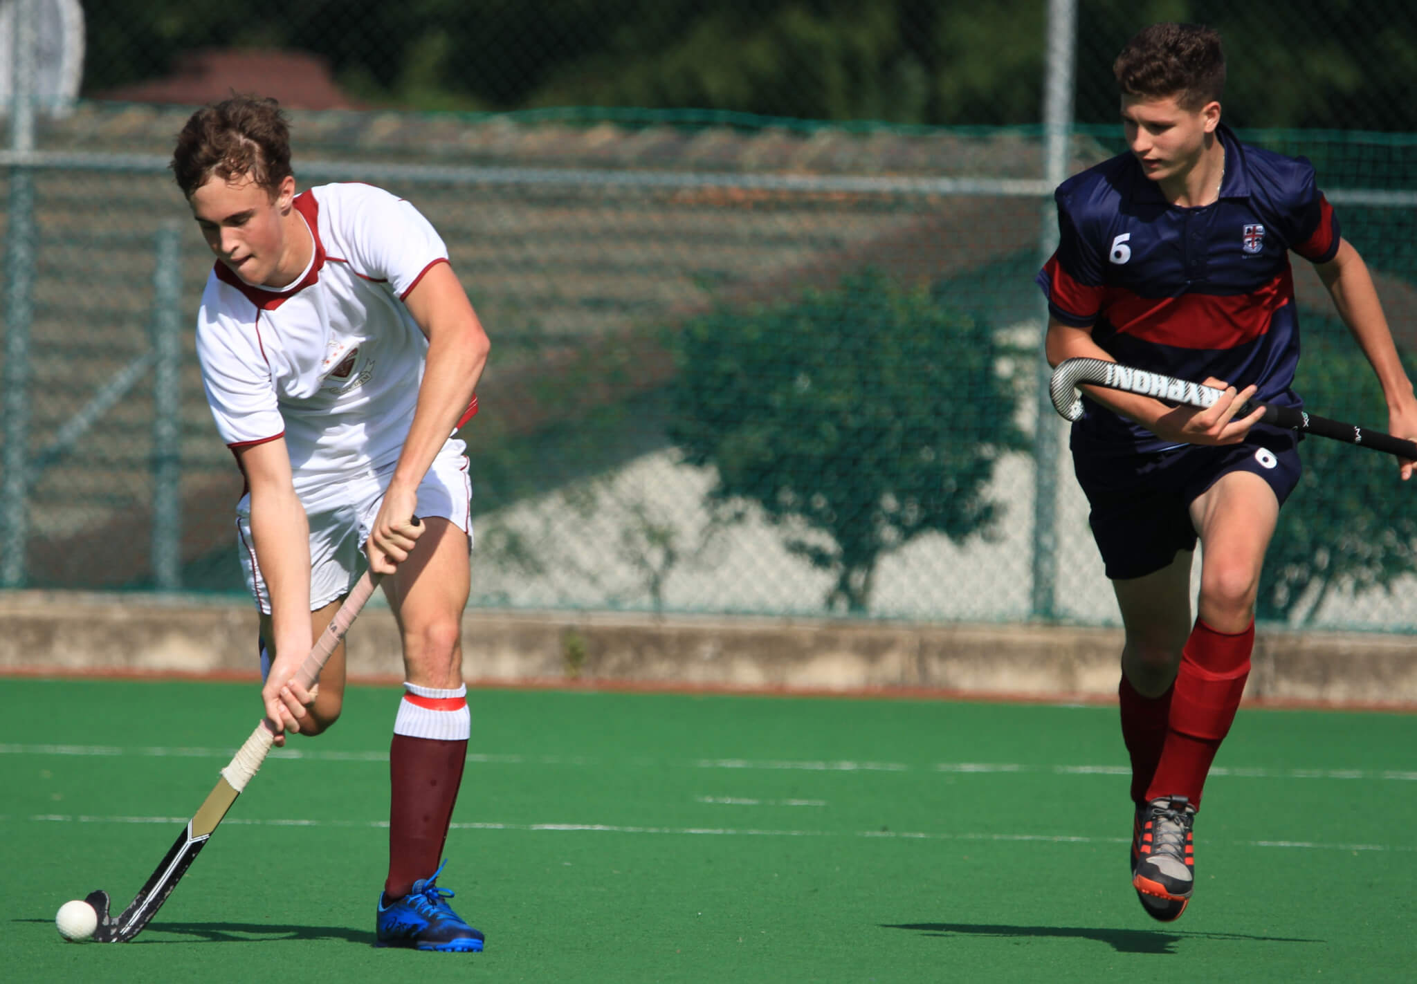
Scenario:
The TWO teams playing against one another in the 1st hockey boys game have been notorious competitors for years. Lets call them the Blue High School and Red High School. Before the game started the teams were already “chirping” (making comments) one another from the side lines of the game. The referee was a past pupil of the Red High School. This pupil had spent the last 6months getting licenced as a referee. The game started with limited infringements but towards the end of the first half the referee had sent off two players from the Blue High School. It seemed like he was highly subjective. In the second half one of the players from the Blue High School got frustrated with the referee's lack of fair refereeing and injured another player from the Red High School. The game was disqualified by the coaches when the Blue High School pulled the team off the field and refused to let their players finish the game.
Notes:
Slide 6:
Take a look at the situation that occurred at a school Derby Day of unfair sports practice. Discuss in your groups how these problems could be prevented in future.
Scenario:
The TWO teams playing against one another in the 1st hockey boys’ game had been notorious competitors for years. Let’s call them the Blue High School and Red High School. Before the game started the teams were already “chirping” (making comments) one another from the side lines of the game. The referee was a past pupil of the Red High School. This pupil had spent the last 6 months getting licenced as a referee. The game started with limited infringements but towards the end of the first half the referee had sent off two players from the Blue High School. It seemed like he was highly subjective. In the second half one of the players from the Blue High School got frustrated with the referee’s lack of fair refereeing and injured another player from the Red High School. The game was disqualified by the coaches when the Blue High School pulled the team off the field and refused to let their players finish the game.
Allow learners 3min to discuss and ask for feedback

Slide 7


Knowing that the media is influenced by unfair practices and bias, you need to become a person who will critically analyse the issue presented.
Let’s take a moment to define HOW you can become a critical analyst of sports coverage in the media:
This means you need to research and make sure you have evidence to support your argument.
You can find this evidence by cross referencing different sports news outlets or articles.
Ask yourself:
What did I find in the media about sports coverage?
How does this support my viewpoint?
Have I found evidence of bias or prejudice in sport?
Once you’ve done all this research, present a critical argument with your evidence. If someone else opposes your viewpoint, take time to listen to them and carefully evaluate what they have said. Stay calm, do not argue! Try to counter their response with evidence.
Notes:
Slide 7: 5min
Remind learners that they need to be individuals who question what they see in the media. This means becoming analytical and critical thinkers.
In Activity 3 of Lesson 3 – Worksheet, learners need to list the SIX major steps that stand out for them from Slide 7.
Let’s take a moment to define HOW you can become a critical analyst of sports coverage in the media:
- This means you need to research and make sure you have evidence to support your argument.
- You can find this evidence by cross referencing different sports news outlets or articles.
Ask yourself:
What did I find in the media about sports coverage?
How does this support my viewpoint?
Have I found evidence of bias or prejudice in sport?
Once you’ve done all this research, present a critical argument with your evidence. If someone else opposes your viewpoint, take time to listen to them and carefully evaluate what they have said.
Stay calm, do not argue! Try to counter their response with evidence

Slide 8

Be a CRITICAL THINKER and EVALUATE!
TEST
TIPS!
Notes:
Slide 8: 10min
In your Lesson 3 - Worksheet, you will now have time to complete Activity 4. Write your best answer into your workbook. You will have 10min to answer this question. This question will give you a taste of the kind of questions you could expect on this topic in your test at the end of this year.
Your teacher will share the Lesson 3 – Worksheet MEMO with you at the end of the lesson.
Let’s get started.

Slide 9


• Write a short paragraph on what you have learnt today about unfair practices in sports.
• How has the media impacted your perceptions on gender bias in sport?
Notes:
Slide 9: 3min
Allow time for learners to take a moment to reflect on what they have learnt about themselves today in class. Answer the questions in Activity 5 on Lesson 3 – Worksheet
• Write a short paragraph on what you have learnt today about unfair practices in sports.
• How has the media impacted your perceptions on gender bias in sport?
There are no memo answers to these questions. Make sure in this time the class is quiet. You can even play an instrumental song to encourage a quieting down and reflecting.

