Slide 1
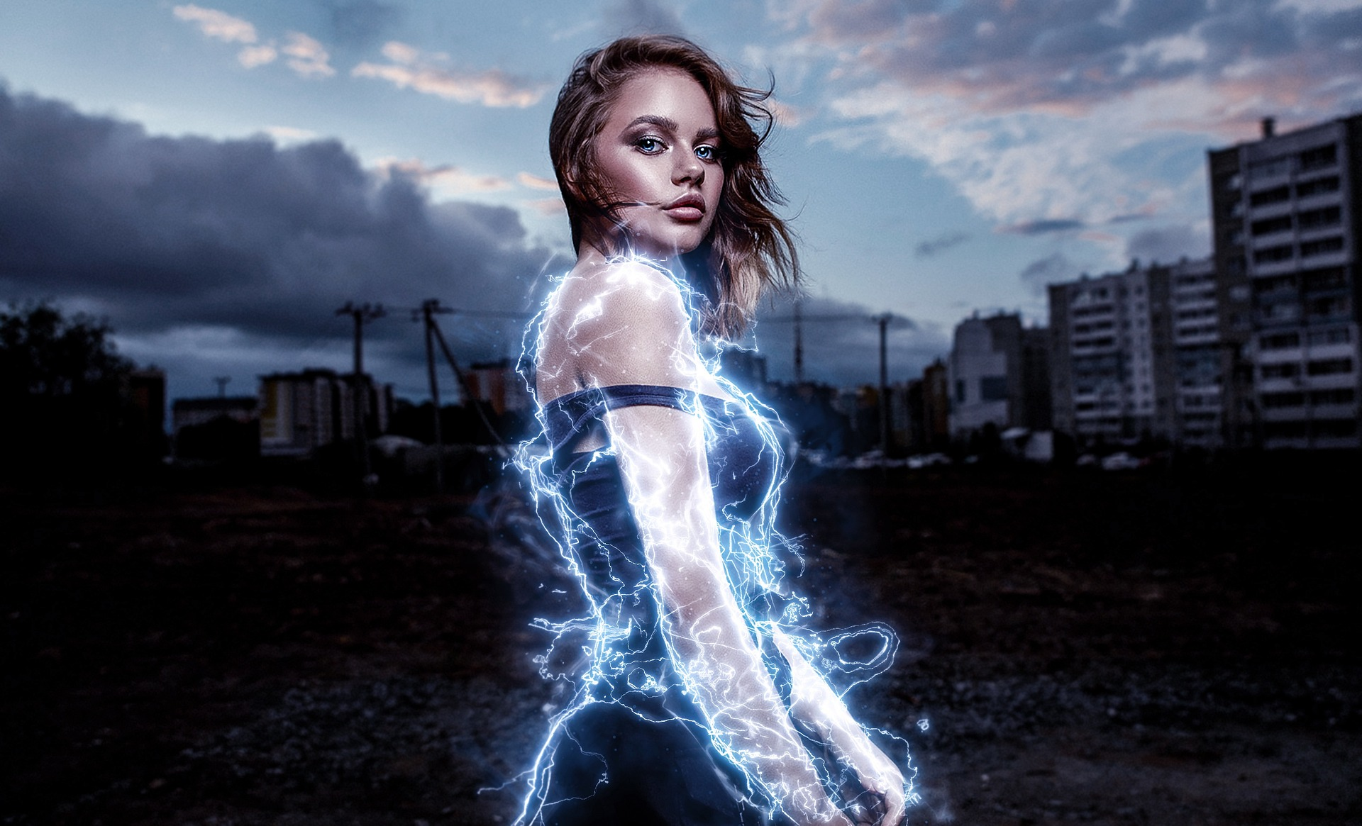

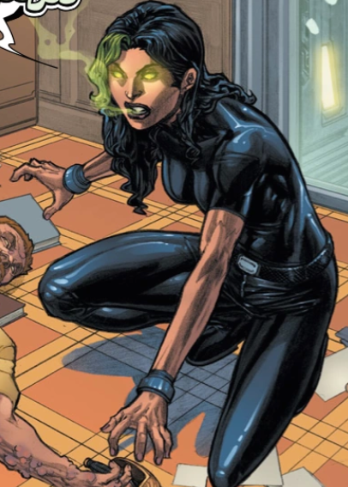
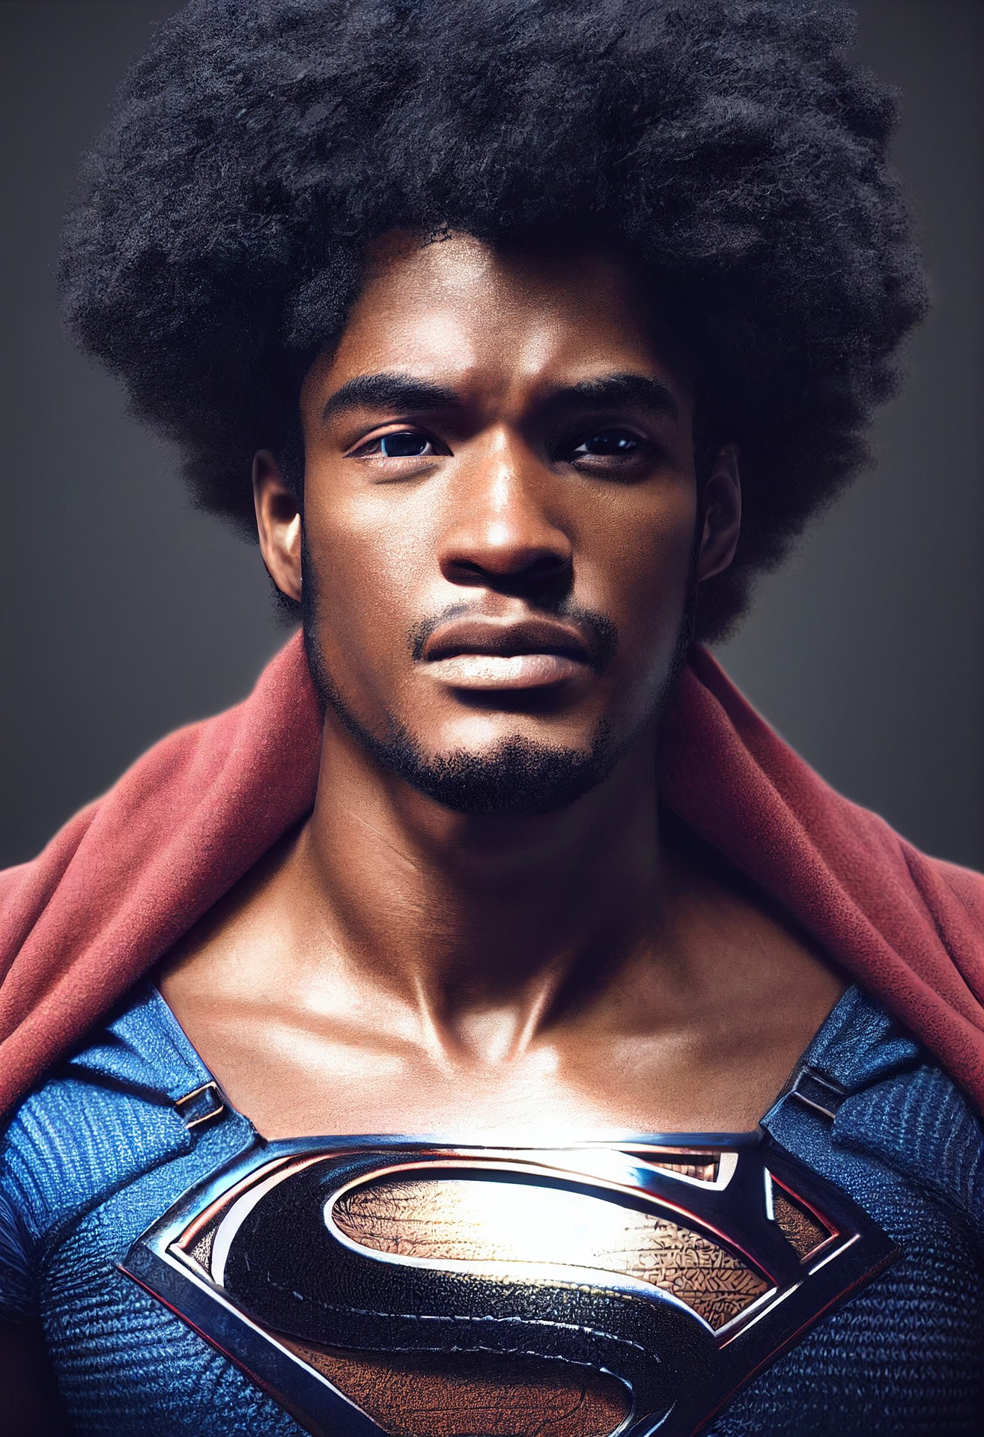
“I need a hero!”
LESSON 3:introducing pathogen…
Notes:
https://marvel.fandom.com/wiki/Host_(Pathogen)_(Earth-616)/Gallery, n.d.)

Slide 2
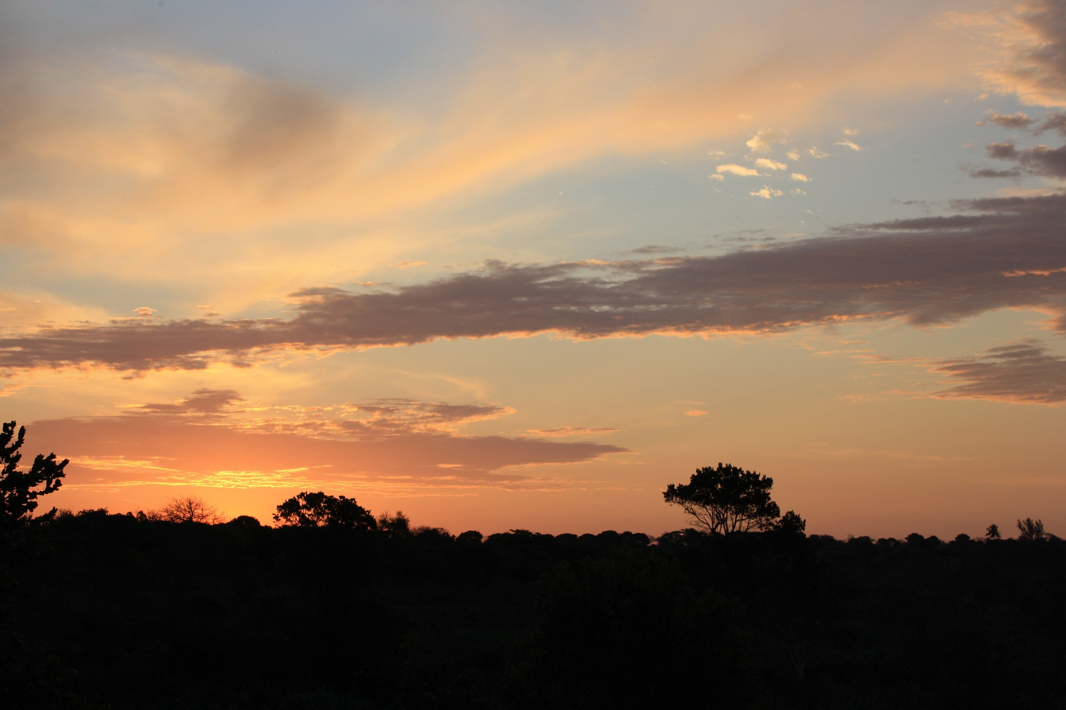

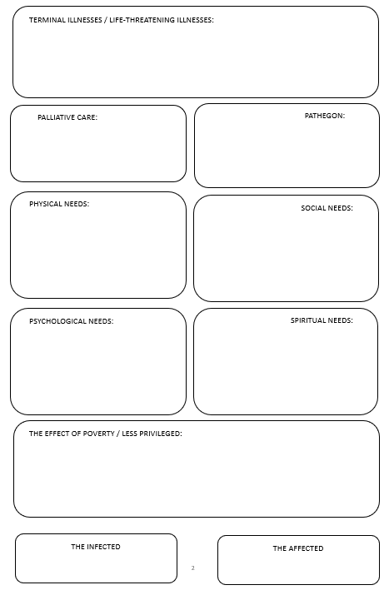

Did you know? Testing your knowledge
-
Knowledge is Power!

Slide 3
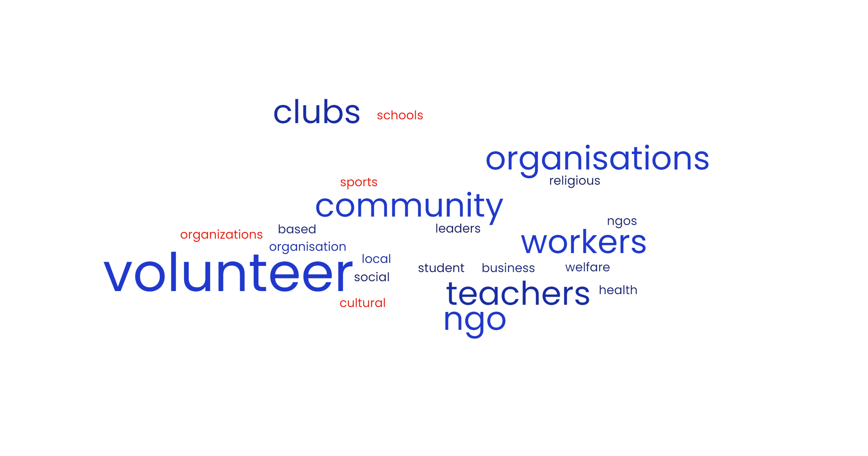
AGENTS OF S.H.I.E.L.D – TOGETHER AGAINST PATHOGEN

Slide 4

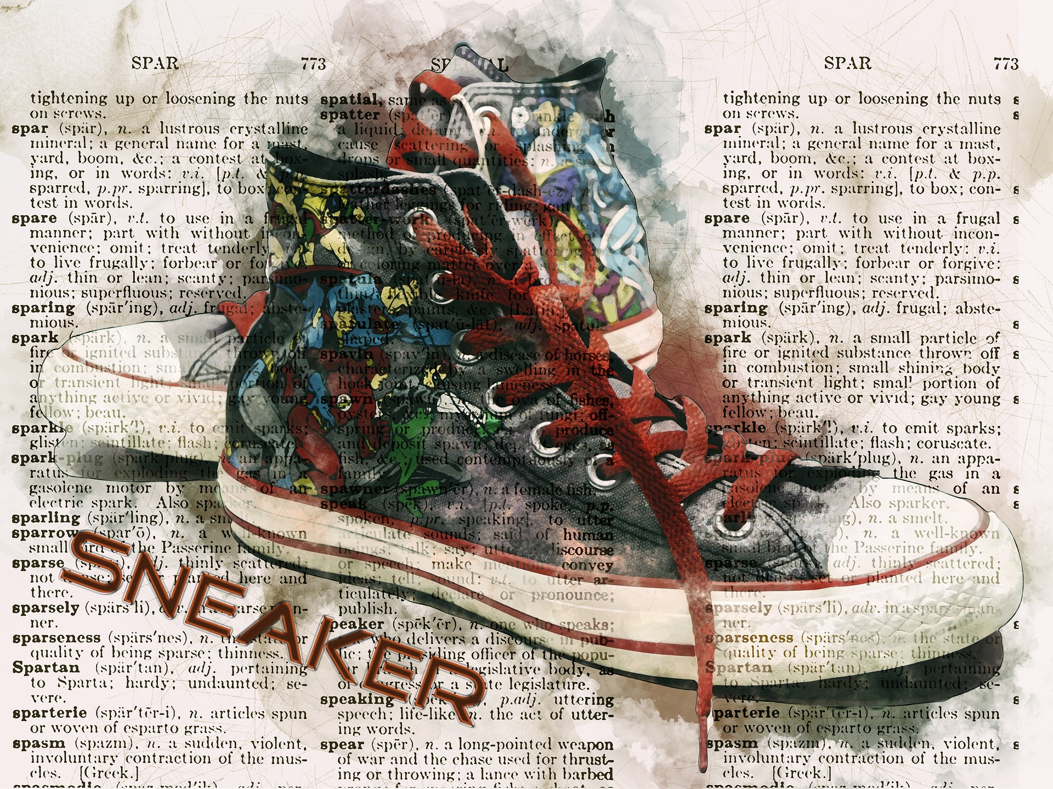
What is your superpower?
Self-reflection
Think about your own skills, passions, interests and talents
(from Activity 3,
Lesson 2 – Worksheet).
Match them to the volunteer opportunities in Activity 4 to help those affected and infected by HIV/AIDS and terminal illnesses.

