Slide 1
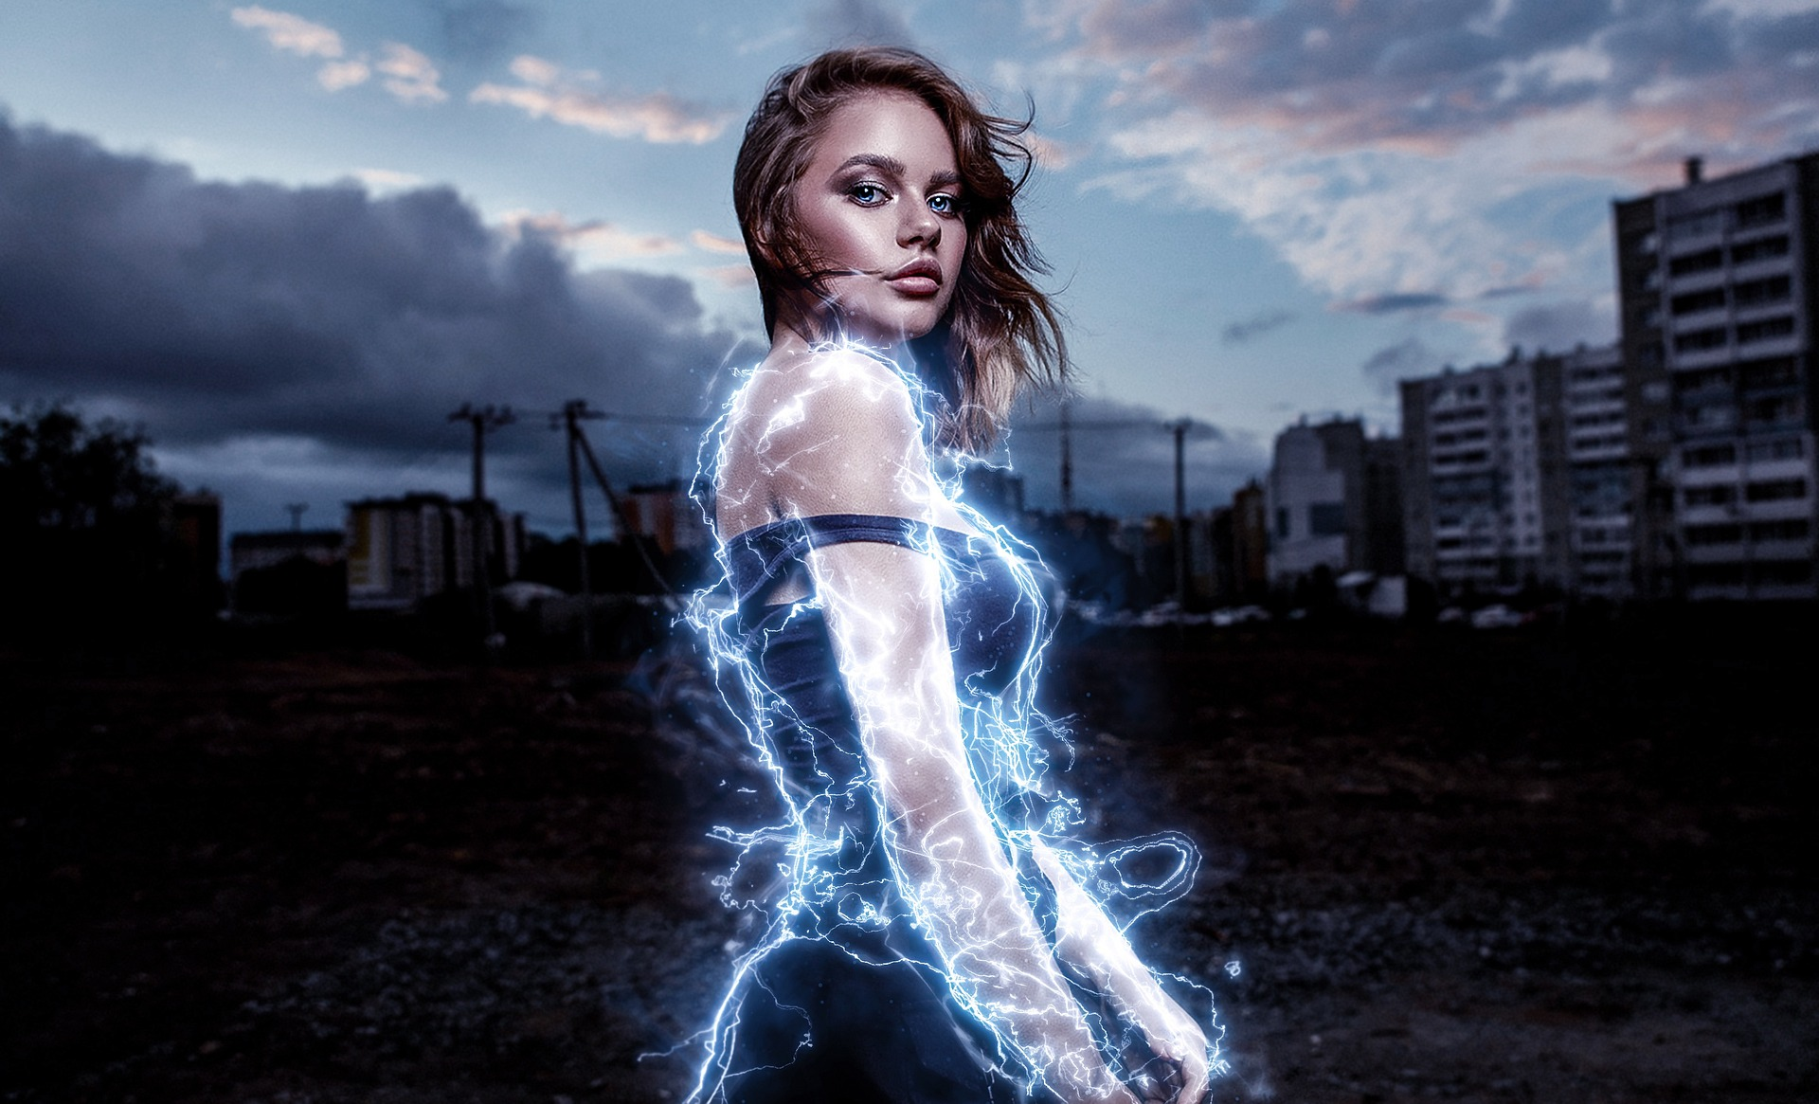

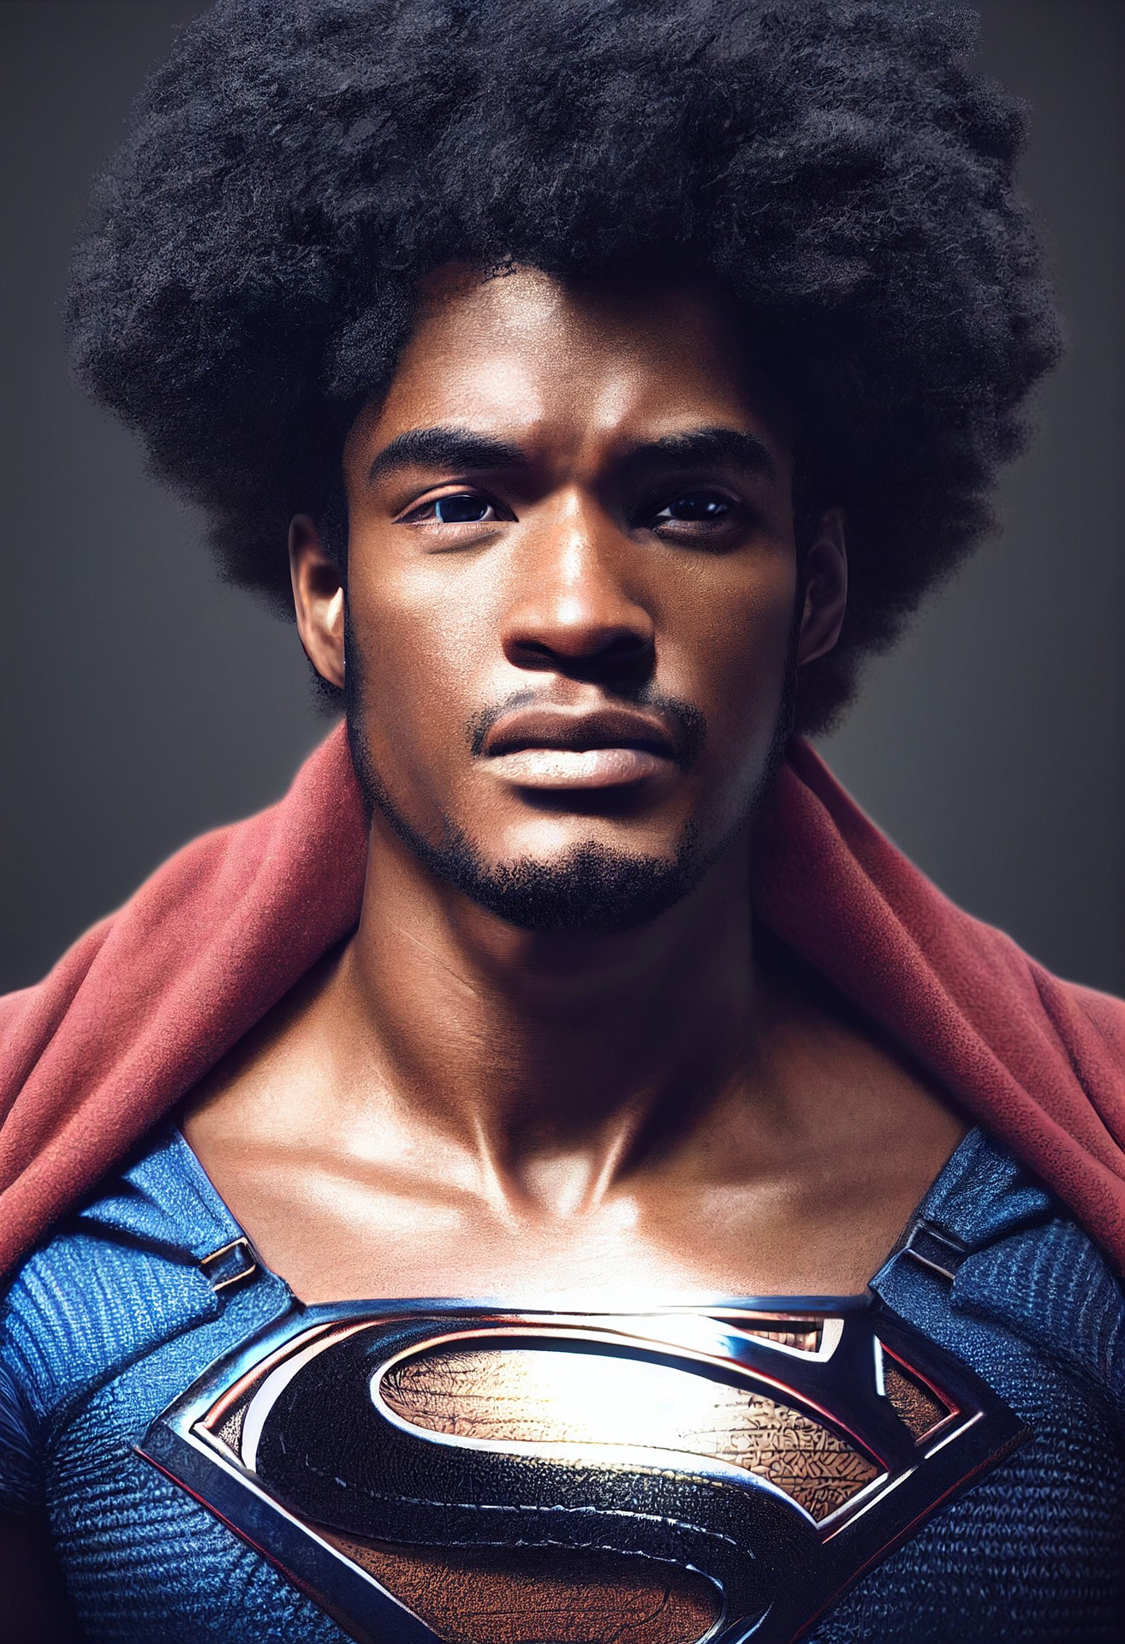
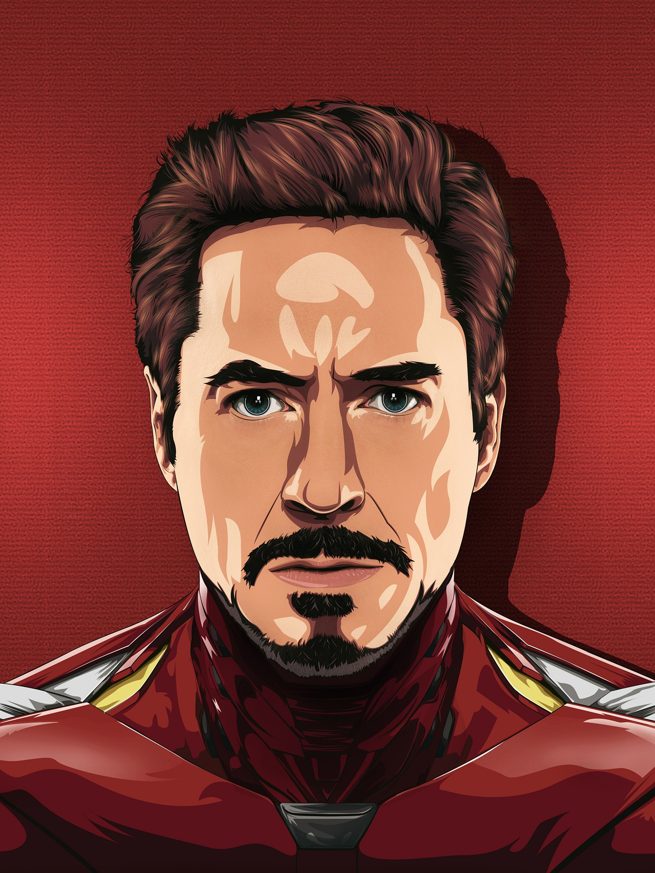

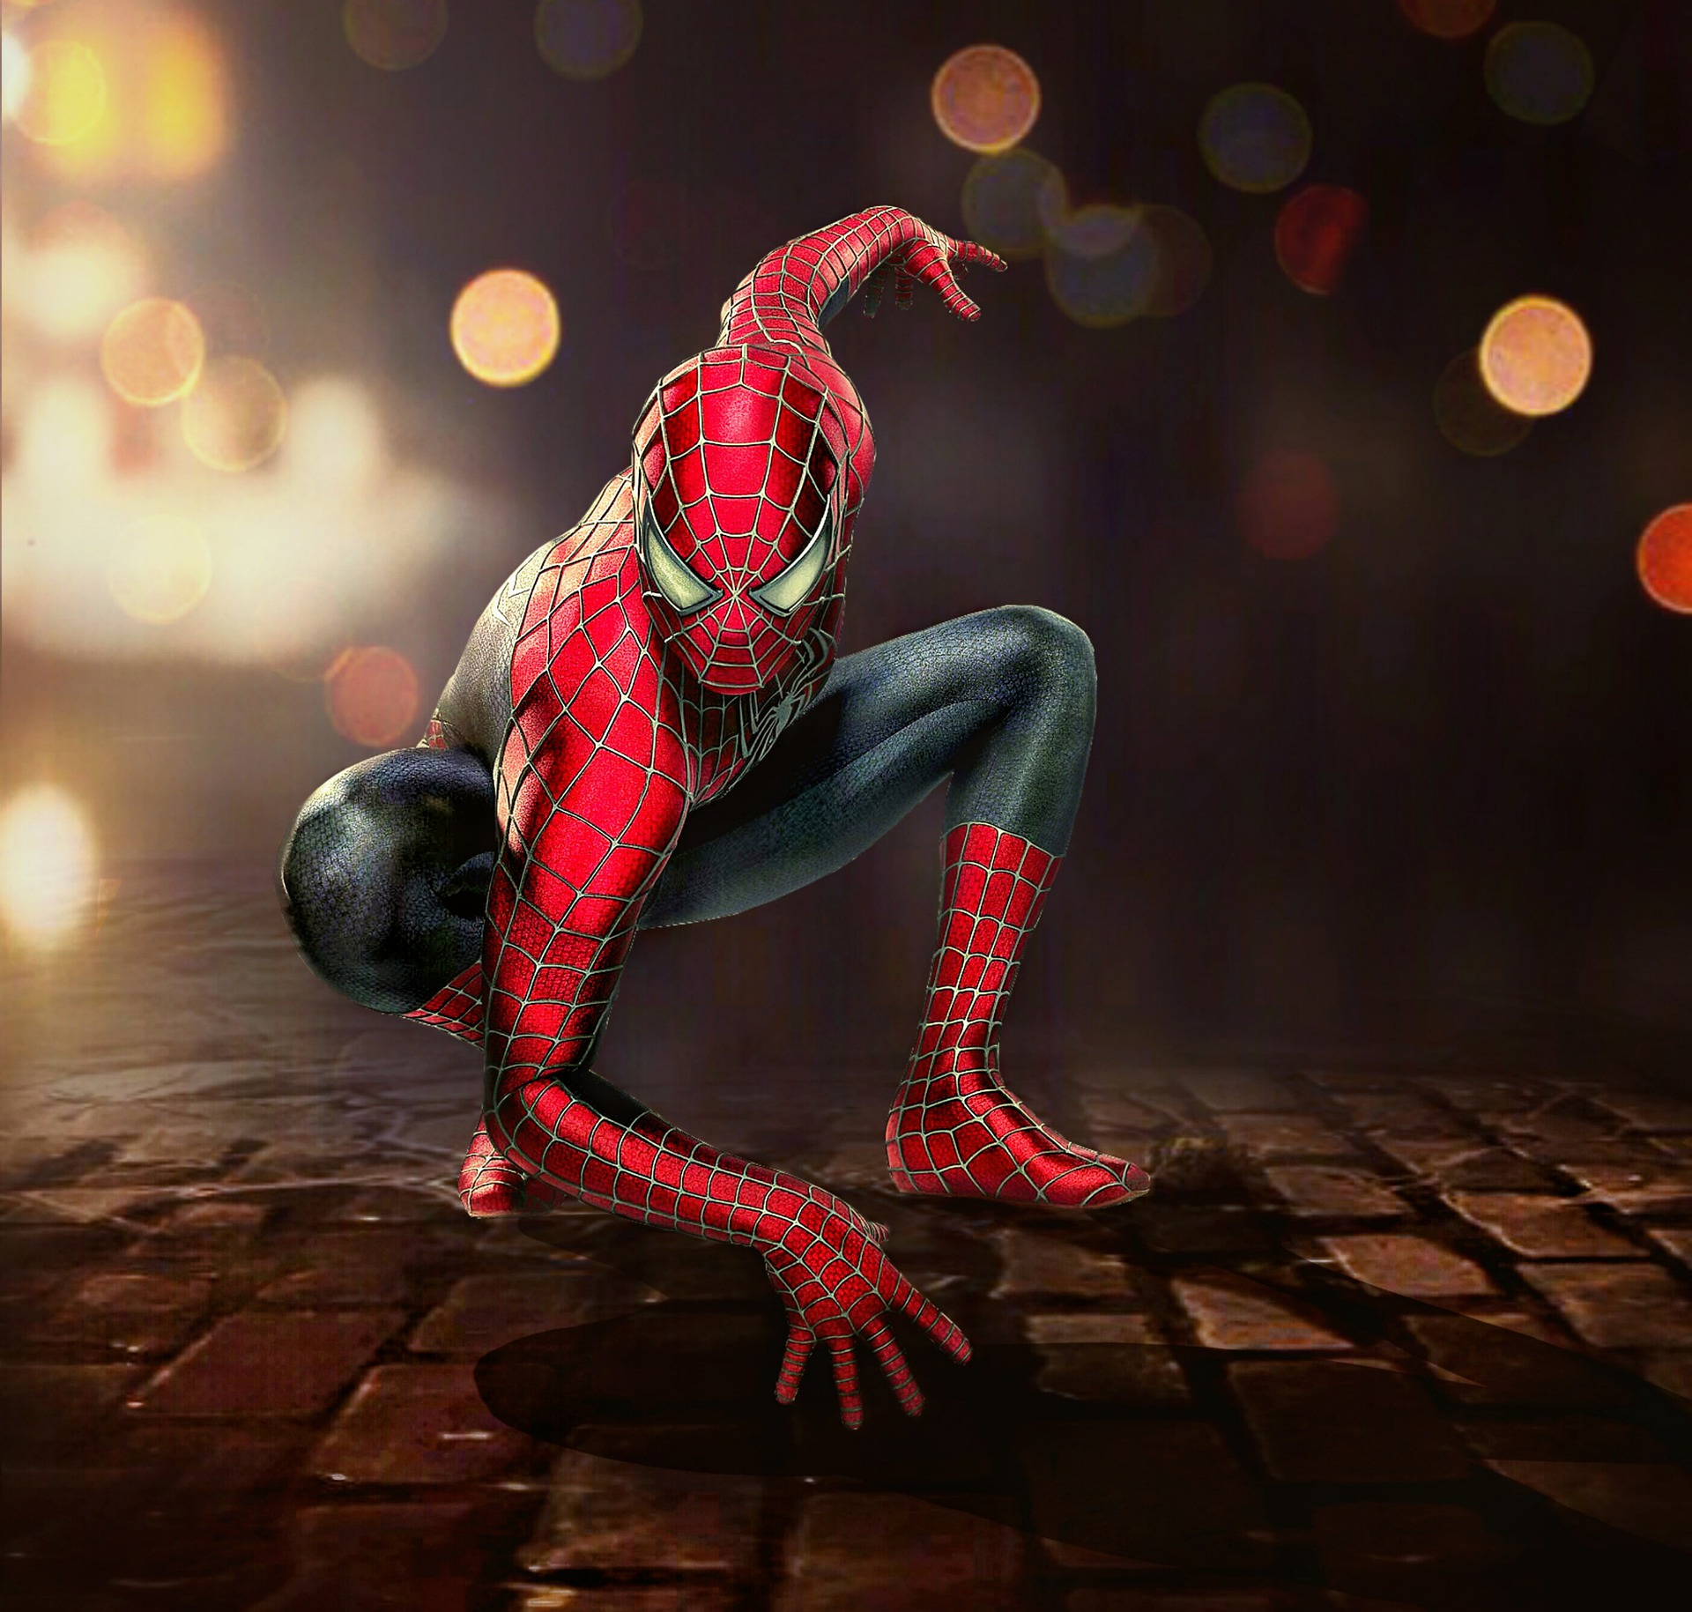
“I need a hero!”
Grade 9 hser term 3 lesson 2:

Slide 2
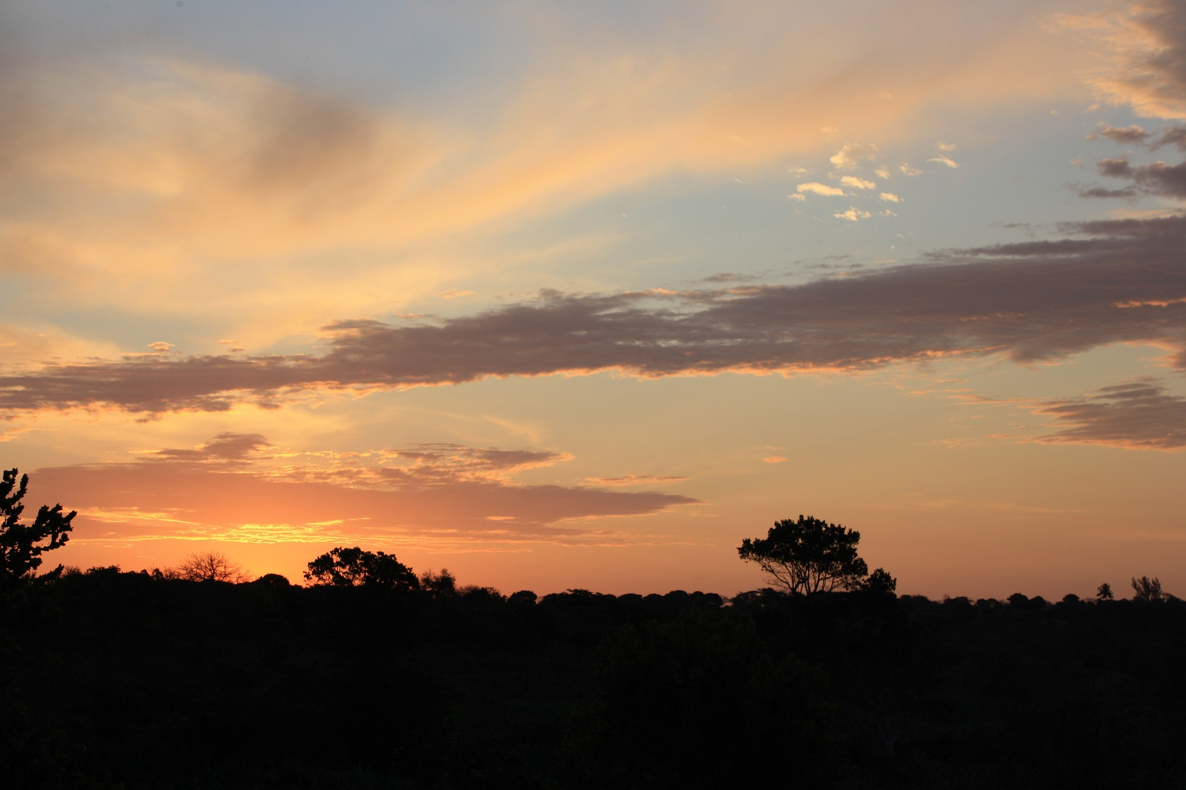

Where is your Wakand?
-
Define community
What is it?
Where is it? Who is it?
Who is responsible for it?
What’s wrong in Wakanda?
What’s going on in Gotham?
What’s missing in Metropolis?
WHERE IS YOUR WAKANDA?

Slide 3
Communities are:
- DIVERSE
- COMMUNITY MEMBERS MUST BE CARING, MODEST AND SELFLESS
- COMMUNITY MEMBERS PARTICIPATE IN COMMON INTERESTS
- TO BUILD COMMUNITY YOU MUST VALUE AND RESPECT OTHERS
- LOOK AT SIMILARITIES TO UNITE TO REACH AND ACHIEVE GOALS
Your GOTHAM, WAKANDA, METROPOLIS… a city that needs you!

Slide 4
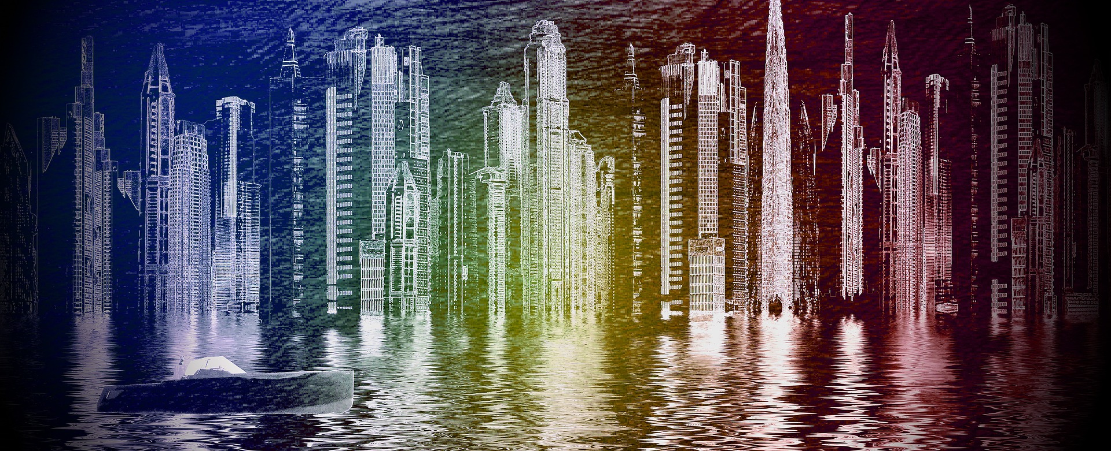
COMMUNITY HEROES
What is a Community-based organization?
What is a Non-Profit organization?
What do they do?
Are there any other types of NGOs?

Slide 5
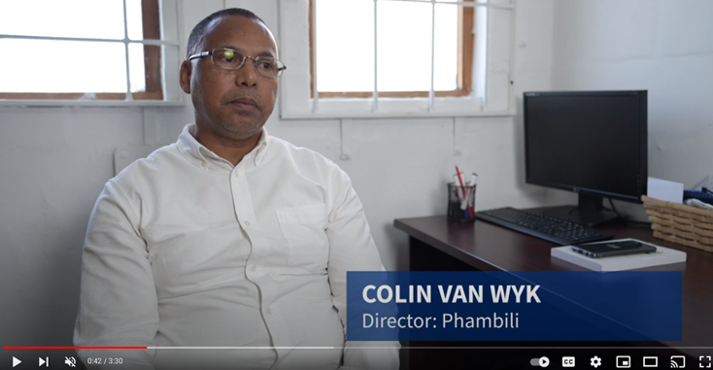
VIDEO CASE STUDY
Watch the YouTube Video
https://www.youtube.com/watch?v=0IAcrpaZA5U

Slide 6
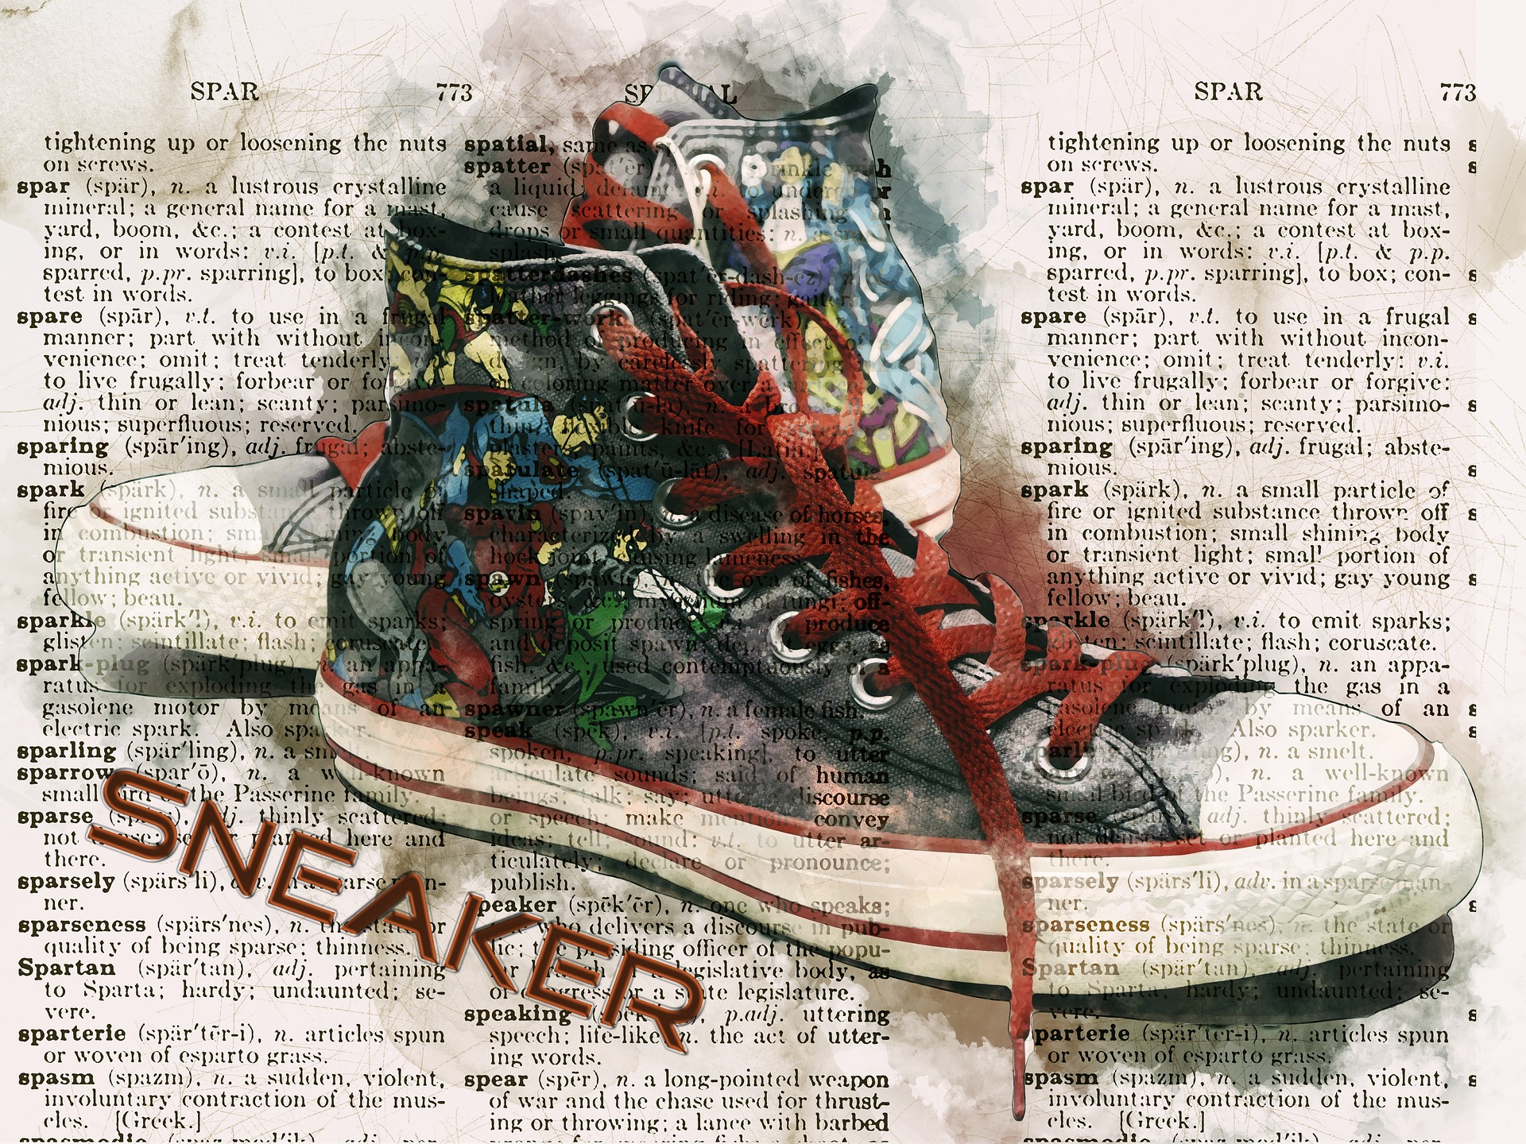
What is your superpower?
Self-reflection
What activities do you like doing?
Do you have any natural aptitude or competencies that you think you could use to help others in a volunteer role?
Have you ever volunteered with a community organisation? What was your experience?
Is there any community organisation you would like to get involved with?

